Slide 1
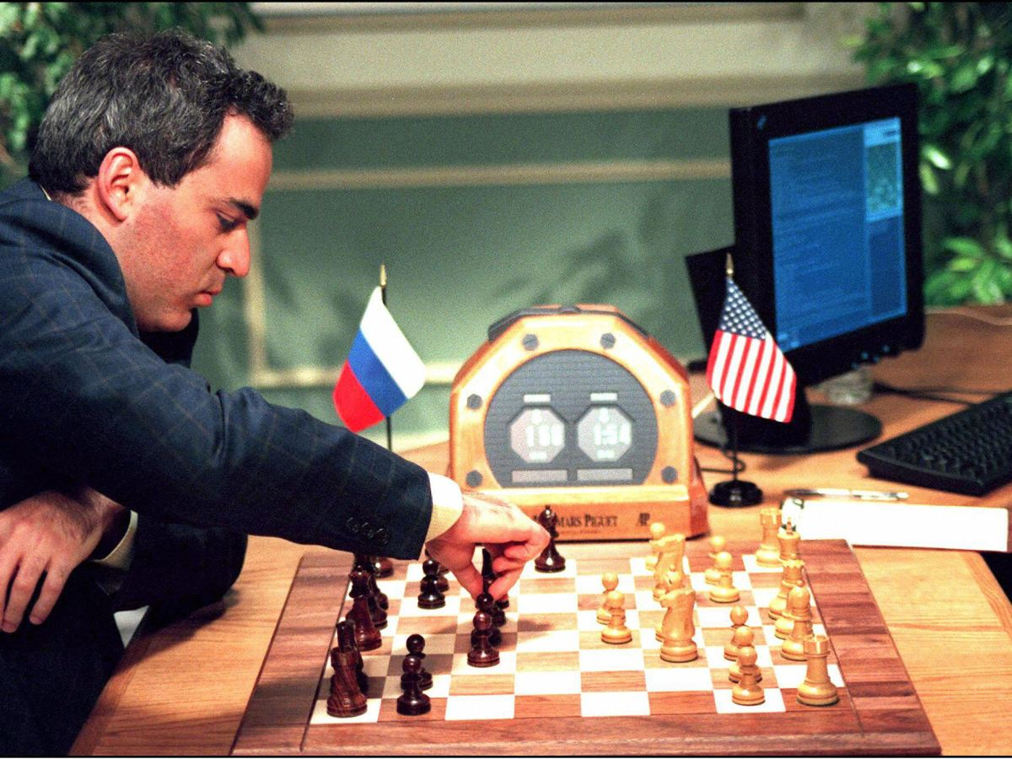
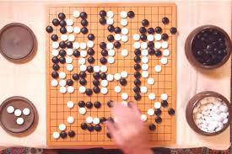
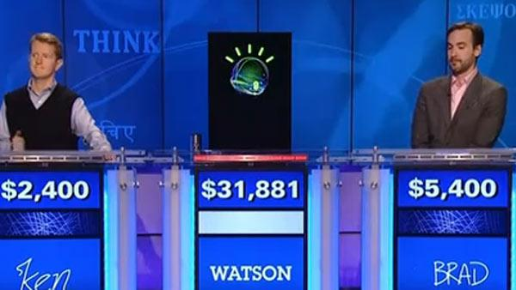
Garry Kasparov vs. Deep Blue (1997)
Deep Mind’s AlphaGo vs. Lee Sedol (2016)
Watson vs. Ken Jennings (2011)
Notes:
1

Slide 2
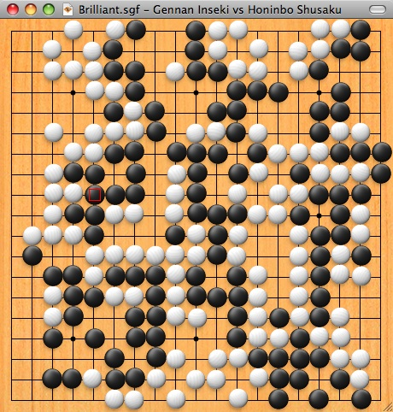
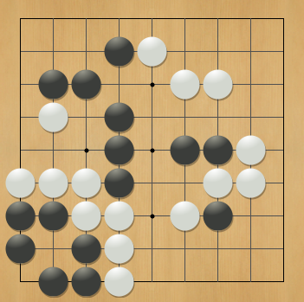

Computer Go
9x9 (smallest board)
19x19 (standard board)
“Task Par Excellence for AI” (Hans Berliner)
“New Drosophila of AI” (John McCarthy)
“Grand Challenge Task” (David Mechner)

Slide 3
A Brief History of Computer Go
1997: Super human Chess w/ Alpha-Beta + Fast Computer
2005: Computer Go is impossible!
Why?

Slide 4
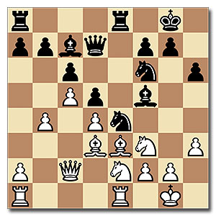
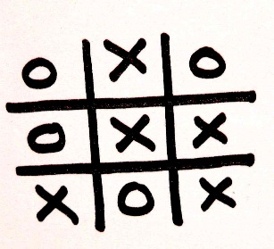
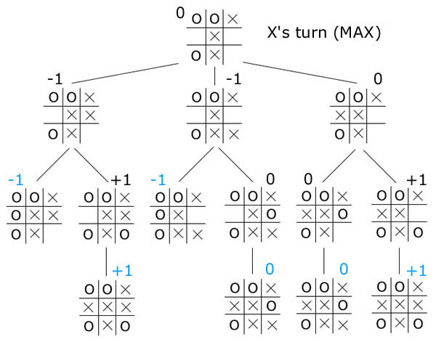
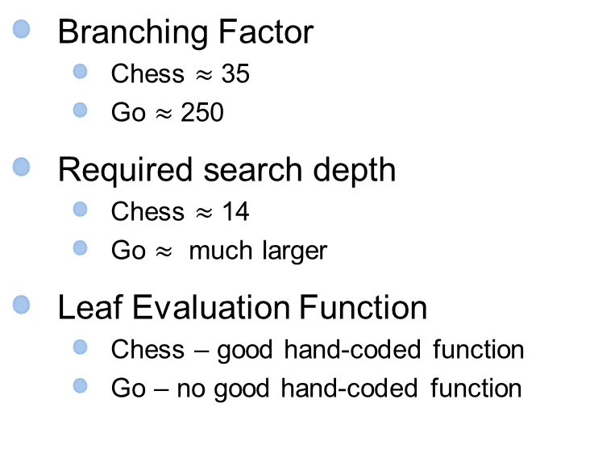
VS
VS
Branching Factor
Chess $≈$ 35
Go $≈$ 250
Required search depth
Chess $≈$ 14
Go $≈$ much larger
Leaf Evaluation Function
Chess – good hand-coded function
Go – no good hand-coded function
MiniMax Tree

Slide 5
A Brief History of Computer Go
1997: Super human Chess w/ Alpha-Beta + Fast Computer
2005: Computer Go is impossible!
2006: Monte-Carlo Tree Search applied to 9x9 Go (bit of learning)
2007: Human master level achieved at 9x9 Go (bit more learning)
2008: Human grandmaster level achieved at 9x9 Go (even more)
2012: Zen program beats former international champion Takemiya Masaki with only 4 stone handicap in 19x19
2015: DeepMind’s AlphaGo Defeats European Champion 5-0 (lots of learning)
2016: AlphaGo Defeats Go Legend Lee Sedol 4-1 (lots more learning)
Computer GO Server rating over this period: 1800 ELO → 2600 ELO

Slide 6
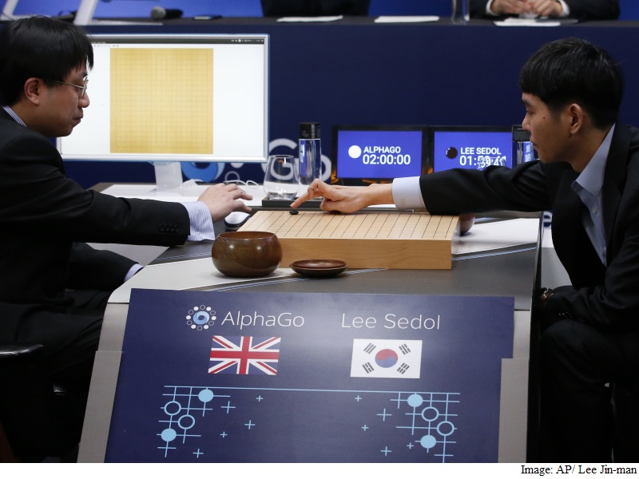
AlphaGo
Deep Learning + Monte Carlo Tree Search + HPC
Learn from 30 million expert moves and self play
Highly parallel search implementation
48 CPUs, 8 GPUs (scaling to 1,202 CPUs, 176 GPUs)
March 2016 : AlphaGo beats Lee Sedol 4-1

Slide 7
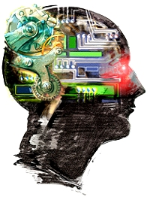
Arsenal of AlphaGo
Distributed High-Performance Computing
Monte Carlo Tree Search
Deep Neural Networks
AlphaGo
Supervised Learning
Reinforcement Learning
Huge Data Set
Mastering the game of Go with deep neural networks and tree search Nature, 529, January 2016.

Slide 8
Arsenal of AlphaGo
Distributed High-Performance Computing
Monte Carlo Tree Search
Deep Neural Networks
AlphaGo
Supervised Learning
Reinforcement Learning
Huge Data Set
Mastering the game of Go with deep neural networks and tree search Nature, 529, January 2016.

Slide 9
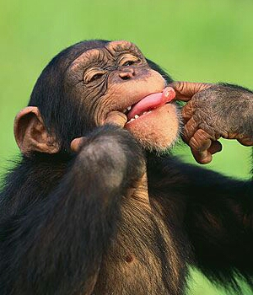
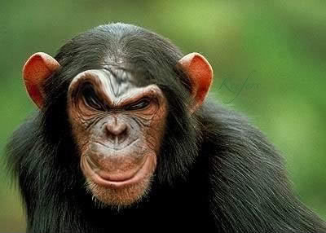
Monte Carlo Tree Search
Idea #1: board evaluation function via random rollouts
Evaluation Function: - play many random games - evaluation is fraction of games won by current player - surprisingly effective
Even better if use rollouts that select better than random moves

Slide 10

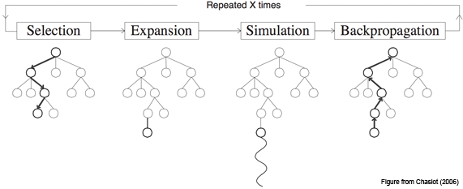
Monte Carlo Tree Search
Idea #2: selective tree expansion
rollout

Slide 11
Monte Carlo Tree Search
Idea #2: selective tree expansion
Non-uniform tree growth

Slide 12
Monte Carlo Tree Search
Idea: learn an improved rollout policy
How?
rollout

Slide 13
Arsenal of AlphaGo
Distributed High-Performance Computing
Monte Carlo Tree Search
Deep Neural Networks
AlphaGo
Supervised Learning
Reinforcement Learning
Huge Data Set
Mastering the game of Go with deep neural networks and tree search Nature, 529, January 2016.

Slide 14
Supervised Learning of Go Policies
Suppose you are given a database of 30 million moves made by Go experts.
Can we use supervised classifier learning to learn a Go policy?
A Go policy is just a classifier
Input = Board Position
Output Class = go move
Classifier
Go Move
What classifier and learning algorithm would you choose?

Slide 15
Arsenal of AlphaGo
Distributed High-Performance Computing
Monte Carlo Tree Search
Deep Neural Networks
AlphaGo
Supervised Learning
Reinforcement Learning
Huge Data Set
Mastering the game of Go with deep neural networks and tree search Nature, 529, January 2016.

Slide 16
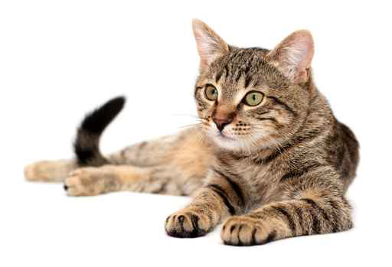
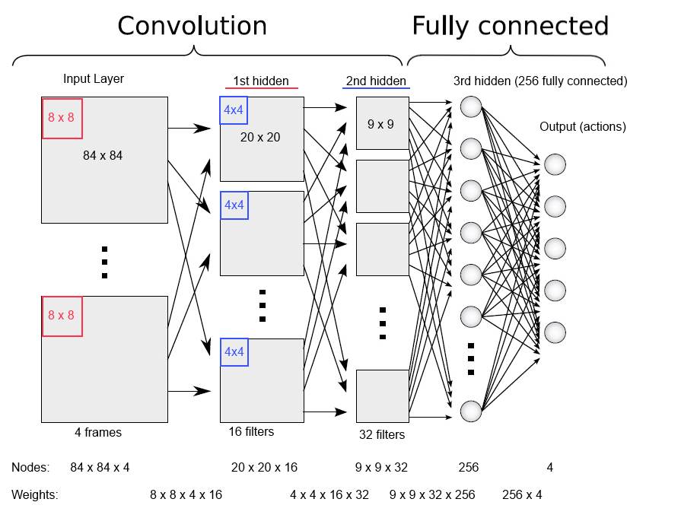
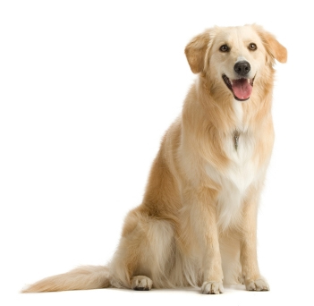
Deep Neural Networks
How can you write a program to distinguish cats from dogs in images?
Machine Learning: show computer example cats and dogs and let it decide how to distinguish them
Deep Neural Network
cat
dog

Slide 17
Deep Neural Networks
State-of-the-Art Performance: very fast GPU implementations allow training giant networks (millions of parameters) on massive data sets
Deep Neural Network
cat
dog

Slide 18
Deep Neural Networks
State-of-the-Art Performance: very fast GPU implementations allow training giant networks (millions of parameters) on massive data sets
Could a Deep NN learn to predict expert Go moves by looking at board position?
Yes!
Deep Neural Network
Go Move

Slide 19
Arsenal of AlphaGo
Distributed High-Performance Computing
Monte Carlo Tree Search
Deep Neural Networks
AlphaGo
Supervised Learning
Reinforcement Learning
Huge Data Set
Mastering the game of Go with deep neural networks and tree search Nature, 529, January 2016.

Slide 20
Supervised Learning for Go
Output: probability of each move
Deep NN Internal Layers
Trained for 3 weeks on 30 million expert moves
57% prediction accuracy!
Input: Board Position

Slide 21
Can we do better?
Output: probability of each move
Predicting expert moves is great. But does it play good Go?
Lets further improve by learning from actually playing Go games?
Input: Board Position

Slide 22
Arsenal of AlphaGo
Distributed High-Performance Computing
Monte Carlo Tree Search
Deep Neural Networks
AlphaGo
Supervised Learning
Reinforcement Learning
Huge Data Set
Mastering the game of Go with deep neural networks and tree search Nature, 529, January 2016.

Slide 23
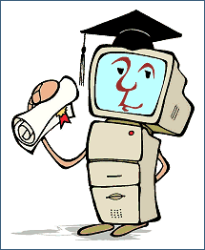
Reinforcement Learning
Reinforcement Learning: learn to act well in an environment via trial-and-error that results in positive and negative rewards
Observations & Reward
Practice
Environment
Action

Slide 24
Table Based Q-Learning
Start with initial Q-function (e.g. all zeros)
Take action from explore/exploit policy giving new state s’ (should converge to greedy policy, i.e. GLIE)
Perform TD update
Goto 2
Basic Q-learning stores Q(s,a) as a table over all state-action pairs.
Could this possibly work for Go?

Slide 25
Q-Function Approximation
Output: Q-values
Instead of using table for Q-function use function approximation to learn a Q-function?
Input: Board Position

Slide 26
Q-learning w/ Non-linear Approximators
is approximation of Q-function with parameters $θ$
Start with initial parameter values
Take action according to an explore/exploit policy (should converge to greedy policy, i.e. GLIE)
Perform TD update for each parameter
Goto 2
Gradient of neural network

Slide 27
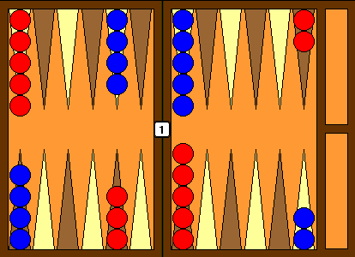
TD-Gammon (1992)
Backgammon
Neural network with 80 hidden units (1 layer)
Used Reinforcement Learning for 1.5 Million games of self-play
One of the top (2 or 3) players in the world!

Slide 28
Reinforcement Learning for Go
Output: probability of each move
Initial Q-network with result of supervised learning.
Continue to train network via self play RL.
AlphaGo did this for months.
80% win rate against the original supervised Deep NN
85% win rate against best prior tree search method!
Still not close to professional level
Input: Board Position

Slide 29
Monte Carlo Tree Search
Idea: use deep NN for rollout evaluation

Slide 30
Monte Carlo Tree Search
Idea: use deep NN for rollout evaluation

Slide 31
Monte Carlo Tree Search
Idea: use Deep NN for rollouts in Monte Carlo Tree Search
Problem: deep NN takes too long (msec) to evaluate

Slide 32
Monte Carlo Tree Search
Solution: use deep NN for selection phase
Evaluate once per tree node
Use probabilities to bias search toward actions that look good to deep NN

Slide 33
Monte Carlo Tree Search
Solution: train smaller network for rollout
Less accurate but much faster

Slide 34
AlphaGo
Deep Learning + Monte Carlo Tree Search + HPC
Learn from 30 million expert moves and self play
Highly parallel search implementation
48 CPUs, 8 GPUs (scaling to 1,202 CPUs, 176 GPUs)
2015 : AlphaGo beats European Champ (5-0)
lots of self play
March 2016 : AlphaGo beats Lee Sedol (4-1)

Slide 35
Computers are good at Go now – So What?
The idea of combining search with learning is very general and widely applicable
Deep Networks are leading to advances in many areas of AI now
Computer Vision
Speech Processing
Natural Language Processing
Bioinformatics
Robotics
It is a very exciting time to be working in AI

