Slide 1
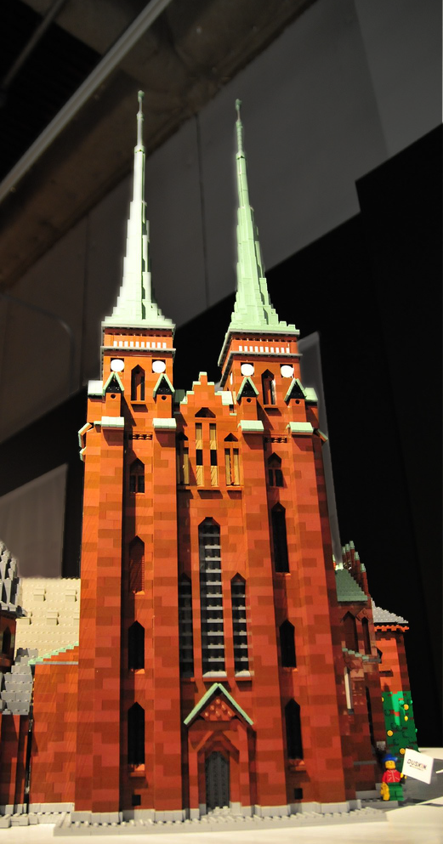


Design Patterns
http://www.flickr.com/photos/ajari/2287240221/sizes/l/

Slide 2
<Patterns>
You need to hang a poster on the wall…
  What do you do?
You need to write a term paper…
  How should it be organized?

Slide 3
Design Patterns
Design patterns (DPs) are…
  Strategies for your “toolkit of ideas”
  Templates for solutions
  Codified best practices
Design patterns are not…
  Architectural styles (DPs are too low level)
  Code libraries (DPs are ideas, not code)

Slide 4
Design Patterns
Primary goals of DPs
  To help maintainability, flexibility, other quality attributes
  To help system designers make good decisions
There are a few dozen very common OO patterns
  Patterns exist for other kinds of non-OO systems.
  Patterns are recognizable based on their
  structure and their purpose.

Slide 5
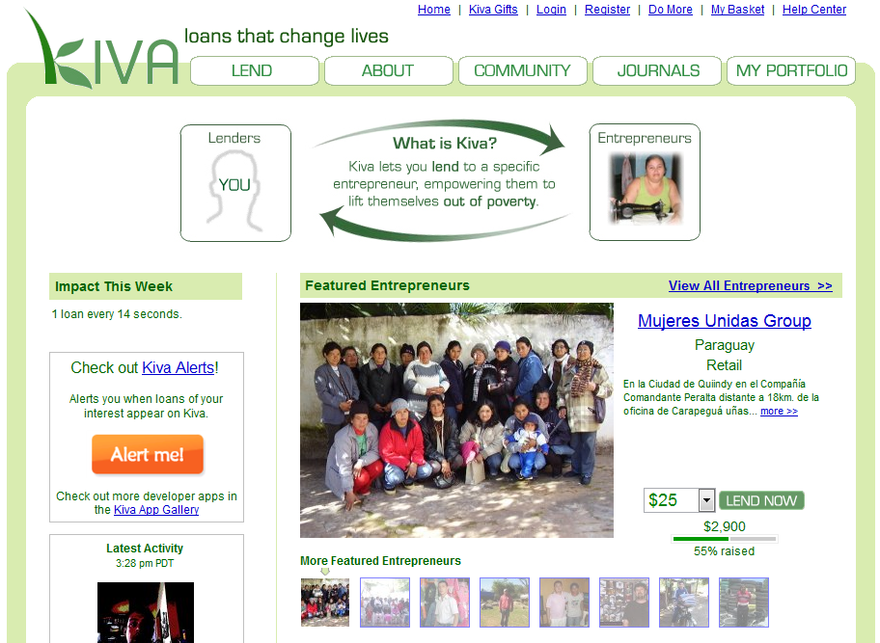
Example system
Kiva system to connect lenders with borrowers
How could we use
DPs to implement
Kiva?
How could we use
DPs to implement
a better Kiva???

Slide 6
Builder
TeamReviewScreenBuilder
+generateHtml()
Knows how to create a complex object
Use when instantiating an object requires filling it with parts or otherwise lengthy configuration
TeamReviewScreen
SearchSection
CategoryFilterSection
TeamTable
TeamHeading
TeamRow
+ image
+ name
+ creation date
+ # members
+ # loans
+ total loaned
+ Join button
TeamInfo
+ link
+ category

Slide 7
Adapter
PaymentProcessor
+ pay($ amount)
Translates one interface to another by wrapping
Use to overcome incompatibility
CreditCardPaymentAdapter
+ pay($ amount)
.netCharge component
+ issueCharge($ amount, timeout)
Remote credit card gateway

Slide 8
Facade
PaymentProcessor
+ pay($ amount)
Object that provides a unified, high-level interface to a subsystem
Use when calling a subsystem requires a frequent series of complex lines of code
CreditCardPaymentAdapter
+ pay($ amount)
.netCharge component
+ issueCharge($ amount, timeout)
ComponentLicense
GatewayProxy
GatewayRequest
Remote server
RequestConfiguration
+ timeout
+ URL
+ HTTP client certificate

Slide 9
Memento
Encapsulate state in an object
Use if you might want to return to a certain state later
BlogEntryEditor
UndoRedoManager
BlogEntry
+ StoreToHtmlMemento()
+ ReloadFromHtmlMemento()
HtmlMemento
+ html

Slide 10
Interpreter
Parses and acts on instructions written in a certain syntax
Use to add scriptability
LoanRequestServer
+ listAll()
+ makeLoan()
AutoLoanInterpreter
+ interpret(script)
AutoLoanScript
+ instructions

Slide 11
Observer
Loan
+ RegisterForRepayEvent()
+ RegisterForDefaultEvent()
+ UnregisterForRepayEvent()
+ UnregisterForDefaultEvent()
FireRepayEvent()
FireDefaultEvent()
Watching for another object to change state
Maintains a list of observers and notifies them
Use in any event-driven design
LoanListener
+ OnRepayEvent()
+ OnDefaultEvent()
LoanRequestServer
+ listAll()
+ makeLoan()
AutoLoanInterpreter
+ interpret(script)
+ OnRepayEvent()
+ OnDefaultEvent()
AutoLoanScript
+ instructions

Slide 12
Which pattern
would you use?
You are building a cool 3D game. Your company licenses a big, ugly library that implements the 3D mathematics.
Builder | Memento
Adapter | Interpreter
Façade | Observer
Notes:
facade

Slide 13
Which pattern
would you use?
Your application might crash at any time. You want your application to save its state so that if it crashes, then it can auto-recover.
Builder | Memento
Adapter | Interpreter
Façade | Observer
Notes:
memento

Slide 14
Which pattern
would you use?
Your application should run after any student uploads a homework to Blackboard.
Builder | Memento
Adapter | Interpreter
Façade | Observer
Notes:
observer

Slide 15
Which pattern
would you use?
Your application needs to generate PDF files (from scratch).
Builder | Memento
Adapter | Interpreter
Façade | Observer
Notes:
builder

Slide 16
Which pattern
would you use?
You want to let users create and run macros inside your application.
Builder | Memento
Adapter | Interpreter
Façade | Observer
Notes:
interpreter

Slide 17
Which pattern
would you use?
Your company already implemented a component that almost implements the interface that you need, but not quite.
Builder | Memento
Adapter | Interpreter
Façade | Observer
Notes:
adapter

Slide 18
Which pattern
would you use?
You have a component that needs to implement three very slightly different interfaces.
Builder | Memento
Adapter | Interpreter
Façade | Observer
Notes:
adapter

Slide 19
Which pattern
would you use?
Your program has to create some big, ugly record objects before inserting them into a database.
Builder | Memento
Adapter | Interpreter
Façade | Observer
Notes:
builder

Slide 20
Which pattern
would you use?
Your program has to support replication. You need a way for the program to save its state so the program can be copied to other servers.
Builder | Memento
Adapter | Interpreter
Façade | Observer
Notes:
memento

Slide 21
Which pattern
would you use?
Your program generates various outputs. You need a way to notify Facebook users when certain outputs are generated.
Builder | Memento
Adapter | Interpreter
Façade | Observer
Notes:
observer

Slide 22
Which pattern
would you use?
Sending a message to Facebook requires lots of big, ugly code.
Builder | Memento
Adapter | Interpreter
Façade | Observer
Notes:
facade

Slide 23
For more info
Your textbook discusses seven other patterns, which we will discuss in next class
  Template method
  Factory method
  Strategy
  Decorator
  Observer
  Composite
  Visitor

Slide 24
Next for you
If you have questions…
  Your textbook discusses a few DPs in detail
  Wikipedia has good articles on all 23 primary DPs
  Email me or visit during office hours
Homework 4 is due Monday
Revise your vision statement.

