Slide 1
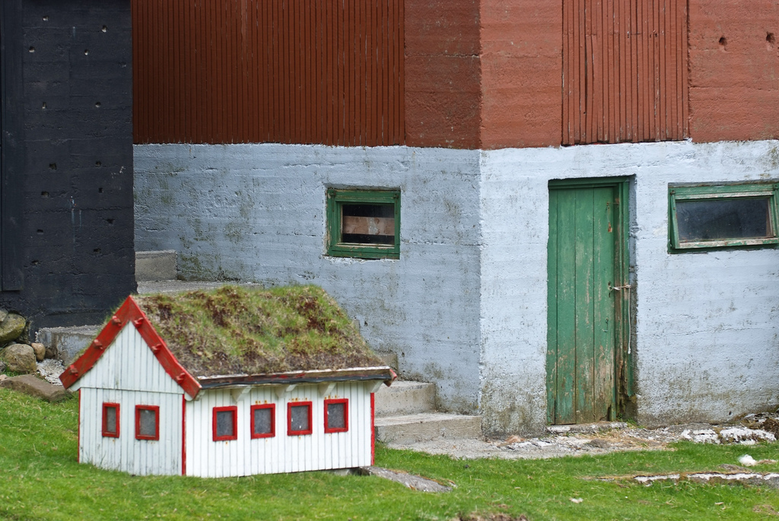
Software Engineering Processes
http://www.flickr.com/photos/arne-list/2586460111/sizes/l/

Slide 2
Quality Attributes of Great Software Revisited
Consistency
Reliability
Accuracy
Error Tolerance
Efficiency
Execution Efficiency
Integrity
Storage Efficiency
Access Control
Usability
Access Audit
Operability
Training
Communicativeness
Notes:
External quality factors on left
Product quality criteria on right

Slide 3
Quality Attributes of Great Software Revisited
Simplicity
Maintainability
Conciseness
Instrumentation
Testability
Self-Descriptiveness
Flexibility
Expandability
Generality
Portability
Modularity
Software System Independence
Machine Independence

Slide 4
Quality Attributes of Great Software Revisited
Simplicity
Reusability
Generality
Modularity
Interopability
Software System Independence
Machine Independence
Communications commonality
Data commonality

Slide 5
Do you want to build “dog houses” or “high rises”?
If you want to build a dog house, you can pretty much start with a pile of lumber, some nails, and a few basic tools, such as a hammer, saw, and tape measure. In a few hours, with little prior planning, you'll likely end up with a dog house that's reasonably functional...
If you want to build a high-rise office building, it would be infinitely stupid for you to start with a pile of lumber, some nails, and a few basic tools. Because you are probably using other people's money, they will demand to have input into the size, shape, and style of the building.... You will want to do extensive planning, because the cost of failure is high. You will be just a part of a much larger group responsible for developing and deploying the building, and so the team will need all sorts of blueprints and models to communicate with one another....
-- Grady Booch, The Unified Modeling Language User Guide
http://www.amazon.com/Unified-Modeling-Language-Addison-Wesley-Technology/dp/0201571684

Slide 6
Process
Process is well-defined and usually involves a set of tools and techniques
  Uses resources, is subject to constraints and produces intermediate and final products
  May be composed of sub-processes
  Has entry and exit criteria
  Activities are ordered with clear relationships
Life-cycle: The process of building a product

Slide 7
Development process
Process = a set of ordered tasks
  Typical software tasks:
    Figuring out what the system should do (requirements)
    Figuring out how the system should do it (design)
    Writing the code for the system (implementation)
    Making sure that the code is right (testing)
    Using the system (operation)
  Should imply some planning and risk management
  Different processes order tasks differently

Slide 8
Requirements analysis
Ways to figure out what the system should do:
  Get the customers to write down what they want
  Talk with customers and make some diagrams
  Watch users in “daily life” to see what they need
  Look up the requirements from a standards body
  Gather with customers, users, and your fellow engineers to discuss/argue/negotiate a contract
Any combination, variation, or extension of the above

Slide 9
Design
Architectural design
  Figuring out the overall structure of the system
    What components should be in the system?
    How should the components be connected?
Program design
  Figuring out how code should be organized
    How should each component’s code be distributed among classes and/or functions?

Slide 10
Implementation
Finally, we get to write some code!
Implementation also may include:
  Writing comments
  Writing other documentation
  Helping fellow engineers with their coding
  Answering questions
  Reading colleagues’ code, documentation, etc
  Messing around with code until it “smells good”

Slide 11
Testing
Testing
  Unit testing
    Good for automatically checking individual components
  System integration testing
    Good for checking that components work well together
  Usability testing
    Good for checking user interfaces
  Acceptance testing
    Good for checking that the customer/user is happy
Notes:
Unit: Tests individual pieces of code before they are linked together, usually at the level of individual functions
System integration: Tests its coexistence with other systems
Usability Testing: Tests the ease-of-use of the system by evaluating it on users
Acceptance testing: Does it meet the requirements specification?

Slide 12
Operation
The code compiles, passes all tests, and looks great on your desktop. Done, right? Wrong!
Operation often includes
  Distributing code to customers/users
  Providing documentation and support
  Debugging, after users try out the system
  Studying how well the system works in practice
  Adapting the system for new markets

Slide 13
Waterfall kinds of processes
Requirements analysis
Prototyping
Design
Implementation
Testing
Operation/Maintainance
(No prototyping in a pure waterfall process)
Notes:
Each step often has one or more deliverables so that milestones can be tracked
Prototyping is useful for:
Validation: Ensures that all requirements were met
Verification: Ensures that each function works correctly

Slide 14
Drawbacks of The Waterfall Model
Non-iterative: hard to handle changes to products and activities during development (assumes requirements can be frozen)
  Views software development as manufacturing process rather than as creative process
  Long wait before a final product

Slide 15
Spiral kinds of processes
Draft a menu of
program designs
Analyze risk &
prototype
Draft a menu of
architecture designs
Analyze risk &
prototype
Draft a menu of
requirements
Analyze risk &
prototype
Establish
requirements
Plan
Establish
architecture
Plan
Operation
Testing
Implementation
Establish
program design

Slide 16
Agile kinds of processes
Do “spike” to evaluate & control risk
Customer provides “stories”
(short requirement snippets)
Prioritize
stories and plan
Write/run/modify
unit tests
Operation
Implement
System and acceptance tests
(Agile processes are rarely this tidy in practice)
Notes:
Value individuals over process and tools
Focus on creating software instead of requirements
Collaboration with customer throughout the process
Accept change and respond to it as necessary
Spike: A quick and narrow implementation to guide decision making

Slide 17
Agile Methods: Examples of Agile Process
Extreme programming (XP): Focus on simplicity and rapid iteration
Scrum: 30-day iterations; multiple self-organizing teams; daily “scrum” coordination
Crystal: a collection of approaches based on the notion that every project needs a unique set of policies and conventions
Notes:
12 facets of XP. See book for details

Slide 18
Contrasting these kinds of processes
 | Waterfall | Spiral | Agile
Emphasizes: | Simplicity Traceability | -Risk management -Exploring alternatives | -Flexibility -Immediacy
Weakness: | Requirement/design mistakes can be costly | Exploring alternatives can be costly | Continual rework can be costly
Style: | -Highly controlled -High ceremony | -Moderately controlled -Moderate ceremony | -Rapid & organic -Low ceremony
Some definitions
“traceability”: relationships between requirements and system elements are documented
“immediacy”: getting some sort of working system to the customer as fast as possible
“rework”: redesigning the architecture and/or refactoring the program code
“controlled”: conformance to process is highly valued, even if it slows a project down
“ceremony”: how much analysis, documentation, and planning is involved

Slide 19
When to choose a particular kind of process
Waterfall is often a good choice for small systems whose requirements can be fully understood before any design or coding.
Spiral is often a good choice for larger systems with vague requirements and many alternatives for designing and coding.
Agile is often a good choice for systems where you can rapidly create something very
small but useful, and then expand from there.

Slide 20
What kind of process would you prefer to use for…?
A nuclear missile’s guidance system
A web server (plain old http)
A web site for people to request prayer
A program that screen-scrapes Google News to watch for swine flu outbreaks
A program to steer the Mars rovers
A controller for a sprinkler system so the lawn gets less water on rainy days

Slide 21
The story doesn’t end with operation— how do you improve the system later?
Iterative
  Get the whole system working pretty well
  Then add features throughout the system
Incremental
  Get part of the system working really well
  Then add more parts to the system
You can mix & match iterative/incremental with waterfall/spiral/agile. E.g.: iterative agile

Slide 22
How to decide on iterative vs incremental development
It all comes down to where the system’s value is:
Incremental is often good when most of a system’s value is tightly concentrated in a small number of components.
Iterative is often good when you need to implement most of a system before you can get much value.

Slide 23
Example: Incremental spiral development of an e-commerce site
Suppose we have a customer who says he wants an “eco-friendly Amazon.com”
Why pick spiral over waterfall or agile?
  Sounds pretty big, with vague requirements and lots of alternatives

Slide 24
Spiral kinds of processes
Draft a menu of
program designs
Analyze risk &
prototype
Draft a menu of
architecture designs
Analyze risk &
prototype
Draft a menu of
requirements
Analyze risk &
prototype
Establish
requirements
Plan
Establish
architecture
Plan
Operation
Testing
Implementation
Establish
program design

Slide 25
Draft a menu of requirements
Should have a shopping cart, etc, obviously.
What does “eco-friendly” mean?
  Search based on product “ecofriendliness” rating?
    Collect data from producers?
    Collect ratings from watchdog organizations?
    Collect ratings from customers?
  “Eco-friendly” “shipping options”?
  Features for swapping/trading items?

Slide 26
Spiral kinds of processes
Draft a menu of
program designs
Analyze risk &
prototype
Draft a menu of
architecture designs
Analyze risk &
prototype
Draft a menu of
requirements
Analyze risk &
prototype
Establish
requirements
Plan
Establish
architecture
Plan
Operation
Testing
Implementation
Establish
program design

Slide 27









Review prototypes with customer (and/or users), document the results
Paper prototypes
Lightweight prototypes
Documentation
These “throwaway” prototypes are cheap to make
because they are usually not interactive.
Let’s suppose that the customer settles on eco-friendliness options based on watchdog data.
http://www.flickr.com/photos/carolshergold/1748174721/sizes/o/
http://www.flickr.com/photos/carolshergold/1920638621/sizes/o/
http://www.flickr.com/photos/carolshergold/1921464196/sizes/o/

Slide 28
Spiral kinds of processes
Draft a menu of
program designs
Analyze risk &
prototype
Draft a menu of
architecture designs
Analyze risk &
prototype
Draft a menu of
requirements
Analyze risk &
prototype
Establish
requirements
Plan
Establish
architecture
Plan
Operation
Testing
Implementation
Establish
program design

Slide 29
Draft a menu of architectures
Watchdog users
Web application
Watchdog data input screens
E-commerce interface
Database
Shopping users
PHP/Apache
MySQL
Linux
Watchdog XML feeds
Scrapers to read watchdog data
Shopping users
E-commerce interface
Database
PHP/Apache
MySQL
Linux

Slide 30
Spiral kinds of processes
Draft a menu of
program designs
Analyze risk &
prototype
Draft a menu of
architecture designs
Analyze risk &
prototype
Draft a menu of
requirements
Analyze risk &
prototype
Establish
requirements
Plan
Establish
architecture
Plan
Operation
Testing
Implementation
Establish
program design

Slide 31



Review prototypes with customer (and/or users), document the results
More prototypes
And now an XML mockup
Documentation
And lots of analysis & discussion
about pros/cons/cost/schedule/etc.
Let’s suppose that the XML feed architecture is selected, omitting XML feeds for now (to be added in later increment).

Slide 32
Spiral kinds of processes
Draft a menu of
program designs
Analyze risk &
prototype
Draft a menu of
architecture designs
Analyze risk &
prototype
Draft a menu of
requirements
Analyze risk &
prototype
Establish
requirements
Plan
Establish
architecture
Plan
Operation
Testing
Implementation
Establish
program design

Slide 33
Draft a menu of program designs
E-commerce interface
  Make each product its own object?
  Make each user account its own object?
  “Hide” the database from the UI code?
  What code should be put into “library” classes for reuse in future increments (e.g.: XML feeds)?
  ……

Slide 34
Spiral kinds of processes
Draft a menu of
program designs
Analyze risk &
prototype
Draft a menu of
architecture designs
Analyze risk &
prototype
Draft a menu of
requirements
Analyze risk &
prototype
Establish
requirements
Plan
Establish
architecture
Plan
Operation
Testing
Implementation
Establish
program design

Slide 35
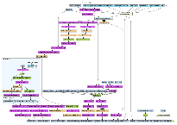
Review prototypes with customer (and/or users), document the results
Heavyweight prototypes
Documentation
These prototypes are pretty expensive to make, since they implement some interactivity.
Therefore, they often are incorporated into the finished product (“evolutionary” prototypes).
http://www.flickr.com/photos/dullhunk/428079229/sizes/l/in/set-72157618027570984/

Slide 36
Spiral kinds of processes
Draft a menu of
program designs
Analyze risk &
prototype
Draft a menu of
architecture designs
Analyze risk &
prototype
Draft a menu of
requirements
Analyze risk &
prototype
Establish
requirements
Plan
Establish
architecture
Plan
Operation
Testing
Implementation
Establish
program design

Slide 37
Implementation, Testing, Operation
Wrap up increment #1
  Manually load database with product data (including eco-friendliness data)
  Finish coding basic UI for searching/ordering
  Write tests, run tests, fix bugs, test some more
  Deliver code to customer
  Customer tests the code some more
  Fix bugs, test, fix bugs, test
  Deploy to public server
  Fix bugs, test, fix bugs, test

Slide 38
Increment #2: load eco-data from XML feeds
We already know this requirement—no need to return to the requirements phase for this!
Return to review the alternative architectures
Create a menu of program designs, prototype and review, implement, test, send to operation, etc

Slide 39
Spiral kinds of processes
Draft a menu of
program designs
Analyze risk &
prototype
Draft a menu of
architecture designs
Analyze risk &
prototype
Draft a menu of
requirements
Analyze risk &
prototype
Establish
requirements
Plan
Establish
architecture
Plan
Operation
Testing
Implementation
Establish
program design

Slide 40
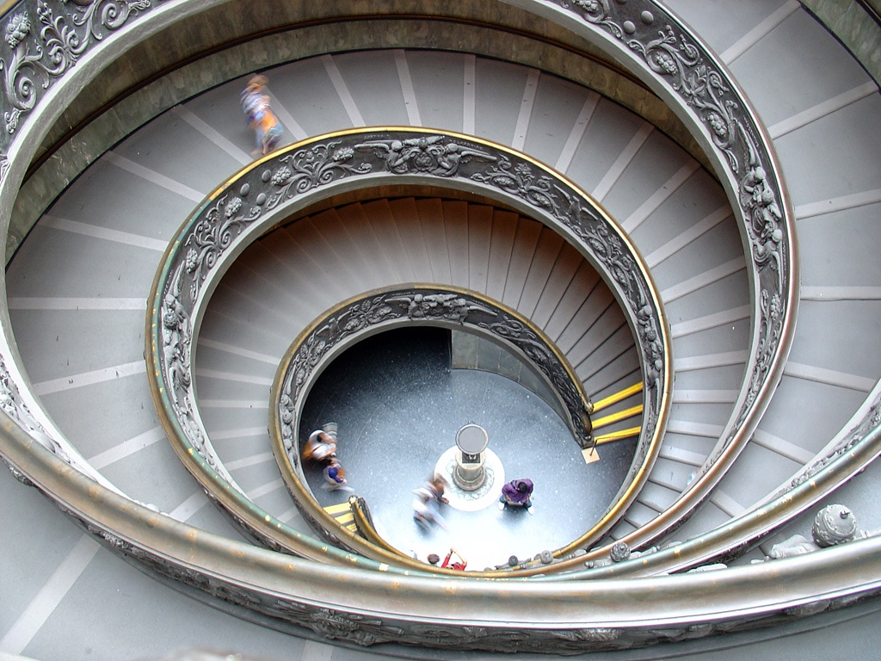

Increment #3 and beyond
  Pay attention to users, discover new requirements - Spiral, spiral, spiral
http://www.flickr.com/photos/villes/696080093/sizes/o/

Slide 41
What’s next for you?
Watch the website and read the posted vision statements:
  Which visions capture your imagination???
  No, you cannot vote for your own.
  You can vote for more than one (for a few)
  I’ll assign you to a team, based on your vote(s)
  One vision per team: that’s the system that your team will design using a waterfall process
Email your votes to me before next class.

