Slide 1

Continuous improvement
http://www.flickr.com/photos/ajagendorf25/1076632419/sizes/l/

Slide 2
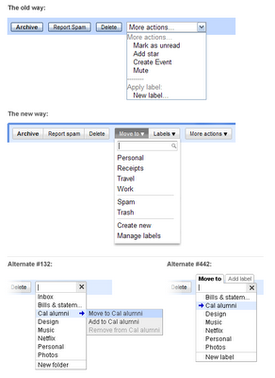

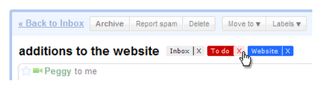

Start simple and continually improve
Example of Gmail labels
http://googleblog.blogspot.com/2009/07/evolution-of-gmail-labels.html

Slide 3
Start simple and continually improve
YAGNI (“You aren’t going to need it”)
  “A design which doesn't meet business needs is bad, no matter how pretty.”
    Don’t add functionality until it’s needed
  “If software is what you want to deliver then measure progress by how much you have working right now, not by how fancy the design is.”

Slide 4
Rules of the simplest design
(with precedence)
The system (code and tests together) must communicate everything you want to communicate.
The system must contain no duplicate code.
The system should have the fewest possible classes.
The system should have the fewest possible methods/functions.

Slide 5
Refactoring
What it is: A program transformation that improve code’s organization, not its function.
Examples:
  Renaming variables or methods
  Gathering duplicated code into a method
  Splitting long methods into two methods
When to do it: When code starts to “smell”

Slide 6
Benefits of refactoring
Improves maintainability.
Improves reusability.
“Prepares” the code for new functionality.
Lets you tidy up existing code by introducing design patterns.
Lets you separate functionality from form, allowing you to focus on one or the other at a time.

Slide 7
Bad smell: Long methods
Sometimes you have a method that tries to do lots of different things.
  Remember, code should have concerns!
  This applies to methods, too.
  Usually, >= 1 screen of code is too much.
Most common way of refactoring:
  Split the method into smaller methods.
  Call each method.

Slide 8
Bad smell: duplicate code
Sometimes you have a few lines of code that appear in many different places
  Often happens during copy-and-paste coding!
  Usually, >= 3 duplicates are too many.
Most common way of refactoring:
  Create a new method (and/or new class)
  Move the duplicated code into the new method
  Call the new method from each old place

Slide 9
Bad smell: Large classes
Sometimes you have a class that tries to do too many things.
  Usually, >= 7 member variables and/or >= 50 methods is too many.
Most common way of refactoring:
  Pick the appropriate design pattern.
  Break the class into pieces, using the pattern.
  Fix up the code.

Slide 10
Bad smell: Long parameter lists
Sometimes your method has a parameter list as long as your arm.
  How is somebody supposed to remember what parameters to pass into the method???
Most common way of refactoring:
  Organize some/all of the parameters together into a hierarchy, using the composite pattern.
  Pass an instance of the composite, rather than a list of individual primitive values.
  Consider moving methods into the class, too!

Slide 11
A few more refactorings
Rename
Delete unused method
Move
Introduce factory
Change signature….
  Modifies visibility, return types and/or parameters

Slide 12
How to do a refactoring right
You absolutely have to have a working unit test suite.
  No refactoring allowed until you’re passing all your unit tests
Then, when you get a whiff of a bad smell, talk with your pair programmer about it
Try out the refactoring idea
Run the unit test
Iterate until you like the code & all unit tests pass

Slide 13
Refactoring early, refactor often
If it takes you too long to refactor than you are not refactoring enough.
  Many tiny refactorings are easier than a single enormous refactorings.
  Each refactoring makes it easier to identify opportunities for further refactorings.

Slide 14
Be alert for opportunities
Refactor when…
  A new feature seems too difficult to code
  You just created a new feature, and the code will be too hard for somebody else to understand
  You “can’t stand to look at your own code”
  You can’t stand to look at your teammate’s code!!
  REMEMBER: It’s not your code, it’s your team’s.

Slide 15
Unit tests are your safety net
“When the test suite stops working
(‘turns red’), it is unsafe to move forward.”
“You might be driving, and then your copilot gets an idea to refactor, so you switch and he codes the changes, and then runs the test suite and voila, it works.”

Slide 16
Shifting focus: improving yourself
Focus so far: the code and the design
Shifting focus to you: improving your team

Slide 17
Use the past to predict the future
Once you have done a lot of software projects
  You (theoretically) can have a lot of data about the past
  Very little is completely new to you
If the future is like the past, then you can use the past to predict the future.

Slide 18
Key assumptions
The future will be like the past
You are reflective enough to pay attention to yourself and what you’re doing.
  Not all people are so aware of themselves
You are disciplined enough to take the time to precisely record and use data
  And evaluate if your predictions are coming true

Slide 19
Example
Joe & Ted are pair programmers
They have implemented 4 web apps
How long should a 30 a.p. web app take?
Web app | # application points | Months required
Balloon sales site | 10 | 2
Balloon rides site | 10 | 4
Insurance sales site | 20 | 6
Find-a-lawyer site | 10 | 3

Slide 20
Personal Software Process
PSP is one way of collecting and using data
Agile does not prescribe any particular method for doing this
  But whatever method is selected, it should be simple and not very time consuming

Slide 21
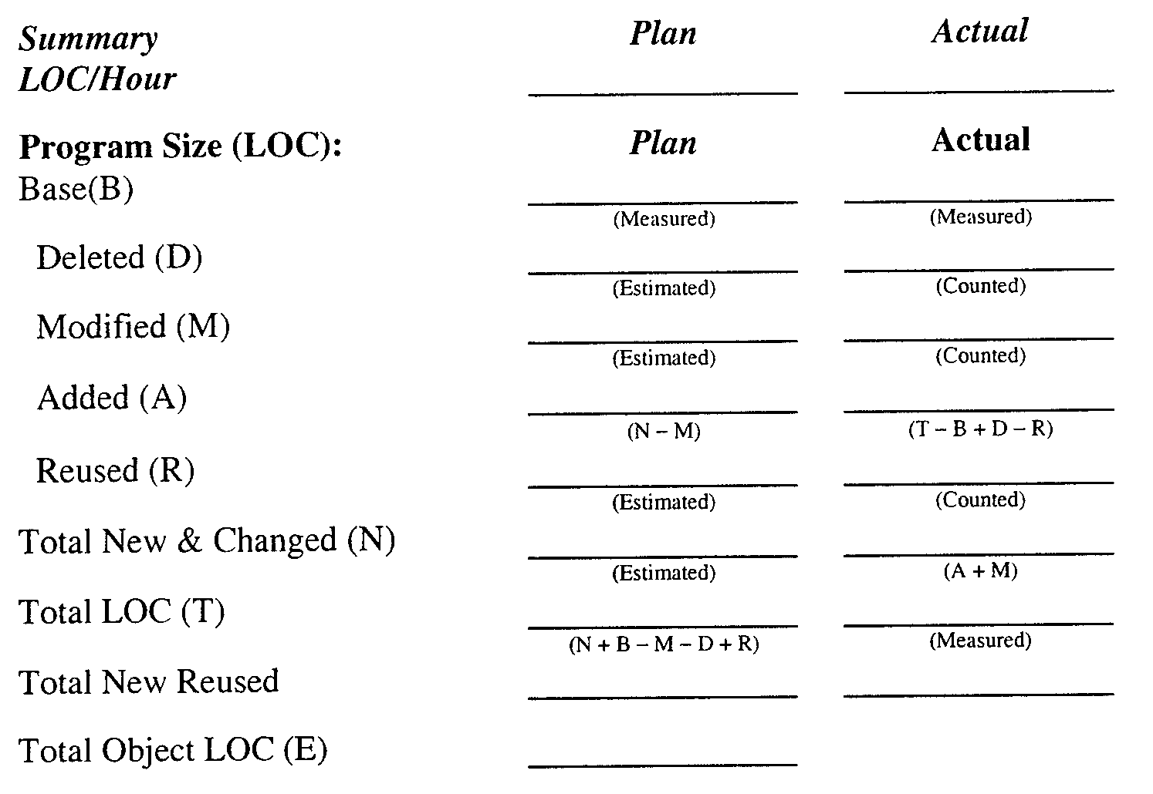
http://web.engr.oregonstate.edu/~cscaffid/storage/psp.pdf

Slide 22
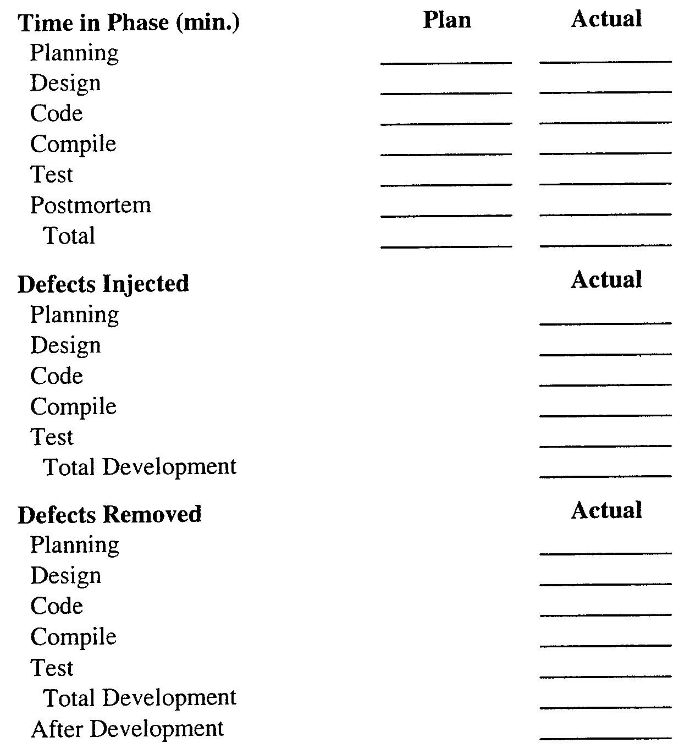
http://web.engr.oregonstate.edu/~cscaffid/storage/psp.pdf

Slide 23
Tips for recording data
Keep a notebook, spreadsheet, or other software with you anytime you code
Get in the habit of recording start/stop info
Bugzilla
If you forget to make a record, then write down an estimate as soon as you remember
At the end of the day, summarize data
  And send an email to your team if you’re falling way far behind

Slide 24
Using the data
For making estimates
  After you receive user stories from the customer, and you’re dividing user stories into tasks, refer to your data about similar tasks.
For refining estimates
  Just before you release code to your customer, and you’re talking with your team about how the iteration went, refer to your data to refine estimates of how long the next tasks will take.

Slide 25
Other opportunities for improving your team
At the end of an iteration, discuss…
  What interesting coding techniques did you discover?
  What new IDE features did you find?
  What key problems did you encounter?
  Is one of your teammates really really good (or bad) at something?
    Use this information for setting up future pairings.

Slide 26
Opportunities for improving yourself
Code something outside your comfort zone
Online tutorials
Books
Mentors
User groups and other clubs
Conferences and workshops
Programming competitions
Getting involved in research

Slide 27
Helpful books
Design Patterns by Gamma et al.
The Unified Modeling Language User Guide by Booch et al.
Problem Frames by Jackson
Algorithms by Cormen et al.
Contextual Inquiry by Beyer and Holtzblatt

Slide 28
What’s next for you?
Finish up HW 6
  Gather some data
    Think back over this week and make estimates of how long your tasks are taking
    And as you do new tasks, collect some data
  Keep your eyes open for refactoring
Prepare for team presentations

