Slide 1
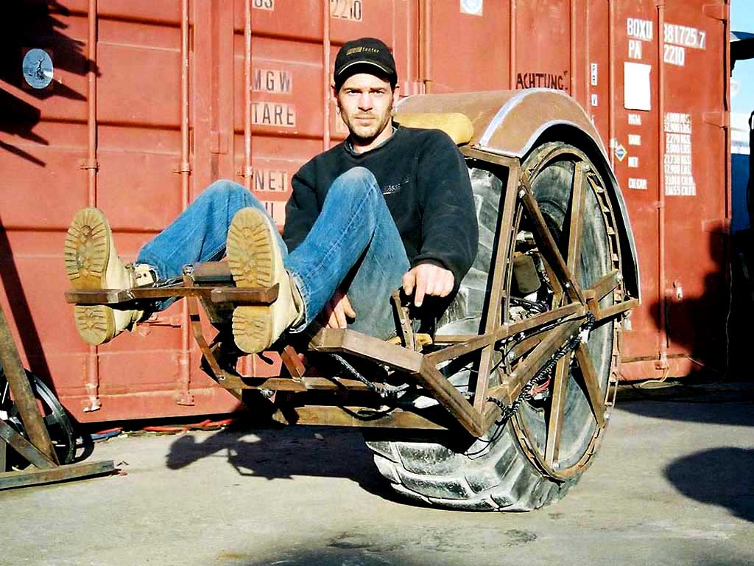
Requirements
http://www.flickr.com/photos/buglugs/1416652608/sizes/o/

Slide 2
Just Right?
Or “all kinds of wrong”?
It depends on the system’s purpose.
http://www.flickr.com/photos/buglugs/1416652608/sizes/o/

Slide 3
Requirements
Requirements state the purpose of the system
  Requirement: Expression of desired behavior
Very helpful for
  Communicating with customers and co-workers
  Keeping track of everything that needs to get done
  Helping you and the customer decide what really needs to get done, anyway
    Hint: customers often don’t know what they really need!
    Discussing requirements helps them to understand their needs.
Notes:
Requirements don’t focus on implementation-specific details

Slide 4
Standish survey of software development projects (1995)
Factors Reported for Failure
  13.1% - Incomplete Requirements
  10.6% - Lack of Resources
  9.9 % - Unrealistic expectations
  9.3 % - Lack of Executive support
  8.7 % - Changing requirements and specification
  8.1 % - Lack of Planning
  7.5 % - System no longer Needed
Notes:
Over 350 companies, 8000+ software projects, 31% cancelled before completion, only 9% on time and within budget
1$ requirement collection
$5 design
$10 coding
$20 unit testing
$200 after delivery

Slide 5
Requirements analysis
Ways to figure out what the system should do:
  Get the customers to write down what they want
  Talk with customers and make some diagrams
  Watch users in “daily life” to see what they need
    apprenticeship
  Look up the requirements from a standards body
  Gather with customer & users to discuss, argue, and negotiate
Any combination, variation, or extension of the above

Slide 6
Good requirements are…
Correct: They have to say the right things.
Consistent : They can’t contradict each other.
Unambiguous: Each must have 1 interpretation.
Complete: They cover all the important stuff.
Relevant: Each must meet a customer need.
Testable: There must be a way to tell if they are satisfied.
Traceable: There must be a way to determine their origin.
Notes:
Unambiguous: Often customers and

Slide 7
Typical parts of requirements documentation
Functional requirements
  Unstructured text
  Use cases
Non-functional requirements
  Unstructured text
    Fit criteria
Diagrams
  Class diagrams and entity-relationship diagrams
  Dataflow, sequence, and state diagrams
See Table 4.2 to help you tease out functional vs non-functional (quality) requirements

Slide 8
Functional requirements: tell what the system should do
Can be written as unstructured text
  Can be written from
    External viewpoint (requirements definition)
    System viewpoint (requirements specification)
Can be written as structured use cases
Notes:
Functional Requirement: describes required behavior in terms of required activities, such as reactions to inputs, and the state of each entity before and after an activity occurs

Slide 9
Unstructured text… external vs system viewpoint
A requirements definition is stated from the viewpoint of somebody outside the system:
  The system is a black box with some interface
  The emphasis is on the role of the system
A requirements specification is stated from the viewpoint of somebody inside the system:
  The environment is accessed via inputs & outputs
  The emphasis is on how the system works
Notes:
Definition usually for stakeholders
Specification usually for developers

Slide 10
External vs system viewpoint, example
External, stated from the viewpoint of somebody outside the system boundary:
  e.g.: “The sprinkler never runs on rainy days”
Internal, stated from the viewpoint of somebody inside the system boundary:
  e.g.: “The controller will not engage the water pump any time the ambient water sensor is triggered.”

Slide 11
Which of these are definitions?
Which are specifications?
“If the system detects that the drawbridge is down at noon, then it will raise the bridge for 10 minutes by activating the lift actuators.”
“The bridge will open 12:00-12:10pm daily.”
“Web sites will be spidered every day”
“The pilot can retract the landing gear by pressing a button”
“When it receives an http DELETE operation, the system will mark the record as deleted.”

Slide 12
Use cases: structured requirements definitions
Each use case describes an activity supported by the system
  Put another way, each use case describes a way to use the system
  Each use case is like a “bundle of scenarios” that are all the same except for very minor details
Being structured, use cases are a little more formal and precise than unstructured text.

Slide 13
What’s in a (basic) use case?
Use case name: succinct and meaningful
Actor: who “does” the activity?
Preconditions: what is true before the activity?
Postconditions: what is true after the activity?
Flow of events: what steps do the actor and the system perform during the scenario?

Slide 14
Example
Use case #1: Report repression
Actor: Citizen in repressive country
Preconditions:
User has a cell phone connectivity
User has Twitter account
Postconditions:
System has recorded information about a repressive event, including location & details

Slide 15
Example continued…
Use case #1: Report repression
Flow of events:
User posts a tweet giving city & country name, description of repression, and tag #repression
System periodically retrieves all #repression tweets via Twitter API
System parses tweet and geocodes locations
If location is ambiguous, system asks user to clarify (UC #2: Clarify tweet)
System records location and event in database

Slide 16
Example
Use case #2: Clarify tweet
Actor: Citizen in repressive country
Preconditions:
- User sent a tweet with ambiguous location
Postconditions:
- System has gotten clarification of location

Slide 17
Example continued…
Use case #2: Clarify tweet
Flow of events:
System replies to user, asking for user to clarify the city and country of the initial post
User edits and re-tweets the original message
Repeat above two steps until system can determine the location of the tweet

Slide 18
Sometimes, use cases are drawn in a cute (?) little diagram
UC#1: Report repression
UC#2: Clarify tweet
Repressed citizen
UC#3: View reports
Concerned public
UC#3a: View on map
UC#3b: View as RSS feed

Slide 19
Non-functional requirements
Describe how well the system should do stuff
  Can be written as unstructured text
  Often written in terms of fit criteria
    Exactly how good does the system need to be?
    Tightly related to important quality attributes
    Fit criteria should not be “imagined”, but instead driven by customer needs
Notes:
Nonfunctional or Quality requirement: describes some quality characteristic that the software solution must possess, such as fast response time, ease of use, high reliability or low maintenance costs.

Slide 20
Non-functional requirements usually relate to quality attributes
The “quality attributes” of great software:
Reliability
Efficiency
Integrity
Usability
Maintainability
Testability
Flexibility
Portability
Reusability
Interoperability

Slide 21
Examples: What quality attribute?
“The system must ask for tweet clarification within 5 minutes.”
  so the user is probably still online
“The drawbridge must rise within 1 minute.”
  so traffic stops only ~ 5 minutes (1+1+ 3 for ship)
“At least 95% of the code must be Java.”
  because porting such applications to Linux has proven to cost only $XXXX in the past

Slide 22
Typical parts of requirements documentation
Functional requirements
  Unstructured text
  Use cases
Non-functional requirements
  Unstructured text
    Fit criteria
Diagrams
  Class diagrams and entity-relationship diagrams
  Dataflow, sequence, and state diagrams

Slide 23
Overview of diagrams
Use case diagram: shows supported activities
UML class and entity-relationship diagrams: show entities, attributes, relationships
Dataflow diagram: shows flow of information
Message sequence diagram: shows flow of control
State chart: shows change over time

Slide 24
What’s next for you?
Your HW1 on requirements is due Monday before midnight.
  Get organized today.
  Meet with your customer today or tomorrow.
  A suggested schedule posted on the website will help you plan your time.
Do your readings too.
  It will help you with your homework!

