Slide 1
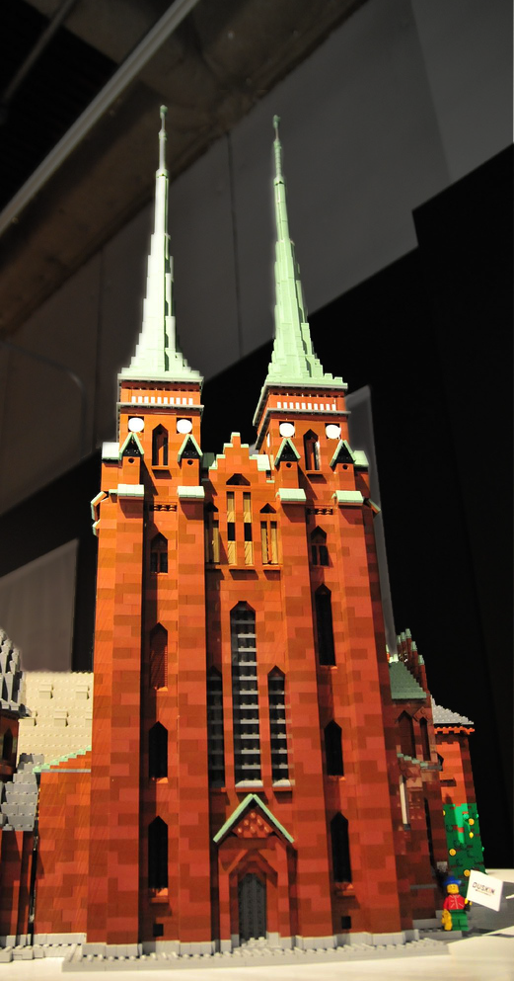


Design Patterns
http://www.flickr.com/photos/ajari/2287240221/sizes/l/

Slide 2
Previous Design Patterns
Builder
Adapter
Façade
Memento
Interpreter
Observer

Slide 3
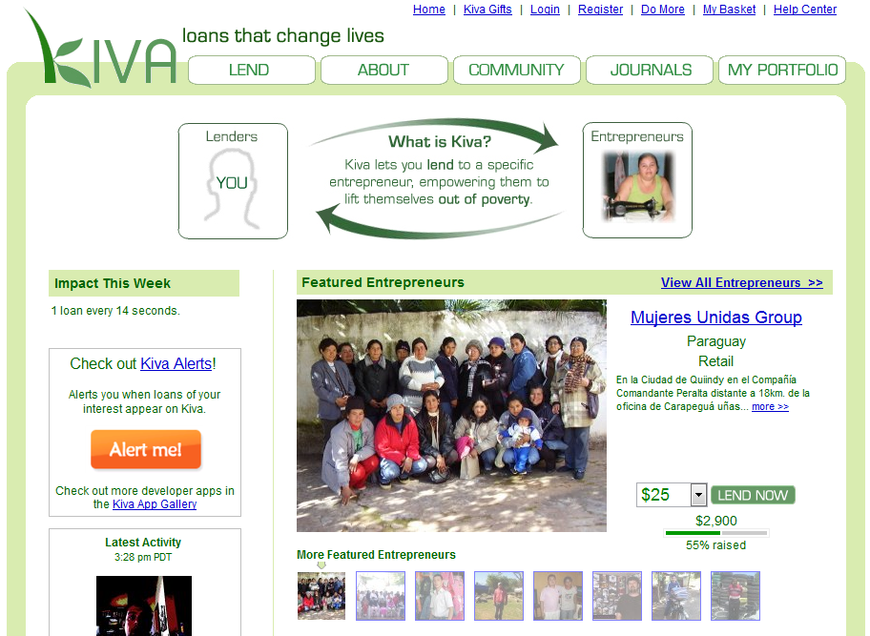
Example system
Kiva system to connect lenders with borrowers
How could we use
DPs to implement
Kiva?
How could we use
DPs to implement
a better Kiva???

Slide 4
Template method
ProcessLoanTemplate
+ withdrawFromAccount()
+ depositToKiva()
+ notifyUser()
Breaks an algorithm into steps
Children inherit and override any step they need to change
Useful if a general algorithm can be modified slightly and be reused
ProcessCreditAccount
+ withdrawFromAccount()
ProcessCheckingAccount
+ withdrawFromAccount()

Slide 5
Factory method
LoanFormFactory
+generateForm()
Define an interface for creating an object, but let the classes that implement the interface decide which class to instantiate. The Factory method lets a class defer instantiation to subclasses
FormProcessor
+ generatePaperForm()
+ generateHtmHorm()
+ generatePdfForm
FormRequestPage
Form
PaperForm
HtmlForm
PdfForm

Slide 6
Strategy
SortListofLoans
+ executeStrategy()
Allows for the selection of algorithm at runtime
SortStrategy
SortByLoanAmount
+ executeStrategy()
SortByName
+ executeStrategy()

Slide 7
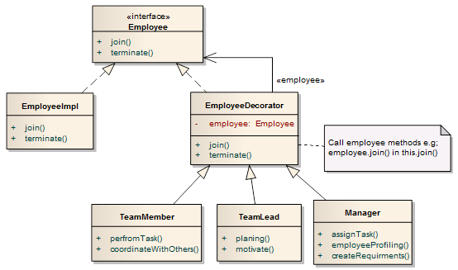
Decorator
Useful for assigning behavior at runtime independently of other instances of the same class.
Allows multiple decorations per class.
http://zishanbilal.wordpress.com/2011/04/28/design-patterns-by-examples-decorator-pattern/

Slide 8
Composite
Allows for the reduction of complexity by dealing with a group of objects as a single object
CompositeLoanRecords
+ addLoanRecord()
+ removeLoanRecord()
+ saveLoanToDb()
ILoanRecord
+ saveLoanToDb()
DebitLoanRecord
+ saveLoanToDb()
CreditLoanRecord
+ saveLoanToDb()

Slide 9
Visitor
Basic Idea:
An element has an accept() method that can take the visitor as an argument.
The accept() method calls a visit() method of the visitor.
The element passes itself as an argument to the visit() method.
Depending on the types of the element and visitor at runtime, an the proper algorithm executes.
See Wikipedia for more details.
Allows for a separation of the algorithm and the data it works on
Built on method overloading and dynamic types

Slide 10
Which pattern
would you use?
Your system needs to be able to dynamically process payment according to what country the payment is coming from.
Template | Decorator
Factory | Composite
Strategy | Visitor
Notes:
strategy

Slide 11
Which pattern
would you use?
You’d like to build your model such that the data and algorithms running over the data are kept separate.
Template | Decorator
Factory | Composite
Strategy | Visitor
Notes:
visitor

Slide 12
Which pattern
would you use?
Your system needs to execute the same algorithm over multiple data sources of the same type.
Template | Decorator
Factory | Composite
Strategy | Visitor
Notes:
composite

Slide 13
Which pattern
would you use?
You have three algorithms that only differ slightly.
Template | Decorator
Factory | Composite
Strategy | Visitor
Notes:
template

Slide 14
Which pattern
would you use?
You’d like to extend the functionality of a credit card processor to allow for customers to change their credit card at runtime.
Template | Decorator
Factory | Composite
Strategy | Visitor
Notes:
decorator

Slide 15
Which pattern
would you use?
Your system needs to issue unique membership cards to your customers. You have both elite and regular customer types.
Template | Decorator
Factory | Composite
Strategy | Visitor
Notes:
factory

Slide 16
Next for you
Homework 4 is due next Monday
Revise your vision statement.

