Slide 1
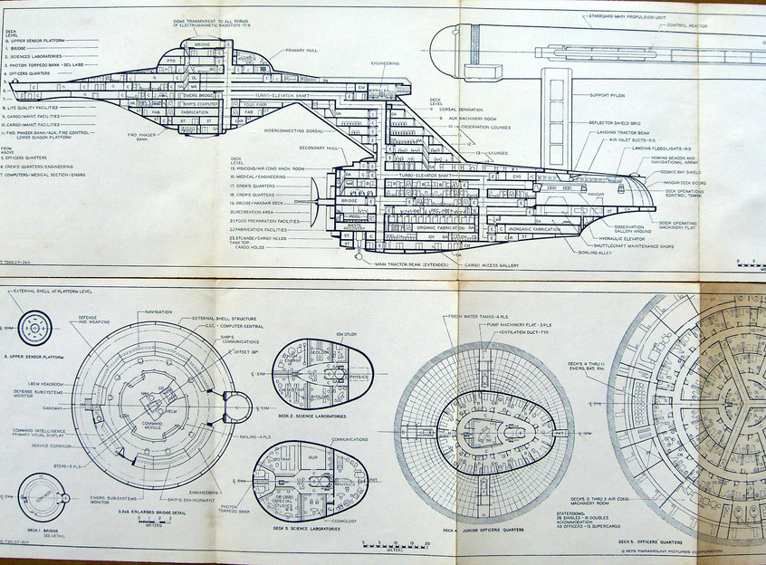
Diagram Notations
http://www.flickr.com/photos/cardoso/2197507288/

Slide 2
Did you plan to build the Enterprise all on your own????
Diagrams are often useful when…
  You need to communicate, visualize, or analyze something
  And that something has some sort of structure

Slide 3
Typical parts of requirements documentation
Functional requirements
  Unstructured text
  Use cases
Non-functional requirements
  Unstructured text
    Fit criteria
Diagrams
  Class diagrams and entity-relationship diagrams
  Dataflow, sequence, and state diagrams

Slide 4





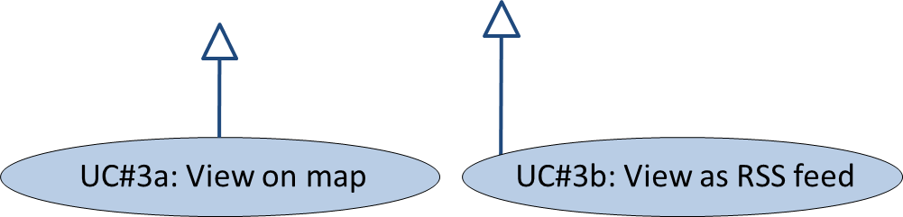
Use case diagram: shows activities supported by the system
Repressed citizen
Concerned public
Notes:
Actors: Users
Use Cases: Ovals, essential behavior only
Arrows: Order of events
Hollow arrowheads: specialization (like subclassing)

Slide 5
Notes on use case diagrams
Stick man for user
Ovals for use cases
  Italicize “abstract” use cases
Simple arrows when a UC “calls” another
Hollow arrowheads for specialization
  Similar to the role that subclassing plays in OO

Slide 6
UML class diagram: shows entities, attributes, relationships
Clarification tweet
+ report
+ when (datetime)
+ text (string)
User
+ Twitter username
Repression report
+ source (tweet)
+ location (geocode)
+ when (datetime)
+ details (string)
*
*
1
0..1
*
*
Repression tweet
+ user
+ when (datetime)
+ text (string)
1
Repression view
+ reports
*
Google map view
+ JavaScript
RSS View
+ XML text
System boundary
Notes:
Class/Entity: Each box
Functions/variables
Lines = associations with cardinality
Hollow triangle = specialization

Slide 7
Notes on UML class diagrams
One box per kind of entity, listing attributes
  Italicize abstract entities, attributes
Lines without arrowheads show references
  Similar to member variables in OO
  Labeled with cardinality (multiplicity)
    Integers, ranges, or asterisk (for unlimited)
Lines with hollow arrowheads for specialization
Lines with regular arrowheads can be used to indicate dependencies
  Usually omitted in requirements’ class diagrams

Slide 8
Entity-relationship diagram: shows entities, attributes, relationships
Clarification tweet
report
when (datetime)
text (string)
r
0..1
User
Twitter username
Repression report
source (tweet)
location (geocode)
when (datetime)
details (string)
p
1
yields
s
writes
asks about
shows
n
1
q
Repression tweet
user
when (datetime)
text (string)
Repression view
reports
Google map view
JavaScript
RSS View
XML text

Slide 9
Notes on entity-relationship diagrams (ERDs)
One box per kind of entity
List entities on branches
Lines with a diamond show relationships
  Diamond label indicates role of relationship
Numbers or variables on lines show cardinality

Slide 10
Dataflow diagram: shows flow of information
Repression
info
Report
Tweet
Reporter
Twitter DB
Send clar req
Tweet
Clarification
message
Clarification
message
Tweet
Inter-pret
Raw
report
Clarify
Viewing user
Location
Geocoder
Map
RSS feed
Geocode
RSS View
Report
Reports
Reports DB
Map View
Reports

Slide 11
Notes on dataflow diagrams
Each oval is a “function” provided by system.
  Each inward arrow is a parameter (labeled)
  Each outward arrow is an output (labeled)
Each rectangle is an actor
  A person, place, or thing that can do stuff and/or initiate events
Each “half-rectangle” is a data store (file or database)
Often clearer if you do a separate dataflow diagram for each use case

Slide 12
Message sequence diagram: shows flow of control
User
Twitter
System
Database
Geocoder
[geocode != null]
Tweet event
Read tweets
Geocode
Create report
[if geocode != null]
Request to clarify
[if geocode == null]
Deliver request

Slide 13
Notes on message sequence diagrams
One box per entity involved
  E.g.: if you have two users interacting with each other, then you would have two boxes
  Each box has a dashed line, showing its “lifetime”, which can end if an object is destroyed
Arrows show messages
  Also, draw an dashed arrow back if there’s a return value
Conditionals are written with brackets [ ]
  Loops can be enclosed in a shaded box

Slide 14
State chart: shows change over time
Report status
Raw tweet
(just text)
record
geocoding fails &
user retweets
Geocoded
(geocode != null)
In database
(geocode == null)
geocoding
succeeds

Slide 15
Notes on state charts
One box per state
Arrows show a possible state transition
  Annotated to indicate under what conditions the transition occurs
Filled circle shows where you “start”
Nested filled circle shows where you “stop”

Slide 16
Putting it together: a typical requirements document
Requirements definition
  Unstructured text: functional & non-functional reqs
  Use case descriptions
  Class diagrams or ERDs showing external entities
Requirements specification
  Unstructured text: functional & non-functional reqs
  Dataflow diagram
  Message sequence diagrams or state charts

Slide 17
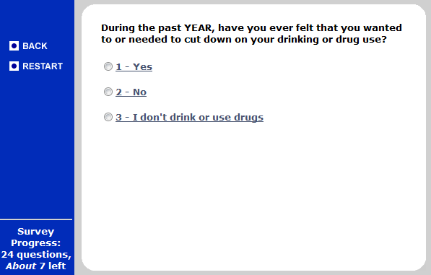
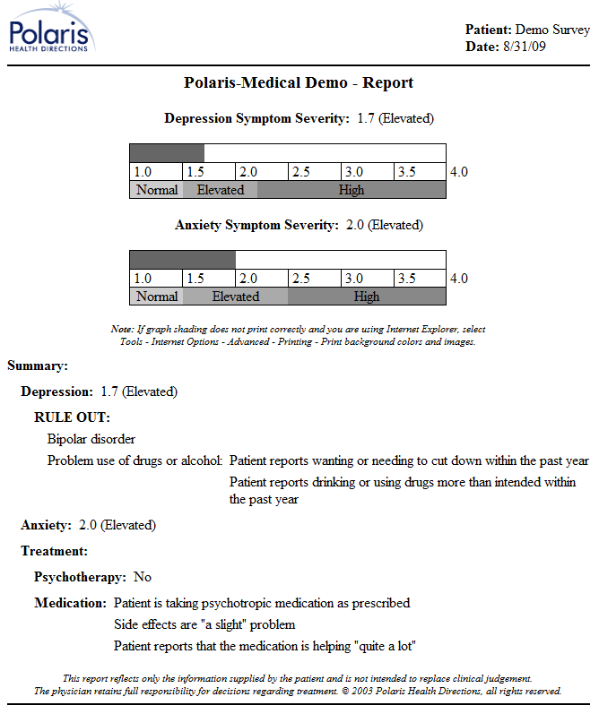
An example system to support drug and alcohol counseling
http://cf.polarishealth.com/demo/start_demo.html

Slide 18
Requirements definition, functional reqs, unstructured text
Before each counseling visit, each counselee takes a survey.
After each survey, the system prints a report showing the counselee’s progress.
Administrative assistants can add counselees and their counselors to the system.
Requirements definition: written from external viewpoint; system is like a “black box”

Slide 19
Requirements definition, non-functional reqs, with fit criteria
Each survey will be short enough for an average user to complete within 10 minutes.
Progress reports will each be 2 pages or less.
The system will print progress reports within 2 minutes of a survey’s completion.
Users can take a survey using a Windows machine that has a Pentium II 550 MHz CPU, with 0.5 GB of RAM.
Requirements definition: written from external viewpoint; system is like a “black box”

Slide 20
UC#1: Survey and report
Actor: Counselee
Precondition: Counselee registered in system
Postconditions:
  Counselee progress data is recorded in system
  Report is printed for use by counselor
Flow of events:
  Counselee logs in (lastname + PIN)
  System collects survey data from counselee
  System prints report

Slide 21
Class diagram of entities
User
+ lastname (string)
+ PIN (int)
Report
+ surveys
+ counselor
*
Counselor
+ reports
1
*
1
*
Survey
+ questions (String [])
+ answers (int [])
+ counselee
Counselee
+ counselor
+ surveys
*
*
1
System boundary

Slide 22
Requirements specification, functional reqs, unstructured text
Survey data will be stored in the database at the end of the survey, and a report will be sent to the printer.
The system will provide screens for adding, editing, and deactivating counselee and counselor records from a database.
Requirements specification: written from system’s viewpoint, involving internal details of system

Slide 23
Requirements specification, non-functional reqs, with fit criteria
95% of the code will be platform-independent (Java or platform-independent JavaScript).
The system will record completed surveys in the database within 30 seconds; reports will be sent to the printer within 30 seconds and emerge within 60 seconds.
Requirements specification: written from system’s viewpoint, involving internal details of system

Slide 24
Dataflow diagram
(note: only shows UC#1)
Last name
& PIN
Authenticate
Counselee
User ID
Survey DB
Health
Information
Survey
answers
Survey
All this
patient’s
answers (ever)
Pick up
Create report
Printout
Printer
Postscript
Printout
Counselor

Slide 25
Message sequence diagram
UC#1
Counselee
Server
Database
Printer
Log in
[survey complete]
Present question
Answer question
Record answers
Get report data
Send report to printer

Slide 26
A few general comments
These are just the basic diagrams.
  Sufficient for our homework, exams, and probably 90% of what you’ll see after graduation
  Fancier versions of these diagrams do exist
It’s OK to draw diagrams by hand
  As long as you respect the notation
  And, at least for homework, scan it into a PDF

Slide 27
What’s next for you?
Finish your HW1 by Monday, before midnight
  Email me if you have questions
Every team member should be contributing
  Remember: Try to resolve any disputes on your own first

