Slide 1
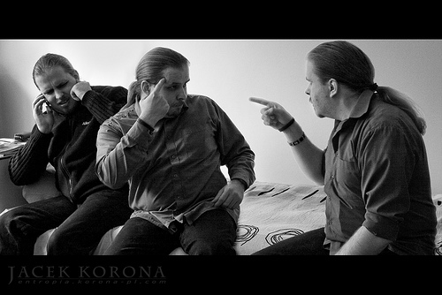
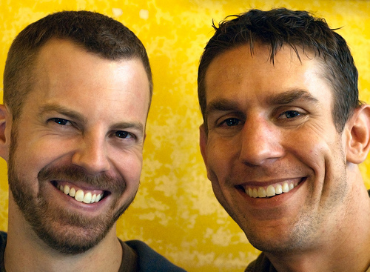
Evaluating
Requirements
http://www.flickr.com/photos/korona-pl/2857014100/sizes/m/
http://www.flickr.com/photos/carbonnyc/3199834377/sizes/m/

Slide 2
Review: Requirements Definition and Specification
Definition
  For your customer
  From the outside perspective
  Written in language the customer understands
Specification
  For the engineers
  From the system’s perspective
  Written in language engineers understand
Each item in definition has a corresponding item in the specification
This is the contract, list of deliverables and design guidelines

Slide 3
Why bother to do a good job when designing software?
To improve the world
  Designing software badly can harm the world
To meet customers’ needs
  Designing software badly can harm customers
To get a paycheck
  Designing software badly can get you fired
To have some fun
  Designing software badly just plain feels bad

Slide 4
Customers and users should be your friends
They probably know much more about the problem than you do.
They probably have some ideas about how to solve the problem.
They are your best resource for discovering your own mistakes before you start to code.

Slide 5
Validation and Verification
Validation: Build the right system
  Does the requirements definition accurately reflect the customers (all stakeholders) needs?
Verification: Build the system right
  Confirm that one document or artifact conforms to another
    Does code match design?
    Does the design match specification?
    Does the specification match the definition?

Slide 6
Good requirements are…
Correct: They have to say the right things.
Consistent : They can’t contradict each other.
Unambiguous: Each must have 1 interpretation.
Complete: They cover all the important stuff.
Relevant: Each must meet a customer need.
Testable: There must be a way to tell if they are satisfied.
Traceable: There must be a way to determine their origin.

Slide 7
Approaches for evaluating requirements
Prototyping
  Depict a design based on requirements, test if people can use it
Stakeholder review
  Present diagrams to customer & engineers, get feedback
Analysis
  Manually or automatically check properties of your requirements and design

Slide 8
Who are Stakeholders?
Customers
Users
Domain experts
Marketing specialists
Lawyers or auditors
Software engineers

Slide 9
Stakeholder review
Sit down with stakeholders
Engineers present their understanding of requirements
Stakeholders correct this understanding
Everybody discusses/argues/negotiates
Engineers revise requirements
Repeat, if necessary.

Slide 10
1. Sit down with stakeholders
Make sure that all of the “right” people attend
  In advance, ask stakeholders if they know of other people who need to attend
  Consciously consider having user representatives attend the meeting
But try to keep the attendee list <= 8 people
  So that everybody at the meeting can be heard
  So that you don’t waste $$$$
➔ People should attend if and only if their attendance would be valuable.

Slide 11
2. Engineers present their understanding of the requirements
The situation of the customers / users
Key problems faced by customers / users
Key use cases to be supported by system
  Often helpful to present diagrams from the requirements definition
Visualizations of possible system interface
  Often helpful to present low-fidelity prototypes
Make it clear that you welcome feedback.

Slide 12
3. Stakeholders correct this understanding
Your customer / users / other stakeholders will probably interrupt the designers
If your stakeholder says something that you don’t understand, try to get him/her to explain in terms of a concrete scenario.
  More details later
It’s often helpful have a note-taker responsible for recording customer feedback.

Slide 13
4. Everybody discusses requirements
Focus on concrete scenarios
  A specific example of how a particular person would use the system in a certain real-world situation
  An instance of a use case
  Scenarios will support system testing later.
Discussion is how you make sure that your requirements are correct, unambiguous, and testable.

Slide 14
4. Everybody argues about requirements
Focus on risk management
  What scenarios might be hard to support?
  What scenarios are impossible to support?
  What requirements contradict one another?
Arguing is particularly necessary when requirements contradict one another.

Slide 15
4. Everybody negotiates about requirements
Focus on prioritization, rather than eliminating support for scenarios
  I only have so much time; what should I do first?
  That way, reqs can be complete yet affordable.
Watch for opportunities to use incremental or iterative development processes
  Incremental: is there a part that we can build really well right now, then add more parts later?
  Iterative: can we do a low-quality version of the entire system, then improve it later?

Slide 16
5. Engineers revise requirements.
Update the requirements definition and specification based on the review’s results.
Every single requirement should have been reviewed with stakeholders at least once.
  Keep track of what scenarios and comments came from stakeholders for each requirement
  Helps to ensure relevance and traceability

Slide 17
Stakeholder review
Sit down with stakeholders
Engineers present their understanding of requirements
  The situation of the customers / users
  Key problems faced by customers / users
  Key use cases to be supported by system ->
  Visualizations of possible system interface ->
Stakeholders correct this understanding
Everybody discusses/argues/negotiates
Engineers revise requirements

Slide 18
UC#1: Configure energy monitors
Actor: A home owner or business worker
Precondition: User has account on web site and has a networked computer
Postcondition: System records user’s energy usage at each power outlet

Slide 19
UC#1: Configure energy monitors
Flow of events
User buys energy monitors and a USB dongle
User plugs USB dongle into computer
User plugs monitor into power outlet
  Monitor wakes up and sends its id via wireless to the dongle, which shows info form on screen
  User enters information about that outlet
  System records information
User plugs electrical appliance into monitor
Monitor transmits on/off info to computer any time that appliance is used

Slide 20
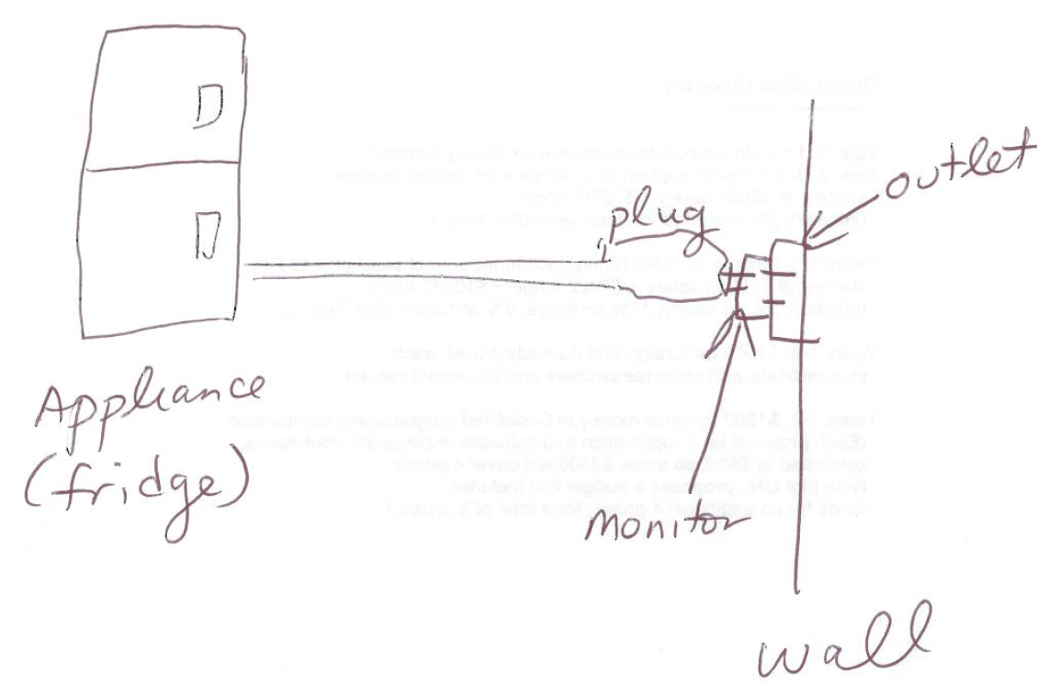
Plugging in an energy monitor

Slide 21
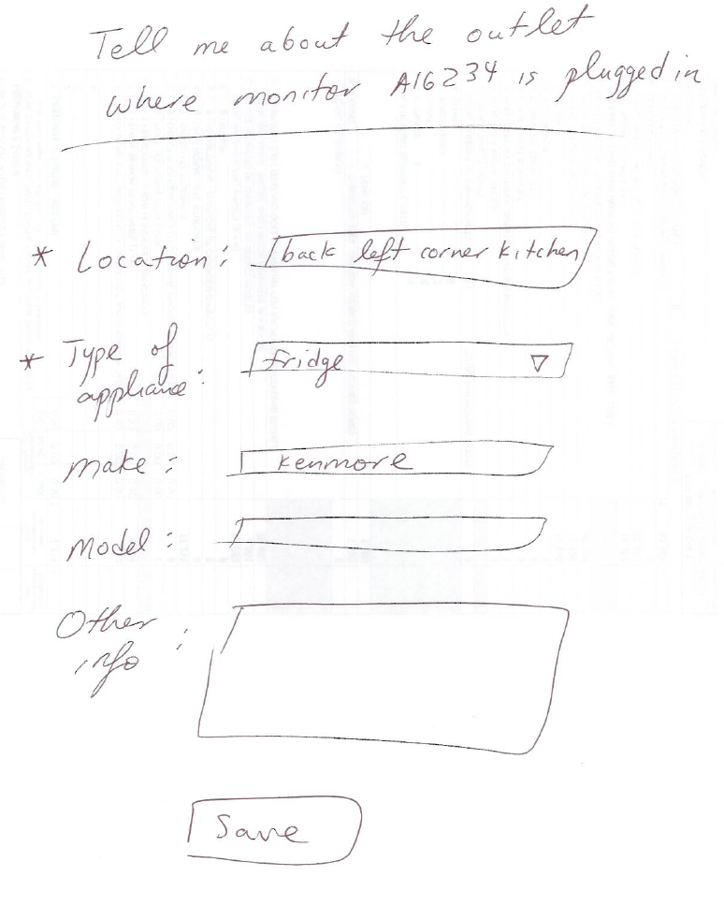
Possible user interface for configuring monitor

Slide 22
UC#2: Transmit energy data
Actor: Homeowner or business worker
Precondition: Monitors have been configured and have been monitoring for a while
Postcondition: Energy usage is sent to website
Flow of events:
  User turns on computer, connecting to internet
  Computer dongle asks monitors to send data
  Monitors transmit data to dongle
  Computer forwards information to website

Slide 23
UC#3: Review online data
Actor: Homeowner or business worker
Precondition: Monitors have been sending information to website for a while
Postcondition: User can see energy usage as well as tips for reducing usage
Flow of events:
  User logs into website
  Website shows configurable charts showing usage
  Website offers tips based on energy consumption, outlet info and external data (e.g. other user data)

Slide 24
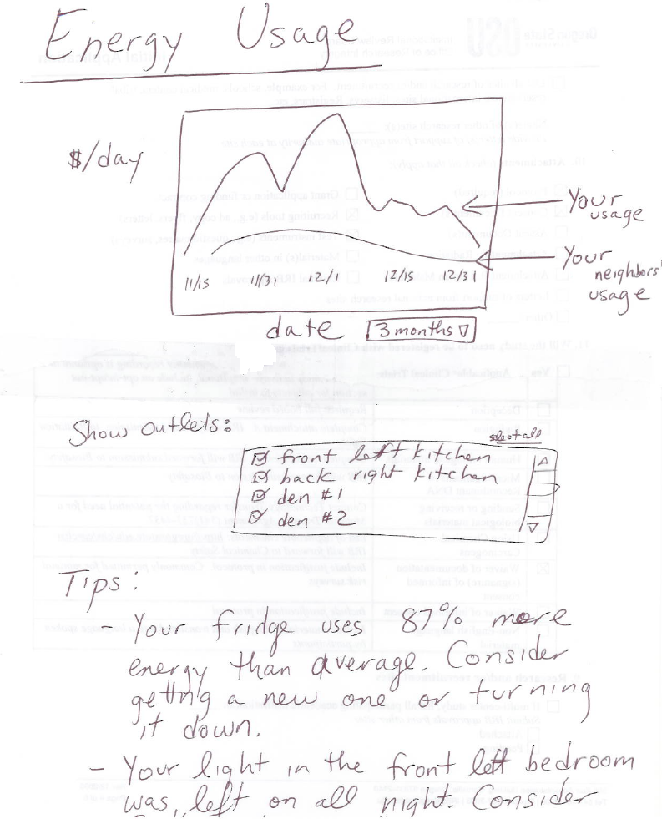
Possible user interface for reviewing online

Slide 25
Stakeholder review
Sit down with stakeholders
Engineers present their understanding of requirements
Stakeholders correct this understanding
Everybody discusses/argues/negotiates
  Explain using scenarios
  Identify risks
  Use incremental or iterative development?
Engineers revise requirements

Slide 26
Approaches for evaluating requirements
Prototyping
  Depict a design based on requirements, test if people can use it
Stakeholder review
  Present diagrams to customer & engineers, get feedback
Analysis
  Manually or automatically check properties of your requirements and design

Slide 27
Approaches for evaluating requirements
Measuring Requirements
  You understand this requirement completely. It is similar to ones you’ve seen in the past.
  There are elements that are new, but not radically different than the past.
  Some elements are very different than the past, but you understand and can develop a good design.
  There are parts you do not understand and you are not sure you can develop a good design
  You do not understand this requirement at all, and cannot design.

Slide 28
Manual analysis
Systematically check consistency between requirements definition and specification
  If you “execute” or “simulate” the use cases, would the system suffice?
  If the definition says that the system has feature X, does the specification indicate how to support X?

Slide 29
Details on formal analysis
Define two formal models
  Describing the requirement definition
  Describing the requirement specification
Automatically check if the specification satisfies the definition
Not really used by many engineers in practice
  See your textbook for examples

Slide 30
Strengths of each requirements evaluation technique
Technique | Especially good for | Weaknesses
Paper prototyping | -Evaluating visual requirements | -Often misses interactions between use cases
Low-fidelity prototyping | -Evaluating visual requirements | -A little expensive -Need design skills
Stakeholder review | -Evaluating fit to context | -Costs customer time
Manual analysis | -Checking for consistency | -Easy to miss errors
Formal analysis | -Can guarantee formally specifiable properties | Expensive Need formal skills
Validation:
Is your goal correct?
Verification:
Is your solution correct?

Slide 31
What’s next for you?
Get HW2 done
  Validating requirements definition: do you thoroughly understand the customer’s problem?
  Verifying requirements specification: have you thoroughly checked that your solution will solve the problem?

