Slide 1
Introducing Data Science & AI
Victor Geislinger

Slide 2
“So Who Are You?”
1
Notes:
You might be asking ”who am I?”

Slide 3
Who Am I?
Physics & Math
Degrees
Creating AI
Especially With
Natural Language
Teacher
Software (ML) Engineer
Data Scientist

Slide 4
Who Am I?
Teacher
Software (ML) Engineer
Data Scientist
Physics & Math
Degrees
Creating AI
Especially With
Natural Language
Notes:
Was a teacher, SWE, DS

Slide 5
Who Am I?
Teacher
Software (ML) Engineer
Data Scientist
Physics & Math
Degrees
Creating AI
Especially With
Natural Language
Notes:
Went to school for physics & math

Slide 6
Who Am I?
Teacher
Software (ML) Engineer
Data Scientist
Physics & Math
Degrees
Creating AI
Especially With
Natural Language
Notes:
Now focus on AI (ML); especially NLP

Slide 7
What is Data Science & AI?
2
You might already be using it
Notes:
I’ve said ”data science” & “AI”; let’s talk about it

Slide 8
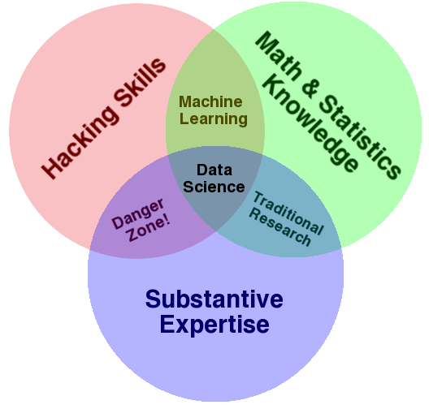
Data Science
Notes:
You probably never heard “data scientist”

Slide 9
What is Data Science?
Various Subjects (Cross-Disciplinary)
Notes:
Fuzzy definition
Image: http://drewconway.com/zia/2013/3/26/the-data-science-venn-diagram

Slide 10
What is Data Science?
Various Subjects (Cross-Disciplinary)
Computers: Doing More Faster
Connecting Math to the Real World
Communicating Ideas

Slide 11
What is Data Science?
Various Subjects (Cross-Disciplinary)
Computers: Doing More Faster
Connecting Math to the Real World
Communicating Ideas

Slide 12
What is Data Science?
Various Subjects (Cross-Disciplinary)
Computers: Doing More Faster
Connecting Math to the Real World
Communicating Ideas

Slide 13
What is Data Science?
Various Subjects (Cross-Disciplinary)
Computers: Doing More Faster
Connecting Math to the Real World
Communicating Ideas

Slide 14
What is Data Science?
Various Subjects (Cross-Disciplinary)
Computers: Doing More Faster
Connecting Math to the Real World
Communicating Ideas

Slide 15

Artificial Intelligence (AI)
Notes:
Exciting part of DS: AI

Slide 16
What is AI?
Past Information (“Data”) to Make “Better” Decisions
Notes:
Question: What do you think is AI?

Slide 17
?
What is AI?
Past Information (“Data”) to Make “Better” Decisions
Predicting
Classifying Groups
“Reinforcement Learning”
Generative
Notes:
One definition

Slide 18
What is AI?
Past Information (“Data”) to Make “Better” Decisions
?
Predicting
Classifying Groups
“Reinforcement Learning”
Generative
Notes:
Predicting future (especially time series regression: stocks, temperature)

Slide 19





What is AI?
Past Information (“Data”) to Make “Better” Decisions
?
Predicting
Classifying Groups
“Reinforcement Learning”
Generative
Notes:
Range of answers

Slide 20
What is AI?
Past Information (“Data”) to Make “Better” Decisions
Predicting
Classifying Groups
“Reinforcement Learning”
Generative
Notes:
Classifying: Supervised vs Unsupervised
Based on attributes

Slide 21
What is AI?
Past Information (“Data”) to Make “Better” Decisions
Predicting
Classifying Groups
“Reinforcement Learning”
Generative
Notes:
All “bugs”

Slide 22
What is AI?
Past Information (“Data”) to Make “Better” Decisions
Predicting
Classifying Groups
“Reinforcement Learning”
Generative
Notes:
All flying

Slide 23

What is AI?
Past Information (“Data”) to Make “Better” Decisions
Predicting
Classifying Groups
“Reinforcement Learning”
Generative
Notes:
All beetles

Slide 24
What is AI?
Past Information (“Data”) to Make “Better” Decisions
Predicting
Classifying Groups
“Reinforcement Learning”
Generative
Notes:
RL: Good vs Bad

Slide 25



What is AI?
Past Information (“Data”) to Make “Better” Decisions
Predicting
Classifying Groups
“Reinforcement Learning”
Generative

Slide 26
What is AI?
Past Information (“Data”) to Make “Better” Decisions
Predicting
Classifying Groups
“Reinforcement Learning”
Generative
Notes:
Generative AI: Writing; art; music
Learns from finding patterns. Sometimes trained to do some other thing (side effect)

Slide 27
How AI Works
3
Many Different Ways…
Notes:
There are a whole lot of ways; let’s focus on one major method

Slide 28


Loudness
Size
Notes:
Goal is to separate groups with a “continuous line”

Slide 29
Loudness
Size
Notes:
Goal is to separate groups with a “continuous line”

Slide 30
Loudness
Size
Notes:
Straight line

Slide 31
Loudness
Size
Notes:
Curvy line better?

Slide 32
Loudness
Size

Slide 33
Notes:
Let’s compare

Slide 34
Loudness
Size
Notes:
Let’s go back to our data

Slide 35
Loudness
Size

Slide 36
Loudness
Size
Notes:
Let’s add “more” data we didn’t see

Slide 37
Loudness
Size

Slide 38
Loudness
Size
Notes:
Where it gets it it right and wrong

Slide 39
Loudness
Size

Slide 40
Loudness
Size
Notes:
Where it gets it it right and wrong

Slide 41
Loudness
Size
Notes:
A more “correct curve”

Slide 42
Loudness
Size

Slide 44
Where’s the AI?

Slide 45
Where’s the AI?
Notes:
The AI create the boundary!
We’ll see later what this “looks” like; to actually understand it, you have to do the math

Slide 46
AI: Current & Future
4

Slide 47
Current
AI
Notes:
Current AI

Slide 48
Current
AI
Decision Making
Generating Writing: ChatGPT
Robotics (Self-Driving)
Image Generation: Midjourney
Science/Medical Research
Notes:
Demos if time

Slide 49

Future of
Current
AI
?
Notes:
Current AI

Slide 50
Current
Current
Future of
AI
?

Slide 51
Concerns About AI
5

Slide 52
Concerns About AI
Privacy
Jobs & Careers
Ethics in Its Usage
Who Has the Final Say
Emerging Technology

Slide 53
TensorFlow Playground Activity
6

Slide 54
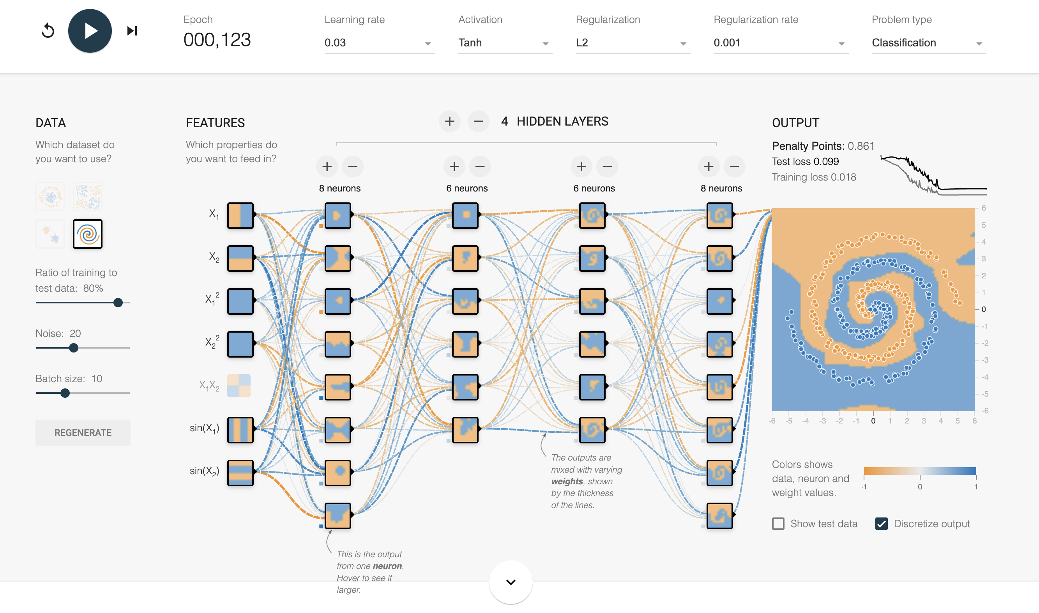
TensorFlow Playground Playing with Real AI
Notes:
playground.tensorflow.org

Slide 55
Questions & Answers Time
7
AMA

Slide 56





THANKS!
@MrGeislinger / mrgeislinger.com

Slide 57
PRESENTATION DESIGN
Special thanks to all the people who made and released these awesome resources for free:
Presentation template by SlidesCarnival
This presentation uses the following typographies:
Titles: Oswald
Body copy: Source Sans Pro
Download for free at:
https://www.fontsquirrel.com/fonts/oswald
https://www.fontsquirrel.com/fonts/source-sans-pro

