Slide 1





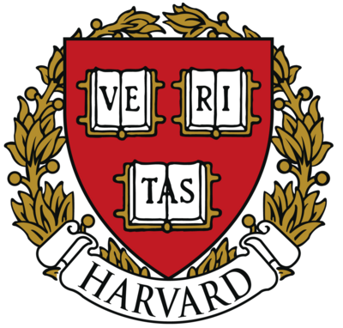



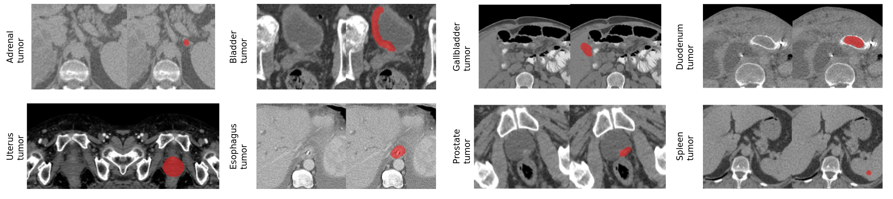

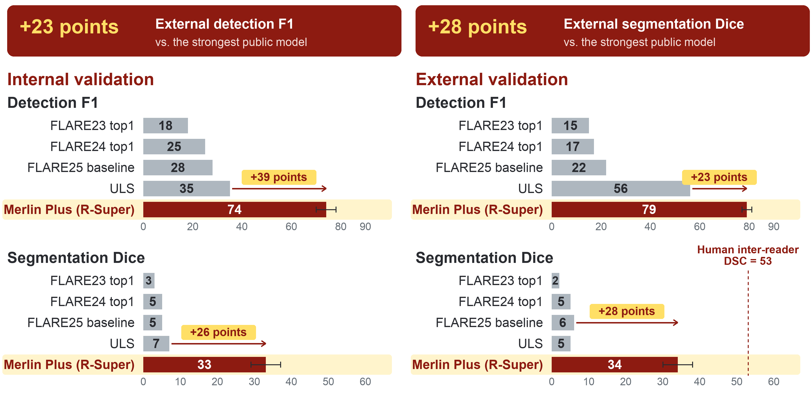
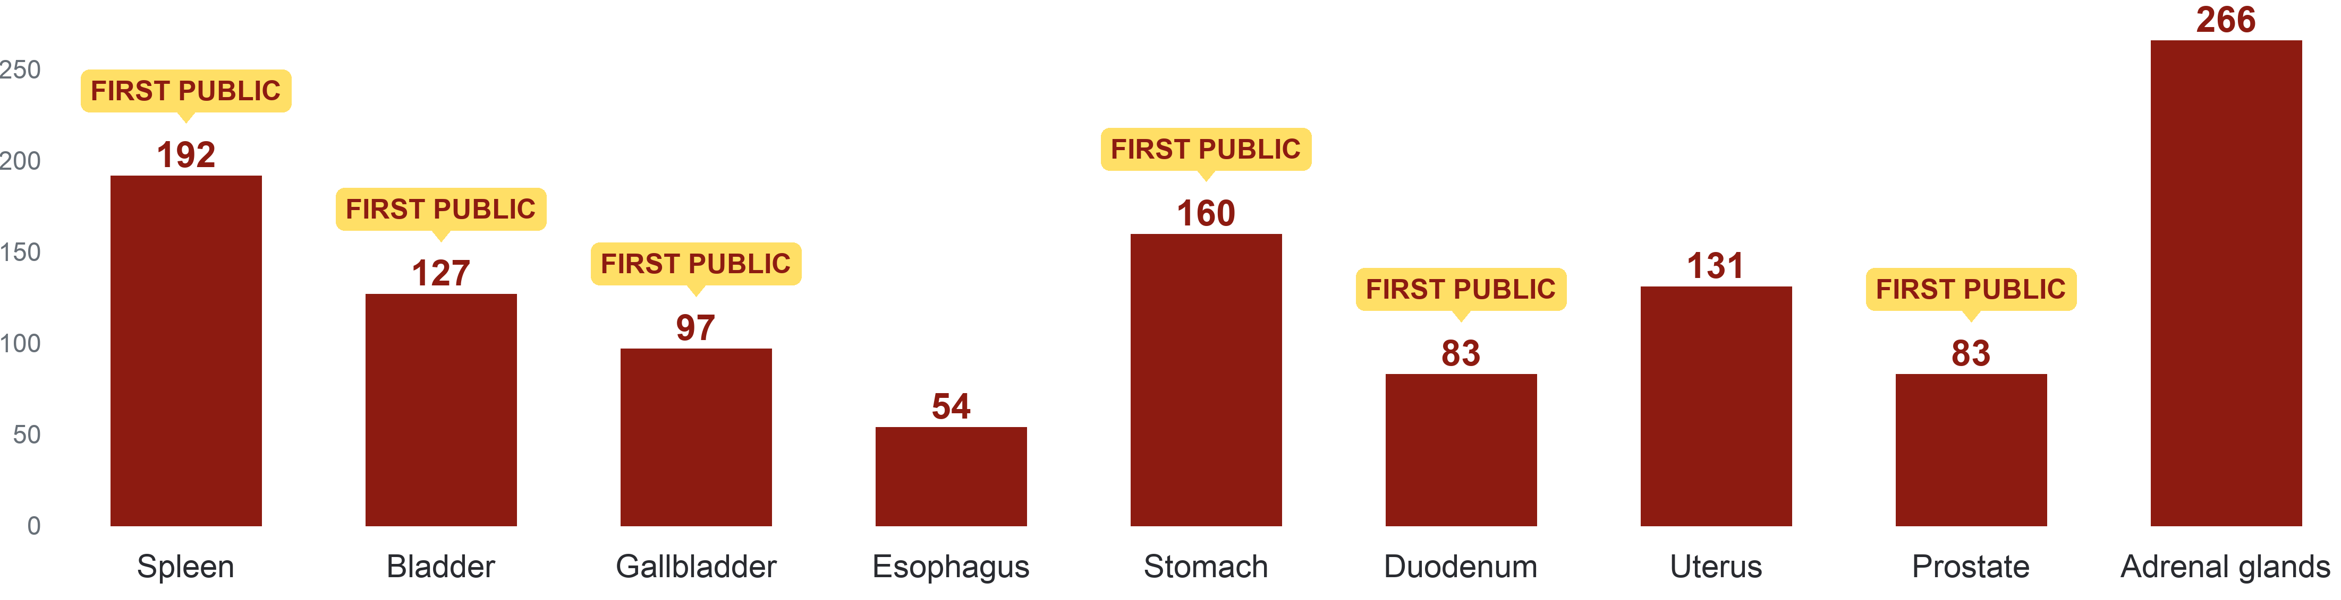
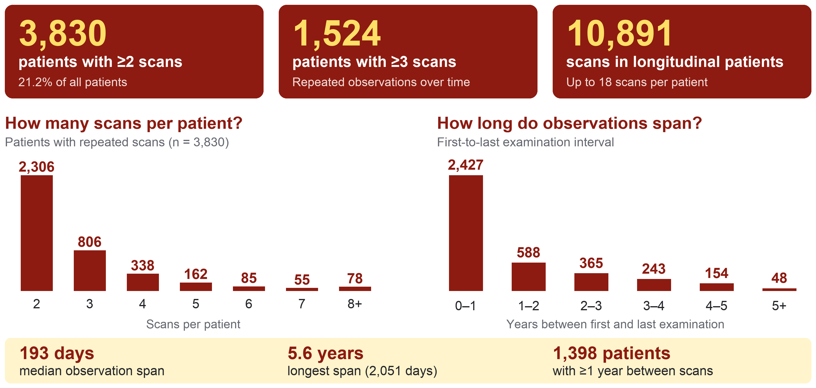
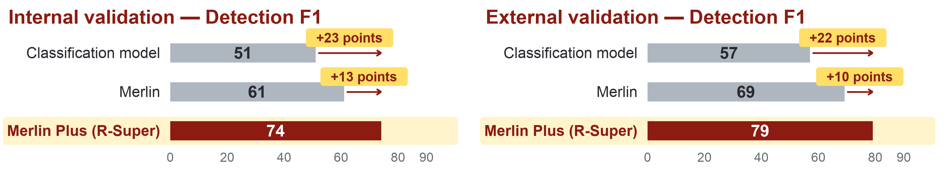
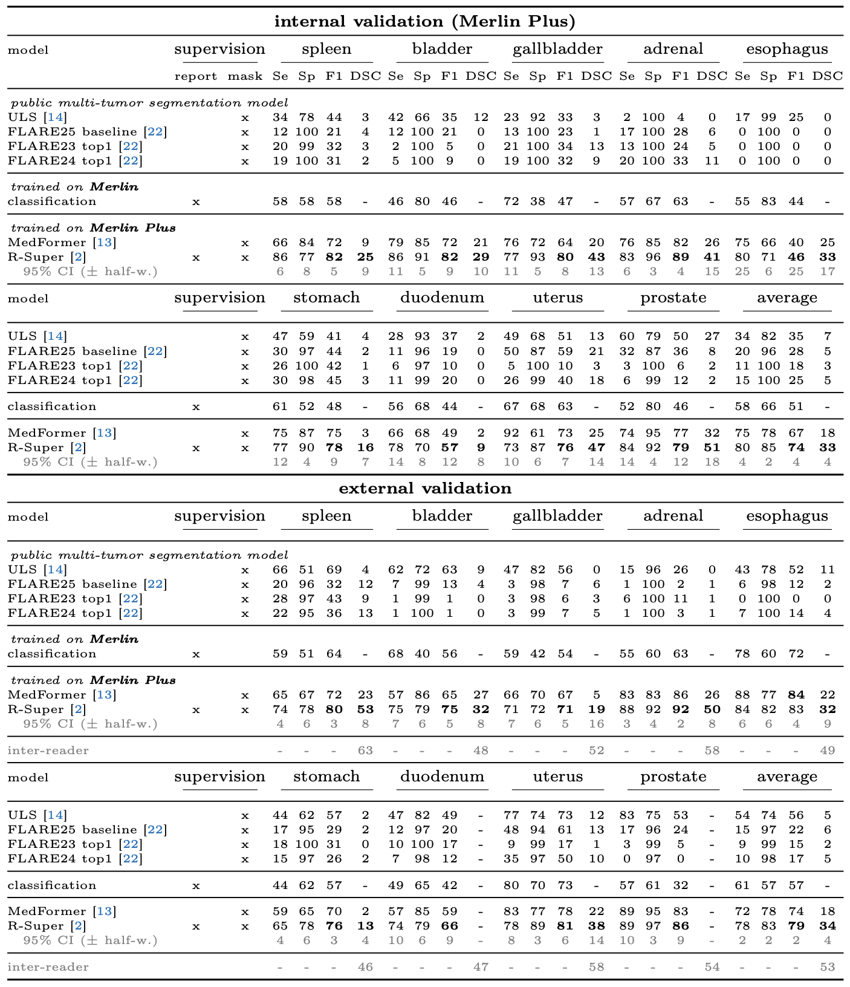
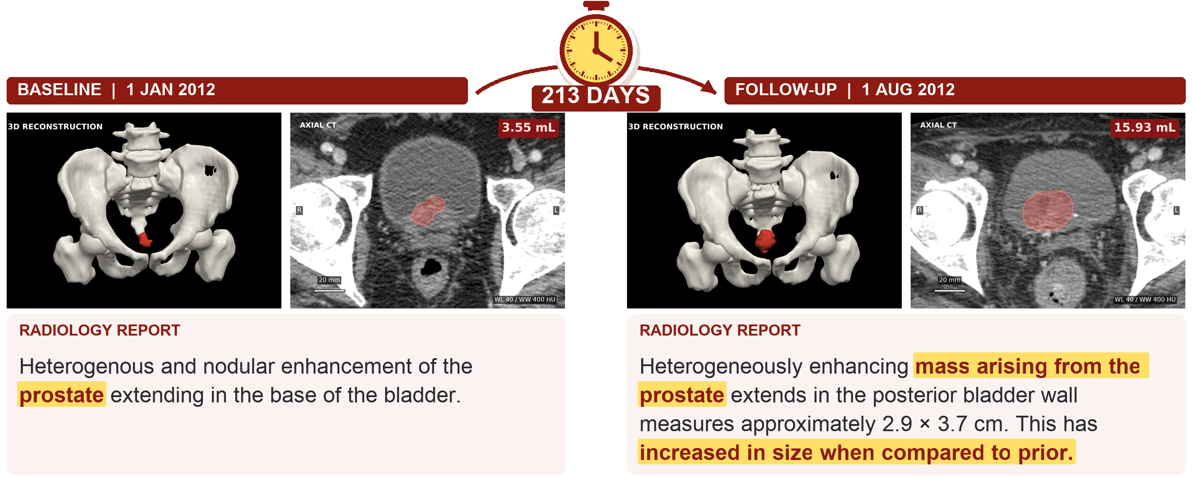

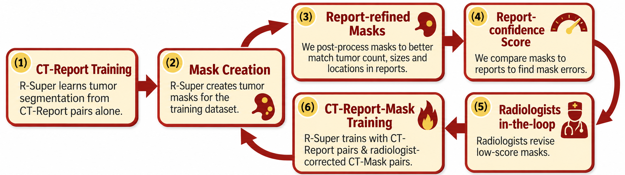
Merlin Plus: A Large-Scale, Multi-Cancer,
Longitudinal, Image-Mask-Report Dataset
Pedro R. A. S. Bassi^{1,2,3†}, Wenxuan Li^{1,2,3†}, Szymon Płotka^{4†},
Ruby Honjol⁵, Jakub Prządo⁶, Xinze Zhou¹, Kang Wang⁷, Yang Yang⁷, Malte Jensen⁵,
Akshay S. Chaudhari⁵, Curtis P. Langlotz⁵, Alan L. Yuille¹, and Zongwei Zhou^{1,8*}
¹Johns Hopkins University ²Harvard Medical School ³Massachusetts General Hospital ⁴Jagiellonian University
⁵Stanford University ⁶Warmian-Masurian Cancer Center ⁷University of California, San Francisco ⁸Johns Hopkins Medicine
zzhou82@jh.edu; Data (QR code): github.com/mrgiovanni/MerlinPlus
Download
the Data!
A Public Dataset of Longitudinal CT Scans, Radiology Reports, and Masks for 9 Cancer Types
Background: Tumor segmentation models can advance cancer detection and surpass VLMs and classifiers, but public datasets lack masks for most tumor types in CT. Furthermore, longitudinal AI models are expected to learn cancer progression, but most public CT datasets lack multiple scans per patient.
Contribution: In Merlin Plus, radiologists created tumor masks for tumors in 9 organs in the Merlin dataset (Stanford hospital, 25,494 CT scans), the largest pelvic and abdominal public CT dataset. Additionally, we release anonymized patient IDs and scan dates, making Merlin Plus a longitudinal dataset: 3,830 patients have two or more CT scans.
Method: A new active learning method, based on radiology reports and Report Supervision (R-Super), allowed 4 radiologists to create masks 3 to 5 times faster.
Results: Segmentation models trained on Merlin Plus substantially surpass state-of-the-art public AI models (ULS and FLARE) in the detection and segmentation of 9 tumor types, with +23% F1-Score and +29% DSC, showing that Merlin Plus fills a substantial gap in public data. Segmentation models trained on Merlin Plus also substantially surpass the Merlin model and classification models trained on Merlin in tumor detection, by +10% F1-Score, revealing the importance of tumor segmentation masks.
Unlike others, the R-Super loss functions can leverage radiology reports to yield massive performance improvements in tumor segmentation.
Large-Scale: 25,494 CT Scans, Masks for Tumors in 9 Organs
New State-of-the-art: Merlin Plus Models Substantially Surpass Previous Public AI in Tumor Detection & Segmentation
1,193 masks, including all confirmed malignant tumors
Unlike others, the R-Super loss functions can leverage radiology reports to yield massive performance improvements in tumor segmentation.
New Tumor Types: First Public Masks for Tumors in the
Spleen, Bladder, Gallbladder, Stomach, Duodenum and Prostate
Masks Improve Cancer Detection: Merlin Plus Models Substantially Surpass Models Trained on Merlin (no Mask) in Tumor Detection
v
Longitudinal: Patients with Multiple Time Points
Full Results: Detection and Segmentation of 9 Tumor Types
Internal & External Validation
We release anonymized patient IDs and scan dates
Allows learning cancer evolution
Large-scale longitudinal CT scans, masks, and reports
Accelerating Mask Creation: Report-Based Active Learning
New post-processing: auto refine masks to match tumor descriptions in reports!
Problematic masks are found by comparing masks and reports
Radiologists revise refined masks: 3X – 5X faster than creating masks from scratch
This work was supported by the Lustgarten Foundation, the National Institutes of Health (NIH) R01EB037669, and the National Science Center, Poland 2025/57/B/ST6/03100.

