Slide 1








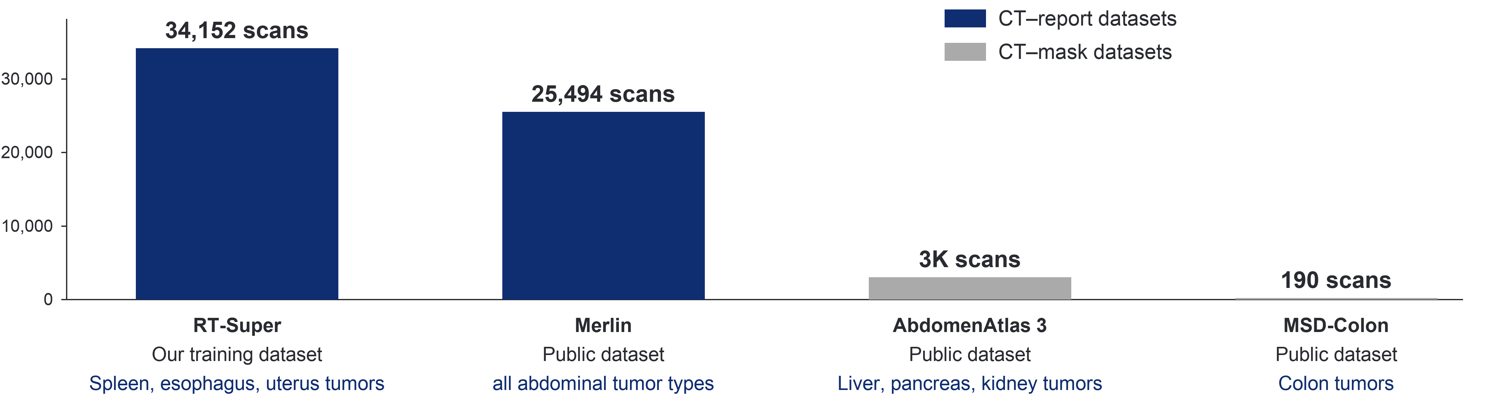
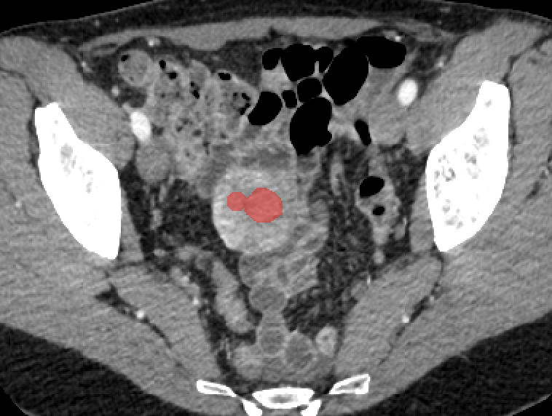


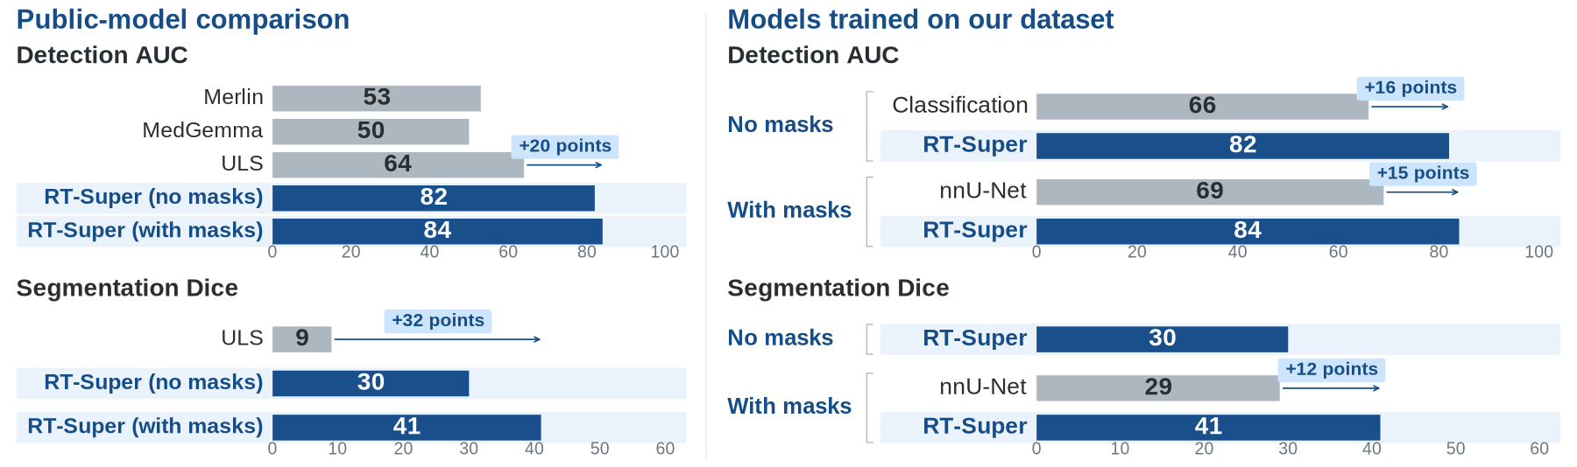
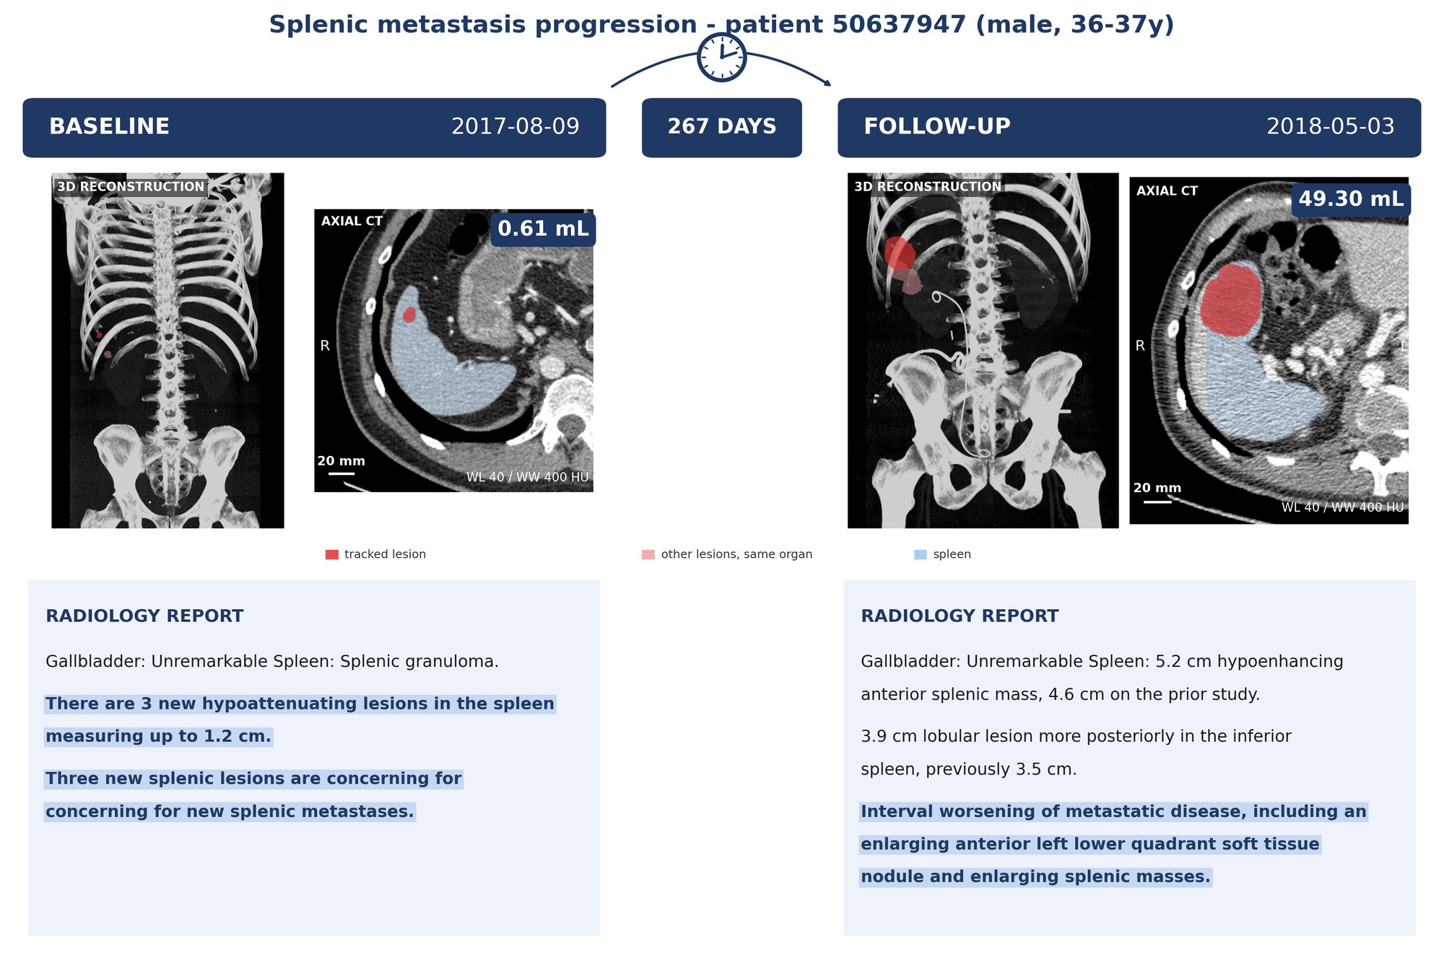
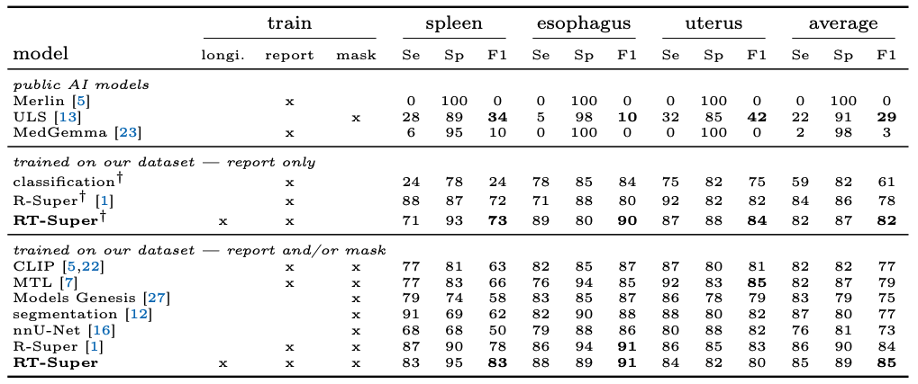
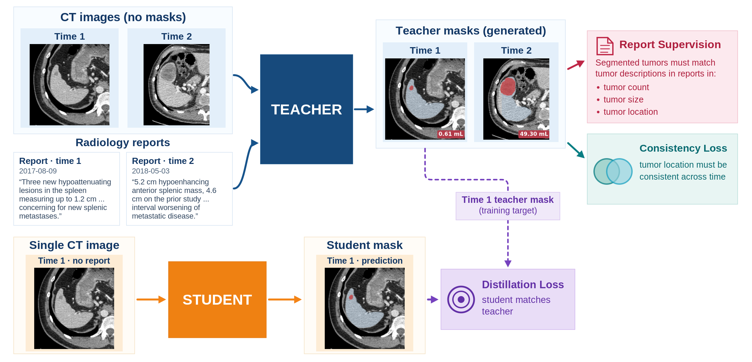
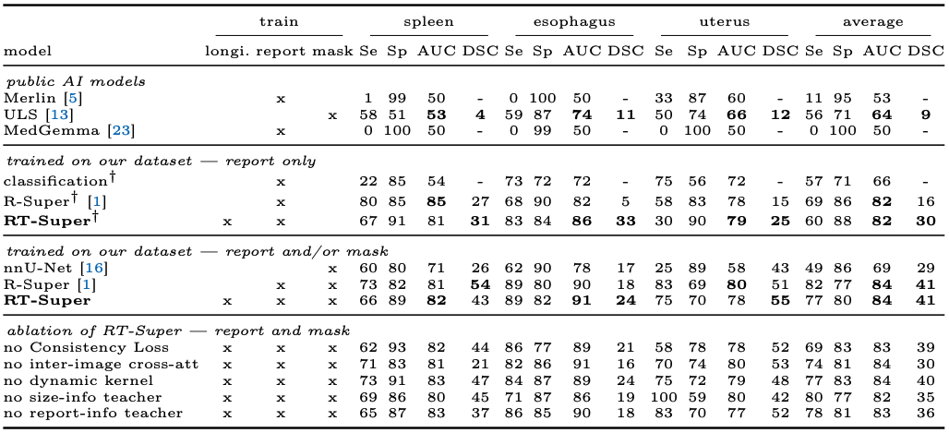
RT-Super: Learning Tumor Segmentation
from Longitudinal Images and Reports
Pedro R. A. S. Bassi^{1,2,3}, Wenxuan Li^{1,2,3}, Hanxue Gu⁴, Jieneng Chen¹, Xinze Zhou¹,
Zheren Zhu⁴, Sezgin Er⁵, Ibrahim E. Hamamci⁵, Bjoern H. Menze⁵, Gulhan E. Akan⁶,
Kang Wang⁴, Yang Yang⁴, Alan L. Yuille¹, and Zongwei Zhou^{1,7*}
¹Johns Hopkins University ²Harvard Medical School ³Massachusetts General Hospital
⁴University of California, San Francisco ⁵University of Zurich ⁶Istanbul Medipol University ⁷Johns Hopkins Medicine
zzhou82@jh.edu; Code (QR code): github.com/mrgiovanni/RT-Super
GitHub
Code
Learning Detection and Segmentation from Large-Scale Longitudinal Images & Reports instead of Scarce Tumor Masks
Background: Tumor segmentation can advance cancer detection and surpass VLMs and classifiers, but segmentation datasets are often small and lack masks for most tumor types in CT. Instead, hospitals and new public datasets have vast, readily available data that can guide segmentation: radiology reports, longitudinal images, and multi-phase images.
Contribution: RT-Super, an architecture that learns from large-scale longitudinal images and reports, instead of or in addition to segmentation masks. Importantly, RT-Super also improves tumor detection and segmentation when a single image and no report are available at inference – common in incidental cancer detection.
Method: A teacher network analyzes all the patient's longitudinal images and reports to create high-quality tumor masks. These masks train a student network, which sees a single image and no report. At inference, when longitudinal images and reports are unavailable, we use the student. RT-Super includes a new CNN-Transformer architecture and Consistency Losses that exploit tumor location consistency across longitudinal images.
Results: Even without training masks, RT-Super surpasses public AI models in segmenting esophagus, uterus and spleen tumors, which have few or no public masks. It also surpasses alternative methodologies trained on our dataset, including other methodologies that can learn from reports (e.g., CLIP and multi-task learning).
Within the upper endometrial cavity, there are two adjacent hyperattenuating lesions measuring up to 1.6-cm (series 4,
image 254).
Background: Report Datasets are Much Larger than Mask Datasets &
Cover All Tumor Types
Modular CNN-Transformer Architecture: the Student is Part of the Teacher
Reports ≠ Image Captions: Detailed Spatial & Lesion Information
Report:
Within the upper endometrial cavity, there are two adjacent hyperattenuating lesions measuring up to 1.6-cm (series 4, image 254).
Caption:
"If you want
to be happy, be."
Modularity & efficiency: the teacher uses the information from radiology reports and longitudinal images to improve the output of the student
  The student can have any segmentation architecture
A transformer creates convolutions: the teacher includes a transformer that
  Reads information from reports and longitudinal images with cross-attention
  Outputs convolutional kernels that process the student’s outputs and features
  Small convolutional kernels are created directly by the transformer
  Big kernels are chosen by the transformer from a kernel bank (mixture-of-experts)
Previous work:
MICCAI 2025: Report Supervision (R-Super), a training method to learn tumor segmentation from reports instead of masks
  MICCAI 2025 Best Paper Award (top 2)
  Top 1 in pancreatic tumor detection on the public PanTS dataset
Results: RT-Super Surpasses Previous Public AI Models in
multi-tumor Detection & Segmentation (+20% AUC, +32% DSC)
Unlike others, the R-Super loss functions can leverage radiology reports to yield massive performance improvements in tumor segmentation.
To Segment or Detect Cancer, Radiologists Analyze the Patient’s Previous Scans & Reports. Our AI should do the same.
External validation: trained in the USA, tested in Turkey
Esophagus/spleen/uterus tumors: few public masks, public AI struggled to detect/segment them. Learning from longitudinal CT-Reports, RT-Super fills this gap.
Internal Test: 501 CT scans, USA
Training Method: Teacher Sees Longitudinal Images & Reports,
Student Sees one Image and no Report
External Test: small tumors (≤ 2 cm), 418 CT scans, Turkey
Inference: use the teacher if longitudinal images are available; if not, use the student
This work was supported by the Lustgarten Foundation and the National Institutes of Health (NIH), Award R01EB037669.

