Slide 1
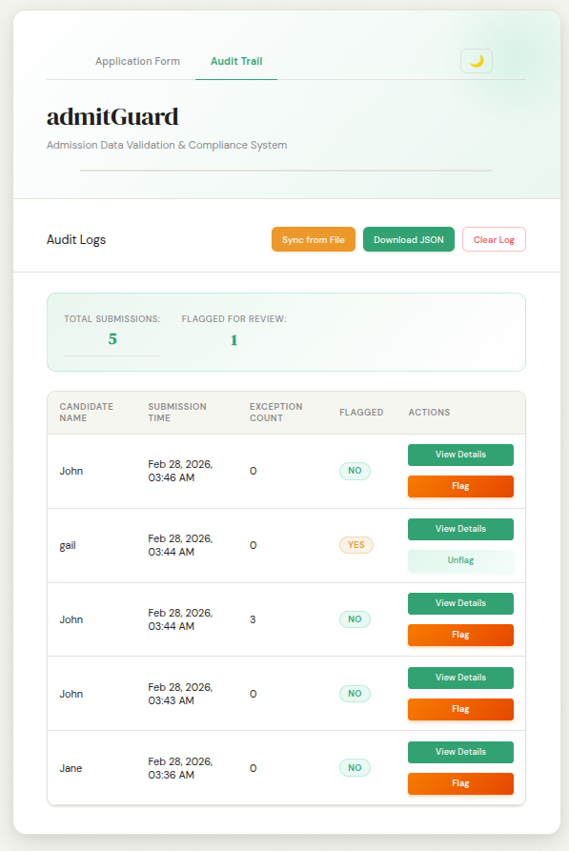
admitGuard
Admission Data Validation & Compliance System

Slide 2
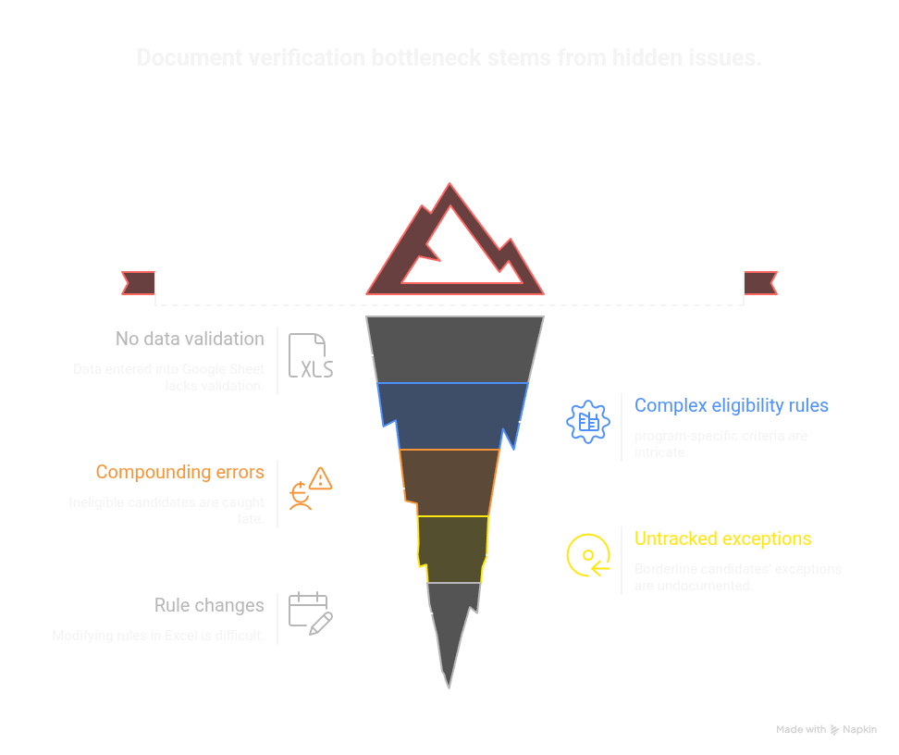

Slide 3
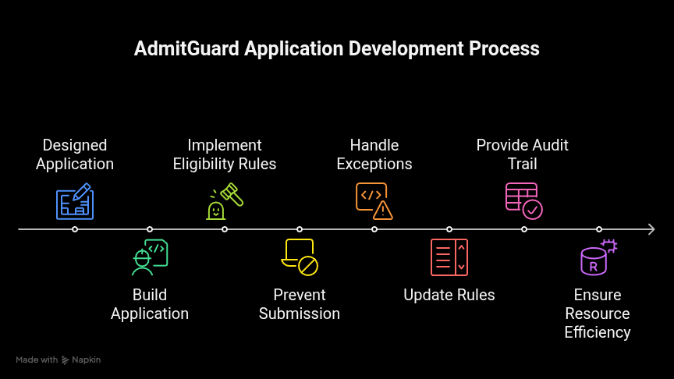

Slide 4
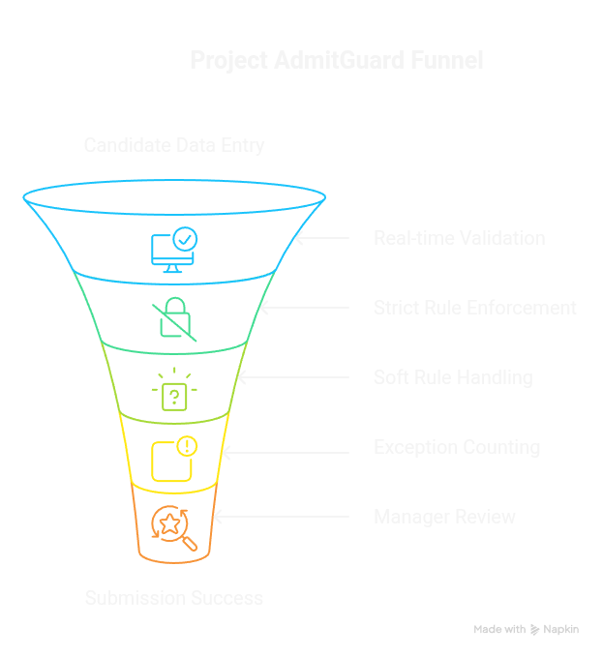

Slide 5
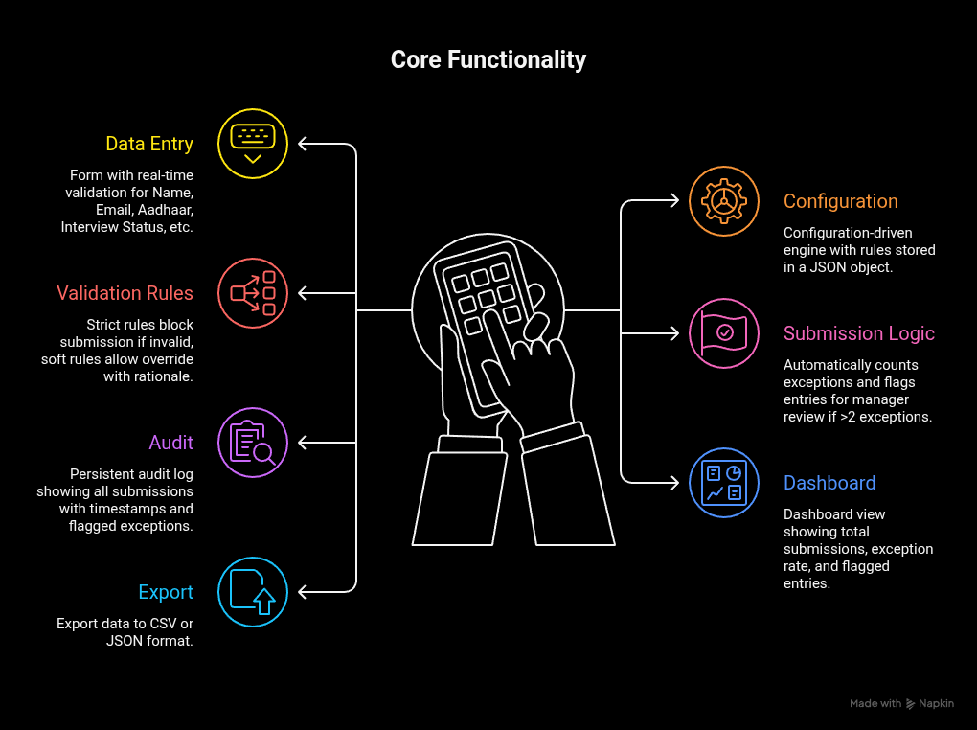

Slide 6
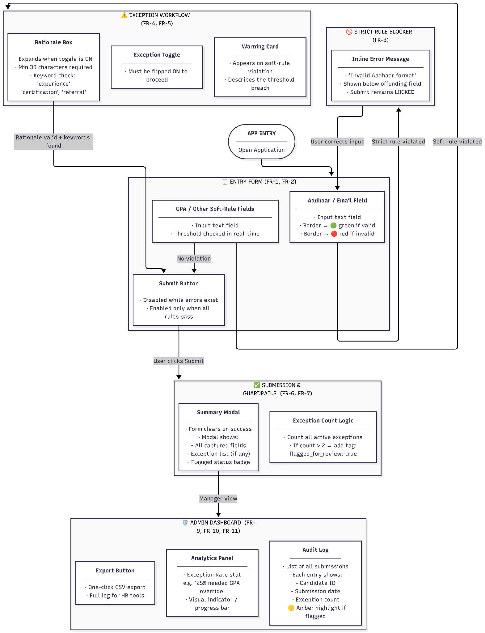

Slide 7
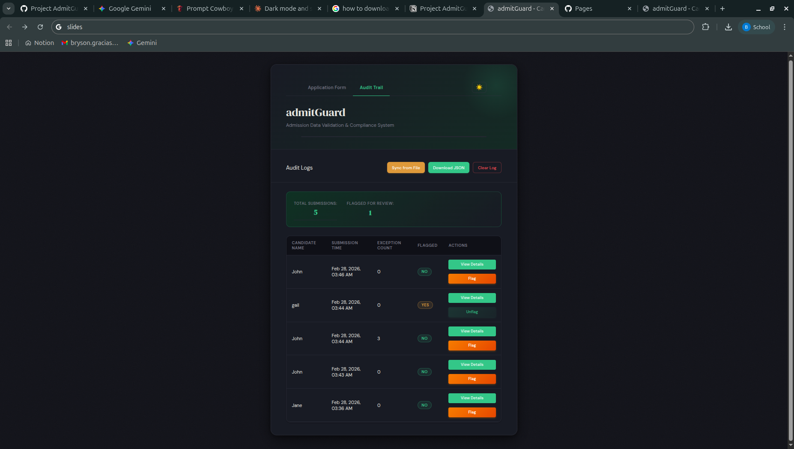
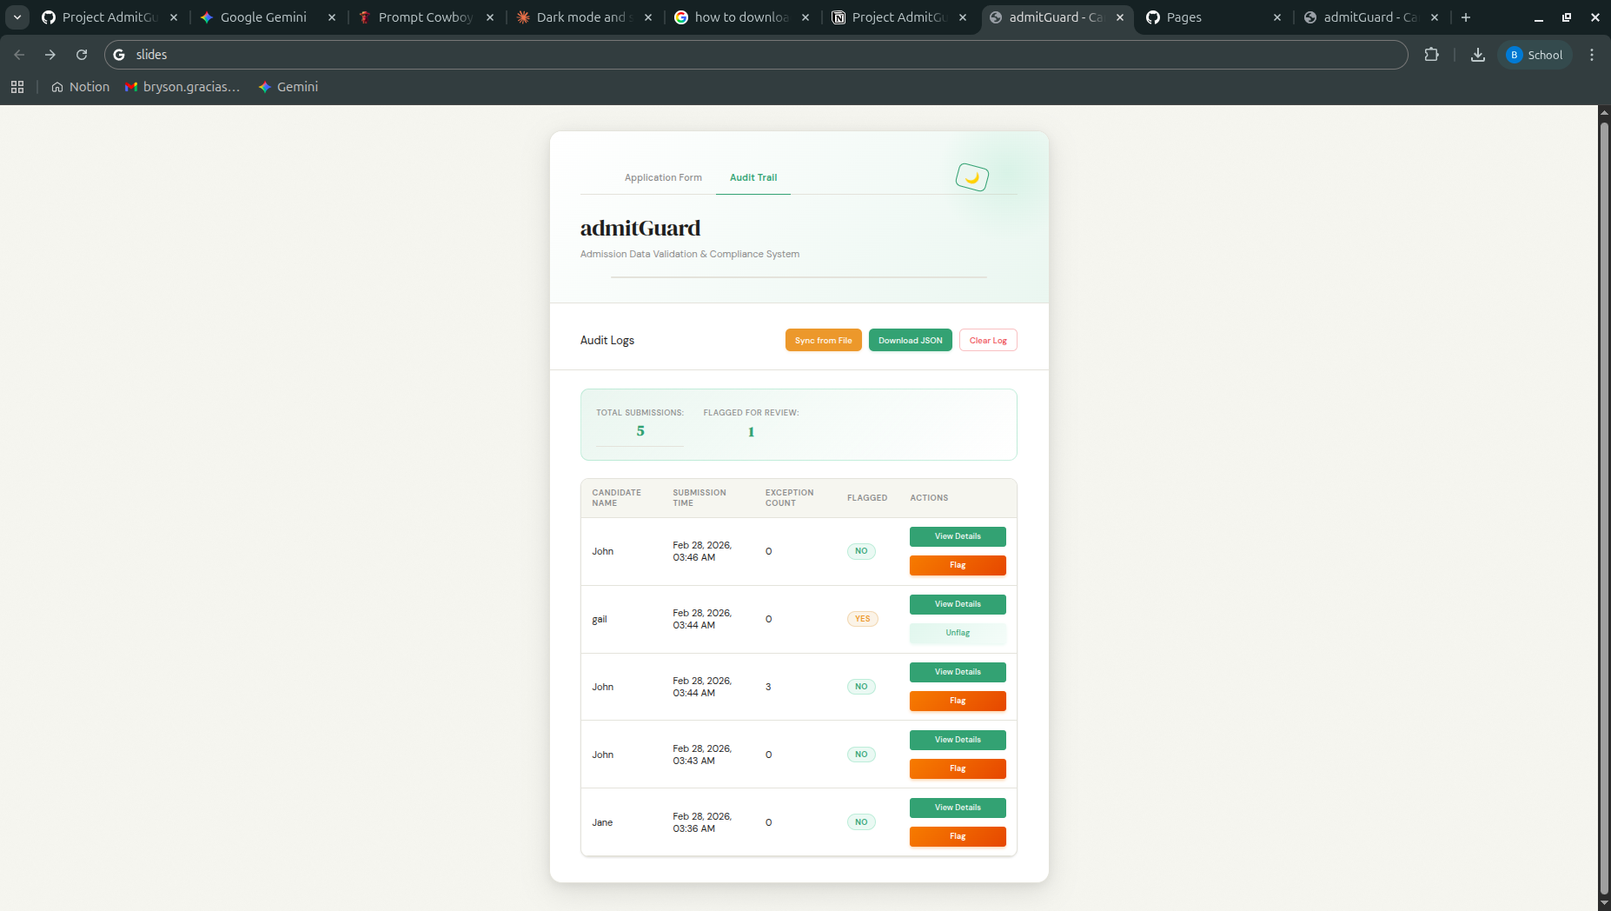

Slide 8
Limitations & Next Steps
Authentication and user roles
Backend server and robust database for storing and retrieving data
Further improve the UI/UX
Deploy service with a load balancer and support auto scaling

Slide 9
Questions, Feedback & Recommendations

