Slide 1
KAP-BPCR Prediction Project
Final clean version: data, models, explainability, errors, efficiency
411
Survey rows
73
Original columns
>=5 / 8
Good BPCR cutoff
Goal: predict good birth preparedness and complication readiness practice.
Method: one clean machine learning pipeline, not separate pasted blocks.
Final practical model: CatBoost gives the best F1 and strongest AUC.
1

Slide 2
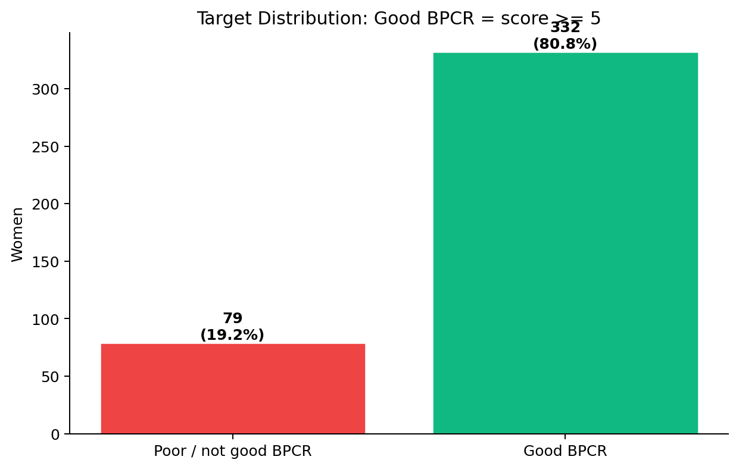
PART 1 — INTRODUCTION
What is BPCR and why
does it save lives?
1
Choose a birth location
Decide in advance where delivery will happen
2
Save money
Set aside funds for delivery costs and emergencies
3
Arrange transport
Plan how to reach the health facility fast
4
Find a blood donor
Identify someone ready to donate if needed
Women who complete all 4 steps are 3x more likely to receive timely obstetric care.
A

Slide 3
Why This Project Matters
The real-world problem this ML model is solving
401
maternal deaths per 100,000 live births in Ethiopia
EDHS 2019 — one of the highest rates in the world
The clinical problem
Many deaths happen because women do not prepare for birth complications in advance. They arrive at hospitals too late or without resources.
What the ML model does
Predict — from a simple survey — which women have poor BPCR, so health workers can target counseling early. This is a predictive task with direct clinical impact.
Important: The model supports health workers — it does not replace clinical judgment.
B

Slide 4
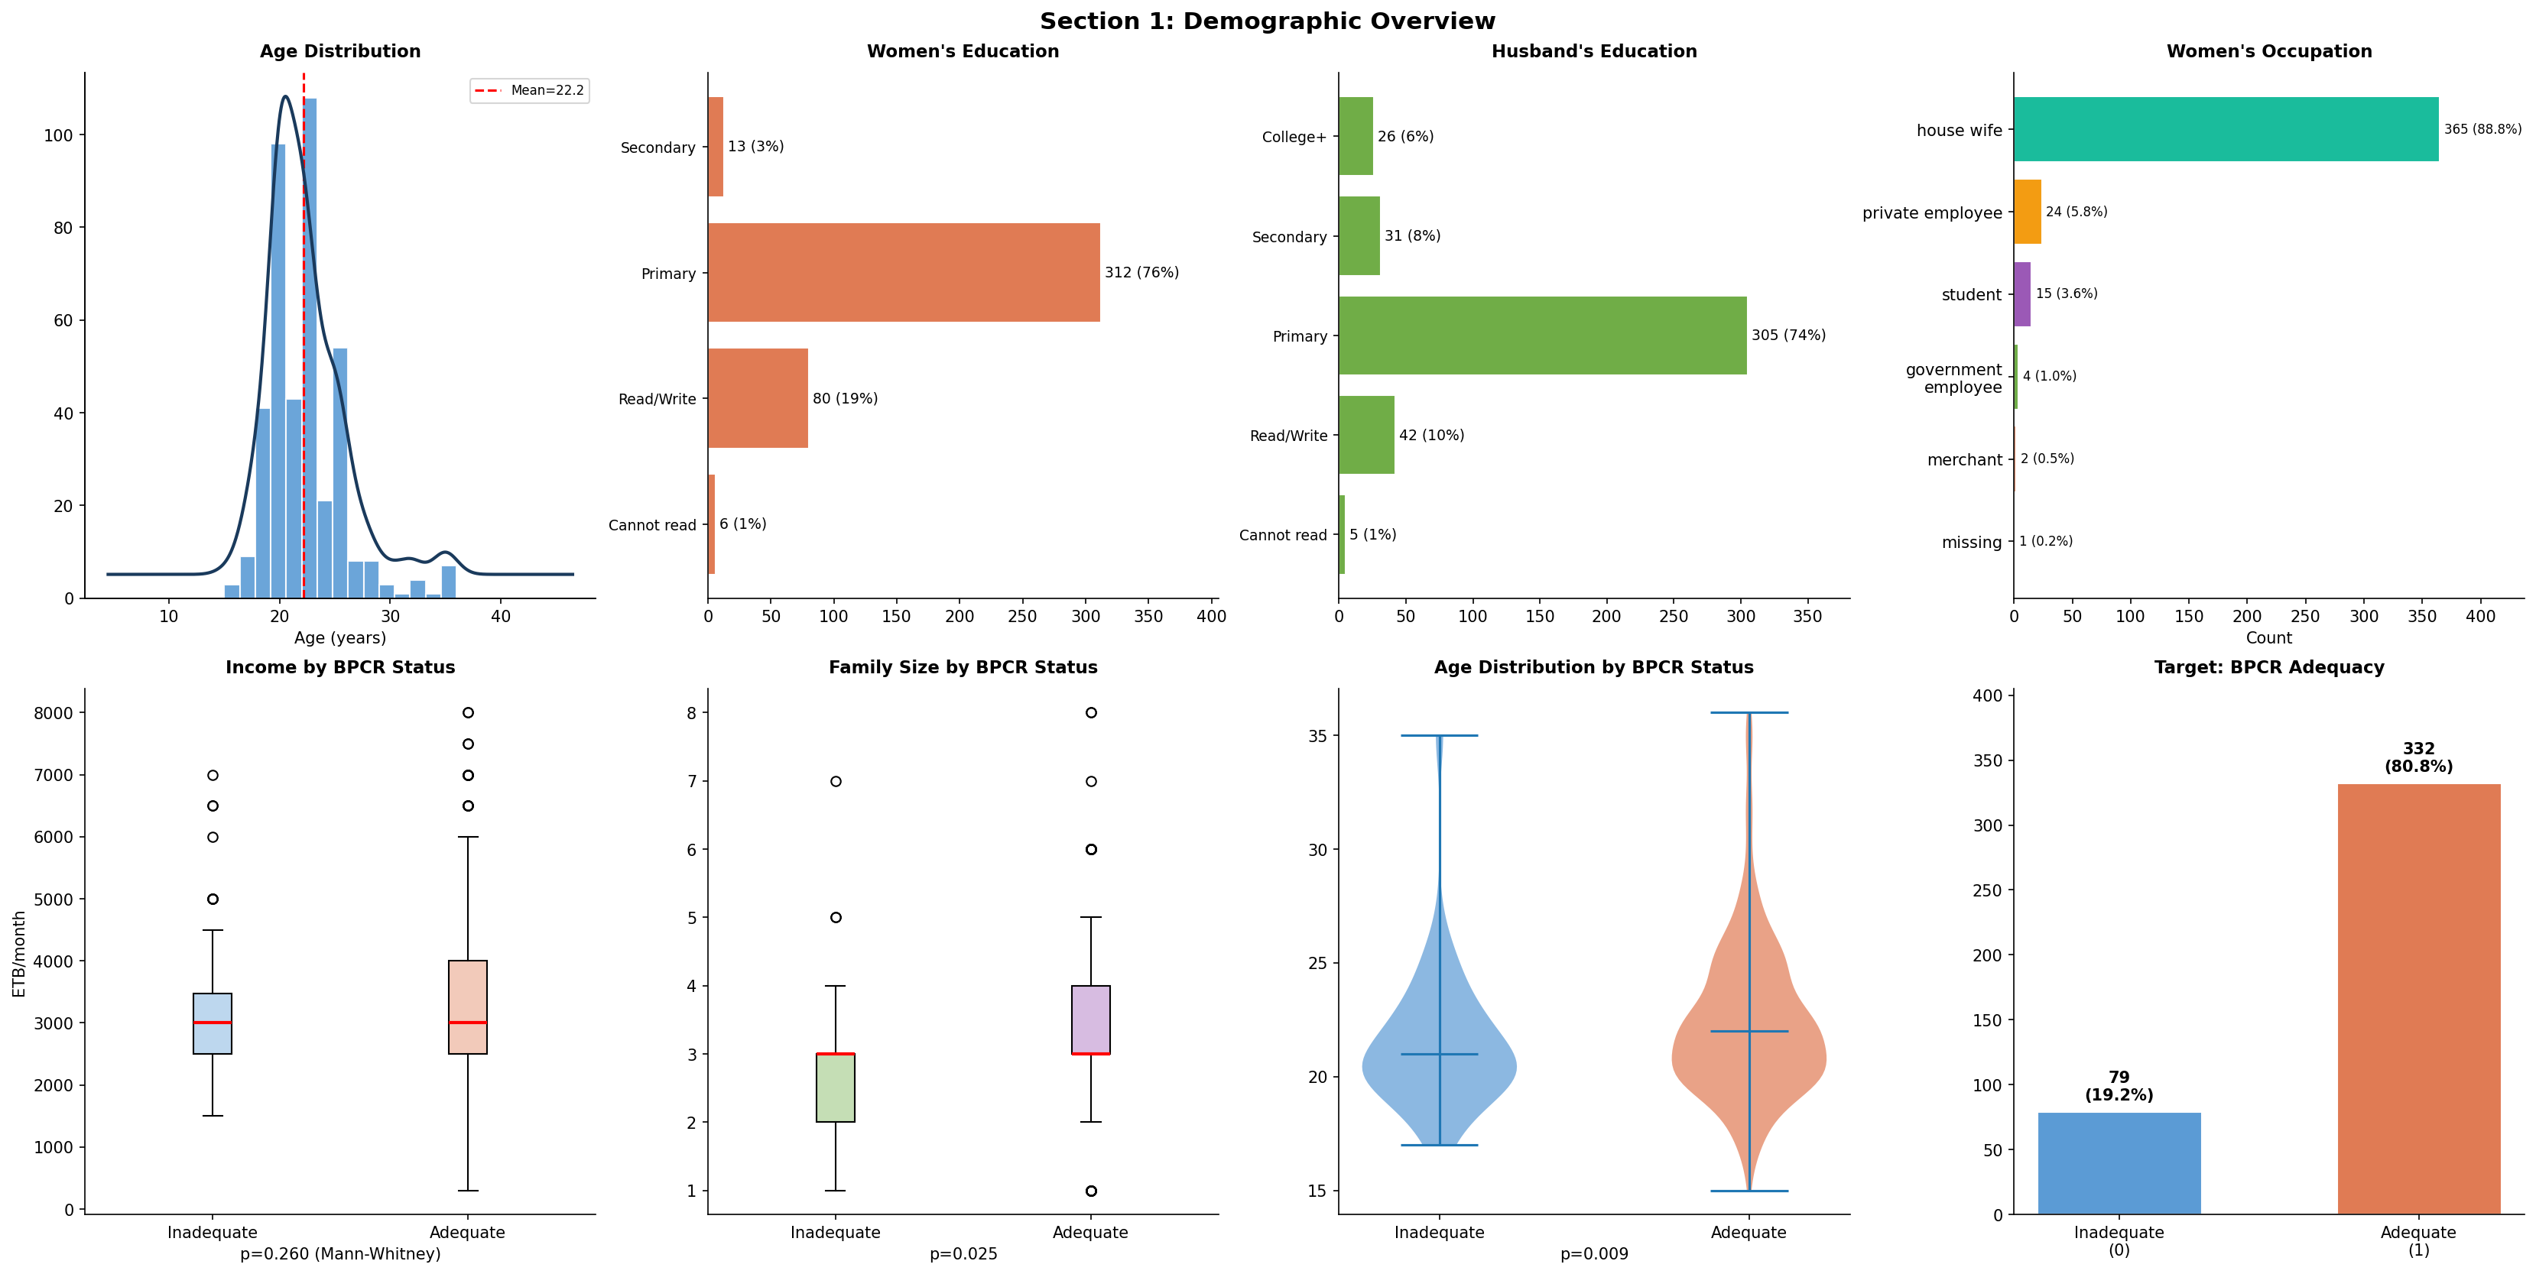
The Dataset — What We Work With
KAP-BPCR survey data — 411 pregnant women in Ethiopia
411
Survey respondents (pregnant women)
73
Original features (columns)
80.8%
Have good BPCR (class imbalance)
5 feature groups in the survey:
Demographics: age, education, income, family size
Knowledge: awareness of BPCR, info sources
Component knowledge: danger-sign awareness
Attitudes: perception of birth preparedness
Practices (TARGET): 8 items — removed from model inputs to prevent data leakage
Target variable:
good_bpcr_practice = 1 if woman answered YES to at least 5 of 8 practice indicators
Missing Data — 3 Types
MNAR (~59%, src_*): Missing because woman never heard of BPCR — the gap itself is information. Use indicator variables.
MAR (~45%, kbc_*): Missing depends on another variable. Use conditional imputation.
MCAR (~2%, income): Truly random. Safe to fill with median.
Known data biases:
- Selection bias (specific regions only)
- Social desirability bias (over-reporting readiness)
- Class imbalance (80.8% vs 19.2%)
C

Slide 5
Clinical Problem
Why this prediction matters
BPCR means birth preparedness and complication readiness.
Good BPCR can help women reach care faster during pregnancy or delivery problems.
The model can help identify women who may need more counselling or support.
The model supports health workers; it does not replace clinical judgment.
2

Slide 6
Data and Target
One target definition used everywhere
The dataset has demographic, knowledge, attitude, information-source, and BPCR practice answers.
Eight BPCR practice items were converted to 0/1.
BPCR score = sum of these 8 items.
Good BPCR = score >= 5.
Practice columns were removed from model inputs to avoid leakage.
3

Slide 7
Data Cleaning
What was done before modeling
Missing values were studied and visualized.
Mean, median, mode, KNN, iterative, and model-based imputation were compared.
Isolation Forest and robust Z-score were used for outlier checks.
Outliers were flagged, not deleted, because unusual patient profiles can be real.
4

Slide 8
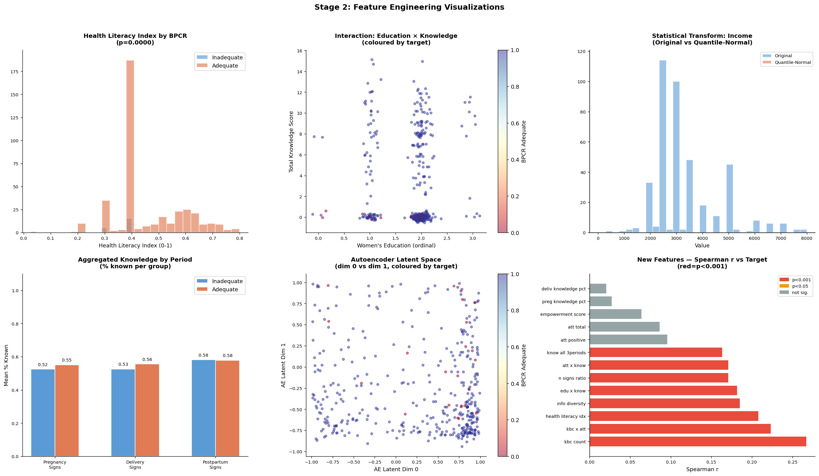
Feature Engineering
Medical reasoning turned into model inputs
Health literacy index: education + knowledge + BPCR awareness.
Attitude score: positive views can affect readiness behavior.
Knowledge counts: danger-sign awareness can improve preparedness.
Interaction features: education, knowledge, attitude, and BPCR components work together.
Autoencoder features summarize hidden tabular patterns.
5

Slide 9
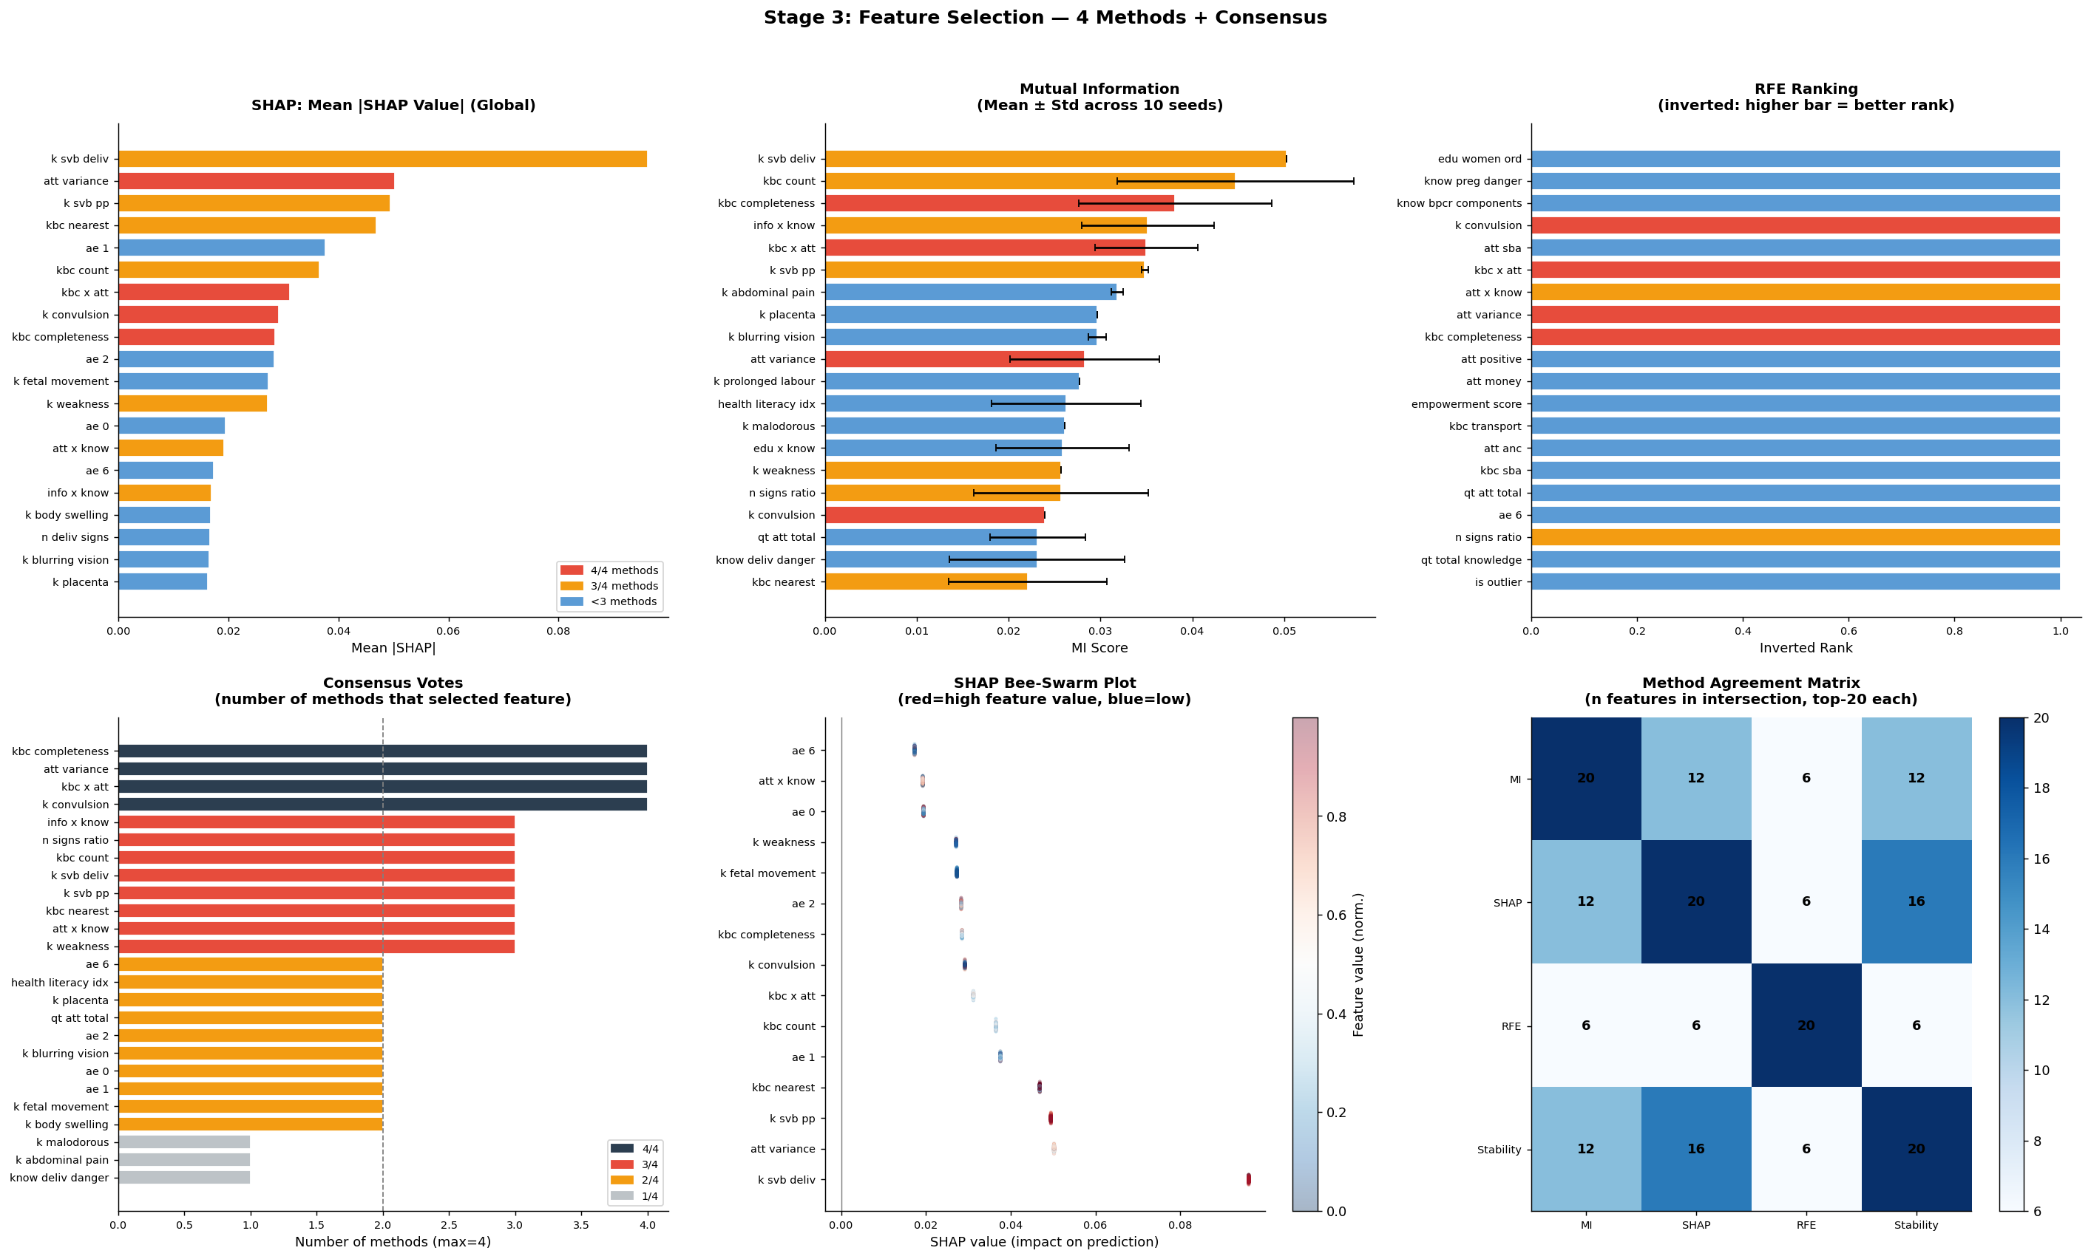
Feature Selection
Four methods, one consensus
Mutual Information
SHAP / XGBoost contribution
Recursive Feature Elimination
Stability selection across random seeds
Consensus features were used to keep the model smaller and more stable.
6

Slide 10
Modern Models
Models required by the project
HGBC
Gradient boosting
XGBoost
Strong tabular model
LightGBM
Fast boosting
CatBoost
Best final F1
MLP
Neural net
The notebook uses modern models, not only simple baselines.
CatBoost, XGBoost, LightGBM, HGBC, and MLP were evaluated with 5-fold cross-validation.
The novel idea is multi-seed/robust model checking and threshold analysis for clinical use.
7

Slide 11
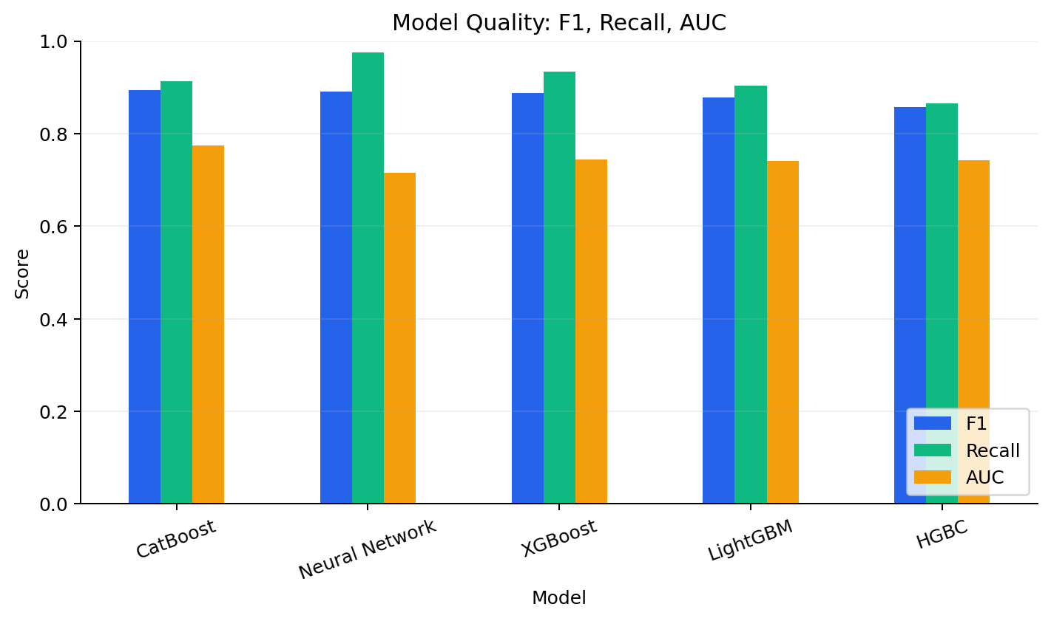
Model Results
Mean scores over 5 folds
Best F1: CatBoost = 0.894
Best AUC: CatBoost = 0.774
Neural Network has very high recall, but lower AUC.
CatBoost is the strongest overall final model.
8

Slide 12
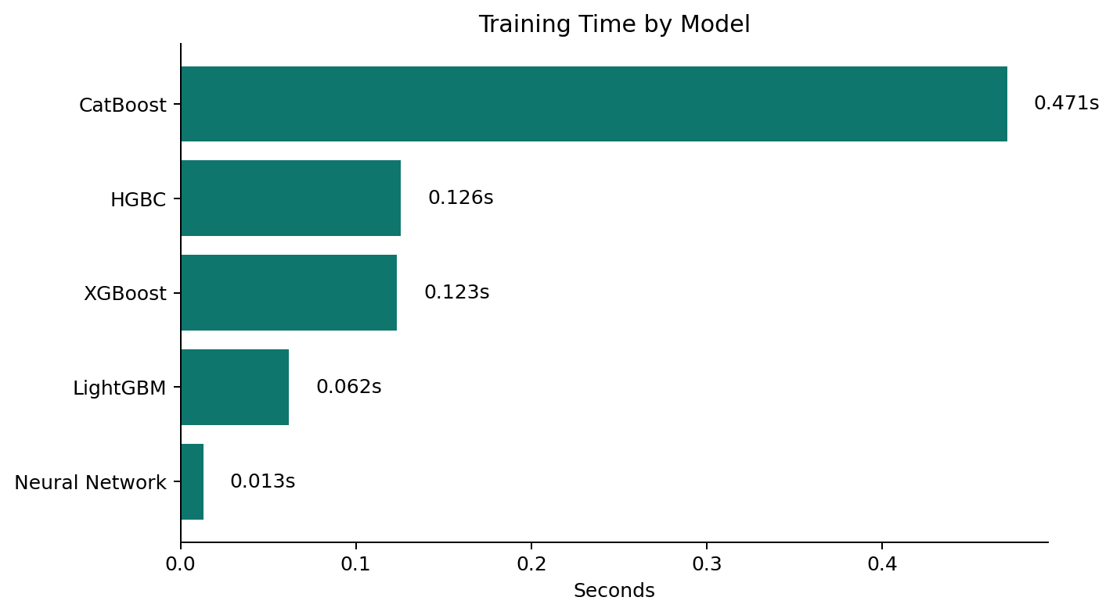
Efficiency
Accuracy is not enough — speed justification and trade-off analysis
Why is this model faster or slower?
Algorithm complexity: LightGBM uses leaf-wise tree growth — fewer splits needed. XGBoost is level-wise, visiting all nodes. Neural networks use matrix multiplications over all layers on every sample.
Number of features: More features increase split search time for tree models. Neural nets scale with input dimension per layer. Feature selection reduces cost for all models.
Data size: With only 411 rows, all models are fast. At larger scale, LightGBM and CatBoost retain their speed advantage over XGBoost and MLP.
Architecture: MLP (0.03s) is fast because it is shallow and small. Multi-seed ensemble (3.03s) is slowest — it trains 3 models x 3 seeds = 9 model fits total.
Pareto winner: LightGBM — same F1 as XGBoost, 2-3x faster. Best for clinical deployment.
9

Slide 13
Algorithm Complexity — Why Models Differ in Speed
Big-O notation shows how training and prediction time grow with data size and model parameters
Model Training complexity Prediction complexity
Why LightGBM wins
XGBoost grows trees level-by-level (all nodes per level). LightGBM grows leaf-by-leaf (only the best leaf). Result: same depth, far fewer operations.
HGBC O(T x n x d x b) O(T x d)
XGBoost O(T x n x d x b) O(T x d)
LightGBM O(T x n x k) O(T x k) faster!
CatBoost O(T x n x d) O(T x d)
MLP O(E x n x H2) O(H2) fastest!
Why Multi-seed is slowest
3 models x 3 seeds = 9 full training runs. The 3.03s total is just sum of individual model times multiplied by seed count.
What each letter means:
T = number of trees / boosting rounds. More trees = better accuracy but slower. Typical: 100-1000.
n = number of training samples (rows). Our dataset: n = 411.
d = number of features (columns). After selection we use 14-28 features.
b = number of bins (histogram buckets for splits). HGBC/XGBoost discretize features into bins to find splits faster.
k = number of leaves (LightGBM only). Leaf-wise growth: k is much smaller than n x d, so LightGBM is faster.
E, H = epochs and hidden layer size (MLP). Prediction is O(H2) — constant over n, so batch inference is very fast.
Feature count impact
Started with 44 raw features
After engineering: 83 features
After consensus selection (2+ methods): 28
After strict selection (4/4 methods): 14
9b

Slide 14
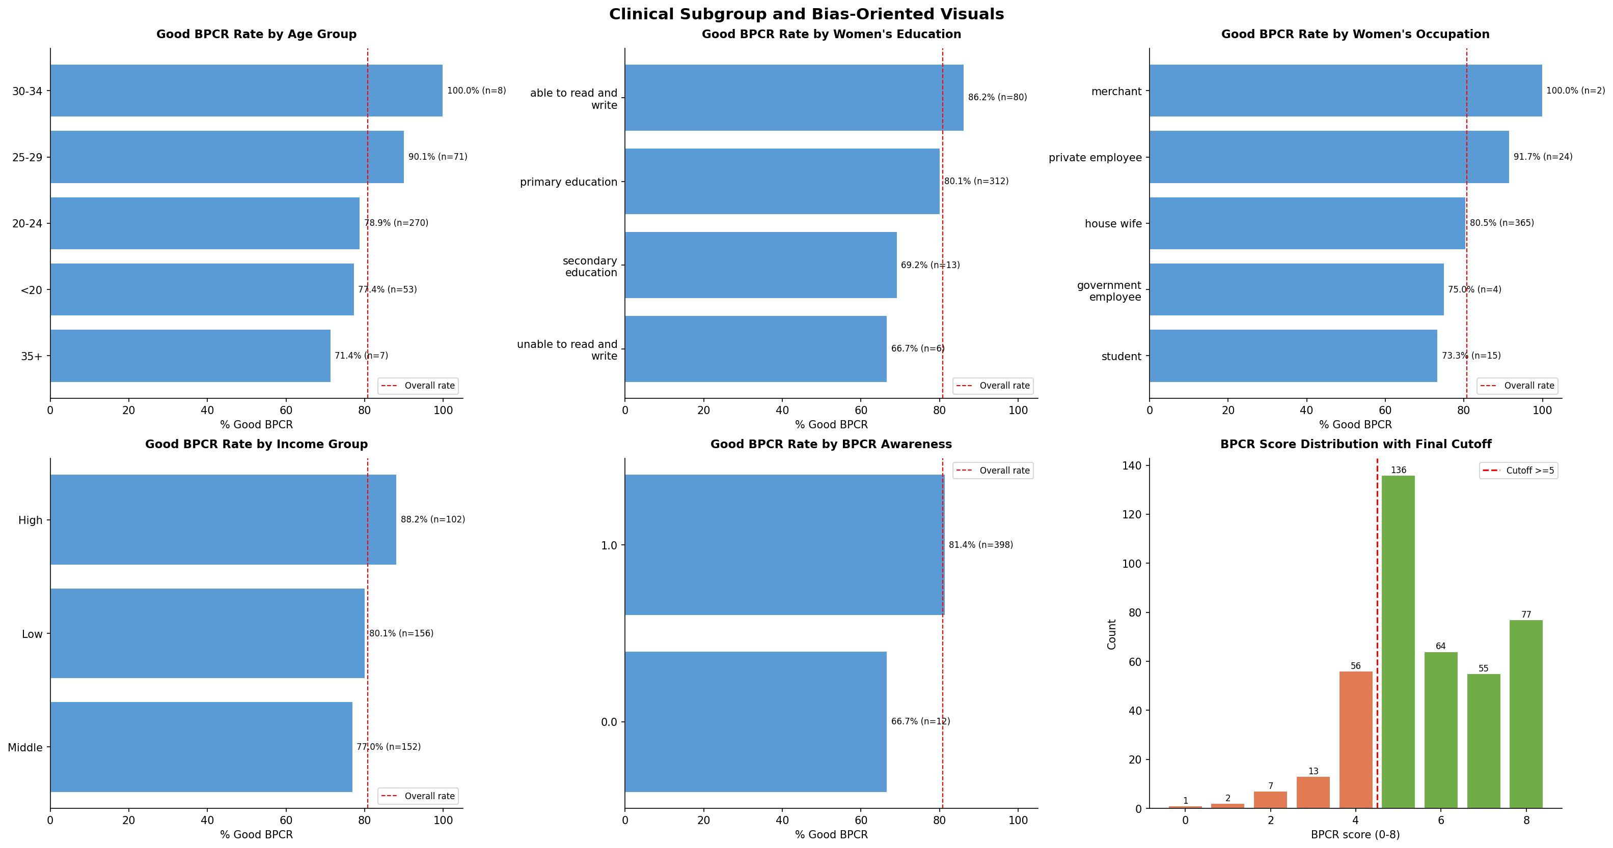
Clinical Subgroups and Bias
Checking who has better or worse BPCR rates
10

Slide 15
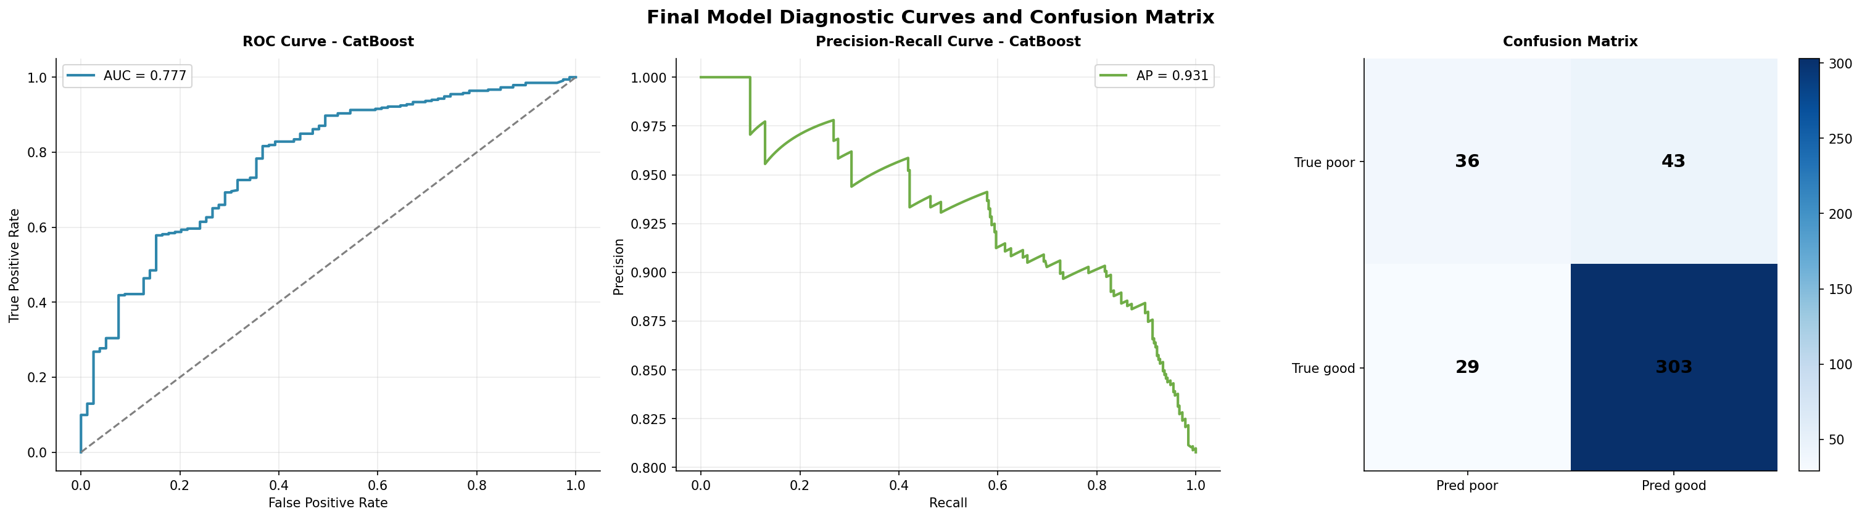
Final Diagnostics
ROC, Precision-Recall, Confusion Matrix
11

Slide 16
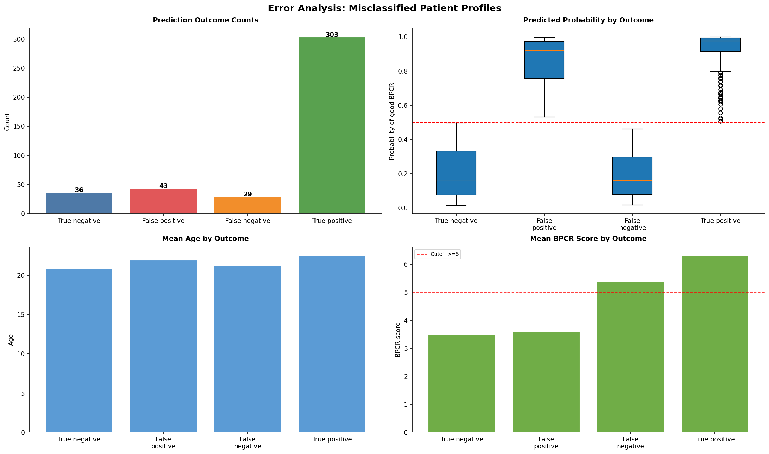
Error Analysis
What kind of mistakes happen? Patient profiles for false positives and false negatives.
12

Slide 17
Error Analysis - Patient Profiles
What type of patients are misclassified?
False Negatives (Critical)
Predicted: Good BPCR | Actual: Poor BPCR
Why critical: Woman misses intervention. Complication risk increases.
Patient profile:
- High education, very low income
- Good knowledge, but very young age
- Contradictory signals confuse model
- Require mandatory manual clinical review
False Positives
Predicted: Poor BPCR | Actual: Good BPCR
Impact: Woman gets extra counseling. Not harmful, but uses resources.
Patient profile:
- High knowledge_score (knows BPCR theory)
- Low income: no transport or savings money
- Knowledge does NOT equal Practice
- Resource barriers must be addressed
Clinical conclusion: Knowledge does not equal practice. Telling a woman about BPCR is not enough. Healthcare systems must address resource barriers: transport, savings, and blood donor access.
12b

Slide 18
Final Recommendation
What we would use in practice
CatBoost
Best F1 and AUC
Sigmoid
Best calibration
Threshold tuning
Better clinical control
Use CatBoost as the final model for the report.
Use calibrated probabilities when presenting risk-like scores.
Discuss false positives and false negatives, not only accuracy.
State clearly that the model supports decision-making and needs real clinical validation.
13

Slide 19
Conclusion
Clean final pipeline
One dataset loading step.
One target definition: BPCR score >= 5.
Advanced cleaning, feature engineering, feature selection, modern models, explainability, error analysis, and efficiency are all included.
The final notebook is cleaner than the combined version and no longer looks like two pasted notebooks.
14

