Slide 1
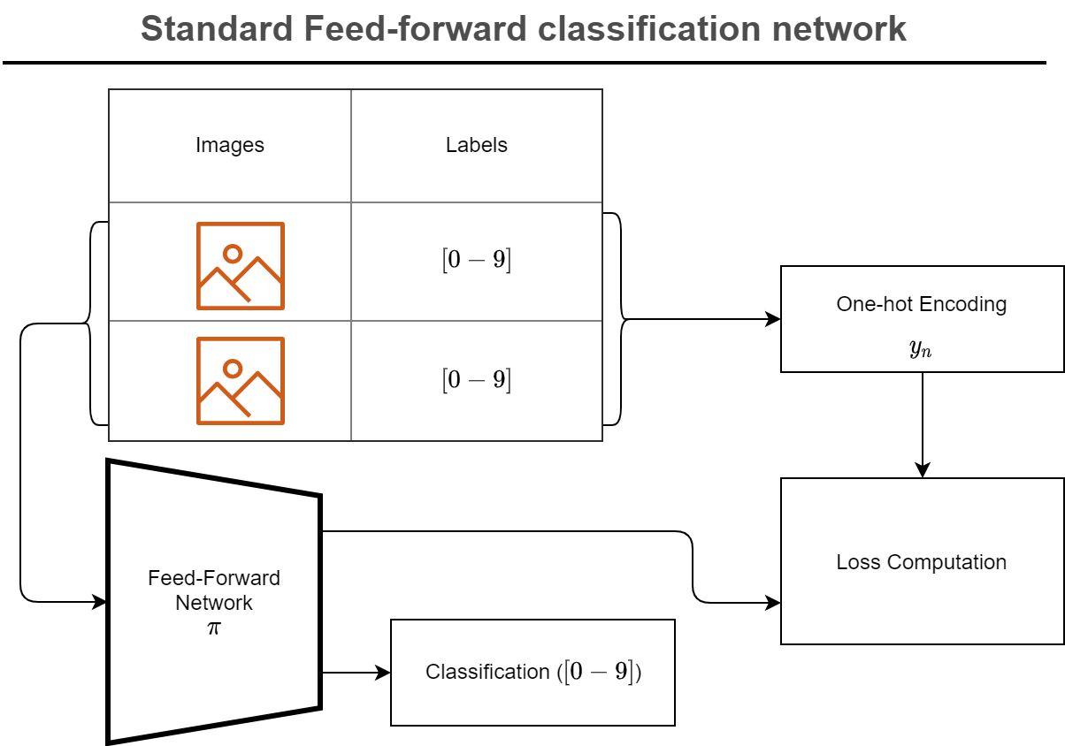
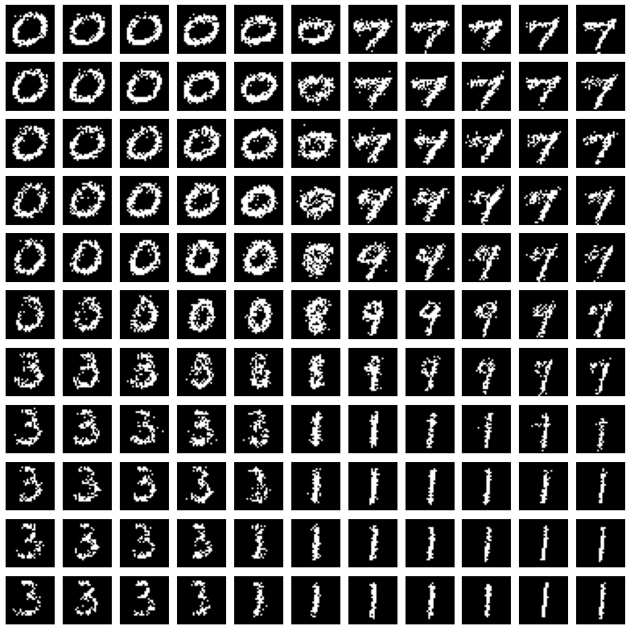
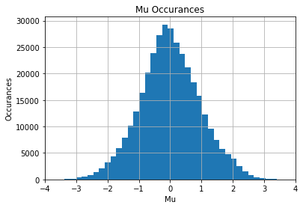
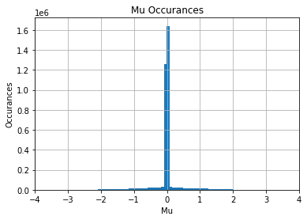
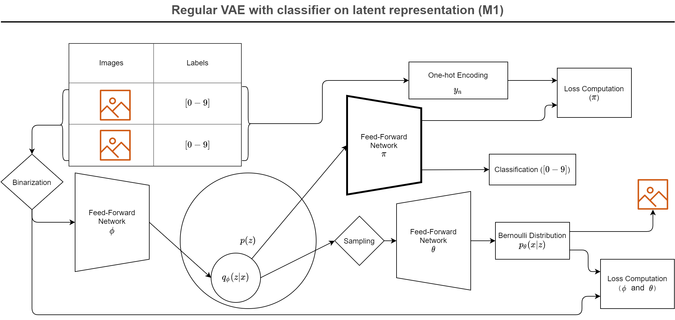
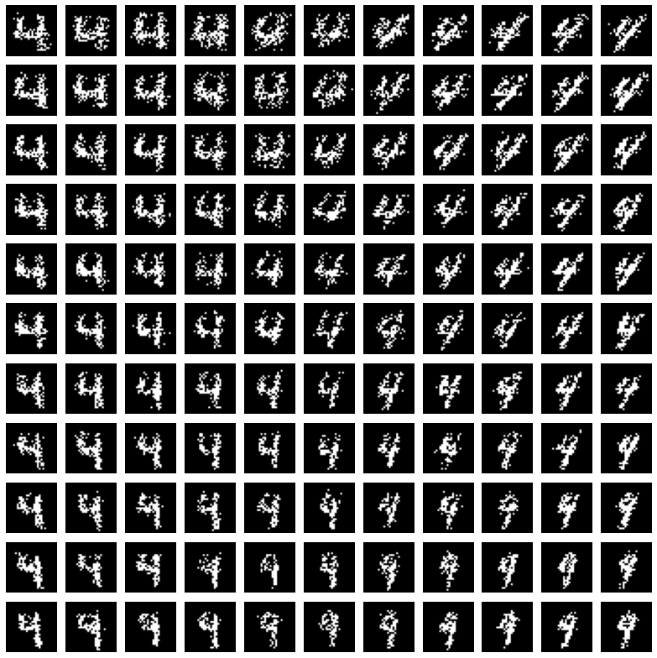
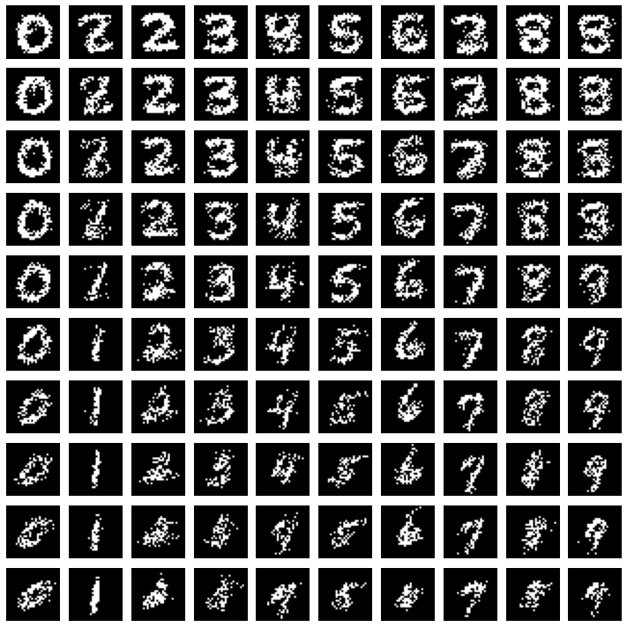
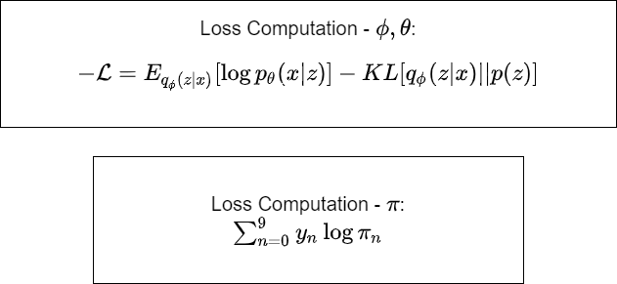
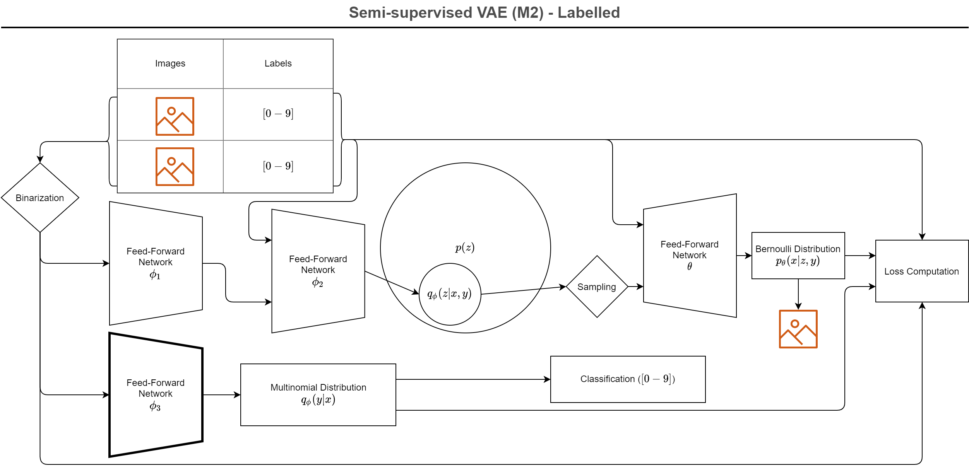
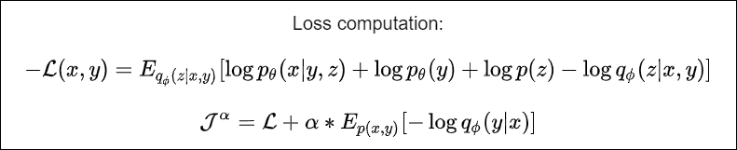
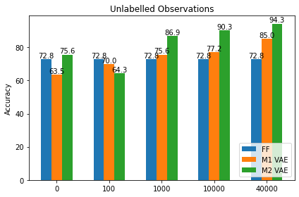
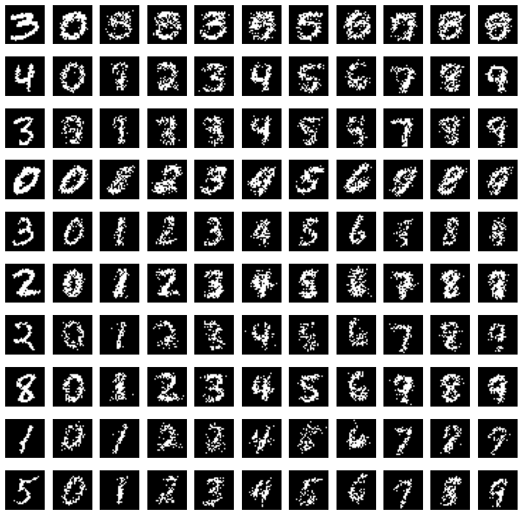
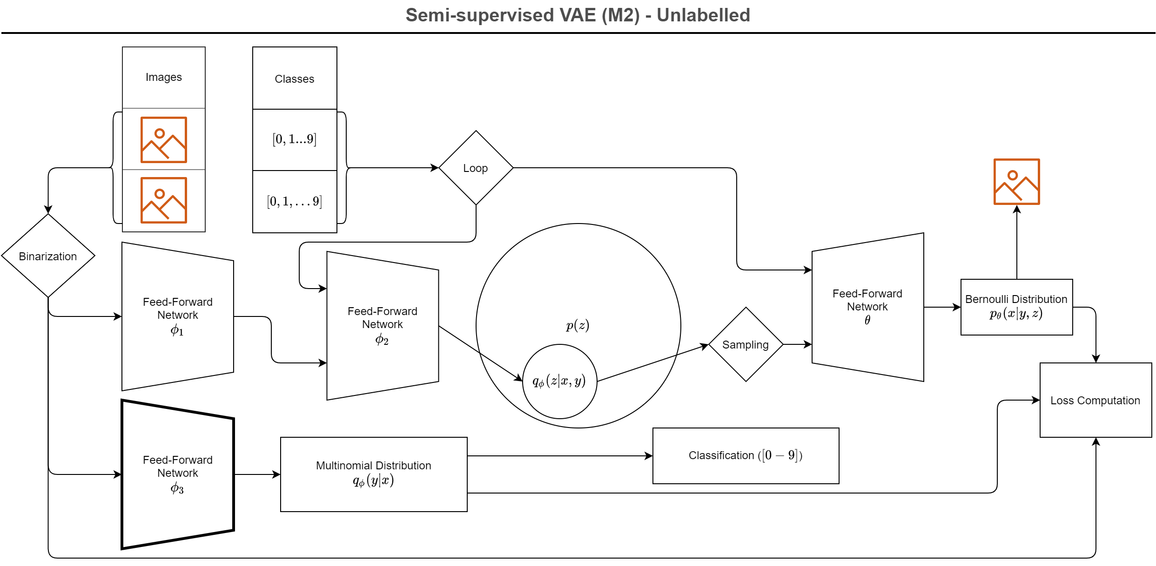
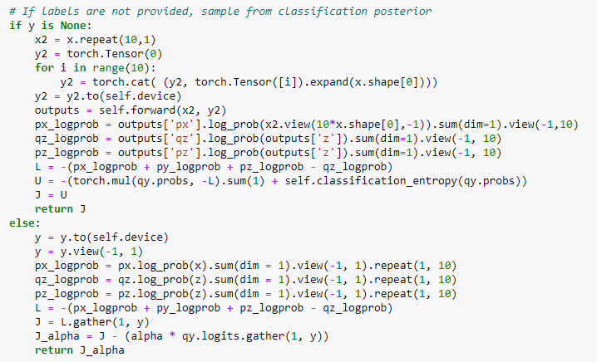

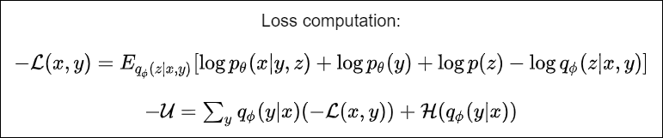
Semi-supervised Learning using Variational Autoencoders
a P14 project in 02456 Deep Learning, autumn 2020 by Uffe Poul Hansen s203264 & Axel Bregnsbo s152672
The Models
Inside the VAE
Introduction
Based on the article by Kingma et al. [1] we have built two different classifiers based on VAE’s, where the VAE part enables us to train the model on non-labelled data. These are then compared to a classical FF model.
M1: VAE + classifier using the much smaller latent space instead of the full image
M2: VAE where the continuous z latent space is augmented with a discreet y class variable, the network generating the p(y|z) posterior is used as classifier.
The M2 model has the interesting property that is enables style transfer: with given input x, one can hold z and vary y, see picture.
[1]: Kingma et al. (2014). Semi-supervised Learning with Deep Generative Models, arxiv.org/abs/1406.5298v2
This histogram depicts the distribution of the Mu parameter of the posterior when encoding all datapoints available on a fully trained M1 model with 5 latent dimensions. The regularization term attempts to force these towards 0, while the reconstruction term demands a certain spread.
This illustration shows renditions of various points in latent space of an M1 model. The depicted model uses 5-dimensional latent space. Three dimensions are locked to 0, while the remaining two dimensions are traversed from -5 to 5.
Same as above, but with 50 latent dimensions. We can see that the increased number of dimensions allows a tighter gathering around 0.
Learnings
This illustration shows renditions of various points in latent space of an M2 model. The depicted model uses 5-dimensional latent space. Three dimensions are locked to 0, while the remaining two dimensions are traversed from -5 to 5. For each coordinate, the digit "4" is rendered.
This illustration shows renditions of various points in latent space of an M2 model. The depicted model uses 5-dimensional latent space. A 5-dimensional diagonal is traversed from -5 to 5. For each point, all digits are rendered.
Classifier Results
Style Transfer
Heart of the M2
Model Parameters
Model | Structure | Classification Parameters | Additional Parameters
FF NN | Classifier: 784 – 500 – 250 - 10 | 520250 | 0
M1 | Encoder: 784 – 450 – 250 – 100 – 100 Classifier: 100 – 100 – 80 – 10 Decoder: 50 – 128 – 256 – 512 - 784 | 520090 | 572544
M2 | Encoder 1: 784 – 200 Encoder 2: 210 – 200 – 10 Classifier: 784 – 500 – 250 – 10 Decoder: 15 – 200 – 400 – 600 | 520250 | 996800
Learning from unlabelled data. On the graph above, we show the achived accuracies when training each of the models on 100 labelled samples and increasing numbers of unlabelled samples. Naturally, the standard FFNN does not support semisupervised learning, and is not trained on the unlabelled data, so the result is constant. The complexity of the variational model penalizes the network when compared to a standard FFNN when identical data is available, but the ability to improve the model from unlabelled data quickly pays off. The M2 VAE performing better with no unlabelled datapoints than with 100 unlabelled datapoints is a curiosity we have yet to explain.
Python implementation of the M2 loss calculation.
Modelling of the various network components.
This illustration shows attempts to copy the style from a provided digit. Posterior distribution is derived from provided image (left most column, and each digit is recreated using a sample from the posterior.
Notes:
1

