Slide 1
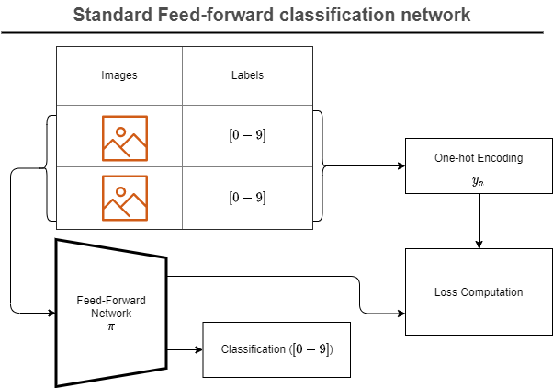
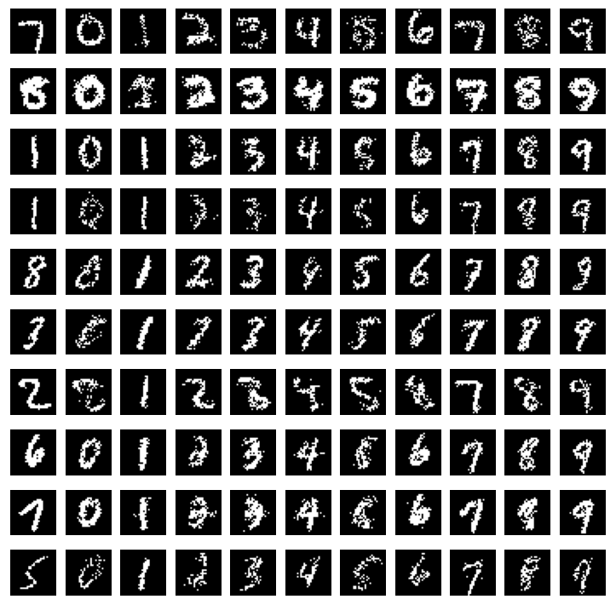
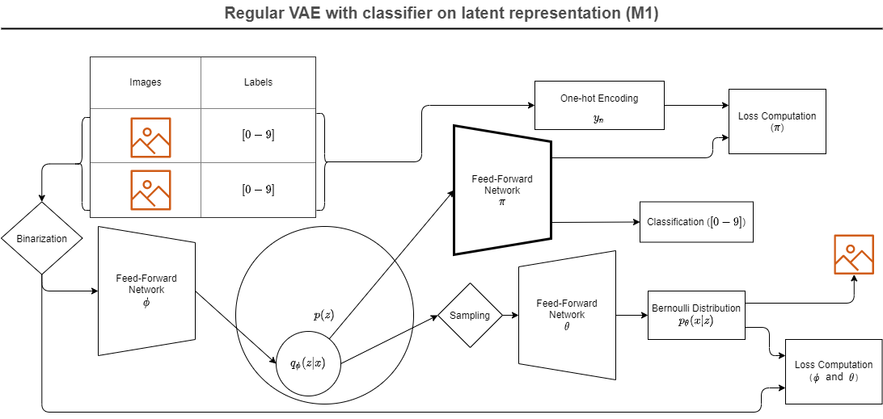
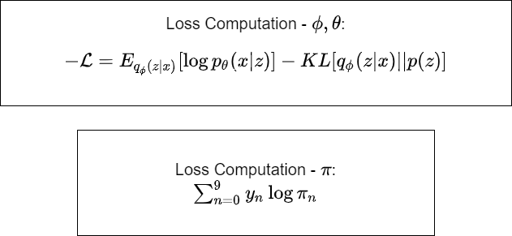
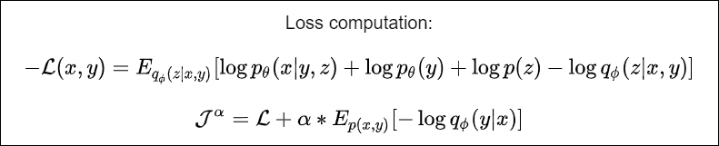
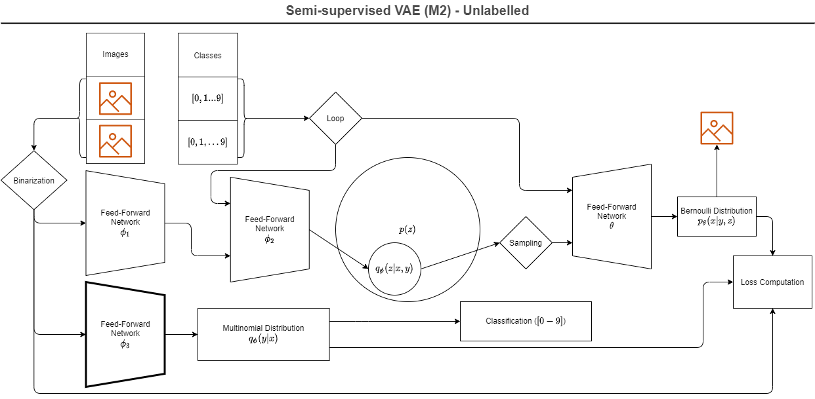
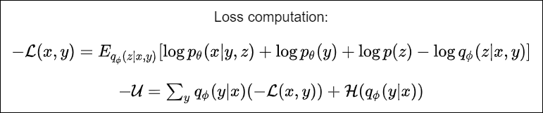

Semi-supervised Learning using Variational Autoencoders
a P14 project in 02456 Deep Learning, autumn 2020 by Uffe Poul Hansen s203264 & Axel Bregnsbo s152672
The Models
Introduction
Inside the VAE
Based on the article by Kingma et al. [1] we have built two different classifiers based on VAE’s, where the VAE part enables us to train the model on non-labelled data. These are then compared to a classical FF model.
M1: VAE + classifier using the much smaller latent space instead of the full image
M2: VAE where the continuous z latent space is augmented with a discreet y class variable, the network generating the p(y|z) posterior is used as classifier.
The M2 model has the interesting property that is enables style transfer: with given input x, one can hold z and vary y, see picture.
[1]: Kingma et al. (2014). Semi-supervised Learning with Deep Generative Models, arxiv.org/abs/1406.5298v2
Model Parameters
Classifier Results
Style Transfer
Learnings
Signature Forging
Notes:
1

