Slide 1
Lifenode database for life
Byte-fang

Slide 2
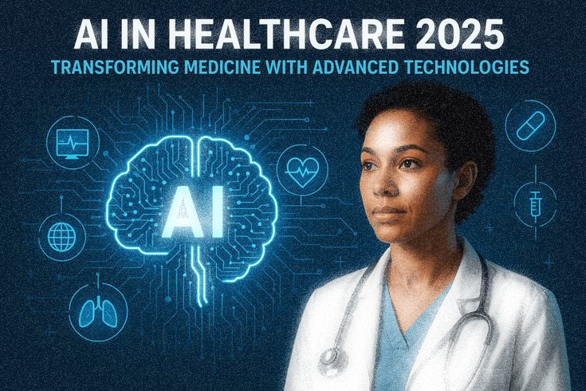
Contents
About us
Problem overview
Why this problem?
Solution overview
Impact
Tech stack
Future scope
Conclusion

Slide 3
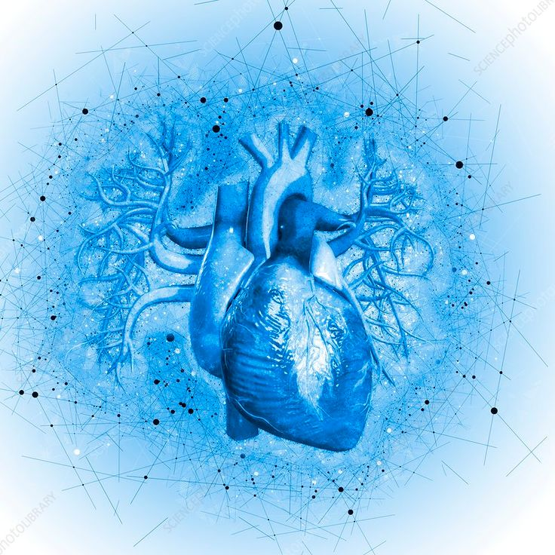
About us
Hrishik Das
Md Anish Ali
Premangshu Sengupta
Lawrence H. Reang
Divided by Depts, United by Innovation.
Together we are Byte-Fang
Aiming to integrate the healthcare industry with the advancements of technology to provide real time solutions

Slide 4
Problem overview
Outdated record systems make data sharing across locations difficult, delaying treatment.
Limited patient monitoring reduces proactive care for high-risk conditions.
Poor information flow across teams leads to missed updates and follow-ups.
Handling large-scale patient data and schedules increases complexity and errors.
Absence of alerts and predictions allows illnesses to go unnoticed.
These issues show the urgent need for an integrated, AI-powered mobile health platform that enables easy access of record/data access, real time monitoring, predictive analytics, and automated communication to channelize care across all provider locations.

Slide 5

Why this problem?
Chronic illnesses are rising:
Conditions like diabetes, hypertension, heart disease, and kidney disorders require ongoing monitoring. Poor management can cause complications, hospitalizations, and reduced quality of life.
Healthcare providers are overloaded:
Doctors and nurses manage many patients across multiple locations using different software systems. Switching between platforms adds extra cognitive load, leading to missed early signs and delayed interventions.
Traditional systems are fragmented:
Hospitals use multiple software platforms (EHRs, labs, imaging, pharmacy) that don’t integrate. Providers spend extra time reconciling data, delaying decision-making.
Delays in insights = delayed treatment:
Even with digital tools, critical trends may go unnoticed. Early warning signs can be missed, increasing the risk of complications and hospitalizations.

Slide 6

Solution overview

Slide 7
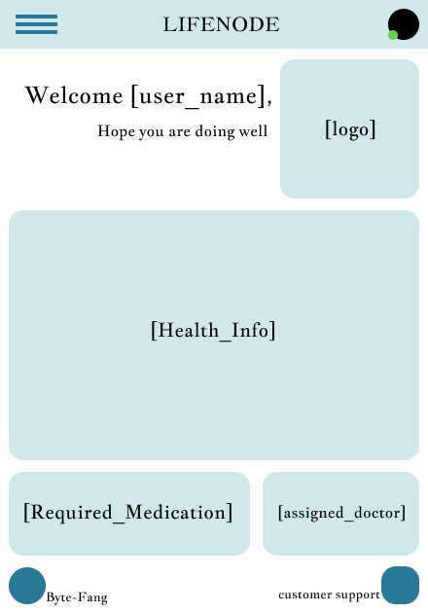
AI DRIVEN HEALTH PREDICTION SYSTEM
We aim to create a system, to help healthcare staff, consultants and doctors with collecting and organising the data of each and every patient in an orderly manner. To maintain a clear sheet of report regarding every patients condition, especially chronic and high risk patients. It will allow the consultants or the doctors to have a clear idea of the needs of every single patient, even if they haven’t met them before.
Even in the absence of trained consultants or doctors, this system will guide the Nurses, Trainee medicos or the nearby staff to provide the most appropriate medication.
This system will also help us to predict the health of a patient in advance, making sure of the availability of required drugs and medical instruments.

Slide 8
Core features:
Centralized Records Keeping System;
Cloud-based, secure EHR(Electronic Health Record) access anytime, anywhere.
Remote Monitoring Possibility;
Wearable/device integration + patient self-logging
Predictive Analytics;
Early detection of health deterioration using AI/ML.
Automated Alerts;
Notifications for abnormal vitals, missed meds, or follow-ups.
AI Decision Support;
Data-driven insights and treatment recommendations.
Collaboration Tools;
Secure messaging, video consults, caregiver access.

Slide 9
How it works?
Patient Data Collection;
Patients’ vitals, lab results, imaging reports, medication schedules, and chronic condition metrics are collected. Data comes from EHR systems, wearable devices, and manual inputs via mobile app.
AI-Powered Analysis;
The platform processes data using predictive analytics and machine learning. Detects early warning signs, trends, and potential risks for chronic deterioration.
Automated Alerts & Insights;
Sends real-time notifications to providers for abnormal readings or missed follow-ups. Generates actionable insights to guide clinical decisions.
Provider Dashboard / Intervention;
Healthcare providers access a centralized dashboard showing patient summaries, trends, and AI recommendations. Providers can act quickly, adjust treatment, or schedule follow-ups efficiently.

Slide 10
IMPACT of this solution
Early Detection.
Fewer hospital visits.
Better quality of life.
Real-time access.
AI-driven decision support.
Reduced admin burden.
Lower Costs.
Optimized Resources.
Improved Trust and Outcomes.

Slide 11
TECH STACK
AIML
Python
PyTorch
Mobile App
Flutter
React Native
Backend
Node.js
Cloud Integration
Security
HIPAA - compliant data handling

Slide 12
Future Scope
Integration with Advanced Wearables: Continuous monitoring through next-gen IoT and biosensors.
Personalized AI Care Plans: Tailored treatment recommendations using advanced predictive models.
Telemedicine Expansion: Seamless integration with virtual hospitals and remote specialist care.
Population Health Analytics: AI-driven insights for disease trend prediction and preventive programs.
Global Interoperability: Cross-border EHR sharing with universal health standards.
Voice & Chatbot Assistants: AI-driven virtual health assistants for 24/7 patient support.

Slide 13
Conclusion
The AI-powered mobile health platform enables real-time monitoring, predictive analytics, and AI-driven decision support, allowing providers or consultants to deliver timely records and data, accurate care for chronic conditions.
By smoothening the operations and reducing delays, it fosters a more efficient, accessible, and patient-centered healthcare system.
LET’S POWER HEALTH WITH AI, CARE WITH LIFENODE

Slide 14
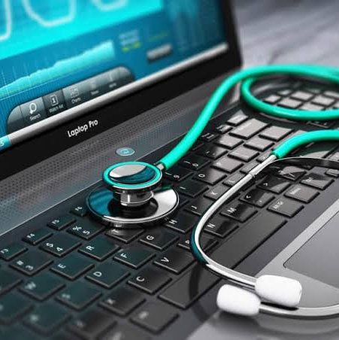
Thank you
Byte-Fang

