Slide 1
Advance Quiz Website
Test your knowledge

Slide 2
Students involved --
gresh
Samarth upadhyay
Gautam giri
Lalit bainsla
sonu

Slide 3
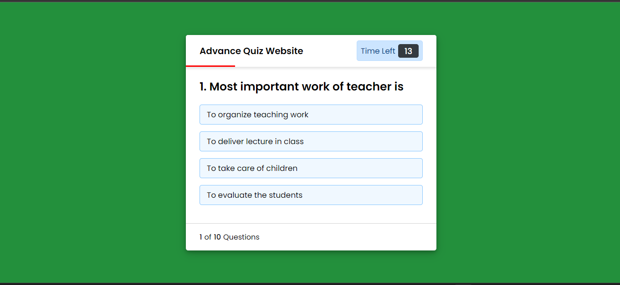
Main PAGE VIEW -

Slide 4
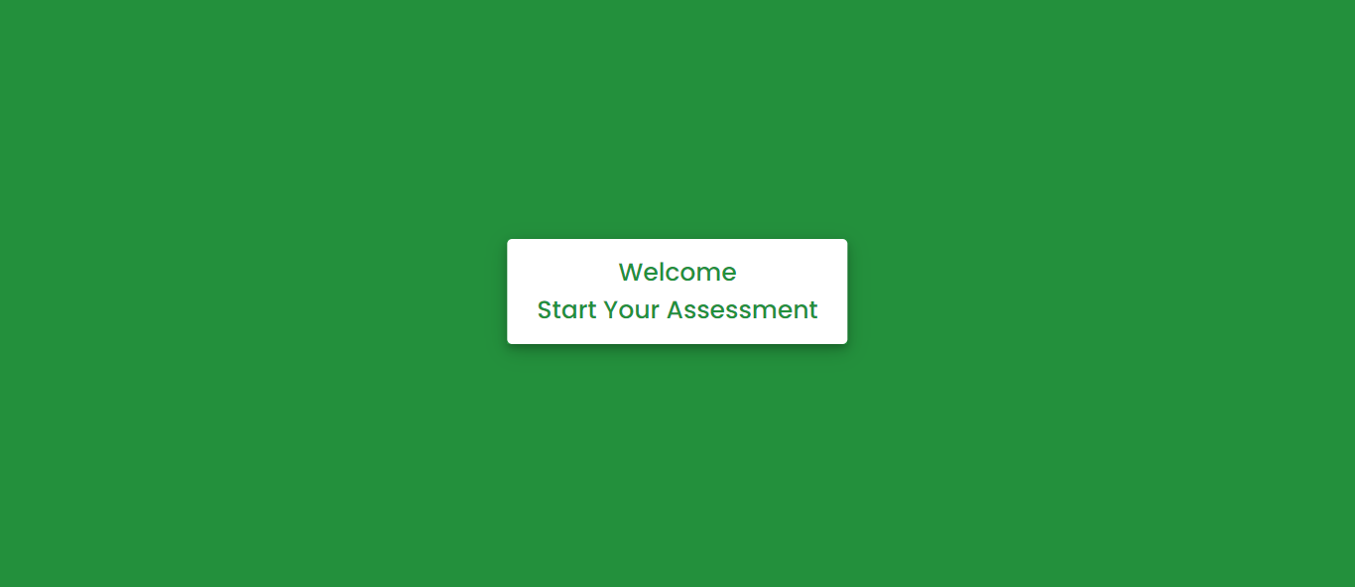
FUNCTIONALITIES-
Start Button

Slide 5
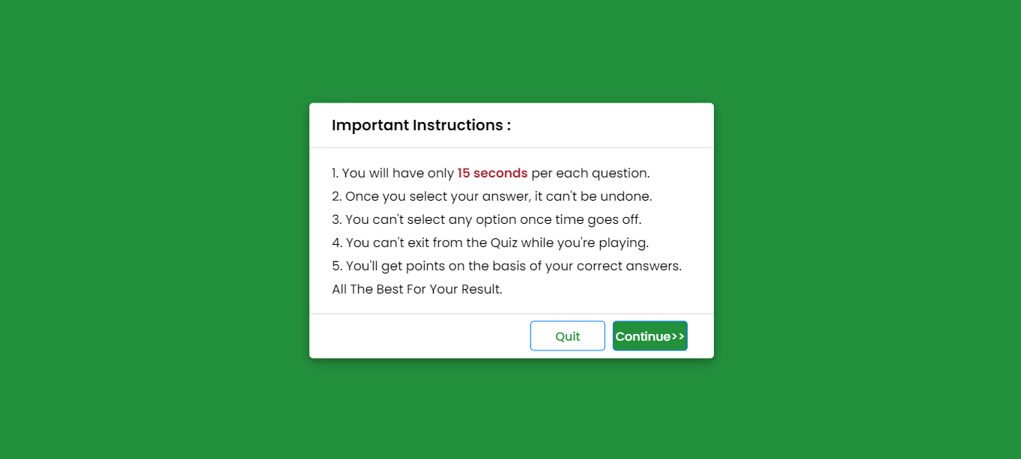
FUNCTIONALITIES-
Instruction
Header
Instructions List

Slide 6
FUNCTIONALITIES-
Title
Timer
Question
Statement
Options List

Slide 7
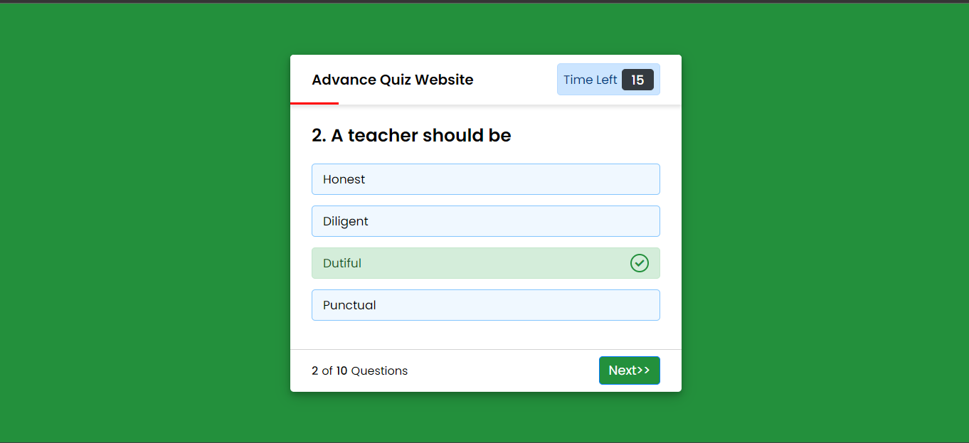
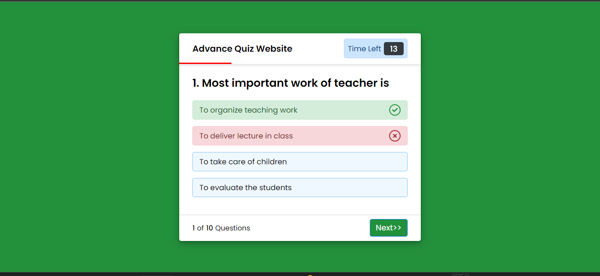
FUNCTIONALITIES-
Timer Line
Correct Option is Clicked
Incorrect Option is Clicked

Slide 8
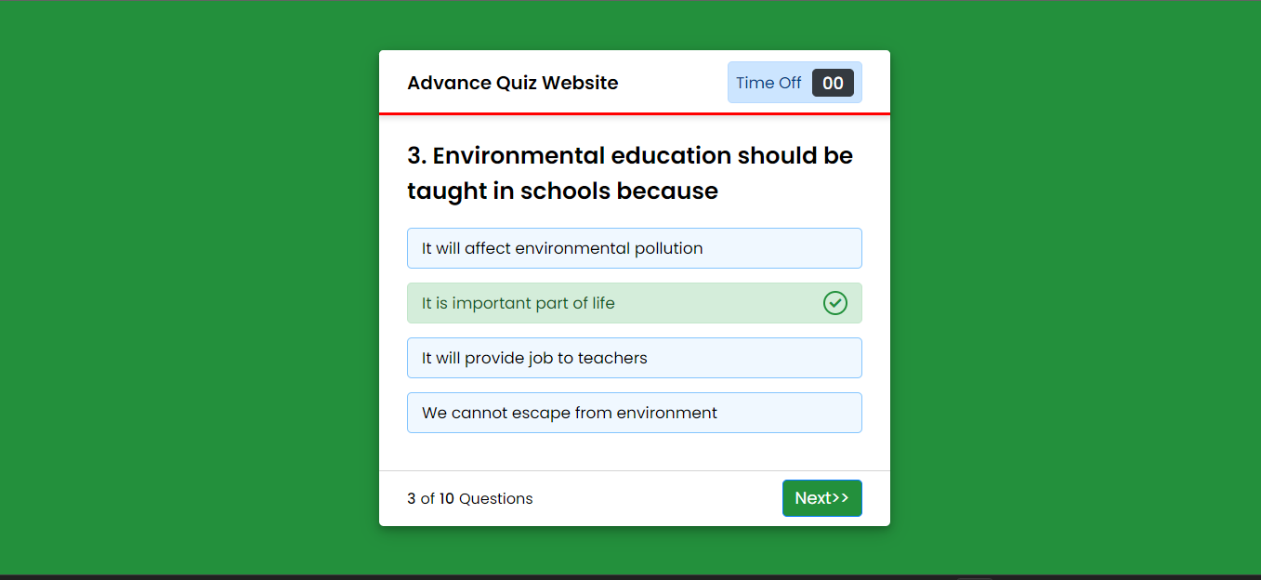
FUNCTIONALITIES-
Timer Off
Answer comes
automatically

Slide 9
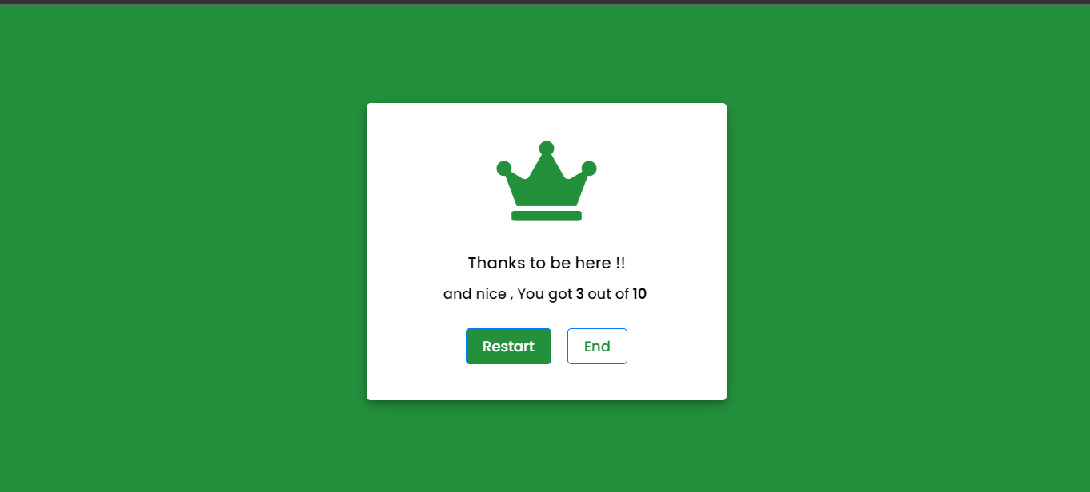
FUNCTIONALITIES-
Score
Restart Quiz
Button
End Quiz
Button

Slide 10
THANK YOU
PLEASE VISIT AGAIN AND test your knowledge……..

