Slide 1


Robustness & Execution
04
Notes:
Thanks. So far, we have discussed the model's architecture and its superior prediction error on the standard test set.
However, as Financial Mathematics students, we know that a low RMSE doesn't automatically translate to a robust investment strategy.
In this section, I will address two critical questions that determine the real-world viability of our project:
First, is the model's performance stable across different time periods and asset classes?
Second, and perhaps more importantly, can it survive the friction of high-frequency execution?"

Slide 2

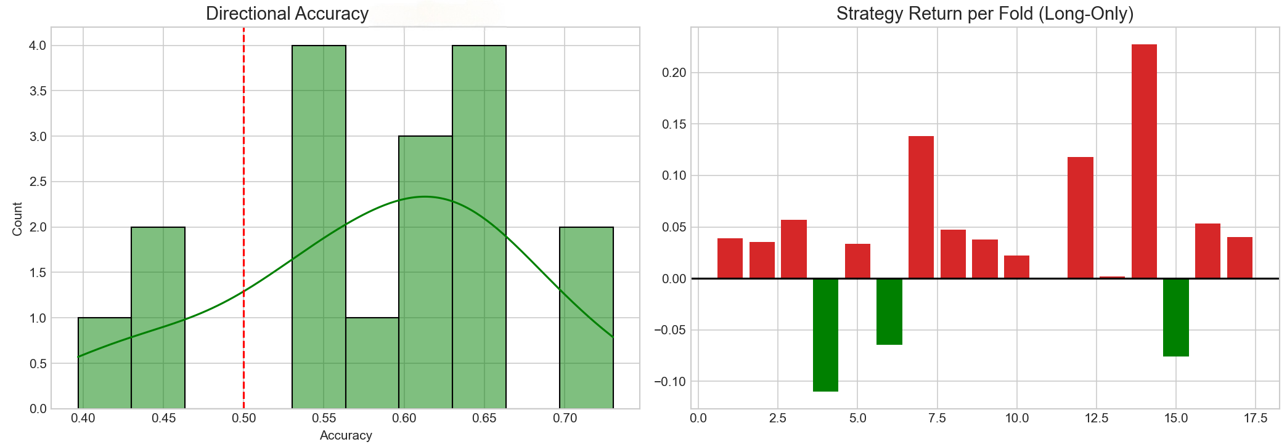
Rolling Window Cross -Validation
• Evaluation across sliding windows (2021–2025) eliminates look‑ahead bias.
• Directional accuracy distribution approximates normality around 60–64%.
• Fold‑wise returns remain positive in most regimes, demonstrating robustness.
Notes:
Let's start with stability. A common pitfall in financial AI is 'overfitting to a specific bull run'. To avoid this, we strictly implemented a Rolling Window Cross-Validation spanning from 2021 to 2025.
Instead of one static test, we constantly retrained the model as time moved forward.
We can see the distribution of our Directional Accuracy approximates centered between 60% and 64%.
Crucially, almost every single fold outperforms the 50% random baseline. This proves that our model captures genuine market dynamics, not just lucky noise.

Slide 3
Generalisation: Bitcoin Market
Total Return: −3.27% vs −25.68%
Sharpe Ratio: −0.207 vs −3.719
Max Drawdown: −27.72% vs −32.66%
The MoE strategy limits losses in a highly volatile cryptocurrency market, highlighting transferability across assets.
Notes:
But we went a step further. We asked: Can this architecture work on an asset it wasn't originally designed for? We tested it on Bitcoin.
As you know, Bitcoin is highly volatile and behaves very differently from the CSI 300 index.
The results in the table are revealing.
Why? Because our heterogeneous experts—specifically the Volatility Expert—successfully identified the high-risk regime and signaled to reduce exposure. This confirms our semantic features are universal, not asset-specific.

Slide 4

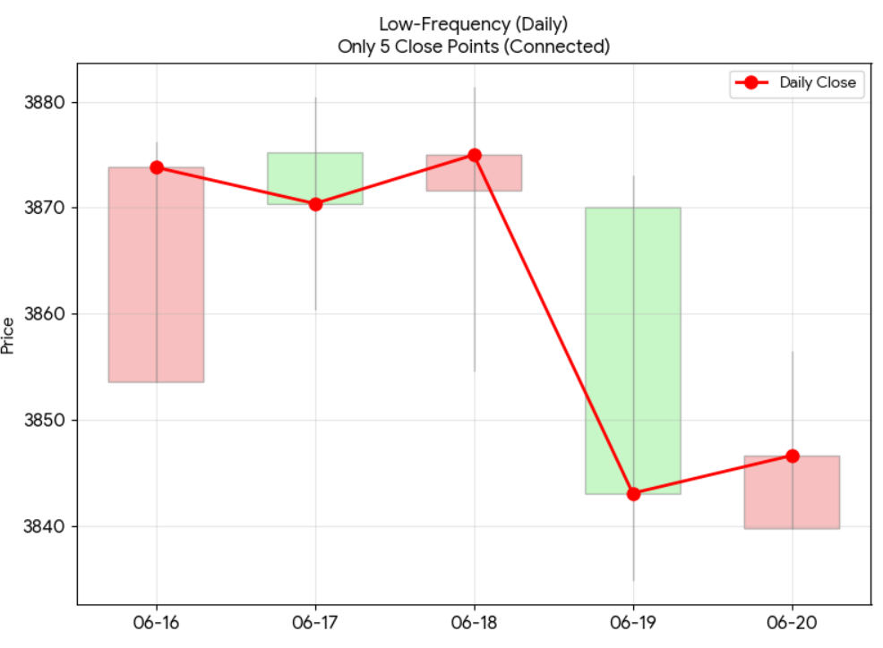
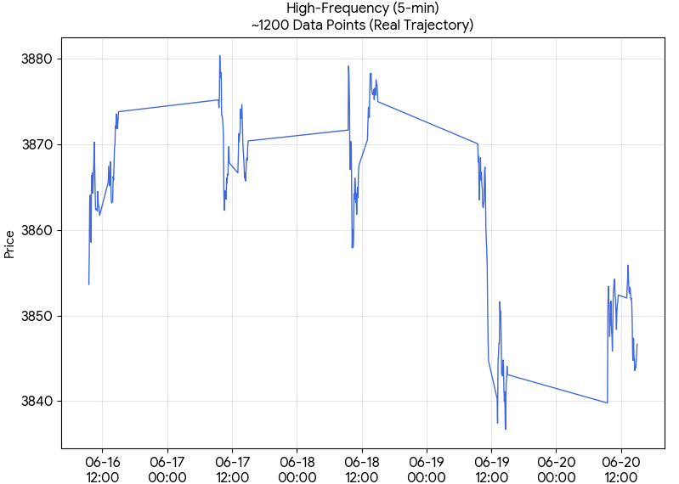

Motivation: Predictively Strong but Operationally Fragile?
The Daily Illusion
Flash Crash Event:
Liquidity Vanishes
1. The Daily Illustion
2. The High-Frequency Gauntlet
3. The Core Question
Daily data smooths out volatility and masks theintense noise of real-time markets.
Intraday microstructure noise and liquidity frictions often erase theoretical alpha.
Can MoE survive high noise to prove real-world viability?
Notes:
Now, let's move on, the bridge between theory and practice.
We identified a phenomenon we call: 'Predictively Strong but Operationally Fragile'.
Academic papers often stop at RMSE. But in the industry, execution is everything.
Please compare the two charts. On the left, daily data looks smooth. But on the right, high-frequency 5-minute data reveals the ugly truth: microstructure noise, liquidity gaps, and rapid reversals.
We term this the 'Daily Illusion'.
Models trained on daily data often fail intraday because they underestimate transaction costs and turnover.
If we simply trade on every signal, the transaction costs will eat up all the alpha.
So, the core challenge of this Chapter is: How do we filter out the 'noise trades' and keep only the 'quality trades'?"

Slide 5
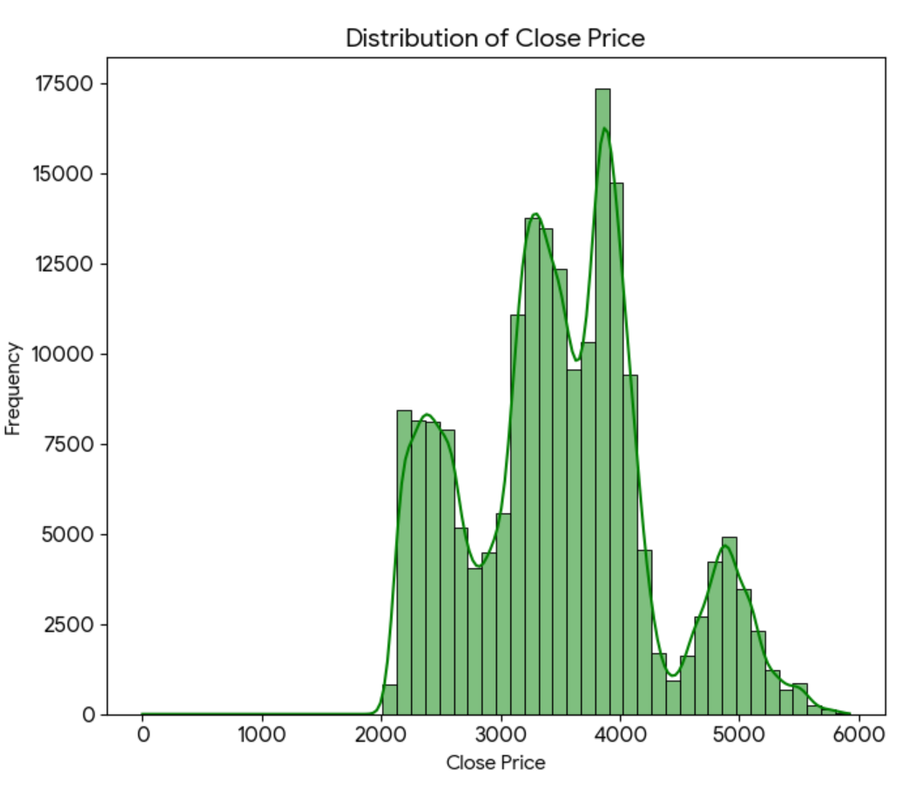


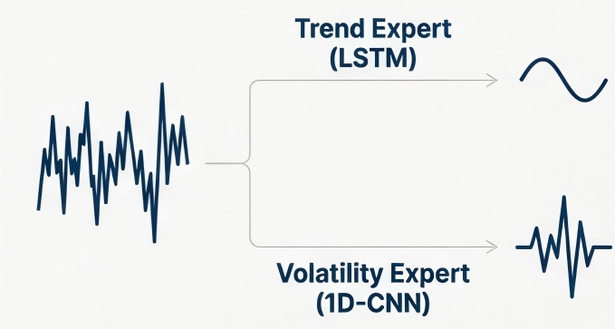

Why Heterogeneous MoE?
KPSS Statistic：
38.548
P-Value：
0.01 < 0.05
Source：
Wind Database
Non-Stationary !!!
Scale: 194,236 data points (vs. ~800 in daily).
Trend Expert handles smooth periods.
Volatility Expert (CNN) handles
the " Fat Tails"
Validation:
Strict Rolling Walk-Forward
(No look-ahead bias)
Notes:
To rigorously test this, standard daily data wasn't enough.
We utilized the Wind Database to acquire high-fidelity 5-minute level data.
This scaled our validation set from hundreds of points to over 194,000 data points.
This massive dataset ensures that our execution logic is statistically significant and not just a fluke.
Financial data has 'Fat Tails'
A standard LSTM is too slow to react to these shocks.
But our model has a dedicated Volatility Expert (a 1D-CNN). Its sole job is to detect these local spikes and sudden crashes.
As we will see, this expert becomes our 'Risk Sensor'.

Slide 6

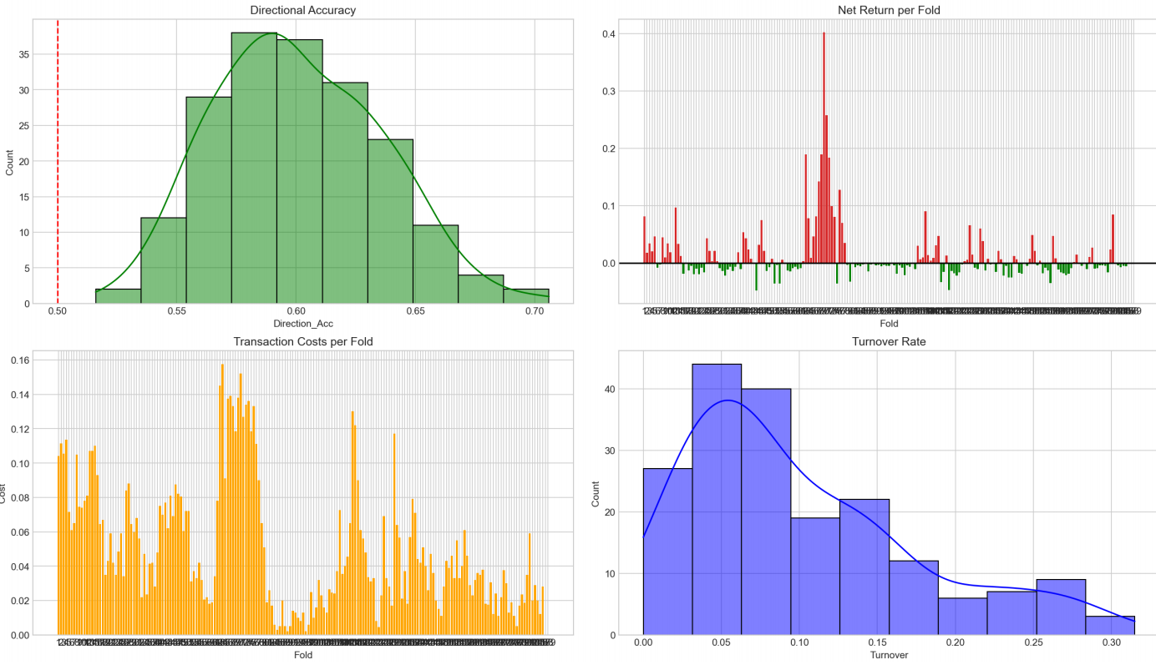
Diagnostic: High Accuracy ≠ High Profit
Setup：
Strategy: Long-only
Transaction Costs: 5 bps (0.05%) per side, reflecting realistic trading frictions
KEY INSIGHTS FROM TRADING BEHAVIOR:
The Paradox: achieves > 50% directional accuracy, which is theoretically profitable.
The Problem: Fat-tailed turnover leads to over-trading.
The Cost: With 5 bps transaction costs, much of the alpha is eroded by trading friction.
Costs are concentrated in periods where the model identifies a clear, profitable opportunity.
Notes:
Before we applied our solution, we ran a diagnostic test.
Look at the top-left chart: our Directional Accuracy is consistently above 50%. Theoretically, we should be profitable.
But look at the top-right: the Net Returns may sometimes around zero, sometimes negative.
And we can see The Turnover Rate is too high. The model is over-trading in uncertain regimes. It's working hard, but not working smart."

Slide 7

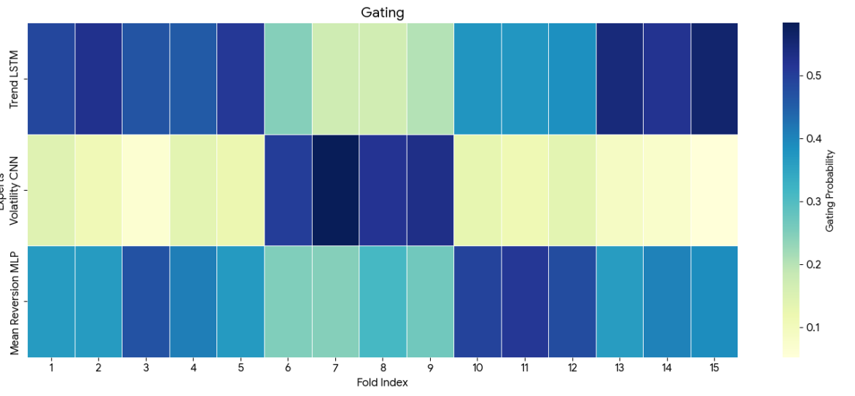
Execution Methodology : MoE-Driven Risk Control
Input：
Model
Prediction
Confidence Gate
+
Trend Filter
Signal Gate
Trend Filter
Output：
Trade
Decision
1. Signal Gate
Trade only when the predicted return exceeds a minimum threshold.
Purpose: Filters out low-conviction signals and reduces noise trading.
2. Trend Filter
Trade only when the price is above the long-term moving average.
Purpose: Aligns trades with the dominant market trend.
Confidence Gate (Core Innovation)
Overrides trades when model-implied volatility risk is high, automatically shifting to cash.
Purpose: Prevents trading in high-uncertainty regimes and protects capital.
Activating the Confidence Gate
Notes:
To solve this, we introduced a hierarchical execution logic.
The position is determined by three components: Signal, Trend, and Confidence.
The first two are standard: trade only when the signal is strong and aligned with the trend.
But the Confidence Gate is our key innovation.
Instead of using an external risk model, we use the internal attention weights of the MoE.
When the Gating Network assigns a high weight to the Volatility Expert (CNN), it implies the market is in a 'Panic State'.
In this scenario, the Confidence Gate overrides the buy signal and forces the strategy to stay in Cash, avoiding the storm."
You can see this mechanism visually in this heatmap.
The colors represent the active expert. Notice how the model dynamically shifts between the Trend Expert (in blue) and the Volatility Expert (in yellow/green) as market conditions change.
This proves the model isn't a black box—it is explicitly reacting to changing risk levels.

Slide 8

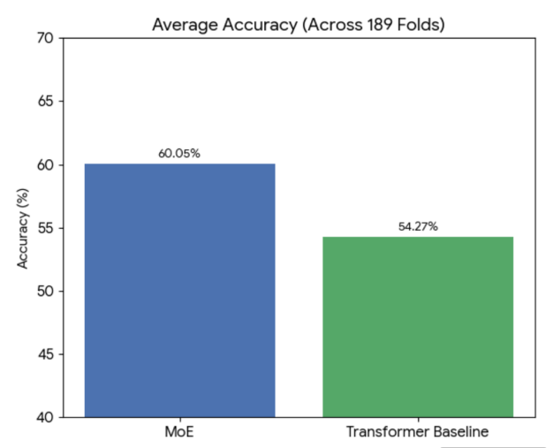
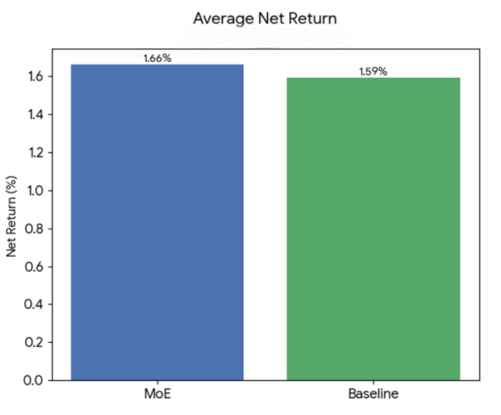
Superior Net Return (Quality > Quantity)
By trading less (lower turnover), we actually earned more.
Notes:
The results validate this approach.
By activating the Confidence Gate, we achieved a higher Net Return of 1.66% compared to the Baseline's 1.59%.
While the margin seems small, look at the efficiency. We achieved this with significantly lower turnover.
We avoided the 'death by a thousand cuts' of transaction costs, proving that in high-frequency trading, execution logic is just as important as prediction accuracy.

Slide 9


Statistical Significance Verification
The Question: is our 1.66% vs.1.59% net return advantage real, or is it a result of Random chance?
1. Check for Normality：The Shapiro–Wilk test on the paired return differences rejects the null hypothesis of normality (p < 0.05). Therefore, a standard t-test is not appropriate.
2. Apply a Robust Test：We apply the non-parametric Wilcoxon Signed-Rank Test to compare paired fold-level net returns, which is suitable for non-normal data.
# p - value = 0.021
At the 5% significance level (α = 0.05), the MoE strategy’s outperformance is statistically significant and unlikely to be driven by random variation.
Notes:
Finally, we had to ensure this 1.66% wasn't just random noise.
We performed a Wilcoxon Signed-Rank Test on the paired fold returns.
We chose this non-parametric test because the return differences were not normally distributed.
The result gave a p-value of 0.021. Since this is below 0.05, we can confidently state that our MoE strategy significantly outperforms the baseline.

Slide 10

Conclusion & Future Work
05

Slide 11





Conclusion
1. Lagging Paradox Resolved
High directional accuracy (DA) with timely responses.
2. Regime-Aware Modeling
Heterogeneous MoE effectively captures diverse market states.
3. Model Interpretability
Provides credible and actionable explanatory tools.
4. Economic Viability
Remains profitable after transaction costs.
Notes:
To wrap up, our Final Year Project resolves the 'Lagging Paradox' by combining ARIMA with a regime-aware Mixture-of-Experts.
We have shown that:
1. The model is Robust across years and assets (Bitcoin).
2. It is Interpretable via the expert gating mechanism.
3. And most importantly, it is Economically Viable under realistic costs.

Slide 12

Limitations & Future Work
LIMITATION
Feature Scope
The current model relies exclusively on technical indicators derived from price and volume data.
Execution Model
The long-only execution framework is simplified and does not account for market impact, execution latency, or partial fills.
Future Directions
Multi-Modal Inputs
Portfolio Optimization
Adaptive Execution
Notes:
The domestic market remains predominantly policy-oriented. In our future model improvements, we plan to incorporate large language models (LLMs) specialized in textual analysis, such as FinGPT, to better capture policy-related information. I have personally experimented with this technique in the Banking course and achieved promising results.

Slide 13

ACKNOWLEDGEMENT
Notes:
First and foremost, I would like to express my sincere gratitude to my supervisor, Dr. Sherry Zhou. Throughout the entire process—from topic selection and research design to model development and writing—Dr. Zhou provided me with patient guidance and invaluable advice. Her professionalism and rigorous approach have greatly benefited me.
I would also like to extend my thanks to Dr. Eric Zhao for taking the time to listen my report and offer insightful feedback despite his busy schedule. Your thoughtful questions will deepened my understanding of the research.
Additionally, I am grateful to all the instructors who have taught and supported me throughout the program, as well as to my classmates who have stood by me every step of the way. Thank you for your help, encouragement, and collaboration during discussions, experiments, and defense preparation. This achievement would not have been possible without everyone's collective efforts.

Slide 14

Thank you

