Slide 1
Modern Solid State Welding Processes
M Tech (Manufacturing Engineering)

Slide 2
Solid State Welding
Coalescence is achieved by
Pressure alone
Heat & Pressure
non-melting of the work material
For successful solid state weld surfaces must be
Very clean,
Brought in close contact to permit atomic bonding
Adv – No HAZ, dissimilar welding without concern about relative thermal expansions, conductivities

Slide 3
Solid State Welding Processes
Forge Welding
Cold Welding
Friction Welding
Ultrasonic Welding
Diffusion Bonding
Explosion Welding

Slide 4
Forge Welding
Forge Welding
conducted at temperatures in the 0.8 to 0.9 Tm range
The forge welding temperature is generally selected to be as high as possible with due consideration to avoiding such metallurgical problems as hot shortness, embrittlment, sensitization, and excessive grain coarsening.
Forge welding requires the application of pressure by means of either a hammer (hammer welding), rolls (roll welding), or dies (die welding).

Slide 5
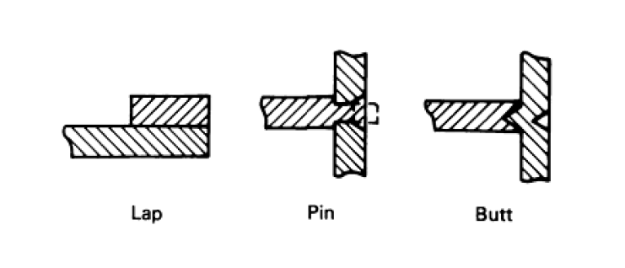
Forge Welding
joint configurations used for automatic forge welding operations

Slide 6
Forge Welding
Hydraulic presses are typically employed to apply pressure. Presses are often highly automated, featuring microprocessor control of pressure and temperature cycles. Heat is applied locally to the joint area by multiple-tip oxyacetylene torches, resistance heating, or induction heating. Often the oxyacetylene torches are oscillated to ensure uniformity of heating.
In a closely related process, magnetically induced arc butt welding, the surfaces to be welded are heated by a rapidly rotating arc plasma.

Slide 7
Forge Welding
Generally, the process is conducted in the open air, with oxygen partially occluded from the joint area by the initial contact of the faying surfaces.
When employing oxyacetylene torches, a slightly reducing flame affords some atmospheric protection.
Vacuum, inert, and reducing atmospheres have been used.
Forge welding is most commonly applied to carbon and low-alloy steels, with typical welding temperatures of about 1125 °C (2060 °F). Low-carbon steels can be used in the as-welded condition, but medium-carbon steels and low-alloy steels normally are given full heat treatments following welding.

Slide 8
Cold Welding
High pressure is applied at room temperature
Localized plastic deformation at the contacting surfaces results in coalescence.
Work pieces must be ductile (Al, Cu) & free of work hardening

Slide 9
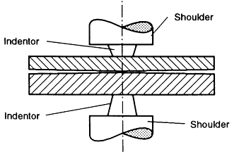
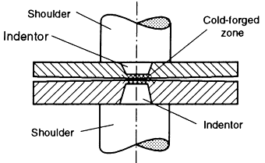
Cold Welding
The geometry of the cold pressure lap welding method
The welds are produced by annular, point, or line-shaped pressure dies in mechanical or hydraulic presses or pneumatic clamps.

Slide 10
Friction Welding (FRW)
Coalescence is achieved by frictional heat combined with pressure
Types
Continuous Drive Friction Welding
One part is driven at constant rotational speed and forced into stationary part
Inertia Friction Welding
Rotating part is connected to a flywheel
Friction Stir Welding (FSW)

Slide 11
Friction Stir Welding (FSW)
introduced in 1991
FSW also makes possible to produce sound welds in 5000 and 7000 series Al alloys that are not possible to be welded using conventional method.
FSW does not produce sparks or flames
FSW process provides good quality and strong welds with inexpensive and lesser number of equipment, eliminates the use of filler metal and improves weld ability

Slide 12
FSW set up

