Slide 1
Dong He 505624627- Xinyi Liu505625976
Teammates
Dong He 505624627
Xinyi Liu 505625976
Design Specification
Technology | Synopsys 32nm
Core Area | 2,380,370 uM^2
Power | 3,010,000 mW
Clock | 8 ns
Delay (cycles) | 64 cycles/image
Delay (ns) | 512 ns/image
Energy/Image | 1,541,120 pJ/Image

Slide 2
Design Feature
We employed a parallelism structure for better throughput
We have 28 multiplier for each neuron and 280 multipliers in total for all 10 neurons for parallel computation.
We use layered based adder scheme (560 adders in total) for adding results from 28 multipliers.
We employed a pipelined structure for best throughput
We took advantage of the pipeline nature of multiplier and adder to compute each neuron. Each stage of pipeline is one set of 28 parallel computation.
Result: Total Latency = 64 cycles, Startup Latency = 28 cycles
Further optimization
We removed some of the pipelined registers to relax the timing requirement.
Result: Area improved 1.21x, Power improved 1.23x

Slide 3
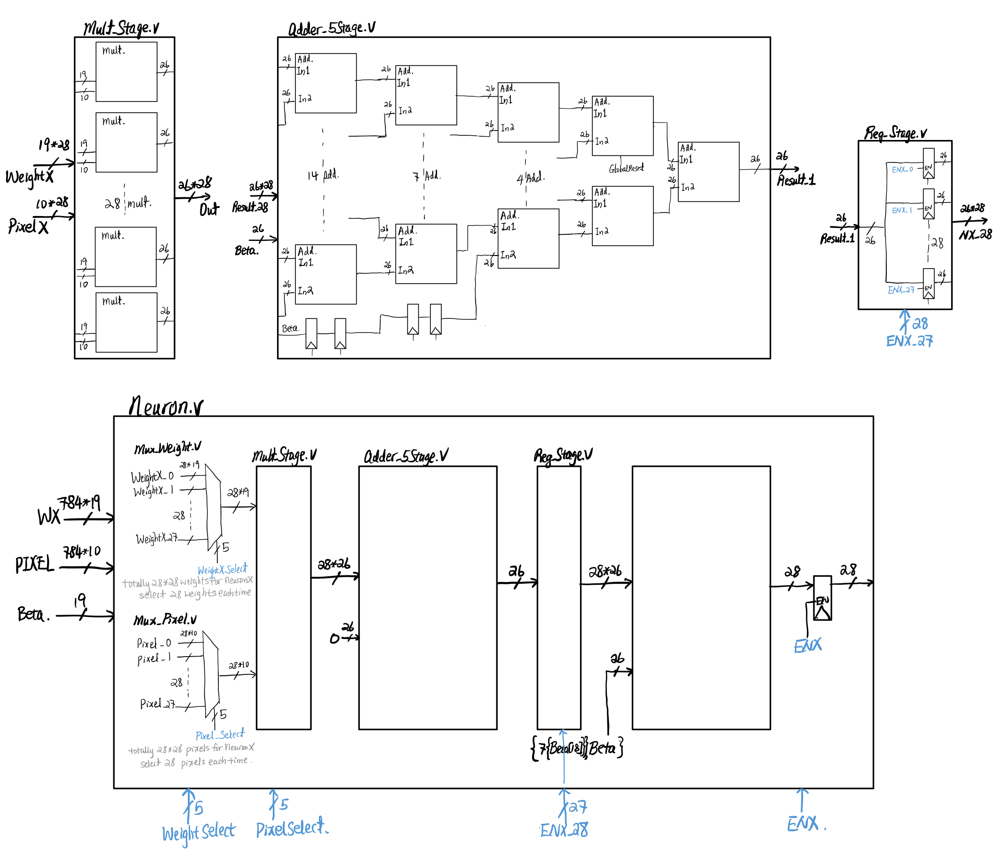
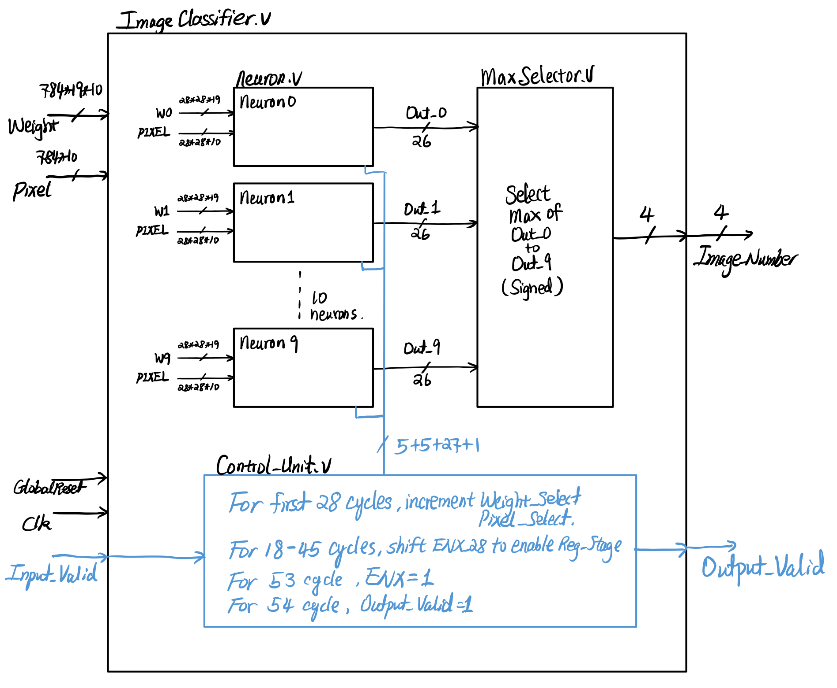
Chip Layout
All Black signals are Datapath signal
All blue signals are Control Signal
Clk and GlobalReset signals are obmitted for some module
GlobalReset is active low for every module except multipliers and adders.

