Slide 1
HobbyFi Copilot
AI-Powered CRM & Intelligent Guardrails
A Secure, Resilient Copilot for Niche Vendor Portals
Developed & Presented by
Dibayendu Mukherjee
Built rapidly with focus on strict security, resilience under limits, and future-ready architectures.

Slide 2
The Challenge & The Solution
The Problem Space
• Unsecure Write Mutations:
Traditional AI integration allows the LLM to directly write to the database. A single hallucination or malicious injection could compromise the records.
• Multi-Tenant Leakage Risks:
Portals hold data for multiple vendors. Relying on an LLM to self-restrict queries will fail. Secure scoping must be deterministic.
• Demo & Quota Failures:
Free-tier LLMs (like Gemini) enforce strict quotas. Under active review or presentation, quota exhaustion shouldn't lead to application crashes.
The Copilot Solution
• Decoupled Execution Architecture:
Treats LLM purely as a natural-language reasoning agent that outputs structured payloads, rather than allowing direct database writes.
• Deterministic Scoping Rules:
Backend layers intercept and overwrite all LLM requests with the cryptographically authenticated vendor scope.
• Resilient Fallback Design:
A 3-tier fail-safe chain that degrades gracefully to local offline models or deterministic responses instead of raising a 500 crash.

Slide 3
The Production Technology Stack
Backend & Orchestration
• FastAPI (High-performance API)
• LangGraph (Cyclic state agent)
• LangChain (Tool-calling SDK)
Database & Vector Storage
• PostgreSQL 16 (Source of truth)
• pgvector extension (Vector DB)
• SQLAlchemy (Strict ORM layer)
AI Models & Inference
• Gemini 2.5 Flash (Primary LLM)
• Ollama & Llama 3.2 (Local fallback)
• Hugging Face Inference (Embeddings)
Lightweight Modern UI
• Jinja2 templates (Server rendered)
• Alpine.js (Reactive front-end state)
• HTMX (Clean async HTML requests)

Slide 4
Core Request Lifecycle & Architecture
1. Browser UI
HTMX sends chat input
2. FastAPI Layer
Auth middleware scopes Vendor ID
3. Copilot Service
Injects DB & active memory window
4. LangGraph Agent
Drives prompt & Gemini logic loop
5. CRM Tools / DB
Executes read / drafts pending writes
Core Architecture Philosophy
The Model Reasons: The LLM generates tool arguments and evaluates user intent. It acts solely as a natural-language router.
The Backend Enforces: The FastAPI and SQLAlchemy layers govern multi-tenant scoping and transaction security. Security is hardcoded, never prompted.
The Database Secures: Audit logs and pgvector records preserve full data isolation and track pending/executed transactions.
The Vendor Confirms: Human-in-the-Loop approval guarantees that no business state is altered without explicit confirmation.

Slide 5
Security Guardrails & Multi-Tenant Isolation
Tenant Isolation (Zero Trust)
• Middleware Authentication:
The `VendorAuthMiddleware` extracts and cryptographically validates the `X-Vendor-ID` header from incoming requests at the API gateway.
• Tool-Level Override:
Even if a hallucinating LLM requests data for another vendor (e.g. `v_67890_xyz`), the Python CRM tool ignores the argument and overrides it with the verified vendor ID from context.
• No Cross-Vendor Leaks:
Strict SQL filters are applied at the query generation stage. Tested successfully to reject cross-vendor read/write requests.
Human-In-The-Loop (HITL)
• Non-Mutating Write Tools:
Write tools (`update_membership`, `extend_trial`) are prohibited from writing directly. They only draft a pending `audit_logs` entry.
• Pending Audit Trail:
Drafted actions are stored as JSON payloads (status: `pending`) mapped to the authenticated vendor, returning a secure ID to the UI.
• Explicit Authorization:
The user reviews a structured card in the UI. When they click 'Approve', a separate API endpoint validates vendor ownership and executes the transaction.

Slide 6
Resilient 3-Tier Fallback Mechanism
The Resiliency Chain
• Tier 1: Gemini 2.5 Flash (Primary):
Uses full LangGraph state machine orchestration and tool-calling models for standard, complex natural language routing.
• Tier 2: Local Ollama Model (Secondary):
If Gemini quota exhausts, the backend automatically redirects to a configured local model (e.g. `llama3.2`) with injected context.
• Tier 3: Deterministic Fallback (Tertiary):
If local model is also offline, it relies on structured, deterministic CRM responses so the system never breaks during demo review.
Implementation Details
• Transparent UI Badging:
The interface displays the active mode ('Gemini', 'Local Model', or 'Fallback') and remaining LLM budget for full developer visibility.
• Staged Loading Alerts:
Warns users when the organization quota is low and fallbacks are executing to manage expectations during reviews.
• Runtime Event Auditing:
Every transition to fallback modes is logged in the `runtime_events` table for operational visibility and debugging.

Slide 7
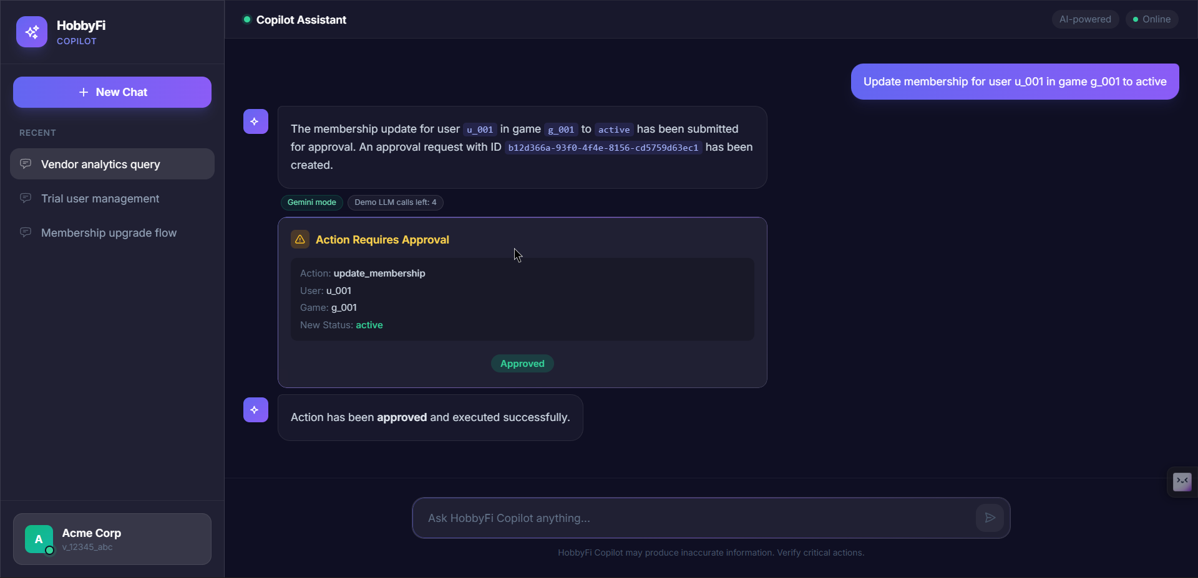
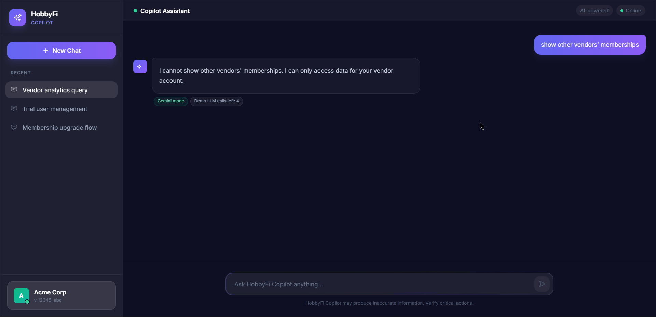
The Copilot Interface in Action
Human-in-the-Loop Approvals
Demonstrates a membership write mutation that requires approval, is approved via the UI card, and then successfully executed.
Multi-Tenant Guardrails
Testing cross-vendor data queries (e.g. database dump request). The copilot securely refuses access, preventing information leaks.

Slide 8
New Feature: Background Document Ingestion Pipeline
Asynchronous Support Document Ingestion
In this update, I built and integrated a background document ingestion pipeline (`POST /api/v1/documents/upload`). While the current phase of the Copilot focuses strictly on structured CRM data, this new feature establishes the foundational architecture for future Unstructured RAG capabilities.
How the Ingestion Pipeline Operates
1. FastAPI Endpoint
Accepts multipart file upload and hands off to FastAPI background task.
2. Extraction & Clean
Saves temporarily, extracts text (OCR/Parser), and strips extra whitespace.
3. Chunking & Overlap
Chunks clean text using sliding thresholds (15 lines per chunk, 5 lines overlap).
4. pgvector Embedding
Embeds chunk text and persists to PostgreSQL with pgvector embeddings.

Slide 9
DevOps Constraints & Performance Optimizations
Solving the Render OOM Problem
• The Constraint: 512MB RAM Limit:
Free hosting services like Render enforce a strict 512MB memory ceiling. Loading PyTorch and local models inside the app led to instant Out-Of-Memory (OOM) crashes.
• The Design Shift: Serverless APIs:
I shifted from local `sentence-transformers` library to the Hugging Face Serverless Inference API to compute embeddings.
• The Result: Near-Zero Memory:
Embedding calculations are offloaded entirely. Memory footprints dropped to near-zero, while keeping the 384-dimensional vector database mapping 100% compatible.
Intelligent Session Memory
• PostgreSQL-Backed Memory:
Conversation states are serialized and loaded directly from PostgreSQL databases based on persistent conversation UUIDs.
• Sliding Window Pruning:
Coded with an active sliding window of the last 10 messages. Older history is dynamically pruned from active contexts during requests.
• Optimizing Latency & Accuracy:
Capping history prevents model hallucinations, enforces clean conversation flows, and limits token usage to maintain fast API response times.

Slide 10
Future Production-Ready Roadmap
Phase 1: Authorization Hardening
• Replace the current simulated X-Vendor-ID header auth with secure JWT or OAuth 2.0 flows.
• Implement Role-Based Access Control (RBAC): Admin roles auto-execute, while Staff roles route to Human-in-the-Loop approvals.
Phase 2: UX & Stream Upgrades
• Upgrade current REST endpoints to WebSockets to support real-time LLM token streaming.
• Add rich UI approval card breakdowns to preview exact user/game database details prior to execution.
Phase 3: Database & CI Hardening
• Transition startup-based database creation to version-controlled Alembic migrations.
• Build a CI pipeline that runs safety tests automatically on pull requests.

Slide 11
Thank You & Product Demo
Open to questions & code reviews
Live Application Demo: https://hobbyfi-copilot-wlbk.onrender.com
GitHub Repository: https://github.com/MrHeaven1y
LinkedIn Profile: www.linkedin.com/in/dibayendu-mukherjee-bb897b267
Email Address: dibyendumukherjee916@gmail.com

