Slide 1

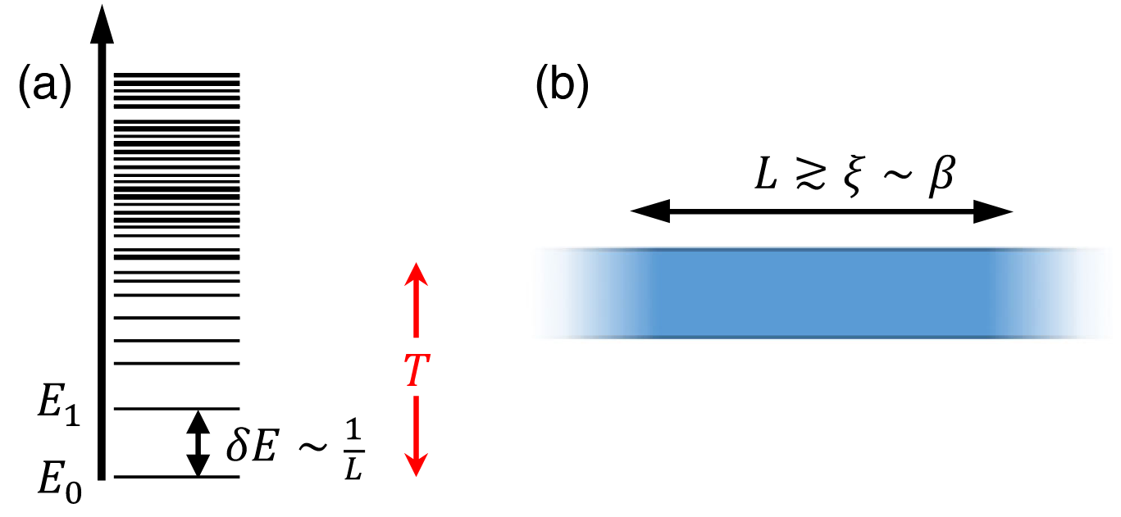
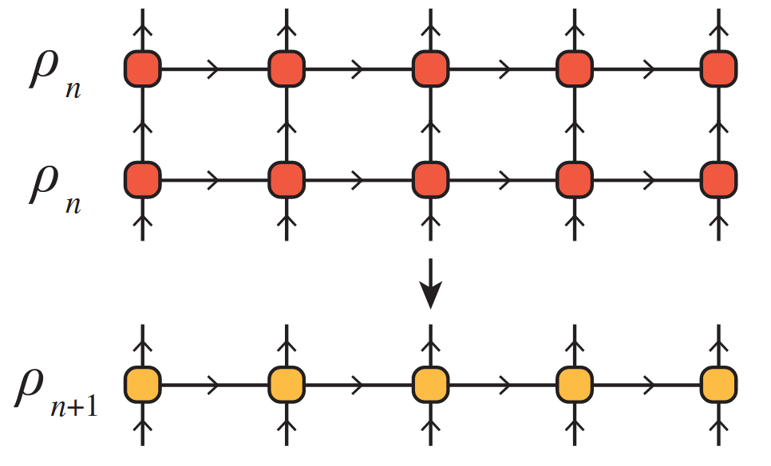
The Thermal Tensor Network Renormalization Group (XTRG)
A Simulation of the XY-Model
PAWLIK Matthias, ALIVERTI Damiano
Tensor Network Course Final Presentation – 23.07.2025

Slide 2
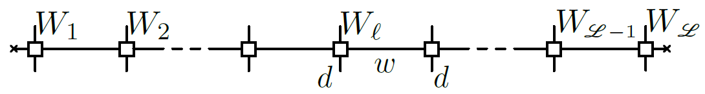
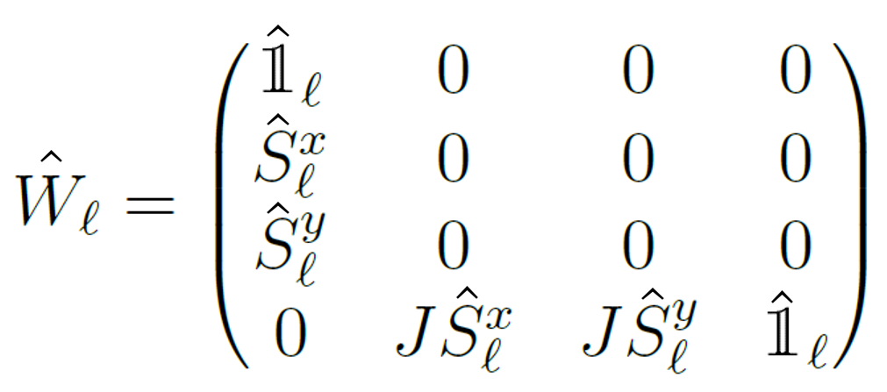
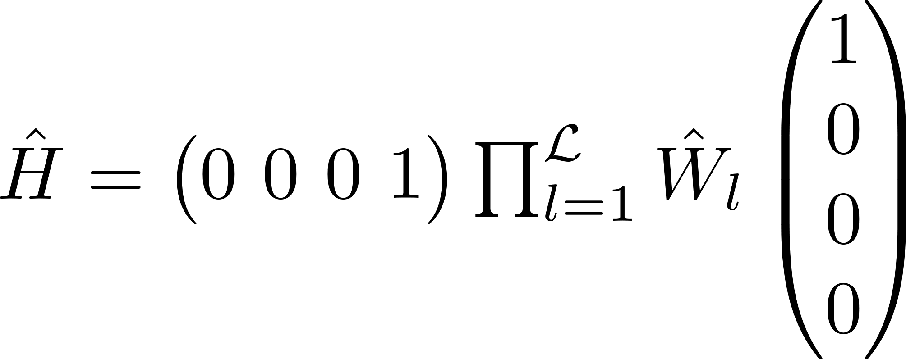
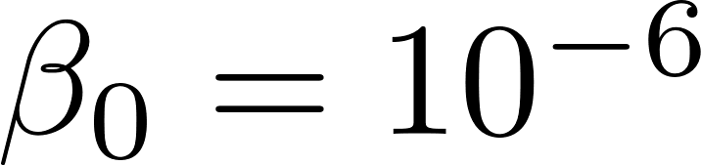
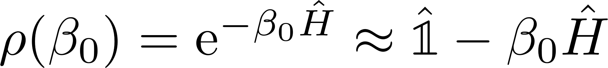
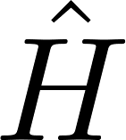

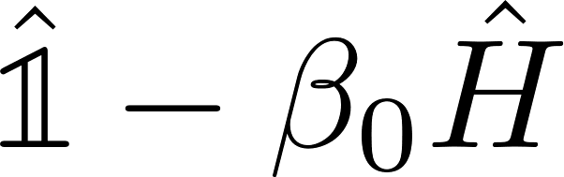
01
Linear High-Temperature Initialization
XY-Model
MPO Representation
with
such that
We linearly approximate the (unnormalized) thermal state at high temperature, , as
Using the fact that and can be represented by MPOs with bond dimension 4 and 1, respectively, we represent with an MPO with bond dim. 5

Slide 3
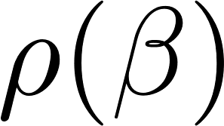
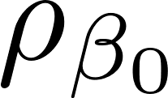
02
Halving temperature by squaring the state
Main idea
Suppose we have computed the thermal state . Then we can compute the thermal state with double inverse temperature as
XTRG algorithm
We start from the high-temperature state , and iteratively halve the temperature. We do the square using the MPO representation of the thermal states. Squaring MPOs implies squaring their bond dimension, too. This calls for a truncation scheme.

Slide 4
02
Title
XY-Model
Bla bla

Slide 5
02
Title
XY-Model
Bla bla

Slide 6
02
Title
XY-Model
Bla bla

