Slide 1

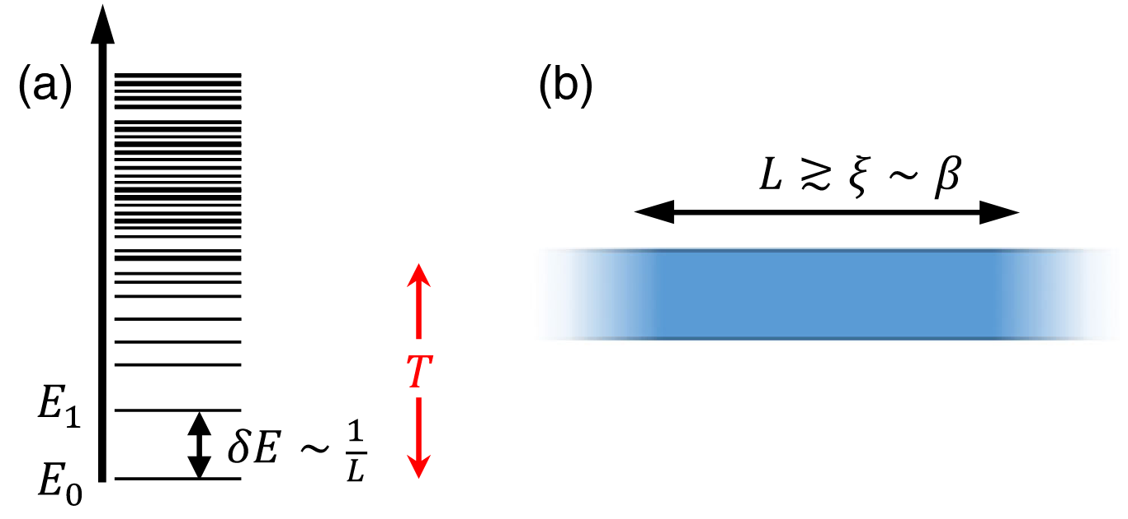
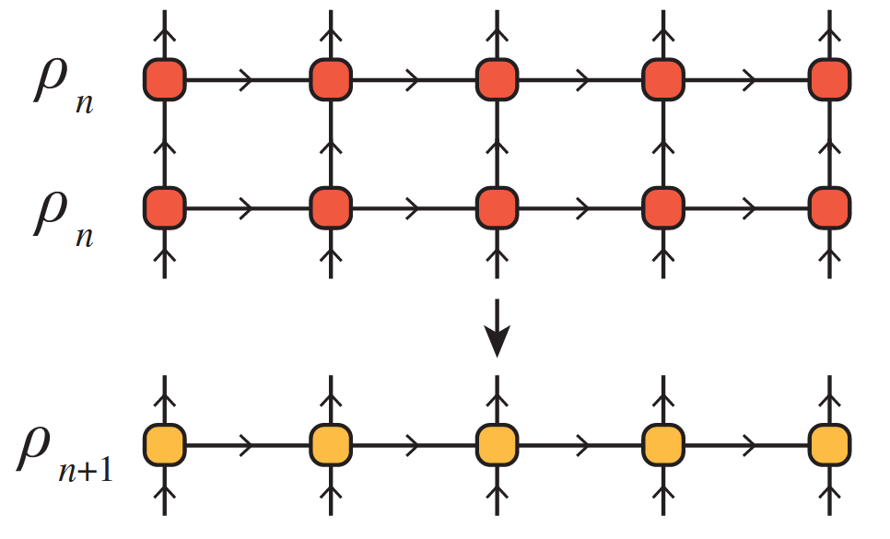
The Thermal Tensor Network Renormalization Group (XTRG)
A Simulation of the XY-Model
PAWLIK Matthias, ALIVERTI Damiano
Tensor Network Course Final Presentation – 23.07.2025

Slide 2
TODO
Can add in line on entanglement how one represents mpos as mpss to get a notion of entanlgemnt
Double check slide numbering
Add animations i.e. split slides into layers
Check dispersion relation epsilon_k,arent we using the one for periodic B.C.??? …no big deal, theyre almost same, but good to make sure and in case fix function epsilon_k in jupyter notebook
Last slide of part 4: complete with rough observed boundaries of numerics (tweak a bit parameters in the code; remove expensive frobenius norm tolerance check and just use agreement with analytical Z as a very rough check on how off we are relative to exact rho?)

Slide 3
1/4 - INTRODUCTION

Slide 4
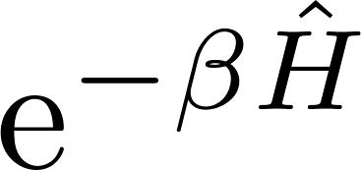

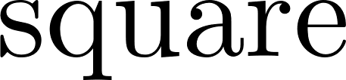
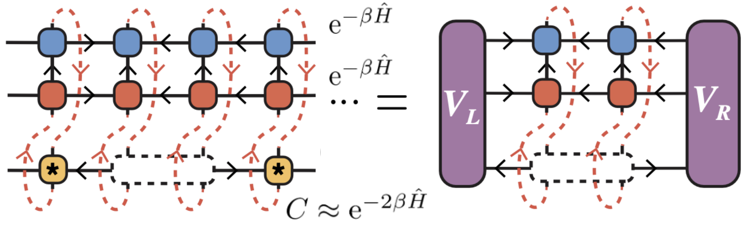
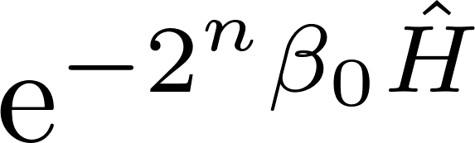
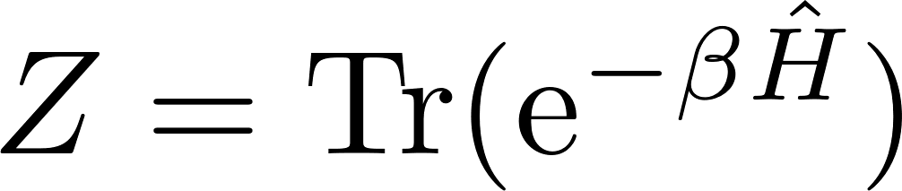
The XTRG algorithm
Main idea
Compute non-normalized thermal states of 1D chain Hamiltonians at different inverse temperatures by iteratively doubling :
XTRG algorithm
Represent with an MPO, compute its square with tensor network techniques, and truncate virtual bond dimension with a variational method [1]
Model
We will use the method on a 1D XY chain of L = 10 sites,
Our goal
Compute the partition function for logarithmically discretized and compare with analytical result
[1] Chen, B.-B., Chen, L., Chen, Z., Li, W., & Weichselbaum, A. (2018)

Slide 5
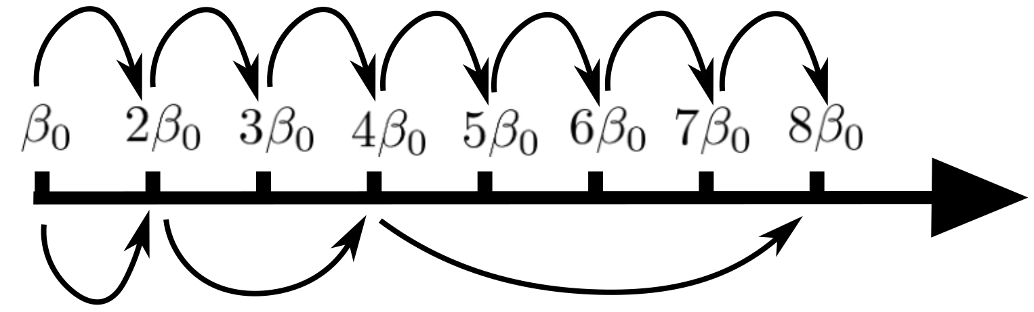
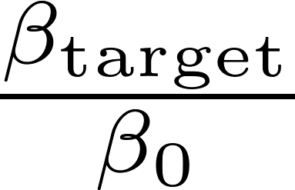
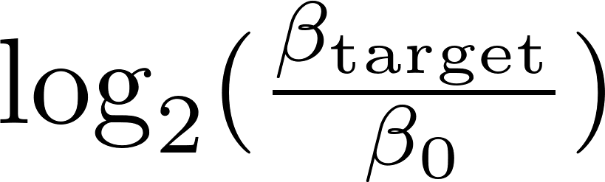
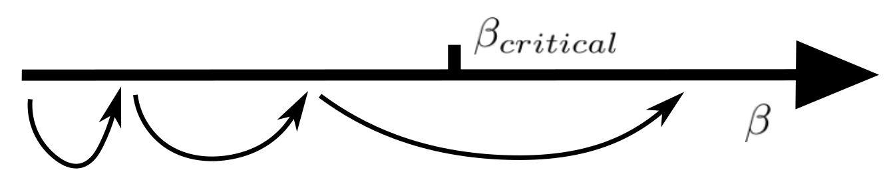
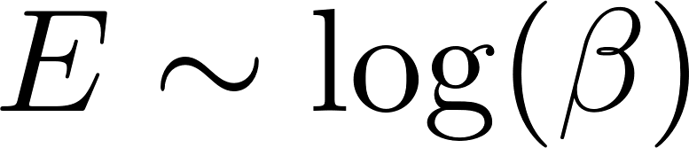
Motivation
Exponential reduction of # steps
Imaginary time evolution:
steps
XTRG algorithm:
steps
Avoid critical points
XTRG is in principle able to jump over phase transitions in space, which is where converged computations get costly
Scaling of entanglement
For many 1D models, thermal state entanglement scales as . . Often, one expects the change in entanglement to describe the change in physical regimes in a linear fashion. Then one should use a logarithmic scale for

Slide 6
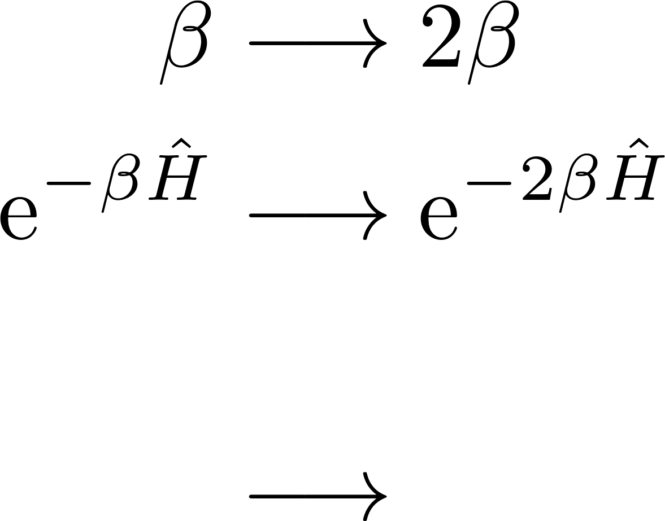
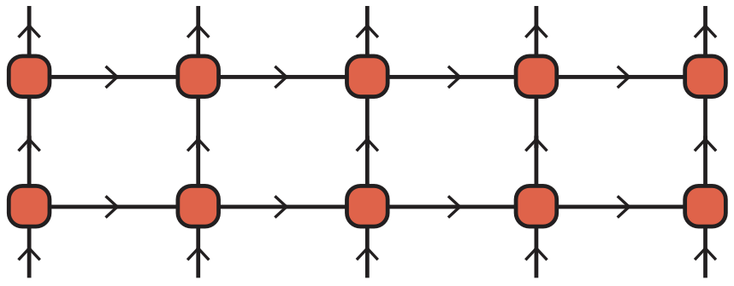

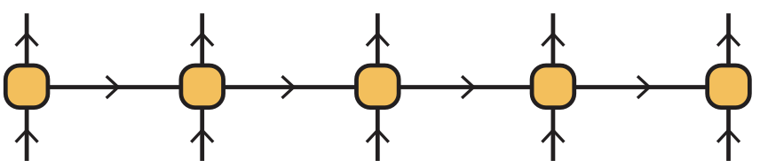
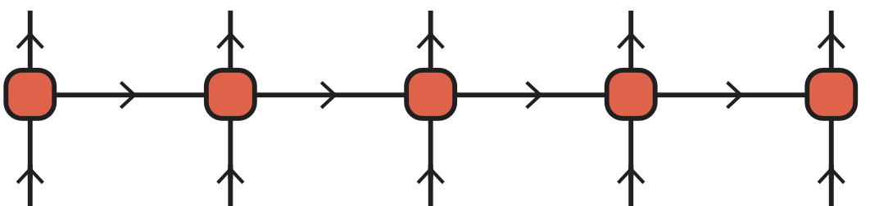
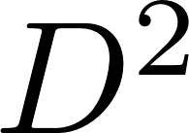


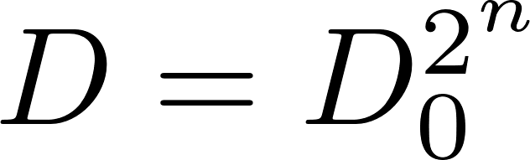
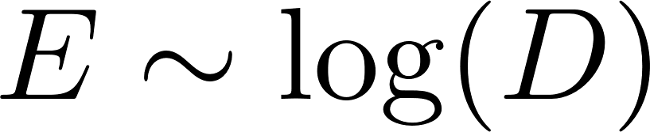
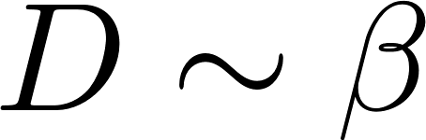
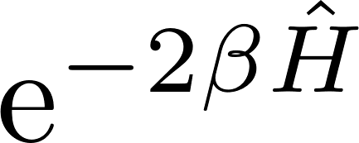


MPOs and truncations
MPO representation
Using tensor network schemes makes the necessary truncation methods clearer. The thermal state will be represented as an MPO.
Why and what to truncate
One XTRG temperature update:
As grow in the XTRG algorithm, , the bond dim. would increase as , exponential in . But the slow entanglement growth along with suggest truncating bond dim. as .
Truncation and optimization scheme
will be approximated by a lower- MPO that minimizes

Slide 7
2/4 – ALGORITHM

Slide 8
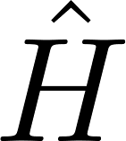

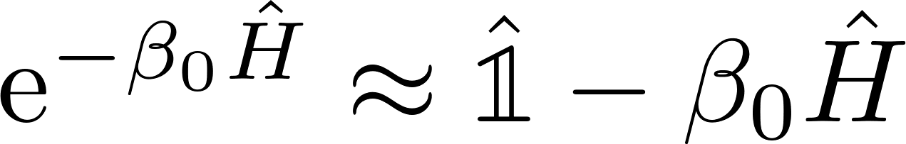
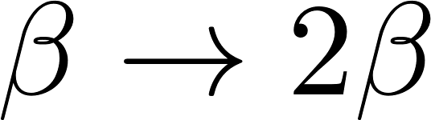
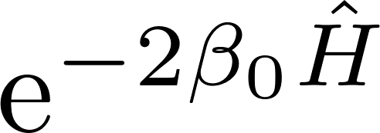
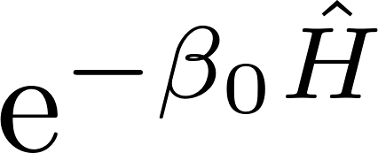
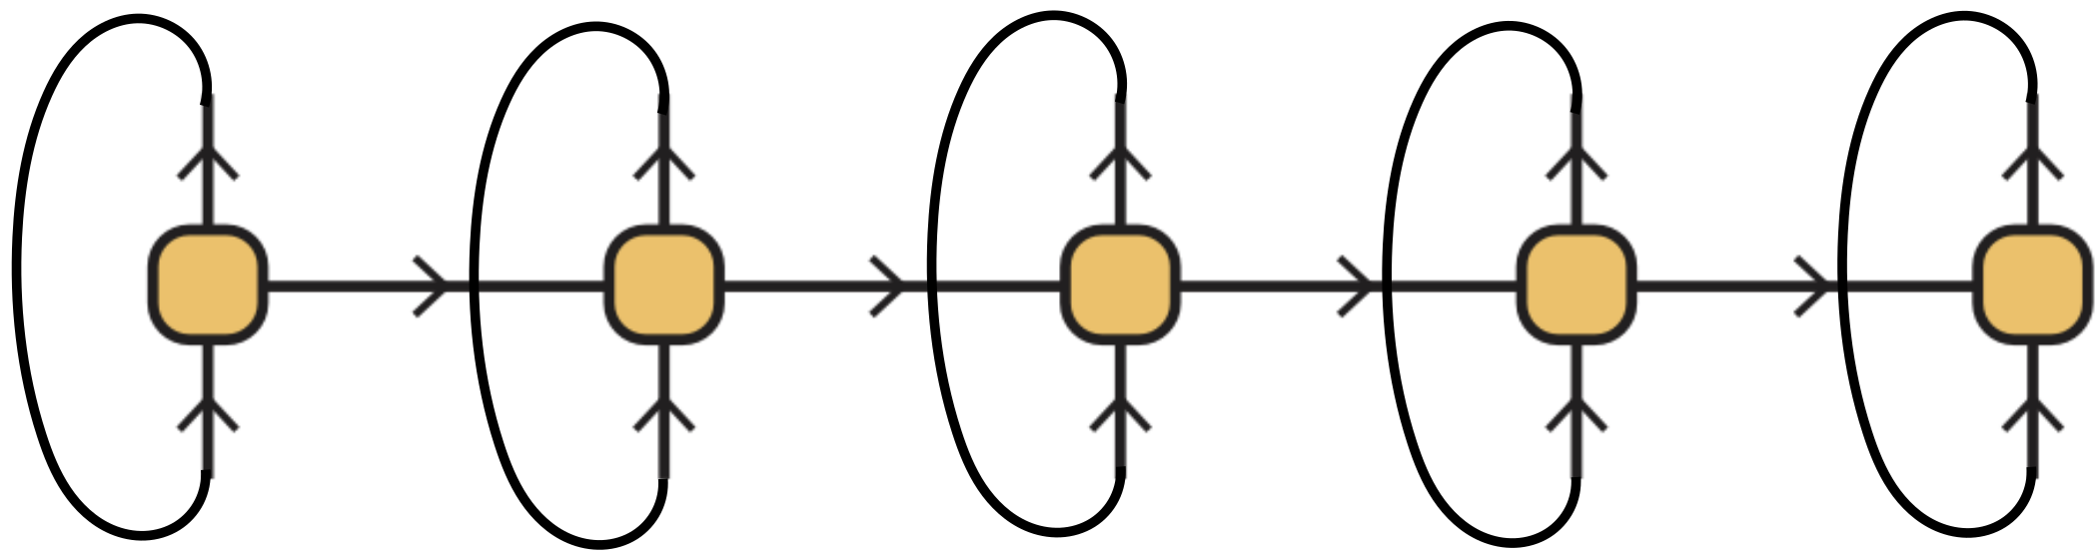
Algorithm structure
Goal
Recall: we want to compute MPO for for many inverse temperatures
Main steps
1) Hamiltonian: get MPO representation of the under consideration
2) Linear high-temperature initialization: choose ‘small’ and approximate
3) XTRG updates, : compute and truncate the MPO for by contracting
the MPO for with itself, . Reiterate at will, while storing values of
as well as any other data of interest.

Slide 9
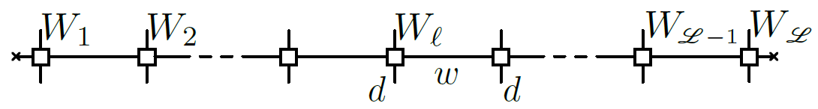
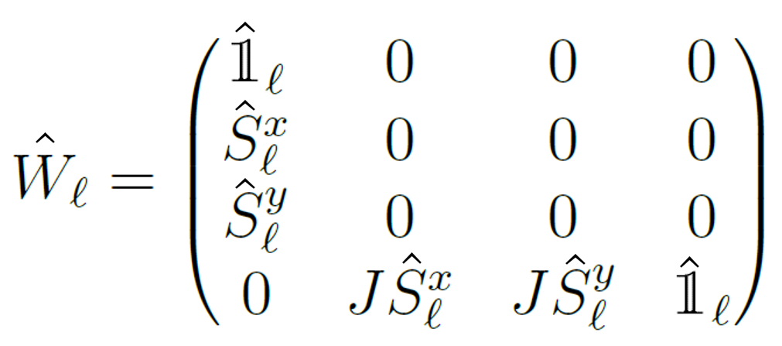
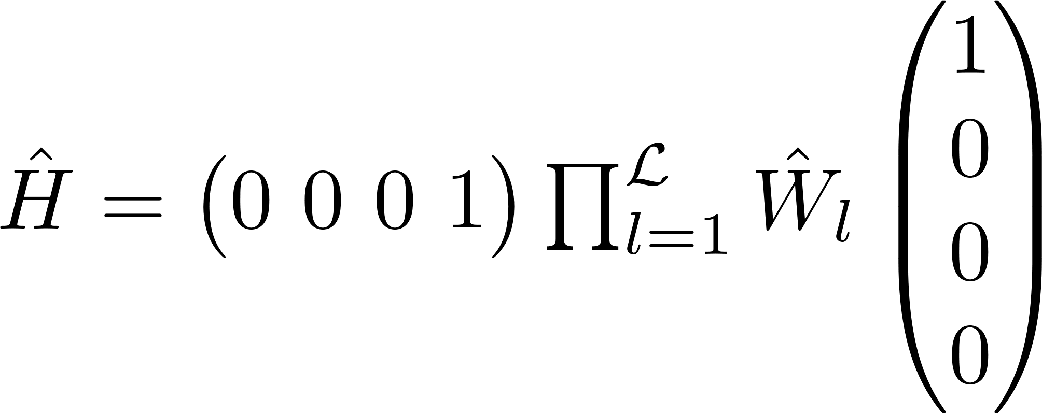
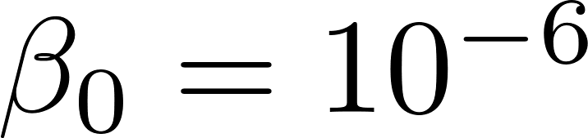
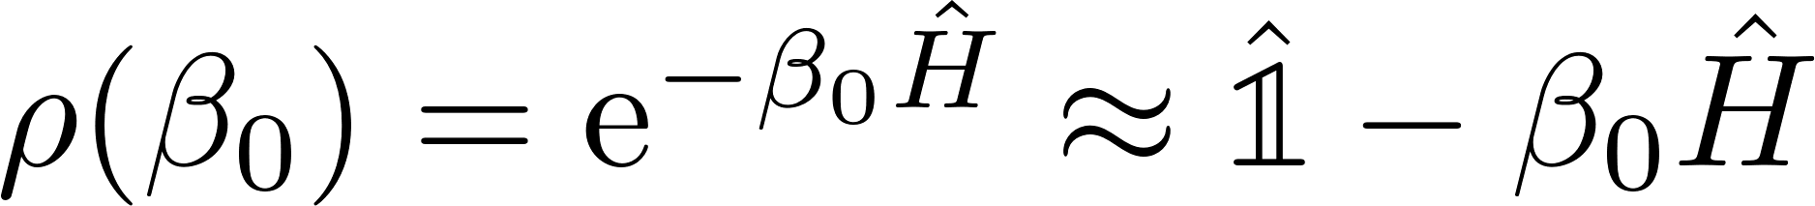

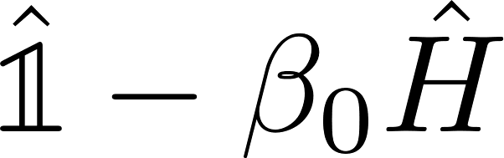
Hamiltonian and initialization
XY-Model
MPO Representation
with
such that
Linear initialization
We approximate the (unnormalized) thermal state at high temperature, , as
Using the fact that and can be represented by MPOs with bond dimension 4 and 1, respectively, we represent with an MPO with bond dimension 5

Slide 10
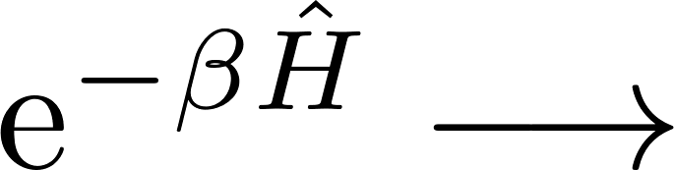

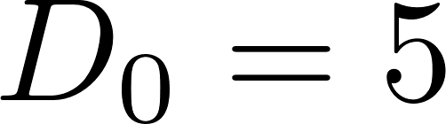

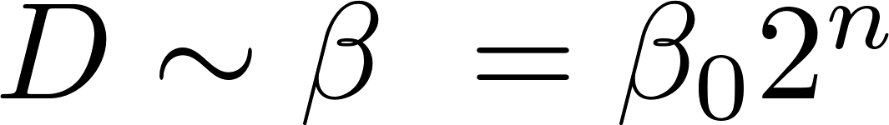
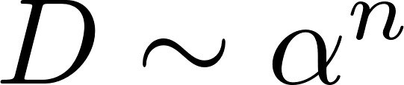
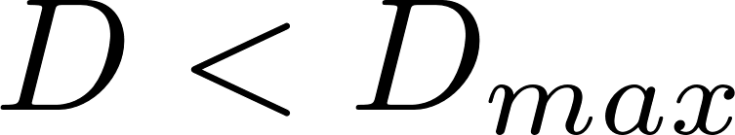
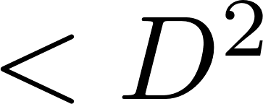
The XTRG update
Initial data
MPO for
Goal
Get MPO for , obtained as an approximation of the MPO for the exact square
Efficiency condition
If we keep the exact square MPO the bond dim. grows as , with for the XY model and # updates. But should be enough!
In practice, we allow for exponential growth, , with a threshold,
Main problem
How to approximate with an MPO with bond dim. ?

Slide 11


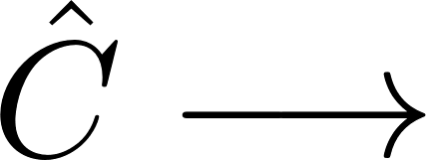
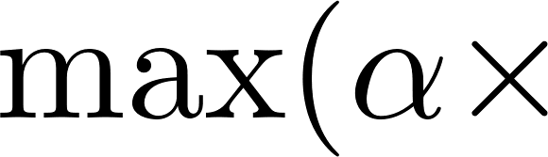
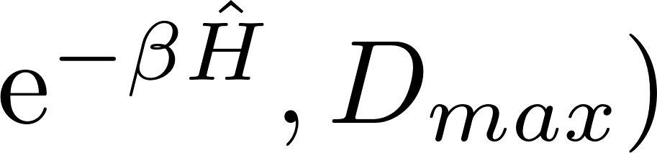

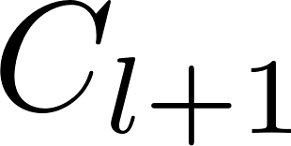
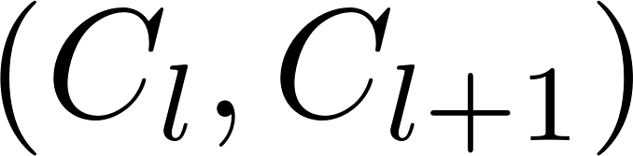
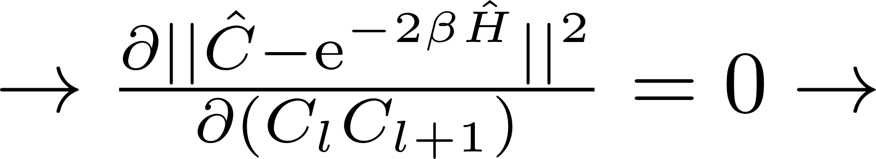
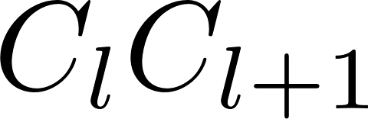
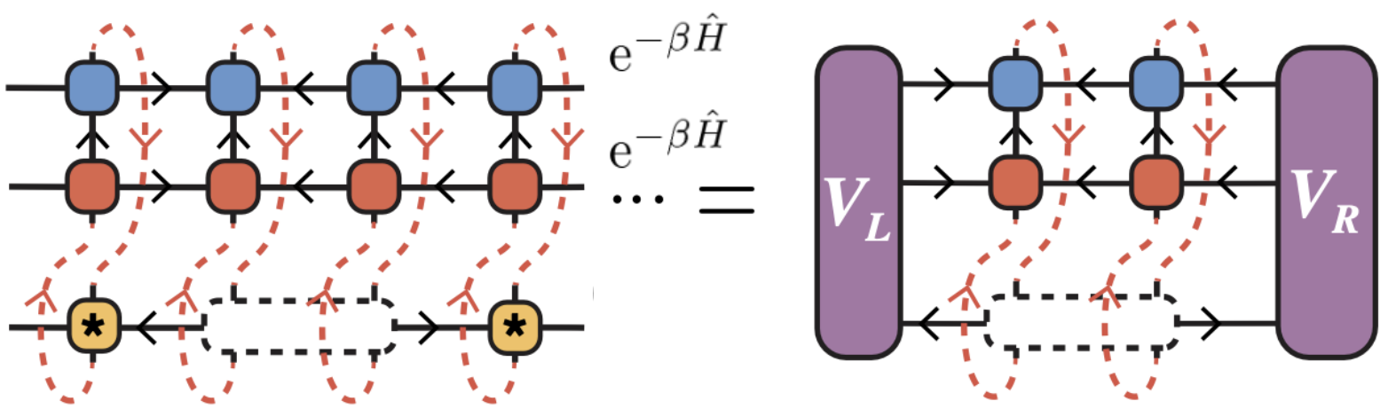
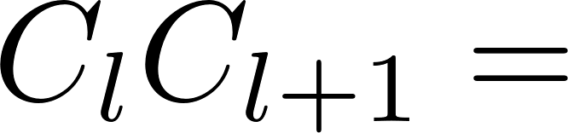
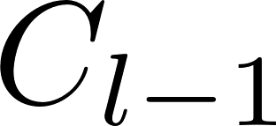
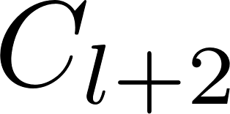


The XTRG update : Approximating the exact square
Solution
We approximate by minimizing
over operators that are represented by MPOs with low
bond dim., i.e., bond dim. of
low bond dim.
We optimize one pair of tensors at a time, as for two-site DMRG
Minimization formula for contraction !
Left and right environments to be computed iteratively
Do appropriate SVD to separate from while keeping MPO site-canonical
Proceed with
Sweep back and forth along the chain until convergence
= open leg

Slide 12
3/4 - IMPLEMENTATION

Slide 13

add_mpo
What does it do?
Adds operators in MPO representation
Why needed?
We use this for linear initialization,

Slide 14

leftcanonicalmpo! (& co.)
What does it do?
Brings an MPO to left-canonical form by treating it as an MPS (with merged physical legs). See next slide. Similarly, we have
and
Why needed?
Canonical forms simplify the minimization equations during XTRG update

Slide 15



Canonicalization of Matrix Product Operators (MPOs)
Canonical forms of MPOs
As for MPSs, MPOs can come in canonical forms [2].
The above MPO is said to be in left-canonical form iff the single-site tensors have the following isometry property:
Similarly, there exist left- and site-canonical forms of MPOs. Like for MPSs, a given MPO can be brought to a canonical form, e.g., by successive QR or SVD decompositions.
Connection with MPSs
MPOs in canonical forms are MPOs s.t. merging physical legs yields MPSs in canonical forms!
[2] Parker, D. E., Cao, X., & Zaletel, M. P. (2020)

Slide 16


square_mpo
What does it do?
Squares an operator in MPO representation
Why needed?
Provides a starting point at each XTRG update
to be later compressed and re-optimized

Slide 17





updateLeftEnv
What does it do?
Slight modification of :
Why needed?
Get environment tensors needed in the update of from the environment tensors previously used to update, e.g., . The tensors will make up the MPO for

Slide 18




normalize_mpo!
What does it do?
Normalizes an operator in MPO representation with its Frobenius norm
Why needed?
Frobenius norm is used in the theoretical background of the XTRG algorithm. We used
to keep track of convergence

Slide 19


trace_mpo
What does it do?
Computes trace of an operator in MPO form
Why needed?
Computation of

Slide 20

XTRG_update
What does it do?
This function combines all previous methods and more. In essence, it takes as input an MPO (for us, in MPO form) and returns its square, truncated and optimized with the XTRG rules

Slide 21


XTRG_algorithm
What does it do?
This function calls XTRG_updat iteratively, and returns data, i.e.,
, sing. values
from all iterations

Slide 22
4/4 – RESULTS FOR THE 1D XY MODEL

Slide 23


1D XY model: analytics
The Hamiltonian
Mapping to spinless fermions
A Jordan-Wigner transformation to a system of spinless fermionic modes yields the isospectral/equivalent fermionic tight-binding Hamiltonian
diagonalize
with single-particle eigenvalues/dispersion relation
Partition function
The partition function factorizes:

Slide 24










Numerical v. analytical partition function
Method and parameters
We ran our XTRG algorithm code for sites, with initial , for up to 23 steps, i.e., up to . We computed the partition function for all ‘s
Technical details
Bond dim. growth cut:
Max bond dim.:
R-L-R sweeps along chain:
Initialization: exact (to be truncated and optimized) or just
Norm error tolerance:
Results
Our values agree with analytics. Our tolerance check was passed up to the 20th step out of 23

Slide 25


Smooth behavior of singular values
Where do we SVD?
Each two-site update yields an optimized value for the contraction , but not the two single tensors. These must be separated after the optimization, using SVD.
Singular values
One (JvD) would expect these singular values to change smoothly as is varied. We checked and this is indeed the case.
Why interesting?
By extrapolating singular values for from those for previous ‘s, one could try to improve the initialization of
at each XTRG update

Slide 26
The low-temperature bottleneck
Question
Given a model, how high ‘s can we reach with the XTRG algorithm?
Tentative answer
‘Low’ bond dimensions should suffice at least as long as is close to identity, i.e.,
Observations
We could push the numerics up to……

Slide 27
Summary and conclusions
We implemented the XTRG algorithm ( ) to compute the partition function of the 1D XY model at various inverse temperatures
The MPO squaring implementation resembles two-site DMRG, with different optimization/update rules
The values of we computed agree with analytics
We stored and plotted against the singular values coming out of two-site tensor SVDs
Main open question: general conditions under which the XTRG algorithm works? Limitations?
Thanks!

Slide 28
Literature References
[1] Chen, B.-B., Chen, L., Chen, Z., Li, W., & Weichselbaum, A. (2018). Exponential Thermal Tensor Network Approach for Quantum Lattice Models. Physical Review X, 8(3), 031082. https://doi.org/10.1103/PhysRevX.8.031082
[2] Parker, D. E., Cao, X., & Zaletel, M. P. (2020). Local matrix product operators: Canonical form, compression, and control theory. Physical Review B, 102(3), 035147. https://doi.org/10.1103/PhysRevB.102.035147

