Slide 1

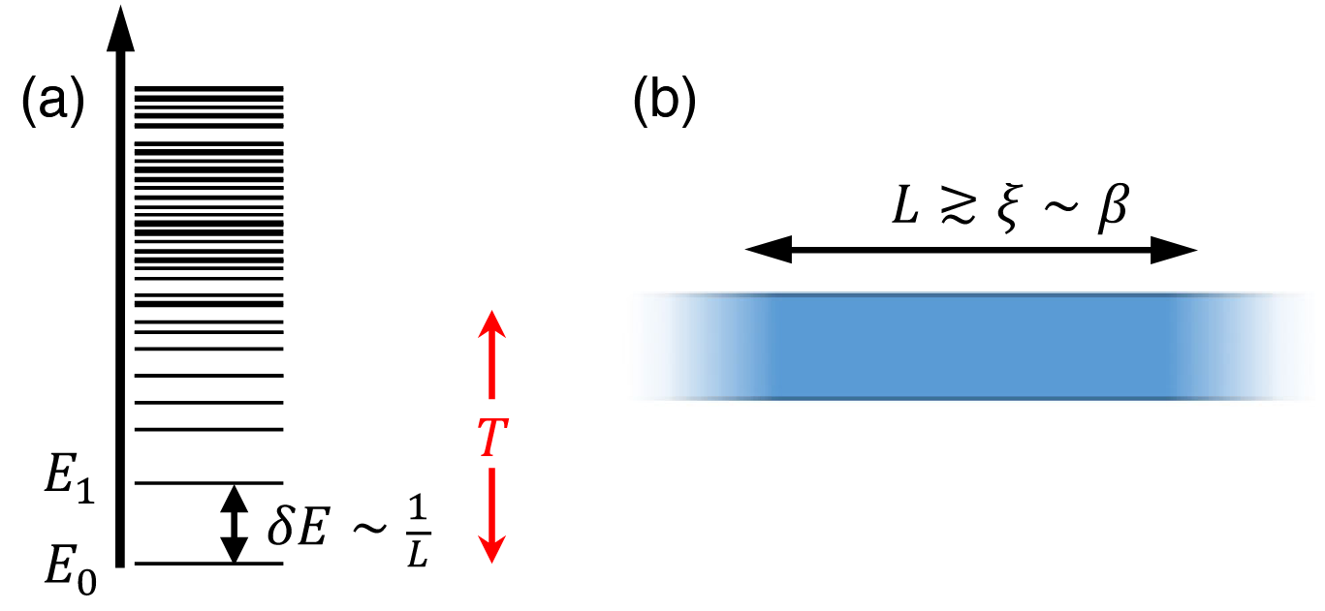
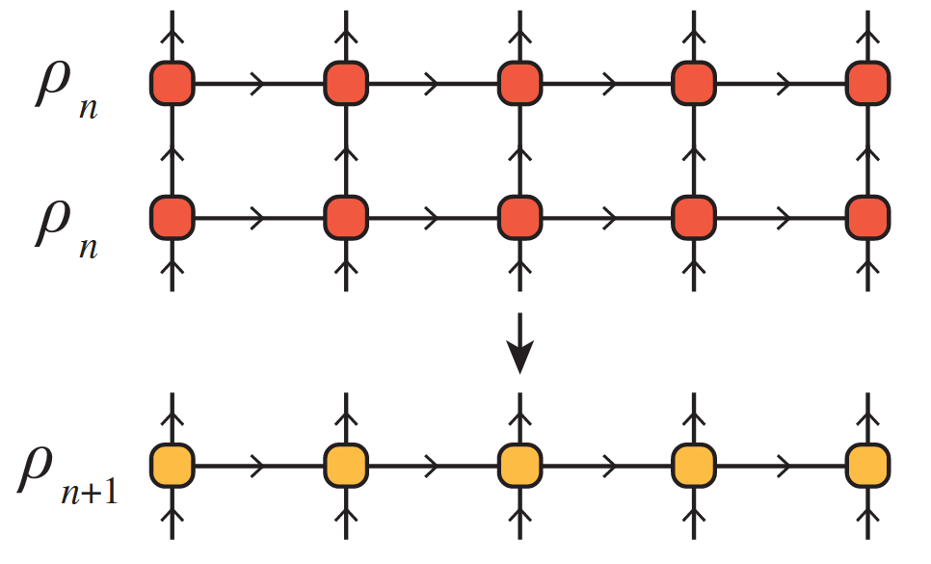
The Thermal Tensor Network Renormalization Group (XTRG)
A Simulation of the XY-Model
PAWLIK Matthias, ALIVERTI Damiano
Tensor Network Course Final Presentation – 23.07.2025

Slide 2
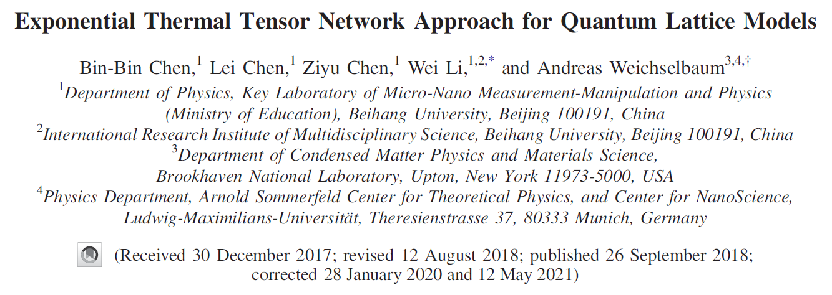
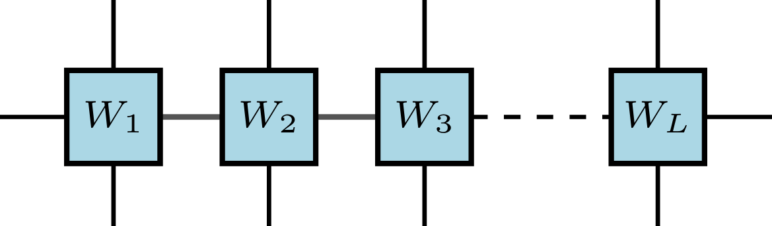
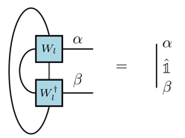
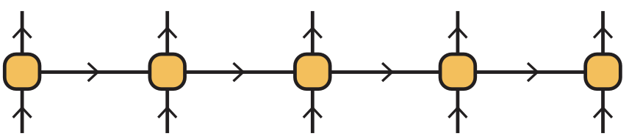
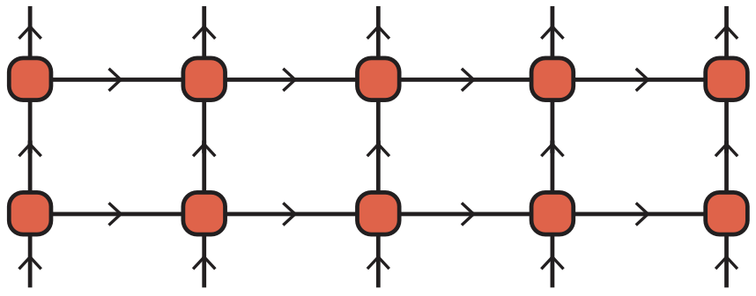
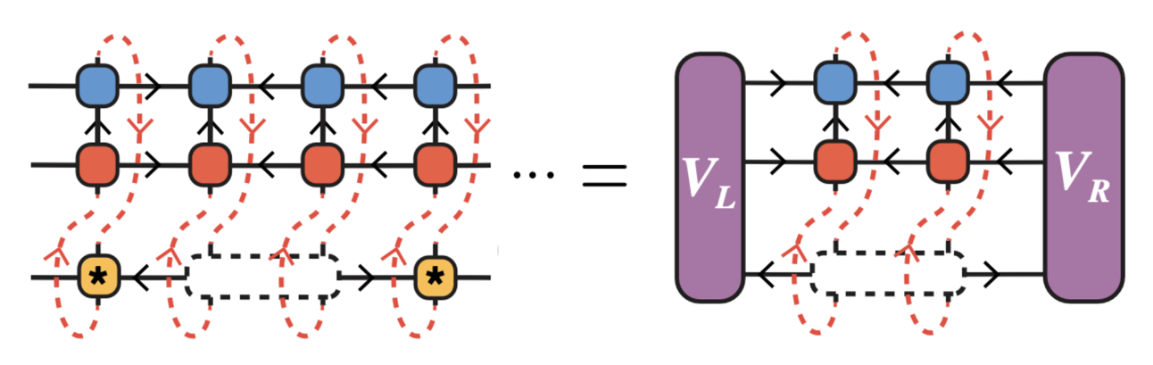
Outline of the Talk
[1]
I. Motivation & Key Ideas of XTRG
III. Implementation of the XTRG Algorithm
trace_mpo
add_mpo
tensor_svd
Tensor manipulations of MPOs
left_canonicalmpo!
square_mpo
normalize_mpo!
Canonicalization of MPOs
DMRG-type sweeping
II. Global Structure of the XTRG Algorithm
XTRG_update
Linear initialization
XTRG_algorithm
Contraction of MPOs
IV. Simulation of the 1D XY-Model
Variational XTRG update
[1] Chen, B.-B., Chen, L., Chen, Z., Li, W., & Weichselbaum, A. (2018)

Slide 3
Motivation & Key Ideas of XTRG
Part I / IV

Slide 4
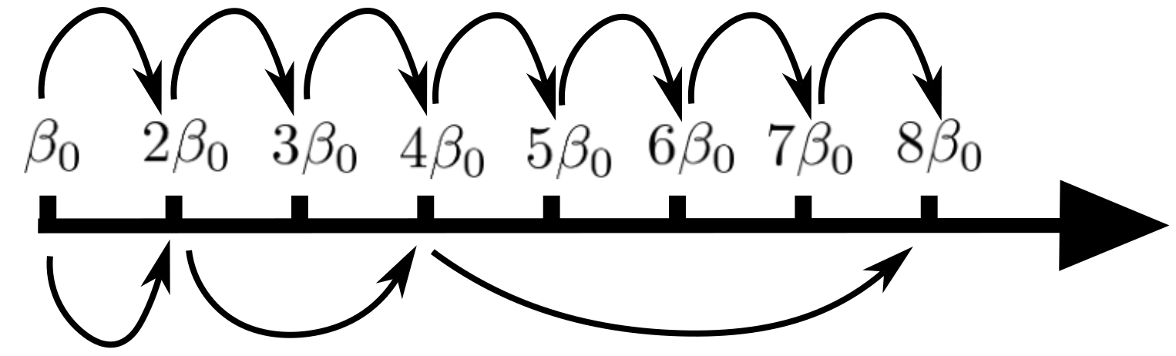
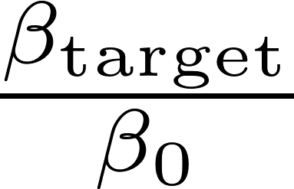
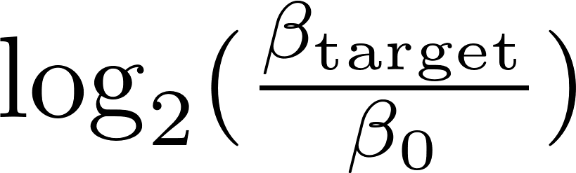

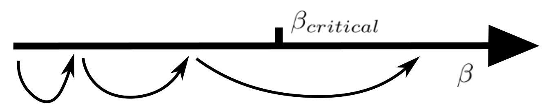
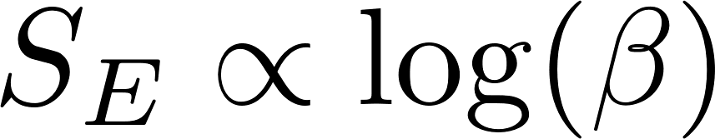
4
Motivation & Key Ideas of XTRG
Motivation & Key Ideas
Exponential reduction of # steps
Imaginary time evolution:
steps
XTRG algorithm:
steps
Avoid critical points
XTRG is in principle able to jump over phase transitions in space, which is where converged computations get costly
Scaling of entanglement
For many 1D models, thermal state entanglement scales as .
It is often expected that changes in entanglement reflect transitions between physical regimes. One should then preferably use a logarithmic scale for .

Slide 5
Global Structure of the XTRG Algorithm
Part II / IV

Slide 6
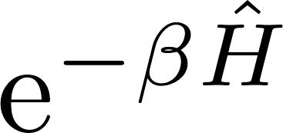

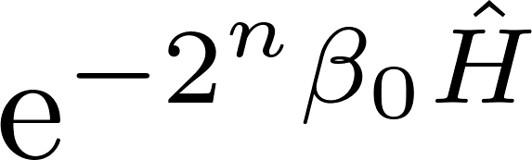
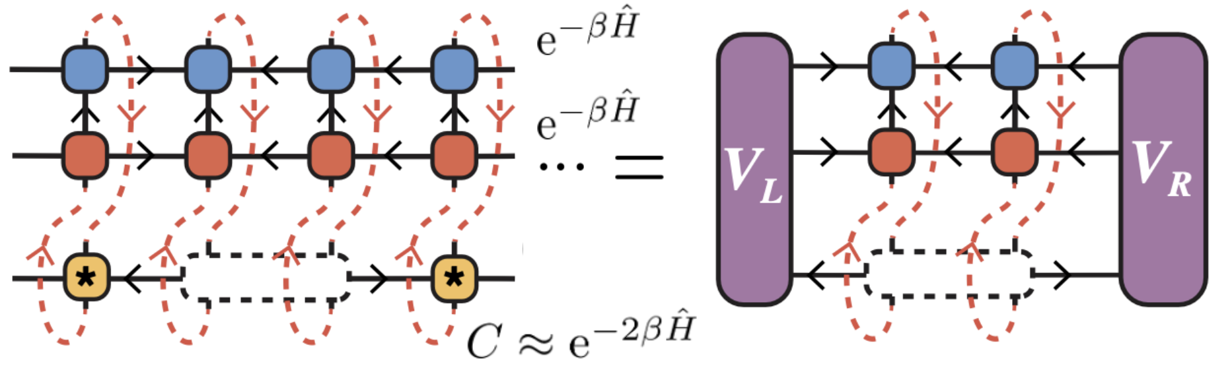
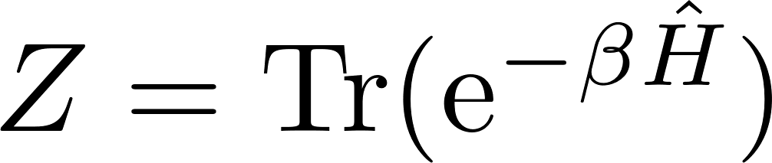
6
Global Structure of the XTRG Algorithm
The XTRG Algorithm
Main idea
Compute unnormalized thermal states of 1D chain Hamiltonians on an exponential temperature scale by iterative self-contraction of the state
Represent as an MPO, compute its square with tensor network techniques, and truncate virtual bond dimension with a variational method
XTRG Algorithm
We will use the method on a 1D XY chain of L = 10 sites,
Model
Goal
Compute the partition function for logarithmically discretized and compare with analytical result

Slide 7
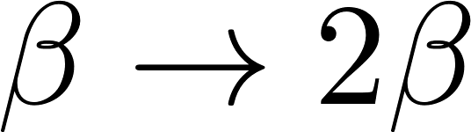

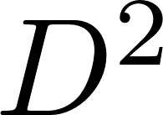
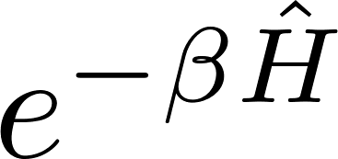
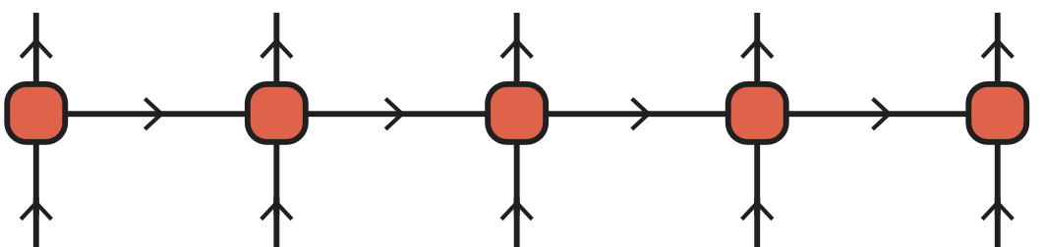
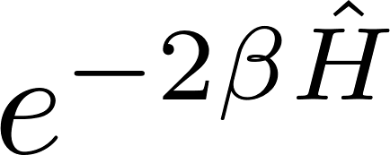



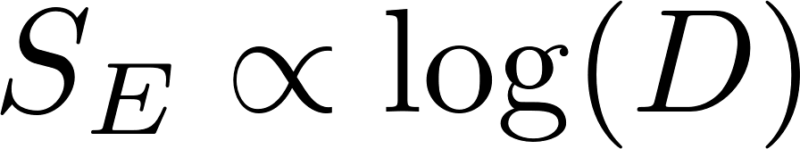

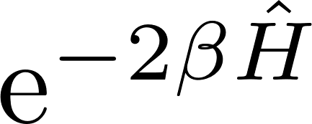

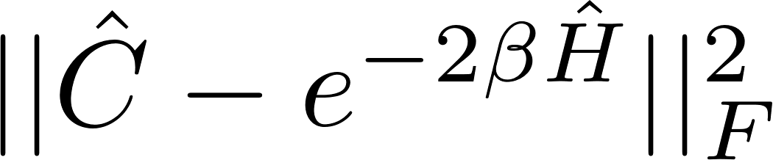
7
Global Structure of the XTRG Algorithm
MPOs and Truncations
MPO representation
Using tensor network representation helps to visualize the applied truncation method. clearer. The thermal state will be represented as an MPO.
Compression by truncation
One XTRG temperature update:
When lowering the temperature, , the bond dimension would increase as exponentially in . But the slow entanglement growth along with suggest truncating bond dimension as .
Truncation and optimization scheme
will be approximated by a low- MPO that minimizes

Slide 8
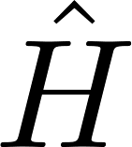

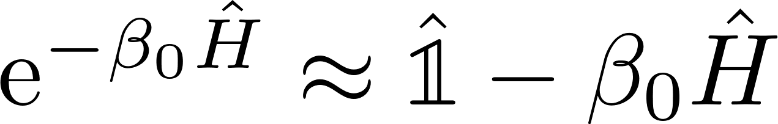
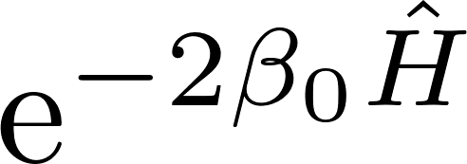
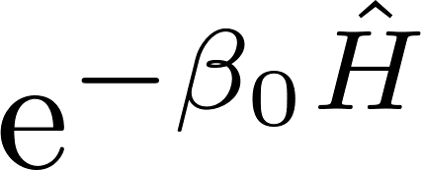
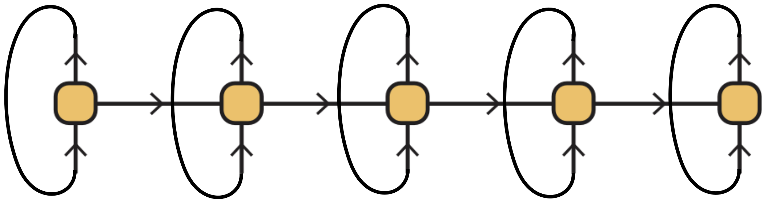
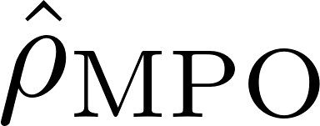
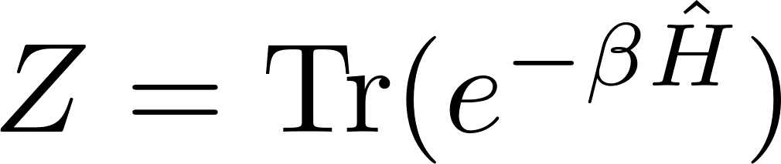

8
Global Structure of the XTRG Algorithm
Algorithm Structure
Goal
Recall: we want to compute the MPO of for many inverse temperatures
1. Hamiltonian: get an MPO representation of the model Hamiltonian
2. Linear high-temperature initialization: choose ‘small’ and approximate
3. XTRG updates : compute and truncate the MPO for by contracting
the MPO for with itself, . Iterate the XTRG update, while storing
as well as any other data of interest (e.g. singular values at the bonds)
Main steps
,
and

Slide 9

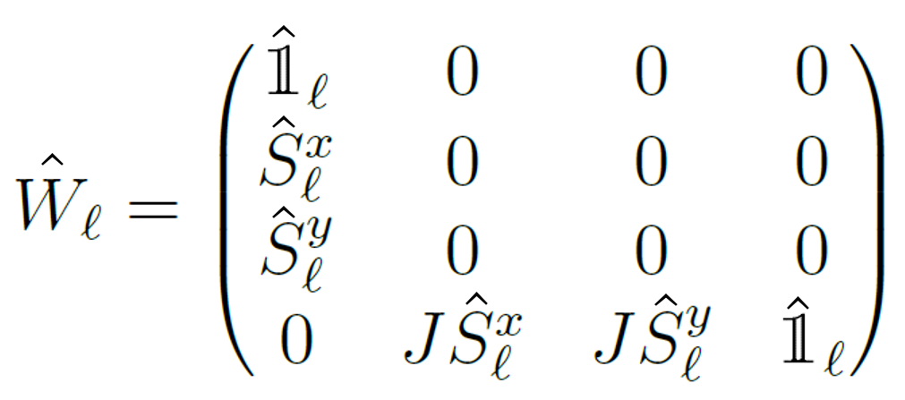
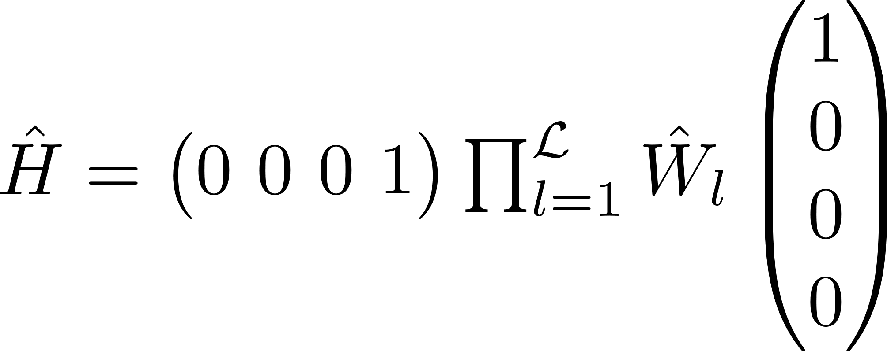
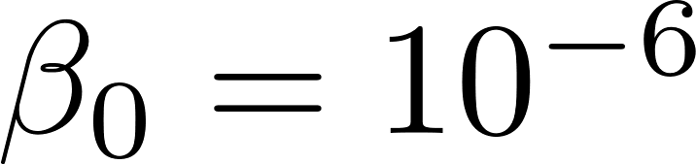
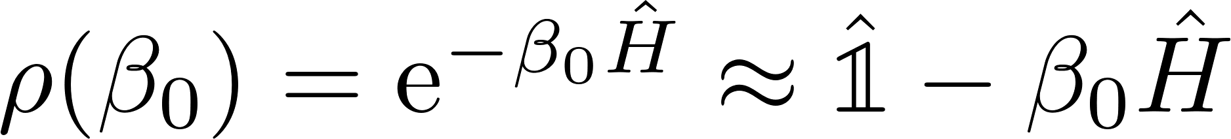

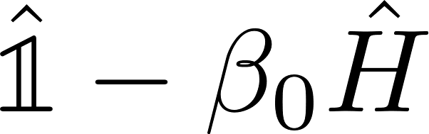

9
Global Structure of the XTRG Algorithm
Hamiltonian and Linear Initialization
XY-Model
MPO representation
with
such that
Linear initialization
We approximate the (unnormalized) thermal state at high temperature, , as
Using the fact that and can be represented by MPOs with bond dimension 4 and 1, respectively, we represent as an MPO with bond dimension

Slide 10
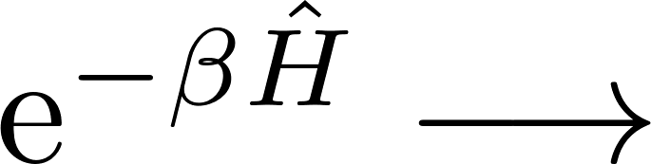

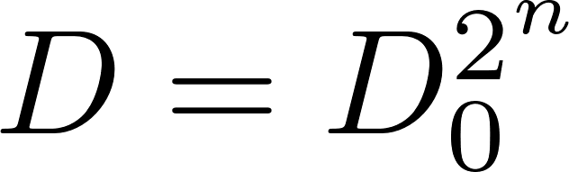
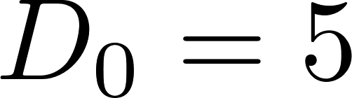

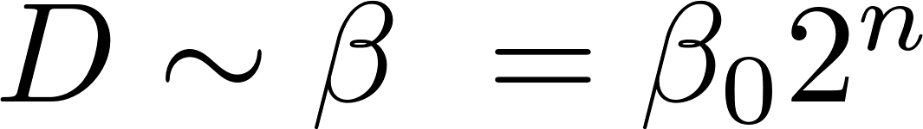

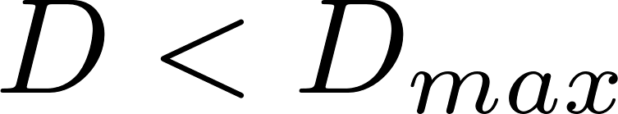
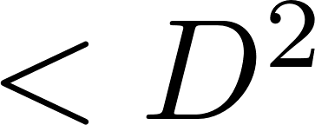
10
Global Structure of the XTRG Algorithm
The XTRG Update
Input data
MPO for
Goal
Get MPO for , obtained as an approximation of the MPO for the exact square
Efficiency condition
If we keep the exact square MPO the bond dimension grows as , with for the XY-Model and # updates. But should be enough!
In practice, we allow for exponential growth, , with a threshold,
Main problem
How to approximate with an MPO of bond dimension ?

Slide 11

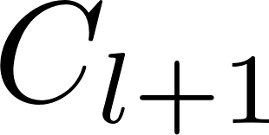
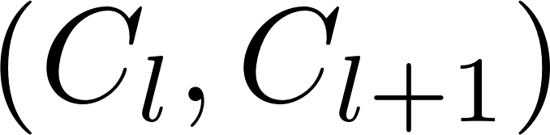
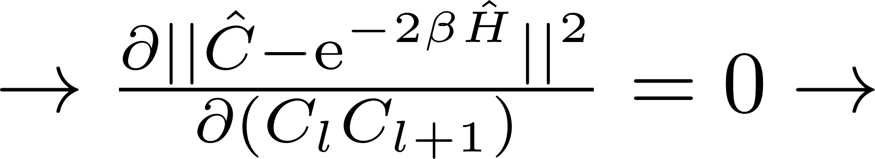
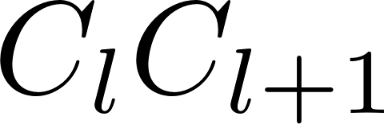

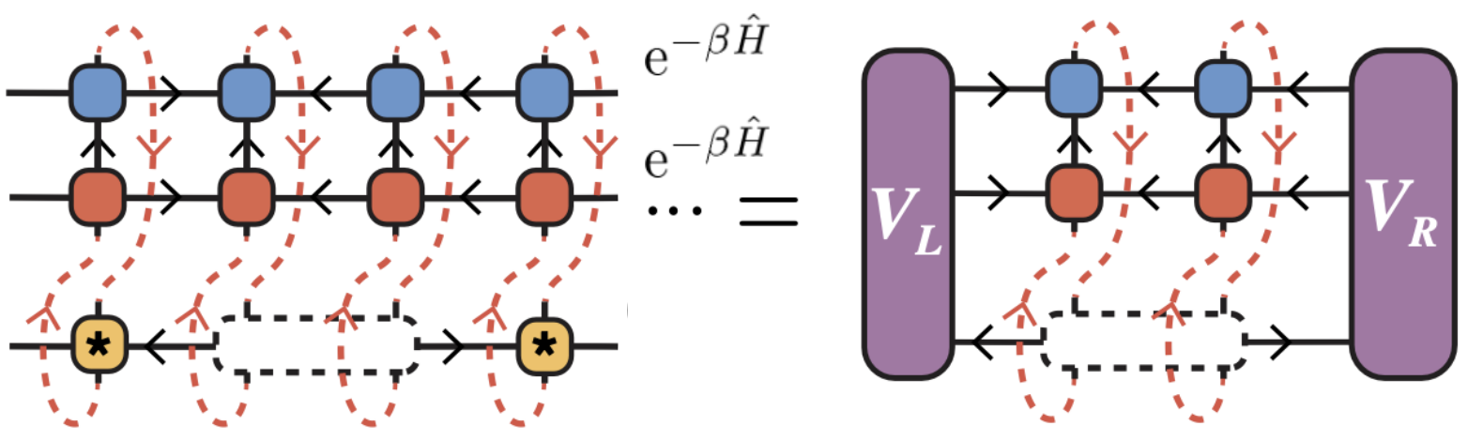
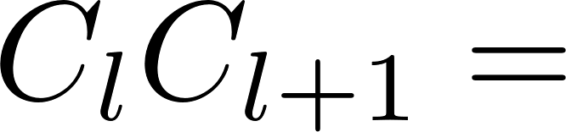
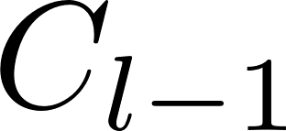



11
Global Structure of the XTRG Algorithm
The Variational Two-Site Update
scaling factor
bond dimension
We approximate by minimizing
over operators with appropriately enlarged bond dimension
Ansatz
We optimize one pair of tensors at a time, as for two-site DMRG
Minimization formula for update of the contraction !
Left and right environments need to be computed iteratively
Do an SVD to separate from while keeping MPO site-canonical
Proceed with sites
Sweep back and forth along the chain until convergence
= open leg

Slide 12
Implementation of the XTRG Algorithm
Part III / IV

Slide 13


13
Implementation of the XTRG Algorithm
Canonicalization of Matrix Product Operators (MPOs)
[2]
As for MPSs, MPOs can be brought into canonical forms
Canonical forms of MPOs
The above MPO is said to be in left-canonical form iff the single-site tensors have the following isometry property:
Similarly, there exist left- and site-canonical forms of MPOs. Like for MPSs, a given MPO can be transformed into a canonical form, e.g., by successive QR or SVD decompositions.
Connection with MPSs
MPOs in canonical form are structured such that merging physical legs yields canonical MPS!
[2] Parker, D. E., Cao, X., & Zaletel, M. P. (2020)

Slide 14




14
Implementation of the XTRG Algorithm
leftcanonicalmpo!
Brings an MPO into left-canonical form by treating it as an MPS (with merged physical legs).
Similarly, one could define the update reversely using
For completeness we also implemented
What does it do?
Why needed?
Canonical forms simplify the minimization equations during the XTRG update

Slide 15


15
Implementation of the XTRG Algorithm
add_mpo
What does it do?
Adds two operators in MPO representation
Why needed?
We use this for linear initialization,

Slide 16



16
Implementation of the XTRG Algorithm
square_mpo
What does it do?
Squares an operator in MPO representation
Provides an initial guess at each XTRG update to start the compression through variational optimization
Why needed?

Slide 17





17
Implementation of the XTRG Algorithm
updateLeftEnv
What does it do?
Slight modification of
Why needed?
Get environment tensors needed in the update of . All left environments are computed in the beginning of the optimization process, and are then iteratively updated by performing one
contraction before the update of the next two sites.

Slide 18





18
Implementation of the XTRG Algorithm
normalize_mpo!
What does it do?
Normalizes an operator in MPO representation with respect to the Frobenius norm
Why needed?
We want to keep track of the convergence of the variational two-site update which minimizes

Slide 19




19
Implementation of the XTRG Algorithm
trace_mpo
What does it do?
Computes the trace of an operator in MPO form
Why needed?
Computation of the partition function
Checked the functionality of all methods with unit tests!

Slide 20


20
Implementation of the XTRG Algorithm
XTRG_update
What does it do?
This function combines all previous methods in a DMRG-type variational two-site update method
In essence, it takes an input MPO
and returns its square, truncated and optimized after several sweeps.
XTRG_algorithm
What does it do?
This function iteratively calls and returns tuples ( ), as well as the singular values on the bonds.

Slide 21



Compute partition function
Increase bond dimension
Initialize and canonicalize MPO
Check convergence
Prepare environments for sweeping
Left-to-right sweeping (back direction analogously)

Slide 22
Simulation of the 1D XY-Model
Part IV / IV

Slide 23


23
Simulation of the 1D XY-Model
1D XY-Model: Analytics
The Hamiltonian
Mapping to spinless fermions
A Jordan-Wigner transformation to a system of spinless fermionic modes yields the isospectral/equivalent fermionic tight-binding Hamiltonian
diagonalize
with single-particle eigenvalues/dispersion relation
Partition function
The partition function factorizes:

Slide 24










24
Simulation of the 1D XY-Model
Numerical versus analytical partition function
Method and parameters
We ran our XTRG algorithm code for sites, with initial , for up to 23 steps, i.e., up to . We computed the partition function for all ‘s
Technical details
Bond dim. growth cut:
Max bond dim.:
R-L-R sweeps along chain:
Initialization: exact (to be truncated and optimized) or just
Norm error tolerance:
Results
Our values agree with analytics. Our tolerance check was passed up to the 20th step out of 23

Slide 25


25
Simulation of the 1D XY-Model
Smooth Behavior of Singular Values
Where do we SVD?
Each two-site update yields an optimized value for the contraction , but not the two single tensors. These must be separated after the optimization, using SVD.
Singular values
One (JvD) would expect these singular values to change smoothly as is varied. We checked and this is indeed the case.
Why interesting?
By extrapolating singular values for from those for previous ‘s, one could try to improve the initialization of
at each XTRG update

Slide 26
26
Simulation of the 1D XY-Model
The Low-Temperature Bottleneck
Question
Given a model, how high ‘s can we reach with the XTRG algorithm?
Tentative answer
‘Low’ bond dimensions should suffice at least as long as is close to identity, i.e.,
Observations
We could push the numerics up to…… compare square == true faster for steps 21,22?
Order of runtime for 22/23 steps = 10min
Check if normalization was correctly added, check power thing
Save the plot data / track the time stamps

Slide 27
27
Summary and conclusions
We implemented the XTRG algorithm ( ) to compute the partition function of the 1D XY model at various inverse temperatures
The MPO squaring implementation resembles two-site DMRG, with different optimization/update rules
The values of we computed agree with analytics
We stored and plotted against the singular values coming out of two-site tensor SVDs
Main open question: general conditions under which the XTRG algorithm works? Limitations?
Thanks!

Slide 28
TODO
Add animations i.e. split slides into layers
Check dispersion relation epsilon_k,arent we using the one for periodic B.C.??? …no big deal, theyre almost same, but good to make sure and in case fix function epsilon_k in jupyter notebook
Last slide of part 4: complete with rough observed boundaries of numerics (tweak a bit parameters in the code; remove expensive frobenius norm tolerance check and just use agreement with analytical Z as a very rough check on how off we are relative to exact rho?), note on complex and tests

Slide 29
29
Literature References
[1] Chen, B.-B., Chen, L., Chen, Z., Li, W., & Weichselbaum, A. (2018). Exponential Thermal Tensor Network Approach for Quantum Lattice Models. Physical Review X, 8(3), 031082. https://doi.org/10.1103/PhysRevX.8.031082
[2] Parker, D. E., Cao, X., & Zaletel, M. P. (2020). Local matrix product operators: Canonical form, compression, and control theory. Physical Review B, 102(3), 035147. https://doi.org/10.1103/PhysRevB.102.035147

