Slide 1

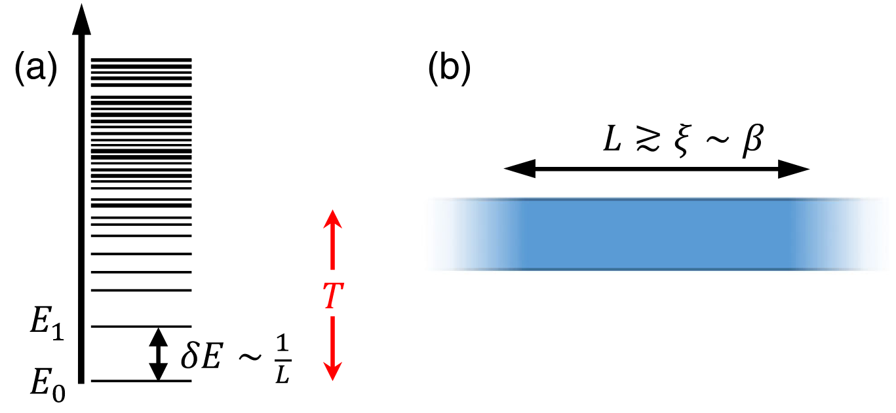
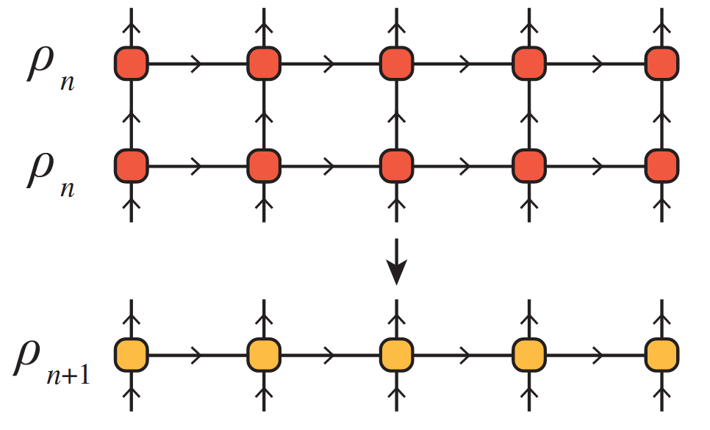
The Thermal Tensor Network Renormalization Group (XTRG)
A Simulation of the XY-Model
PAWLIK Matthias, ALIVERTI Damiano
Tensor Network Course Final Presentation – 23.07.2025

Slide 2
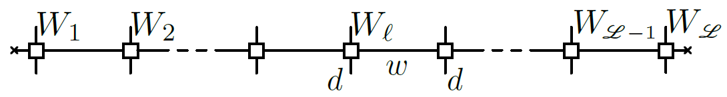
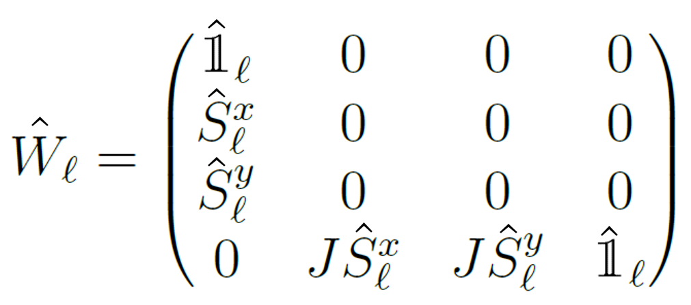
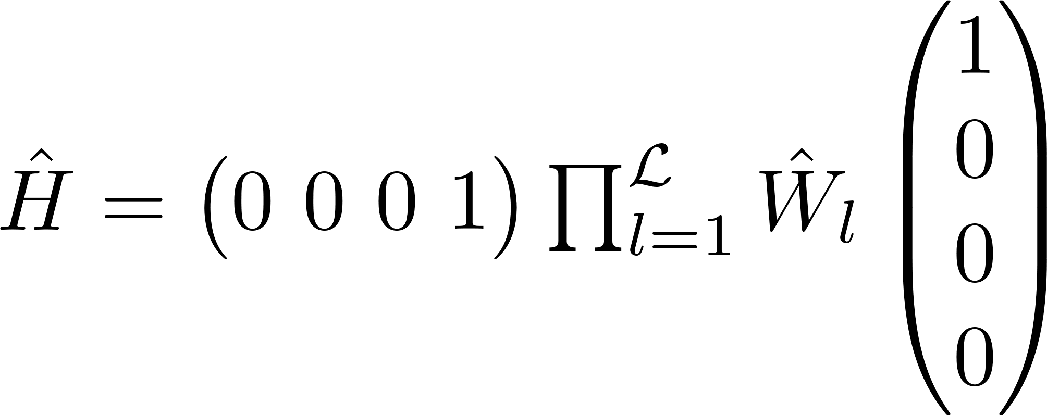
01
Linear High-Temperature Initialization
XY-Model
MPO Representation
with
such that

