Slide 1

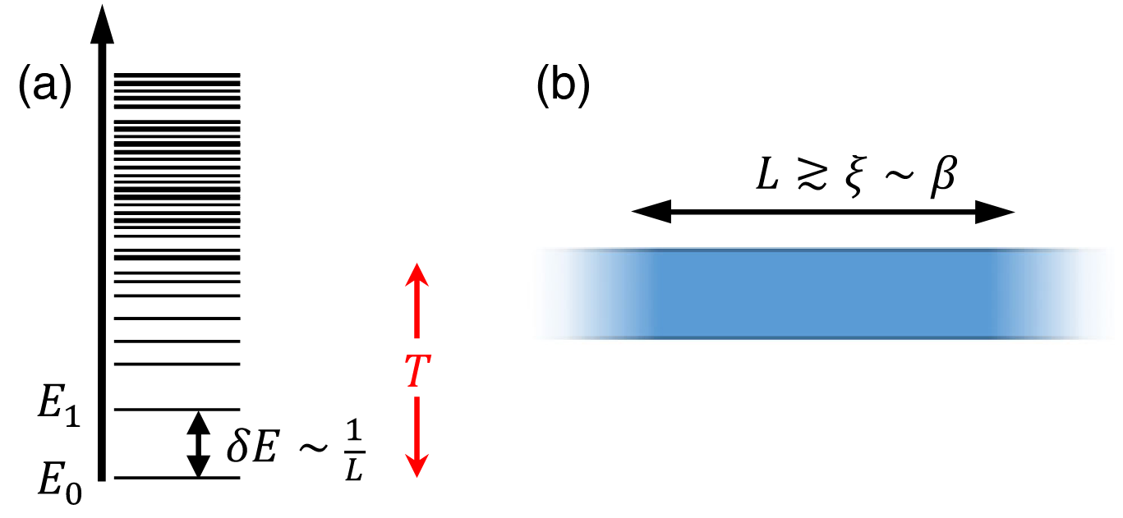
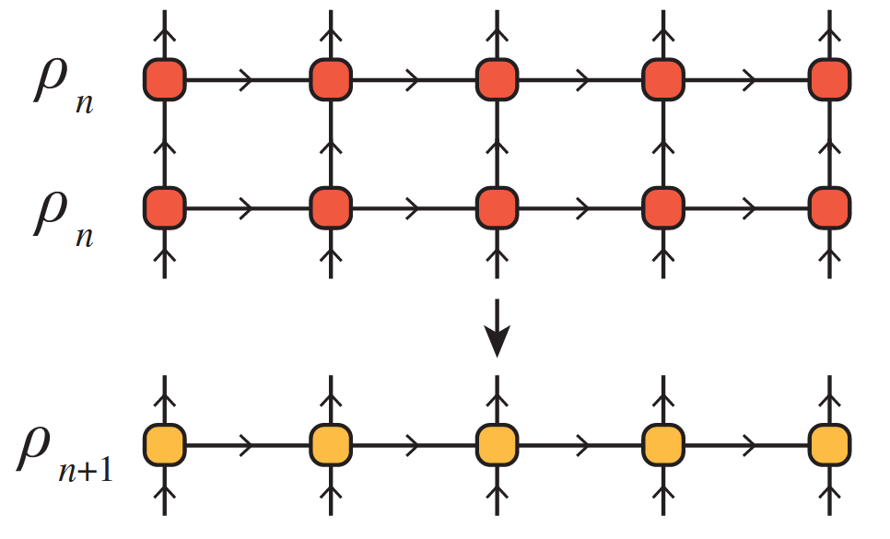
The Thermal Tensor Network Renormalization Group (XTRG)
A Simulation of the XY-Model
PAWLIK Matthias, ALIVERTI Damiano
Tensor Network Course Final Presentation – 23.07.2025

Slide 2
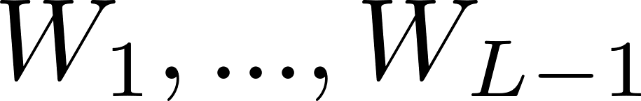
01
Canonicalization of Matrix Product Operators (MPOs)
Canonical forms of MPOs
As for MPSs, MPOs can come in canonical forms [2].
The above MPO is said to be in left-canonical form iff the single-site tensors have the following isometry property:
Similarly, there exist left- and site-canonical forms of MPOs. Like for MPSs, a given MPO can be brought to a canonical form, e.g., by successive QR or SVD decompositions.
Connection with MPSs
MPOs in canonical forms are MPOs s.t. merging physical legs yields MPSs in canonical forms!
[2] Parker, D. E., Cao, X., & Zaletel, M. P. (2020)

Slide 3
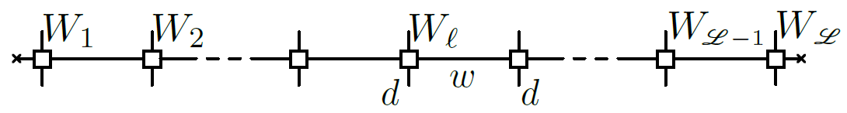
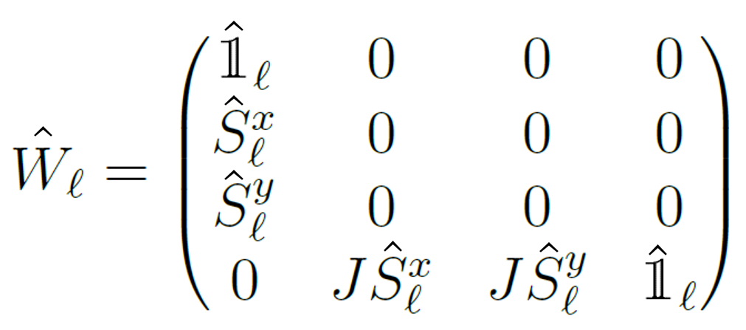
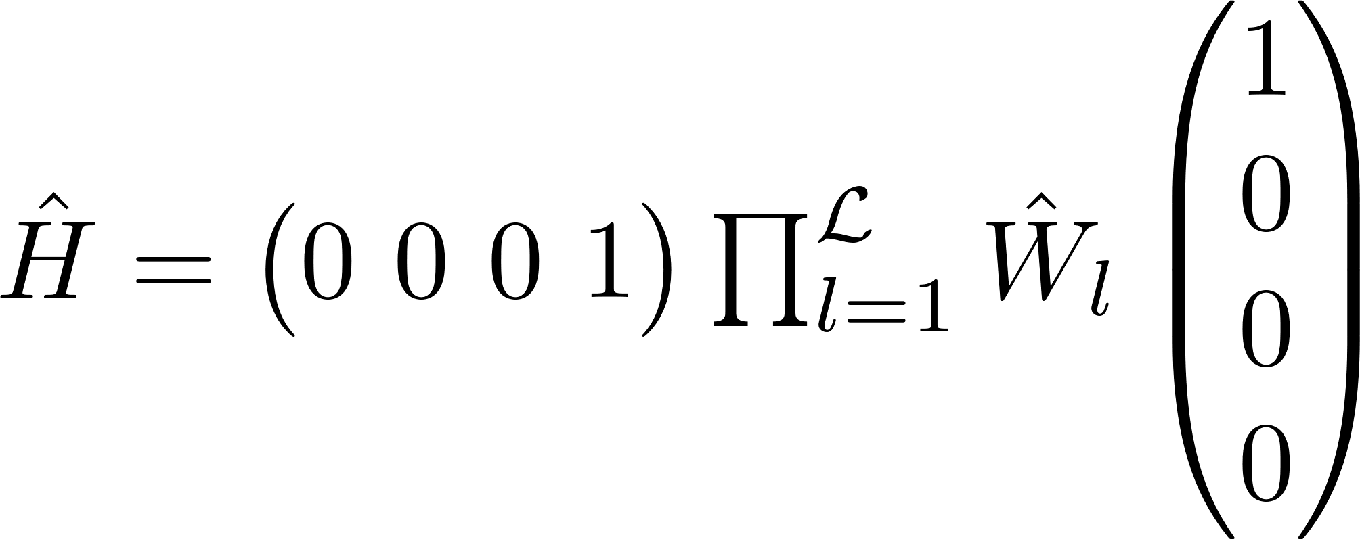
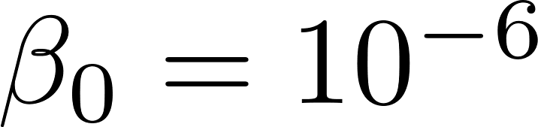
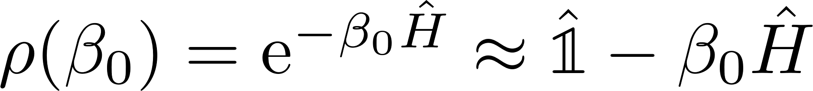
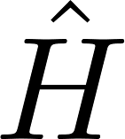

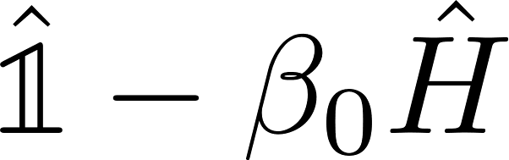
02
Linear High-Temperature Initialization
XY-Model
MPO Representation
with
such that
We linearly approximate the (unnormalized) thermal state at high temperature, , as
Using the fact that and can be represented by MPOs with bond dimension 4 and 1, respectively, we represent with an MPO with bond dimension 5

Slide 4
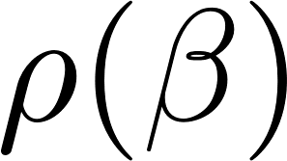
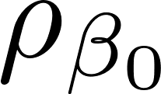
03
Halving temperature by squaring the state
Main idea
Suppose we have computed the thermal state . Then we can compute the thermal state with double inverse temperature as
XTRG algorithm
We start from the high-temperature state , and iteratively halve the temperature. We do the square using the MPO representation of the thermal states. Squaring MPOs implies squaring their bond dimension, too. This calls for a truncation scheme.

Slide 5
Literature References
[1] Chen, B.-B., Chen, L., Chen, Z., Li, W., & Weichselbaum, A. (2018). Exponential Thermal Tensor Network Approach for Quantum Lattice Models. Physical Review X, 8(3), 031082. https://doi.org/10.1103/PhysRevX.8.031082
[2] Parker, D. E., Cao, X., & Zaletel, M. P. (2020). Local matrix product operators: Canonical form, compression, and control theory. Physical Review B, 102(3), 035147. https://doi.org/10.1103/PhysRevB.102.035147

