Slide 1

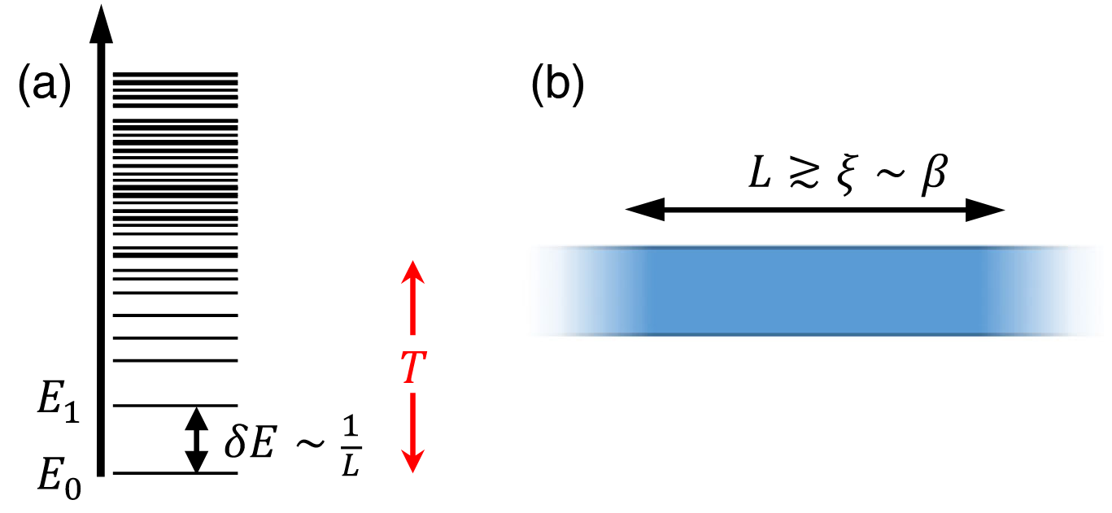
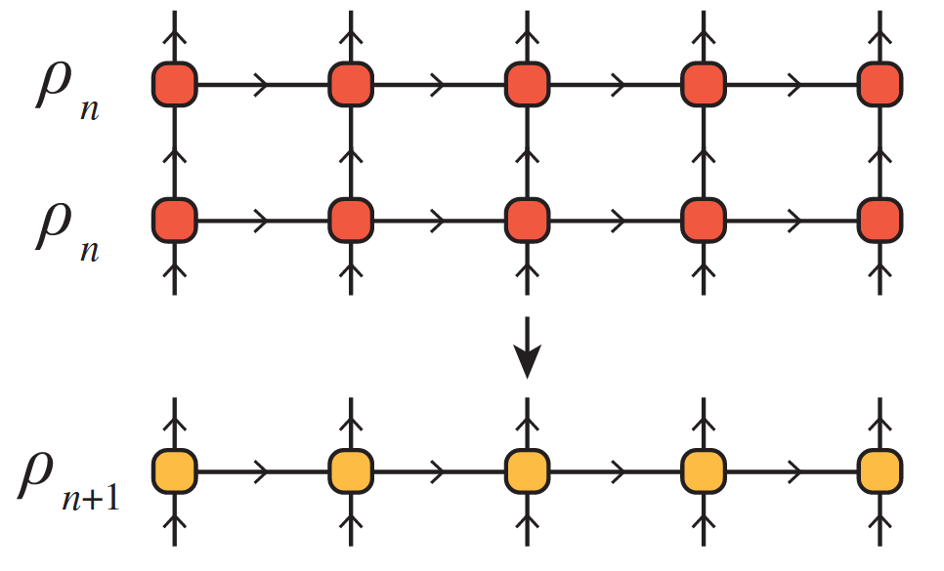
The Thermal Tensor Network Renormalization Group (XTRG)
A Simulation of the XY-Model
PAWLIK Matthias, ALIVERTI Damiano
Tensor Network Course Final Presentation – 23.07.2025

Slide 2
TODO
Can add in line on entanglement how one represents mpos as mpss to get a notion of entanlgemnt
Double check slide numbering
Add animations i.e. split slides into layers

Slide 3
1/5 - INTRODUCTION

Slide 4
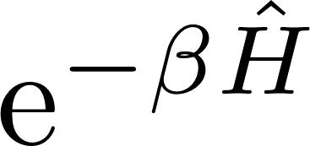


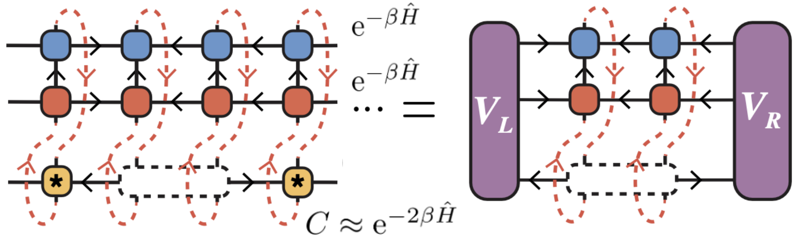
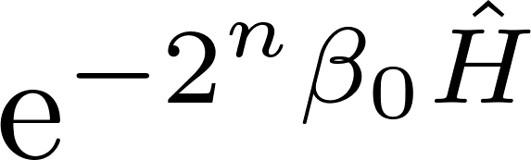
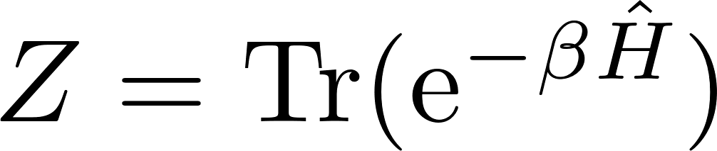
The XTRG algorithm
Main idea
Compute non-normalized thermal states of 1D chain Hamiltonians at different inverse temperatures by iteratively doubling :
XTRG algorithm
Represent with an MPO, compute its square with tensor network techniques, and truncate virtual bond dimension with a variational method [1]
Model
We will use the method on a 1D XY chain of L = 10 sites,
Our goal
Compute the partition function for logarithmically discretized and compare with analytical result
[1] Chen, B.-B., Chen, L., Chen, Z., Li, W., & Weichselbaum, A. (2018)

Slide 5
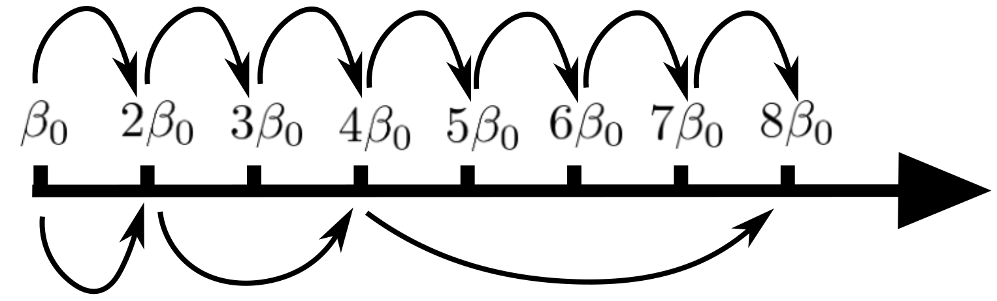
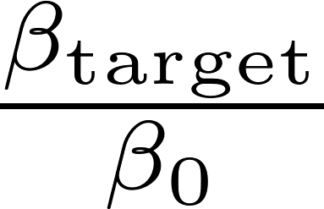
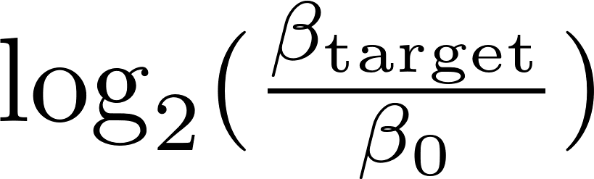
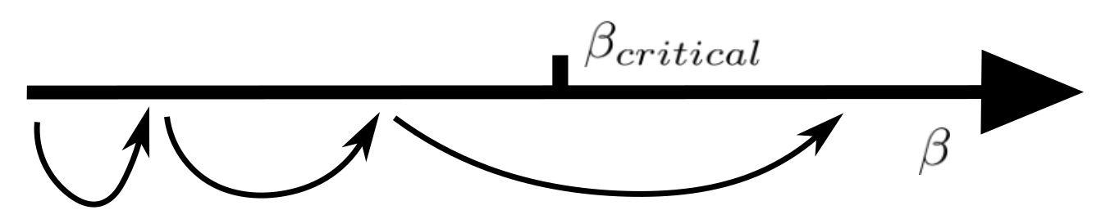
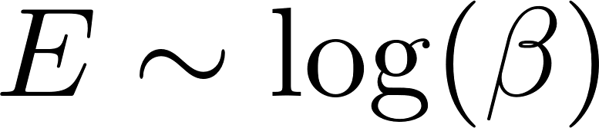
Motivation
Exponential reduction of # steps
Imaginary time evolution:
steps
XTRG algorithm:
steps
Avoid critical points
XTRG is in principle able to jump over phase transitions in space, which is where converged computations get costly
Scaling of entanglement
For many 1D models, thermal state entanglement scales as . . Often, one expects the change in entanglement to describe the change in physical regimes in a linear fashion. Then one should use a logarithmic scale for

Slide 6
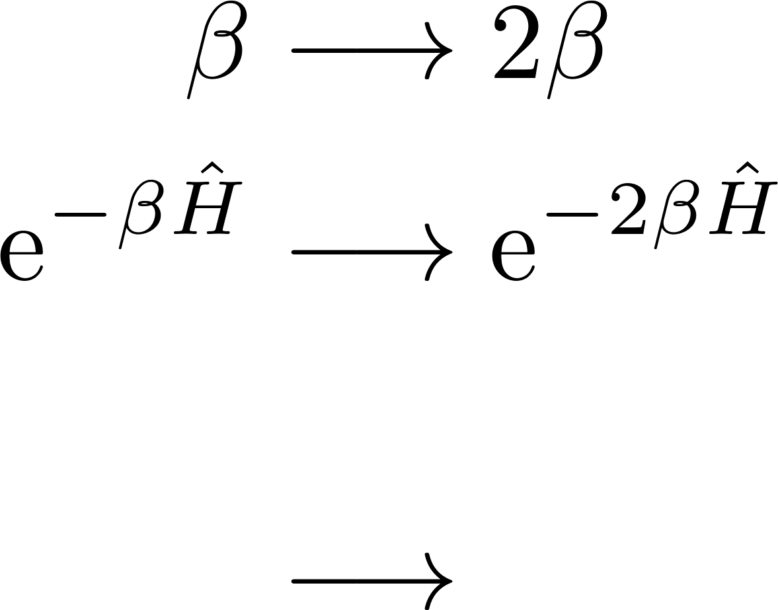
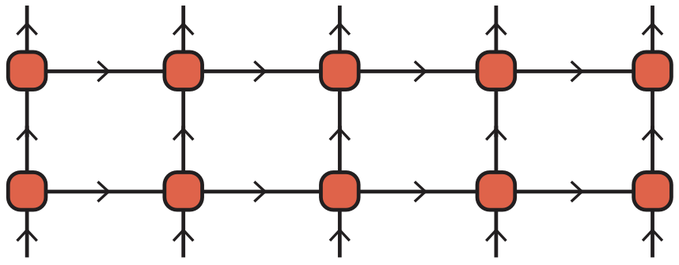

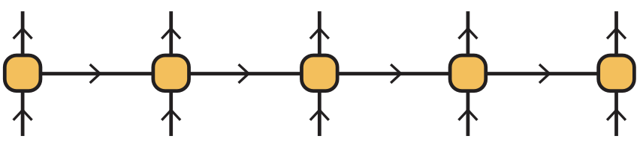
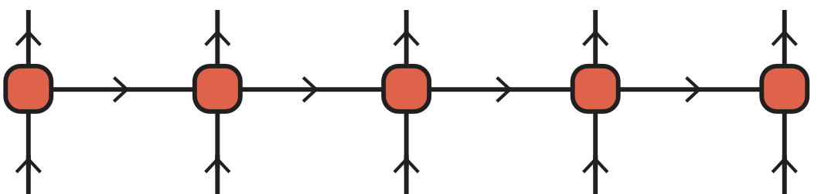
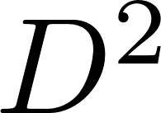


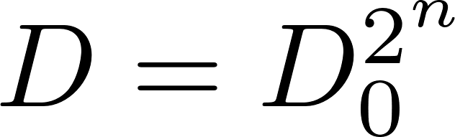
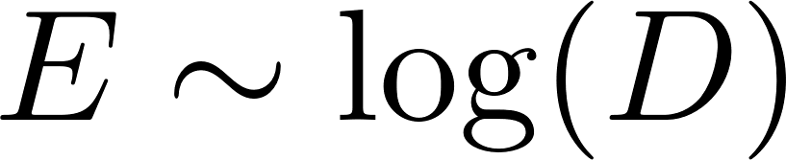

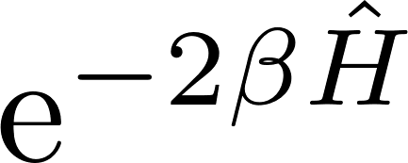


MPOs and truncations
MPO representation
Using tensor network schemes makes the necessary truncation methods clearer. The thermal state will be represented as an MPO.
Why and what to truncate
One XTRG temperature update:
As grow in the XTRG algorithm, , the bond dim. would increase as , exponential in . But the slow entanglement growth along with suggest truncating bond dim. as .
Truncation and optimization scheme
will be approximated by a lower- MPO that minimizes

Slide 7
2/5 – ALGORITHM

Slide 8
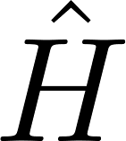

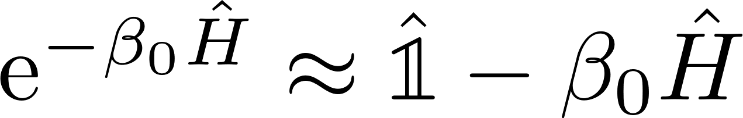
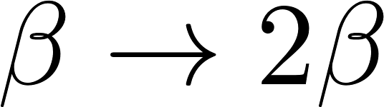
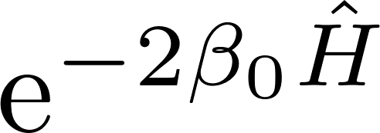
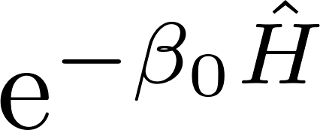
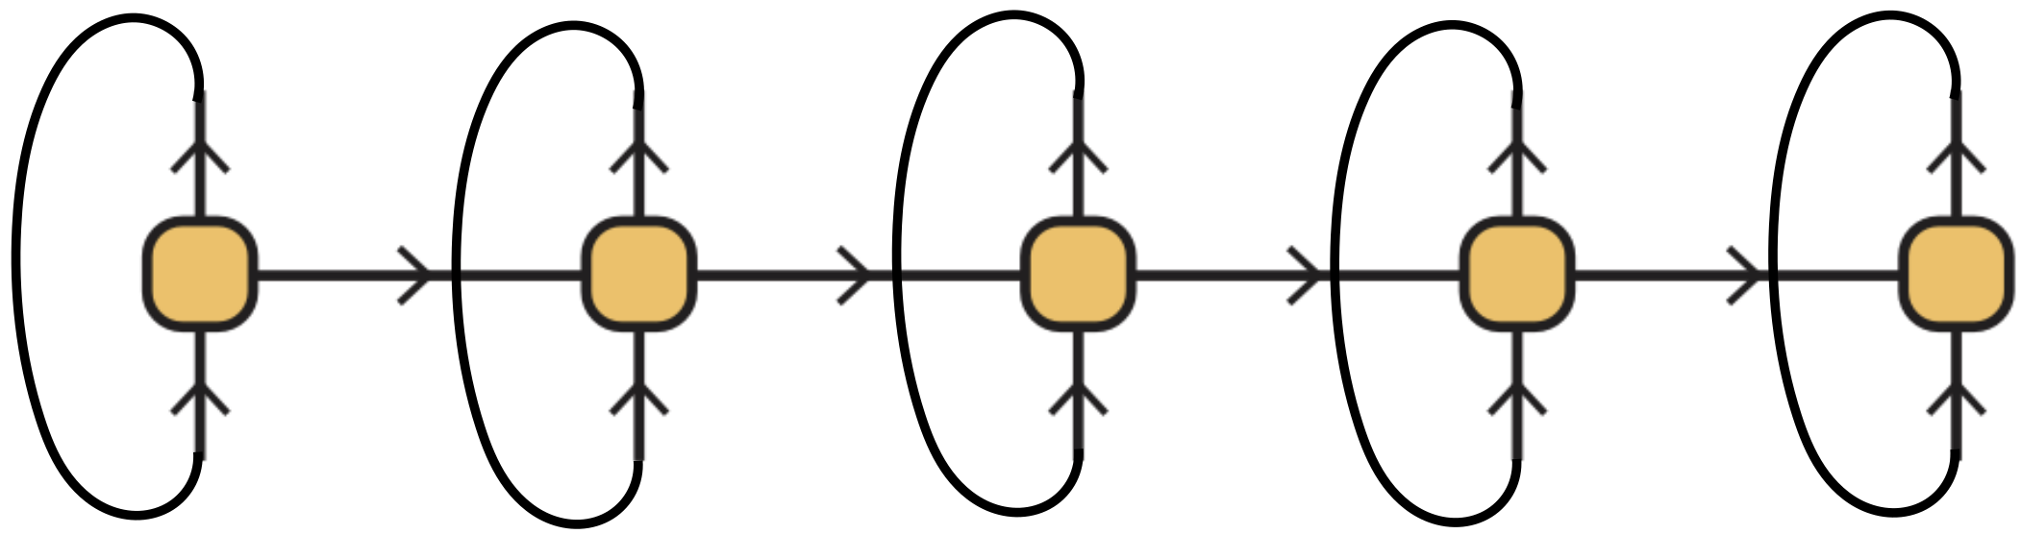
Algorithm structure
Goal
Recall: we want to compute MPO for for many inverse temperatures
Main steps
1) Hamiltonian: get MPO representation of the under consideration
2) Linear high-temperature initialization: choose ‘small’ and approximate
3) XTRG updates, : compute and truncate the MPO for by contracting
the MPO for with itself, . Reiterate at will, while storing values of
as well as any other data of interest.

Slide 9
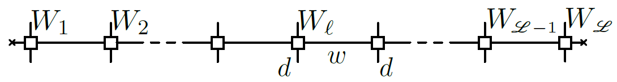
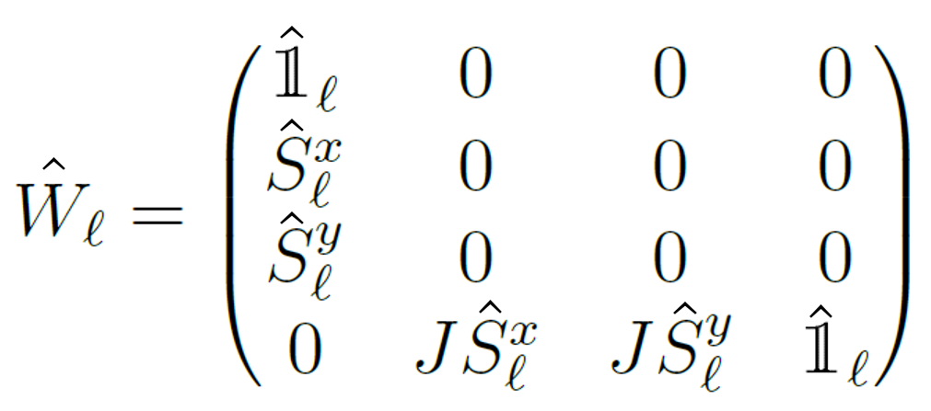
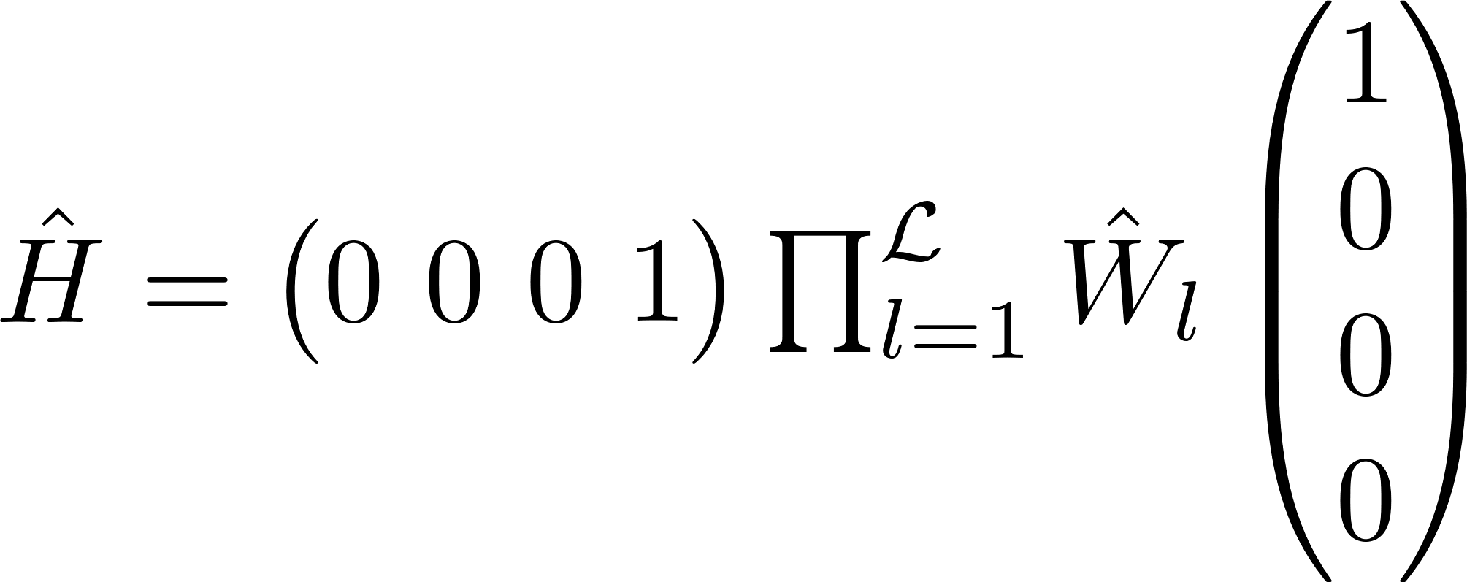
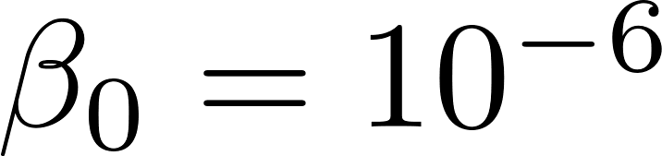
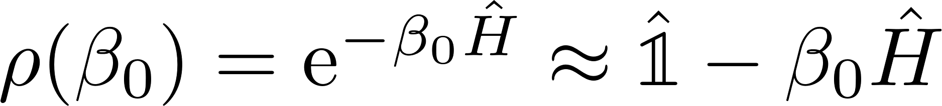

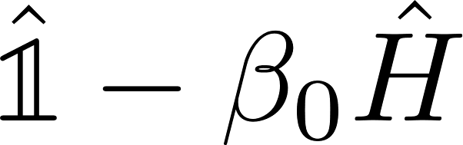
Hamiltonian and initialization
XY-Model
MPO Representation
with
such that
Linear initialization
We approximate the (unnormalized) thermal state at high temperature, , as
Using the fact that and can be represented by MPOs with bond dimension 4 and 1, respectively, we represent with an MPO with bond dimension 5

Slide 10
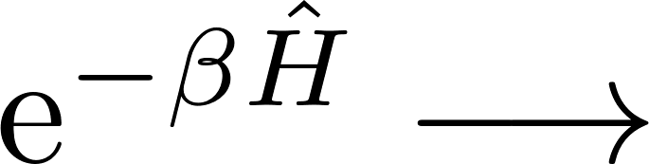

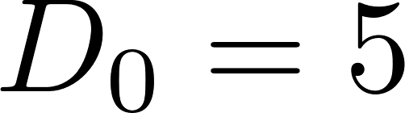

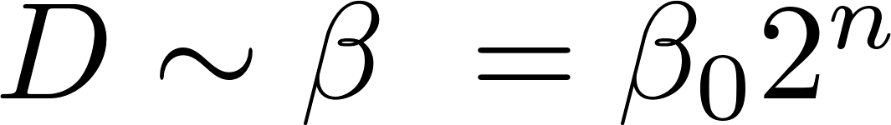
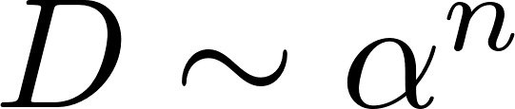
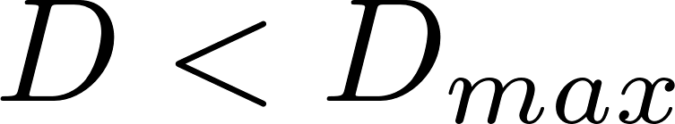
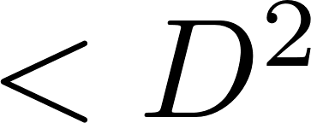
The XTRG update
Initial data
MPO for
Goal
Get MPO for , obtained as an approximation of the MPO for the exact square
Efficiency condition
If we keep the exact square MPO the bond dim. grows as , with for the XY model and # updates. But should be enough!
In practice, we allow for exponential growth, , with a threshold,
Main problem
How to approximate with an MPO with bond dim. ?

Slide 11


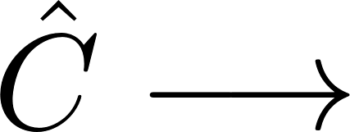
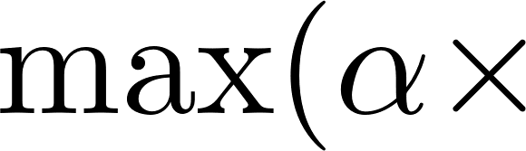
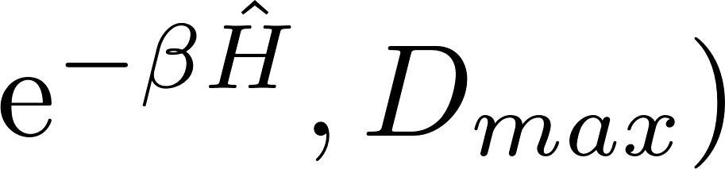

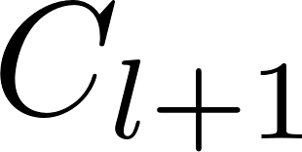
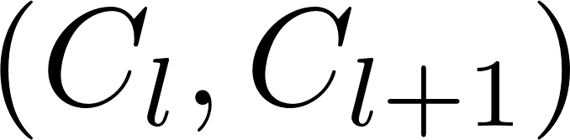
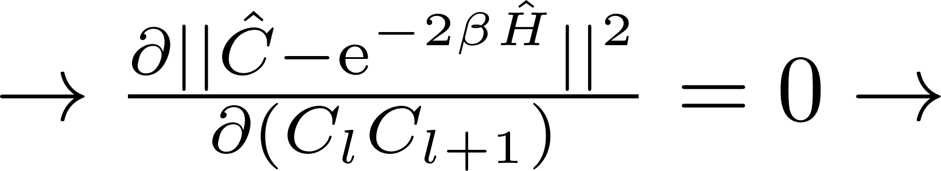
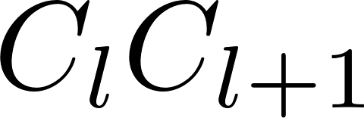
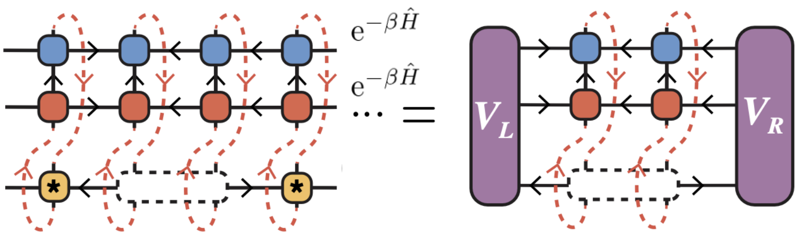
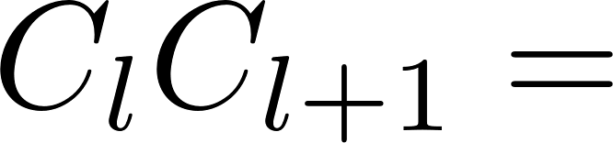
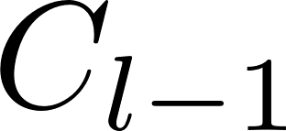
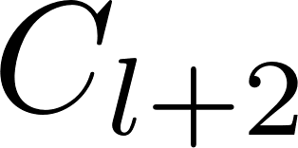
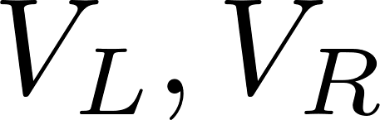
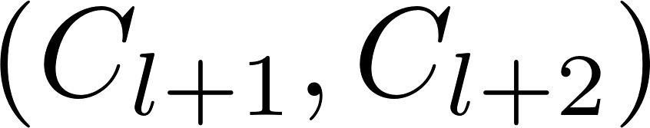
The XTRG update : Approximating the exact square
Solution
We approximate by minimizing
over operators that are represented by MPOs with low
bond dim., i.e., bond dim. of
low bond dim.
We optimize one pair of tensors at a time, as for two-site DMRG
Minimization formula for contraction !
Left and right environments to be computed iteratively
Do appropriate SVD to separate from while keeping MPO site-canonical
Proceed with
Sweep back and forth along the chain until convergence
= open leg

Slide 12
3/5 - IMPLEMENTATION

Slide 13

01
Canonicalization of Matrix Product Operators (MPOs)
Canonical forms of MPOs
As for MPSs, MPOs can come in canonical forms [2].
The above MPO is said to be in left-canonical form iff the single-site tensors have the following isometry property:
Similarly, there exist left- and site-canonical forms of MPOs. Like for MPSs, a given MPO can be brought to a canonical form, e.g., by successive QR or SVD decompositions.
Connection with MPSs
MPOs in canonical forms are MPOs s.t. merging physical legs yields MPSs in canonical forms!
[2] Parker, D. E., Cao, X., & Zaletel, M. P. (2020)

Slide 14
4/5 – RESULTS FOR THE 1D XY MODEL

Slide 15
5/5 – SUMMARY AND CONCLUSIONS

Slide 16
Literature References
[1] Chen, B.-B., Chen, L., Chen, Z., Li, W., & Weichselbaum, A. (2018). Exponential Thermal Tensor Network Approach for Quantum Lattice Models. Physical Review X, 8(3), 031082. https://doi.org/10.1103/PhysRevX.8.031082
[2] Parker, D. E., Cao, X., & Zaletel, M. P. (2020). Local matrix product operators: Canonical form, compression, and control theory. Physical Review B, 102(3), 035147. https://doi.org/10.1103/PhysRevB.102.035147

