Slide 1
H4 Verification Tool
Platform Team Arzano : Vincenzo Signore

Slide 2
Why?
What is it?
It is an interface developed in python for verifying the operation of Hercules4, via commands sent via SSH.
The Hercules4 calibration deadline is just around the corner, so with the support of Marco Piscitelli I developed an interface to verify the proper operation of the H4 using only the loopback while waiting for the official calibration procedure to be released.
But How?
Diagnostics provides us with the essential commands for verification, from which we have extrapolated those we need to then send them via SSH to the Hercules4(s) on which we need to perform the appropriate verifications.

Slide 3
What are the advantages?
PROS
Execution speed
The whole process is faster, as it is possible to run it simultaneously on the Hercules4 chosen by the user.
Intuitive interface with ease of use
I took care to create an intuitive GUI by which anyone even without reading any documentation can work with it.
No document compilation
The tool automatically returns the output of the submitted commands, on txt files, and then compares the results and stipulates a certificate in PDF format with the final feedback.
Automatic signature
The tool can find the user doing the verification, so his name will automatically come up in the certificate.

Slide 4
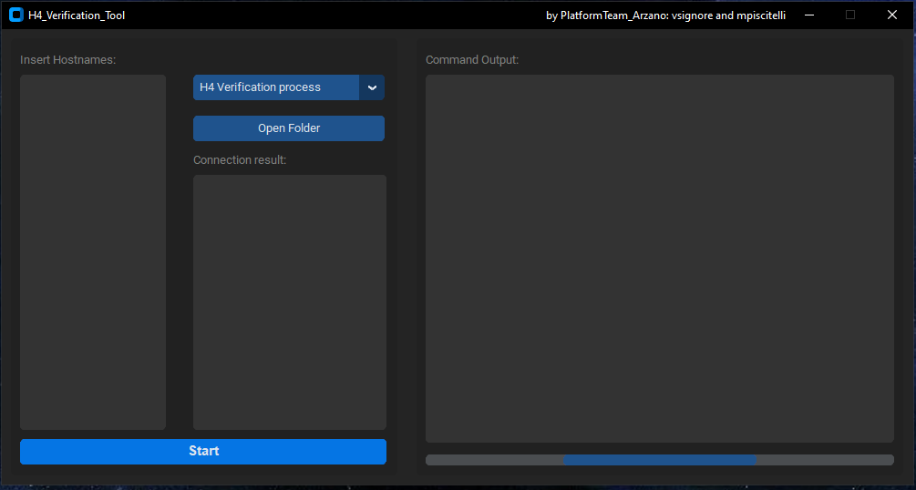
The GUI
Text box where the hostnames of the Hercules4 on which the operability check is to be performed should be entered.
Drop-down menu where the user will be able to choose whether to perform the verification operation or the installation of the library needed on Hercules4 for the tool to work properly.
Button that allows you to open the folder where txt files and certificates divided by Hercules will be saved.
Text box indicating whether the connection with Hercules was successful.
Start button to start the process chosen by the user.
Text box where the output of commands launched via SSH will go.
Progress bar indicating the progress of the process.
2
3
1
6
4
5
7

Slide 5
Output Structure
source folder
Following the diagram on the left, the tool will go on to create the directories with the indicated structure, and then upload the TXTs and the pdf certificate.
To get more specific:
Source folder = Folder where the program is located.
TESTERs = Name of the first folder.
Hostname of the rack = It is a folder named with the hostname that is assigned by the network switch to the H4.
Canonical Hostname = H4 canonical hostname.
As mentioned earlier then we will have the TXTs with the results of the commands sent via SSH and the PDF certificate with the information regarding Hercules and Loopback and the result of the verification.
TESTERs
Hostname given by the switch of the rack
Canonical Hostname
2 types of Files
TXTs
PDF

Slide 6
Step by Step guide
H4 Verification Tool

Slide 7
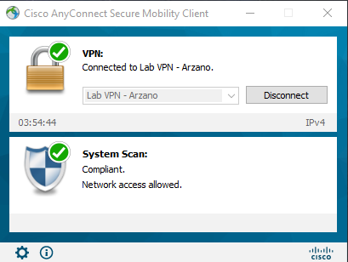
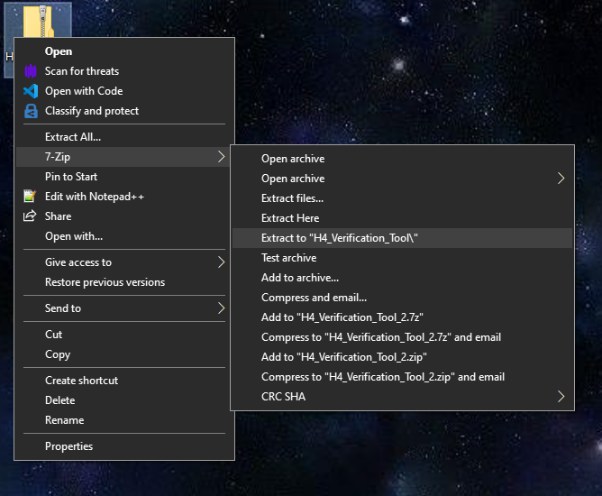
Step 1
Step 3
Download the tool from here: H4_Verification_Tool
Make sure you are connected to your local LAB VPN
Step 2
Extract the files as shown below:
Step 4
Open the .exe file in the extracted folder

Slide 8
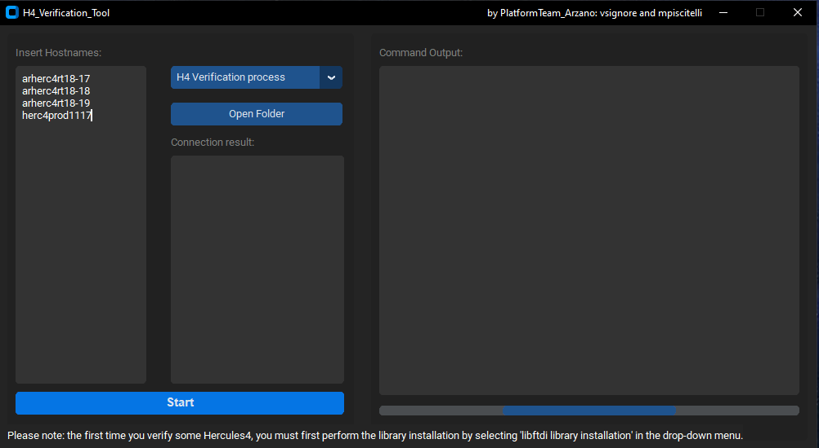
Step 4
Enter the hostnames of the Hercules4 whose operation you need to verify.
Be careful, hostnames must be one below the other. I recommend to use Notepad++ to adjust the format with the "replace" function.

Slide 9
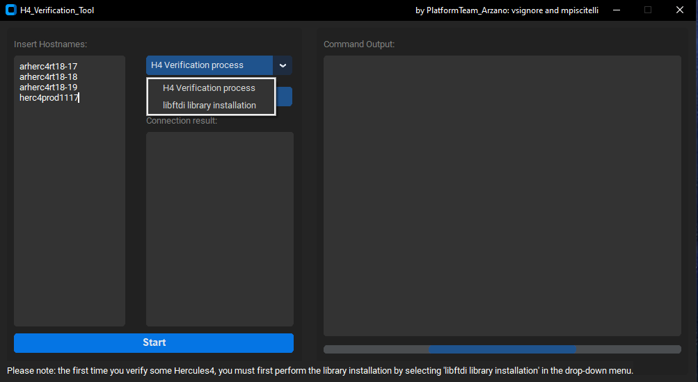
Step 5
From the drop-down menu you can choose whether to install the library or check Hercules4.
If you are to perform the verification for the first time on the hostnames you have indicated, you must first in the drop-down menu select "libftdi library installation" and then click on "START" and carry out the process.
For example:
I have to perform the verification for the first time on the whole rack-35, before performing it, I select the library choice, press start and wait for the end of the process, which will also be notified. Once the installation is completed, I then select "H4 Verification process" and click “START” again.

Slide 10
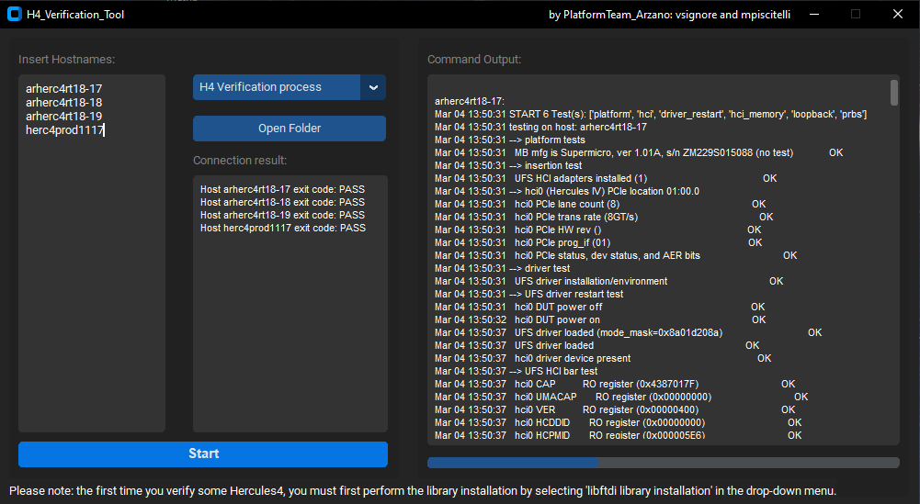
Step 6
After you select the process, press "START" and if everything is successful you will get a screen very similar to the one on the right.
You may notice two outputs, one under "connection result" indicating whether the connection to Hercules4 was successful, while the second under "Command Output" is the output of the SSH commands sent for verification.
In addition to the on-screen outputs, results in .txt format and the .pdf certificate are also returned. You can see on the next slide.

Slide 11
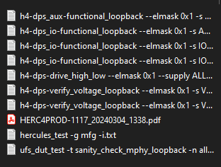

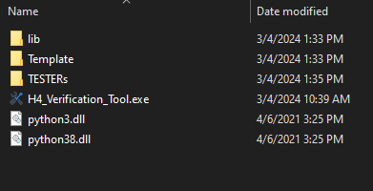
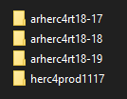
Outputs
If at first you extracted the downloaded .zip file correctly, we will have a folder with this structure:
As an example, we open the Hercules herc4prod1117 folder.
We can see text files, which have the name of the command launched and inside it the result. In addition, we have the certificate, which will be described in the next slide.
The Outputs we need are all located in the TESTERs Folder.

Slide 12

The PDF certificate
I will now explain how the various parts of the document will be filled in.
After "Calibration Status" the result of the operation check will be entered. It can be either FAIL or PASS.

Slide 13
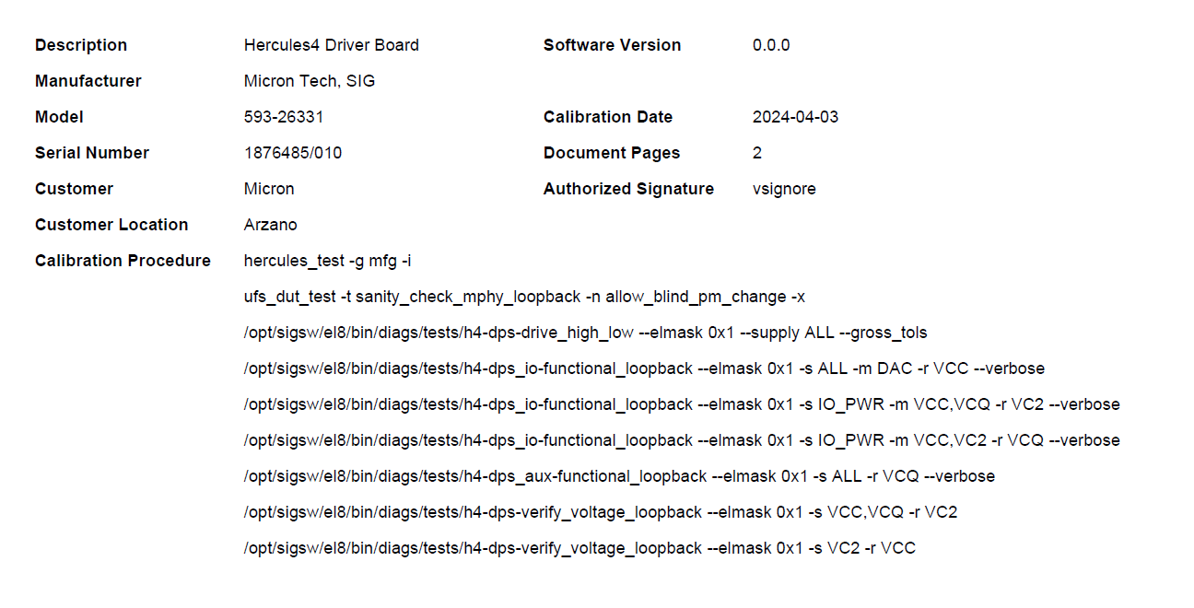
The PDF certificate
1. Part where the tool will automatically compile the Model and Serial Number of the Hercules4.
2. Date on which the verification was carried out.
2
1
3
4
3. Name of the user that perform the verification.
4. List of the SSH commands sent.

Slide 14
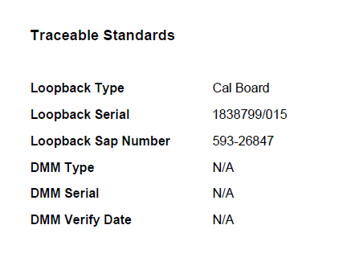
The PDF certificate
Finally in this last part of the document we have the automatically derived information about the used loopback.
Information regarding multimeters is not available since this is a verification using loopback only.

