Slide 1
DOSYFACE - Diffusion Order Spectroscopy - Interface
Calculating the Diffusion Coefficient requires script base processing of multiple datasets.
Interface could facilitate faster evaluation of data quality based on easy clickable tools for everybody who is not able to write own evaluation script
1500 lines of code
13.5 Version – v14 is not succesfull
Buttons are listed in Yellow

Slide 2

Mathematic Principles Behind DOSYFACE
Stejskal-Tanner Equation is being used to determine the Diffusion Coefficient using either linear (ln) or exponential (curved)
Gradient Strength and Gradient Strength are the two variables you use to determine D – Diffusion Coefficient using incremented Length/ strength which give you different NMR-Signal intensity.
This different intensity is due to molecular diffusion occuring and reducing the signal due to its „transversal relaxation“ -> Signal attentuation through movement into undetectable NMR-Measurement Area

Slide 3
Gyroscopic Ratio
Diffusion-Coefficient
Measured Intensity
Gradient Length
Gradient Strength and Gradient Length are the two variables you use to determine D – Diffusion Coefficient using incremented Length/ strength which give you different NMR-Signal intensity.
Initial Signal
Gradient Strength
Diffusion Time
Stejskal, E.O., and Tanner, J.E., Chem. Phys. 42, 288 (1965).

Slide 4
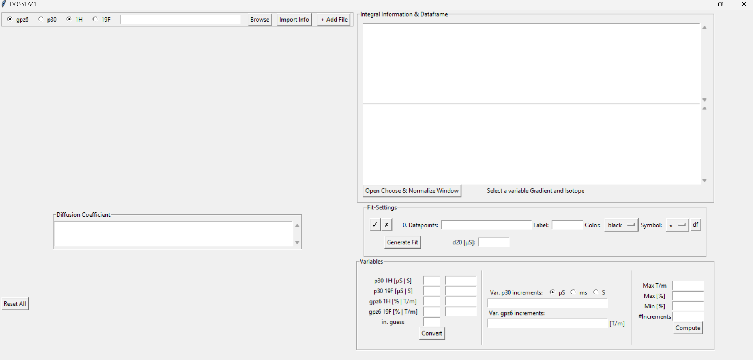
NMR-Terms:
Gpz6 = Gradient Strength
P30 = Gradient Length
D20 = Diffusion time
1H = Proton NMR
19F = Fluoride NMR

Slide 5
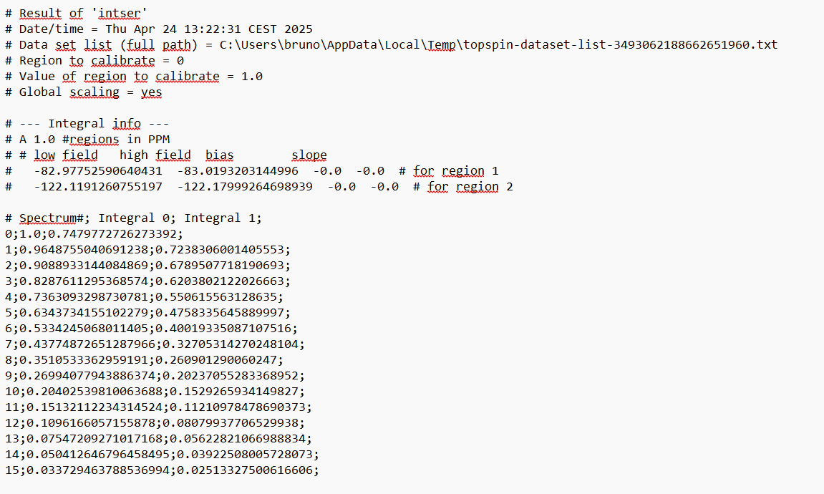
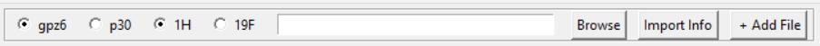
Imports data & information into Data and Information Window
Filepath
Example Text File
Gpz6 = Gradient Strength
P30 = Gradient Length
D20 = Diffusion time
1H = Proton NMR
19F = Fluoride NMR
Add File to perform Fit based on multiple datasets
e.g. Global Fit
Not Working 100%
Browse within file system

Slide 6
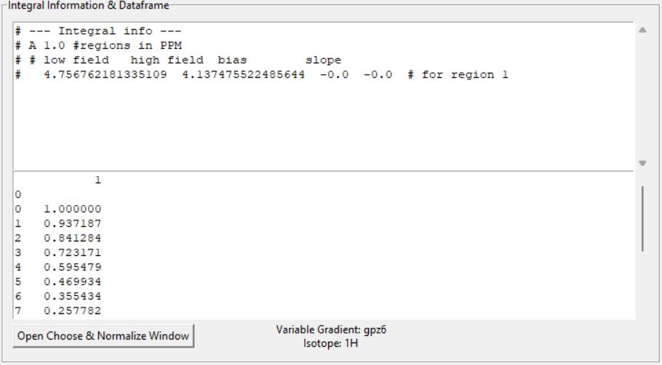
„All in one click“
Import Info
Lists Integral (which was processed beforehand in TopSpin-Bruker)
Shows Integral Info e.g. Regions on ppm-scale
Shows gpz6, p30 and Isotope combination
From This to That

Slide 7
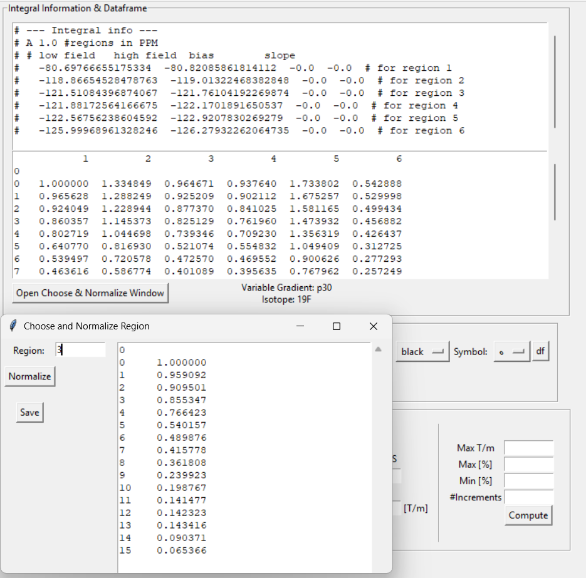
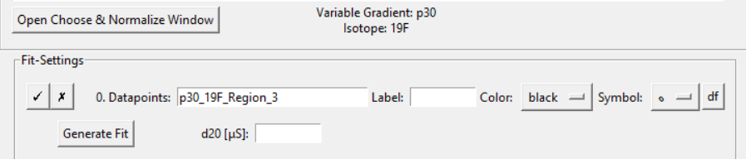
Sometimes multiple Integral regions can be listed
With Open Choose & Normalize Window - Button one can choose Region and normalize by dividing by the highest number
Save automatically saves combination as the file name in Fit-Settings Window

Slide 8
Fit Settings

Slide 9
D20 – Diffusion time [seconds]
1H – 100 ms = 0.1 s
Depending on your combo:
Gpz6-1H/19F or p30-1H/19F
Fixed Variables have to be assigned for the fit:
You vary gpz6 (Gradient Strength) you have a fixed p30 (Gradient Length)

Slide 10
Fixed Variables Window / Converter
Not Working as intended
Only insert values here directly!!
Do not use convert button
Example Values:
Gpz6-1H Combo:
Insert 0.001 in second p30 1H [uS | S]
It is necessary to press Convert once to allow the Generate Fit button to function (i dont know why)
And then enter values from above

Slide 11
Increment Settings

Slide 12
Gpz6 – X – Combo means:
Increments of gpz6-(Gradient strength accross all datapoints)
Here you can either calculate increments using percentages (right)
Or directly paste these into Var. Gpz increments:

Slide 13
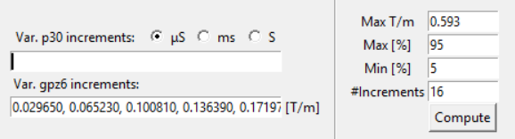
NMR-Device Settings GPZ6
Max Pulse-Gradient NMR-Device Strength = 0.593 T/m
Max %
Min %
16 equally distant increments from beginning (5% to end 95%)
Once pressing Compute the increment is automatically being importet into var. Gpz6 entry window
Result:
0.029650, 0.065230, 0.100810, 0.136390, 0.171970, 0.207550, 0.243130, 0.278710, 0.314290, 0.349870, 0.385450, 0.421030, 0.456610, 0.492190, 0.527770, 0.563350

Slide 14
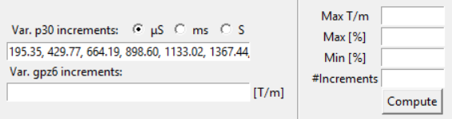
NMR-Device Settings P30
Max Pulse-Gradient NMR-Device Strength = 0.593 T/m
Max %
Min %
16 equally distant increments from beginning (5% to end 95%)
Once pressing Compute the increment is automatically being importet into var. Gpz6 entry window
195.35, 429.77, 664.19, 898.60, 1133.02, 1367.44, 1601.86, 1830.26,2070.70, 2305.12, 2539.53, 2773.95, 3008.37, 3242.79, 3477.21, 3711.63
In Microseconds e.g.
Depending on what Radiobutton (uS, ms, S) they are AUTOMATICALLY converted to Seconds and used for calculations (in seconds) when generating the fit using the Generate Fit Button

Slide 15
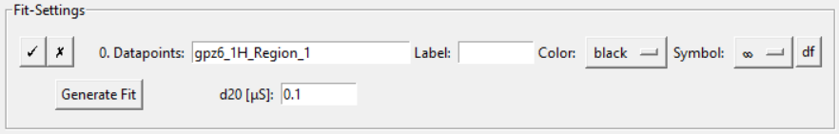
Where everything comes together – Generate Fit
The initial idea was to have one button which summarizes all caluclations and graph creation.
I was only able to create the calculation of the D-fit resulting in the succesfull calculation of the diffusion coefficient (without Standard deviation)
Review dataframe (normalized integral)
Relict from previous versions!! See next slide
Set Graph Settings
NOT WORKING

Slide 16
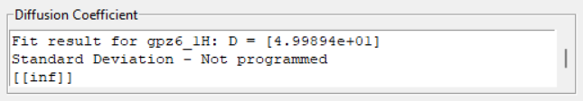
Result
Diffusion Coefficient heavily depending on correct values

Slide 17
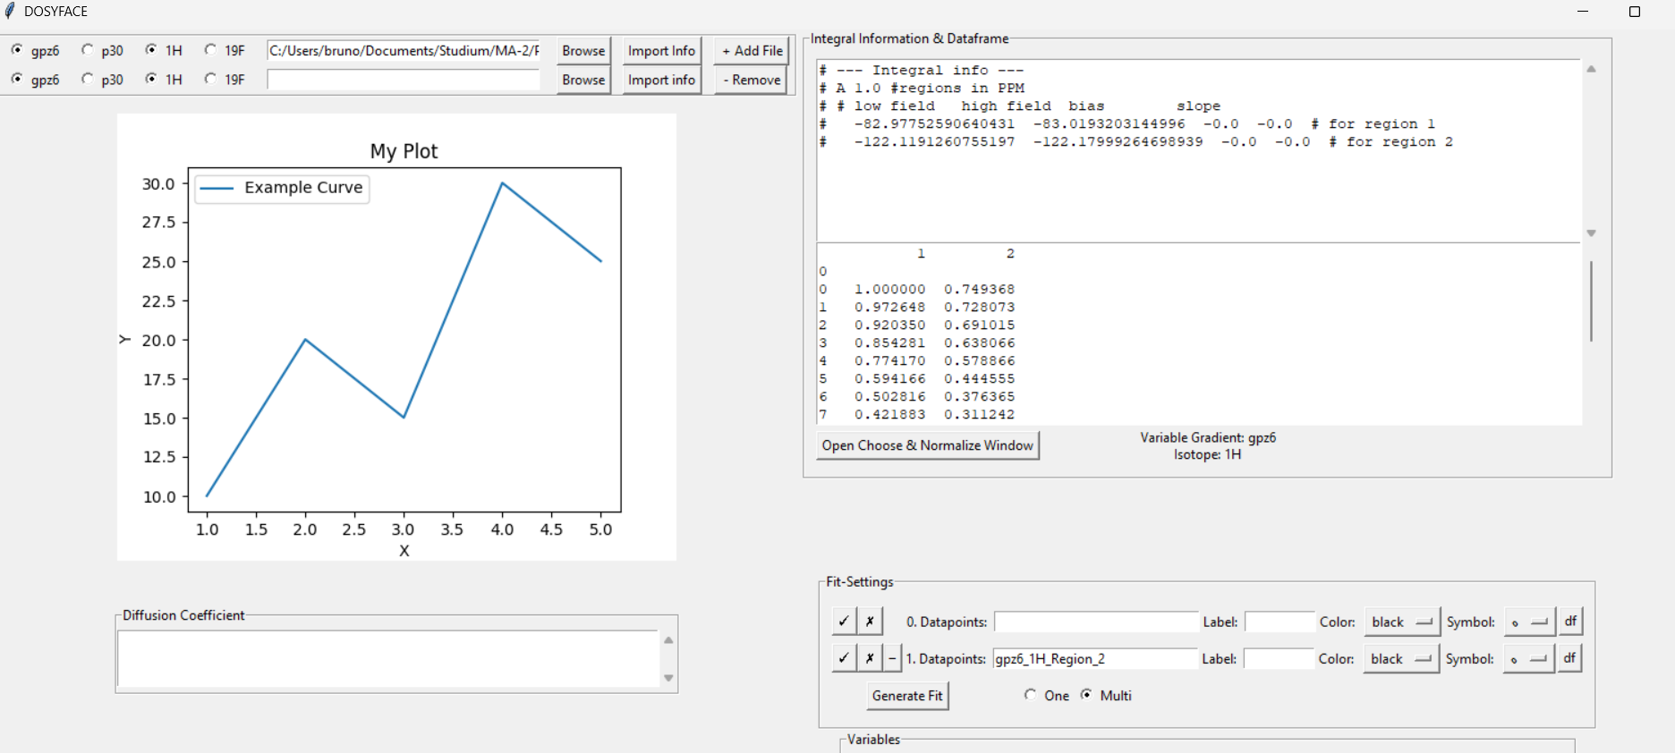
Global Fit – A tragedy

Slide 18
Global fit – combine multiple datasets & fits into one
Implementing functions like automatic line addition and file naming when adding multiple files has not worked.
Really work intensive and not worth the time
V_10_1 is still worth exploring due to the automatic functionalities of adding and removing lines which are quite satisfying function
Unsuccesfull

Slide 19
Graphical Fit – A second tragedy
Has not worked
V15 has some relicts within the code which show some desperate tries, but as well: UNSUCCESFULL
Graphical Fit is critical for fit quality analysis, at least visually, numerical residual results would also provide insights, yet its easier to detect visually

Slide 20
Summary -
Project was not succesfull regarding real world application, which was the initial aim of the project
Project has tought me incredible amounts of python knowledge and integrating functions to each other. Calling functions and overall planning of automation and ideas behind using script based language to automate result evaluation.
For not having had any previous experience in python. I am still proud, yet unsatisfied by time constraints e.g. exam periods / early exchange semesters start.
Overall hours invested: at least 50-60 h +

