Slide 1
Lab2: C++ under UNIX
EC327
“Introduction to Software Engineering”
Fall 2015

Slide 2
LAB1: SUMMARY
What do the following commands stand for, do, and what arguments do they take?
ls
cd
mv
man
:q
zip
ls –l

Slide 3
AGENDA
The GNU C++ compiler (g++)
UNIX
Environment Variables
Piping
New commands:
cat, less, tail, more
User Input

Slide 4
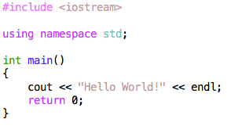
The GNU g++ Compiler
hello.cpp:

Slide 5
The GNU g++ Compiler
Compile:
g++ hello.cpp
Execute:
./a.out
Environment Variables
echo $PATH
/opt/local/bin:/opt/local/sbin:/usr/bin:/bin
Directories of executables

Slide 6
The GNU g++ Compiler
g++ -E hello.cpp
Phases:
Preprocessing
#include
#define
Lexing and Parsing
Syntax Checking
Compilation from C to Assembly to Machine Code
Linking multiple Object Files
g++ -E hello.cpp | less
g++ -E hello.cpp | tail
g++ -E hello.cpp | head
g++ -E hello.cpp > hello.E
“Piping”

Slide 7
The GNU g++ Compiler
Phases:
Preprocessing
#include
#define
Lexing and Parsing
Syntax Checking
Compilation from C to Assembly to Machine Code.
Linking multiple Object Files
g++ -S hello.cpp
g++ -c hello.cpp
cat hello.s
cat hello.o
Assembly Code
Object File

Slide 8
The GNU g++ Compiler
Phases:
Preprocessing
#include
#define
Lexing and Parsing
Syntax Checking
Compilation from C to Assembly to Machine Code.
Linking multiple Object Files
g++ -E hello.cpp
g++ -S hello.cpp
g++ -c hello.cpp
g++ hello.cpp -o hello
./hello
Preprocessing
Assembly Code
Object File
Naming the Executable

Slide 9
User Input (1/3)
user_input.cpp
#include <iostream>
using namespace std;
int main(){
//initializing number variable
int number;
//reading user input
cin>>number;
//output
cout<<”Your input is ”<<number<<”!”<<endl;
return 0;
}

Slide 10
User Input (3/3)
Compile:
g++ user_input.cpp
–o lab2
Execute:
./lab2

Slide 11
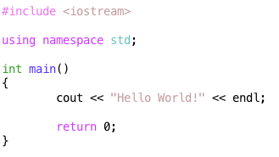
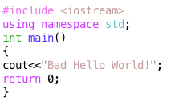
Lab2: Takeaways
Re-compile when changing the source code
Compile all .cpp Files
Name the executable
g++ hello.cpp –o hello
Only clean code is good code!
BAD! ☹
GOOD! ☺

Slide 12
QUESTIONS?

