Slide 1

STACK OVERFLOW DEVELOPER SURVEY 2019
CAPSTONE
Ayoub Ouakani
10/04/2022

Slide 2

OUTLINE :
OUTLINE
Executive Summary
Introduction
Methodology
Results
Visualization – Charts
Dashboard
Discussion
Findings & Implications
Conclusion
Appendix

Slide 3

EXECUTIVE SUMMARY
The correlation between the progress of the IT Field and the skills required to keep up with it is ever-evolving and increasing exponentially
In order to stay in the competition of constant IT evolution it is imperative to identify, understand and target the rising trends and skill requirements in demand
This presentation will show current and future trends in Programming Languages, Databases, Platforms and WebFrames
Overall, the aim in identifying future skill requirements and trends is to help the firm make more informed data- driven hiring and budgetary decisions.

Slide 4

INTRODUCTION
This presentation’s goal is to identify and quantify future skill requirements based on the survey, in order to understand what is necessary to keep pace with the constant change and progress and technologies and remain competitive in the IT field
It is delivered to stackholders and decision makers within the domain of IT and consulting firms

Slide 5

METHODOLOGY
Data Collection
Data Exploration ( EDA )
Data Cleaning
Data Visualization
Presentation

Slide 6
RESULTS

Slide 7
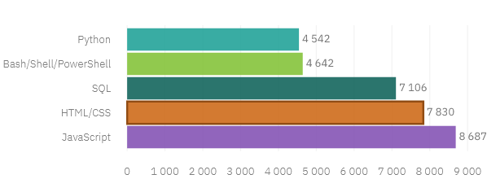
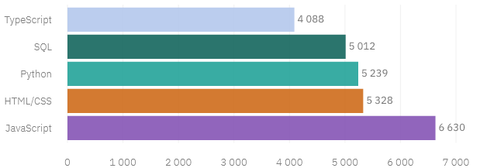
PROGRAMMING LANGUAGE TRENDS
Top 5 most used languages in the Current Year
Top 5 most desired languages for the Next Year

Slide 8
PROGRAMMING LANGUAGE TRENDS FINDINGS & IMPLICATIONS
Findings
The interest in JavaScript & HTML/CSS remains to be high
Pyton and TypeScript gained more interest and demand
The interest and demande for SQL and Bash/Shell/PowerShell has weakned
Implications
Reduce interest in people skilled in SQL and Bash/Shell/PowerShell
Continue to employ people with a strong specilization in JavaScript & HTML/CSS
Employ more people skilled in Python and TypeScript

Slide 9
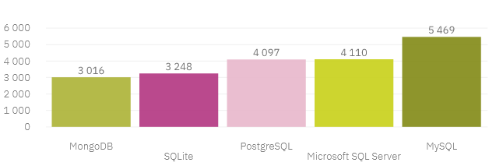
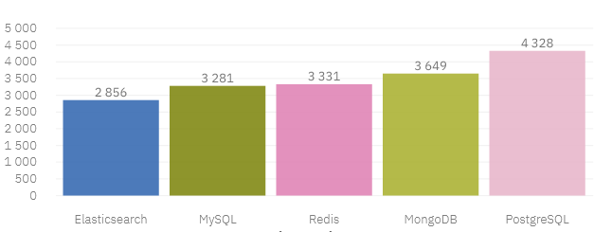
DATABASES LANGUAGE TRENDS
Top 5 most used Databases in the Current Year
Top 5 most desired Databases for the Next Year

Slide 10
DATABASES TRENDS FINDINGS & IMPLICATIONS
Findings
Interest in MySQL, Microsoft SQL Server and SQLite has decreased for next year
On the other hand the opposite for PostgreSQL and MongoDB it increased
A startup interest in Redis and Elasticsearch for next year
Implications
Start noticing and employing people skilled in Redis and Elasticsearch
Continue to employ people with a specilization in PostgreSQL and MongoDB and MySQL
Employ less people skilled in Microsoft SQL Server and SQLite

Slide 11

Dashboard LINK : Here

Slide 12
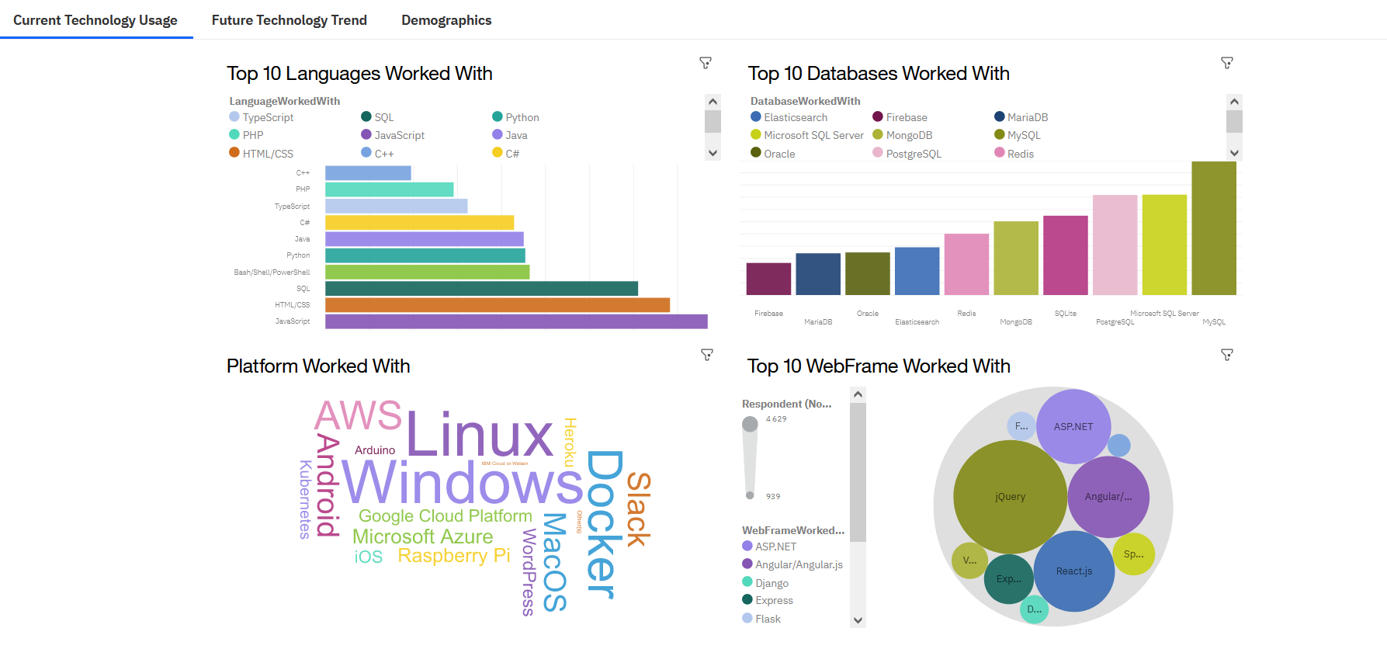
DASHBOARD TAB 1

Slide 13
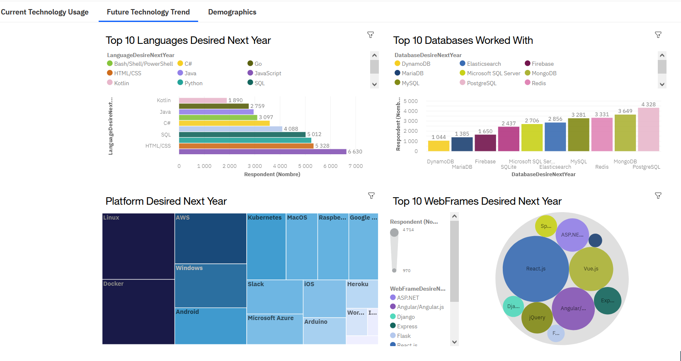
DASHBOARD TAB 2

Slide 14
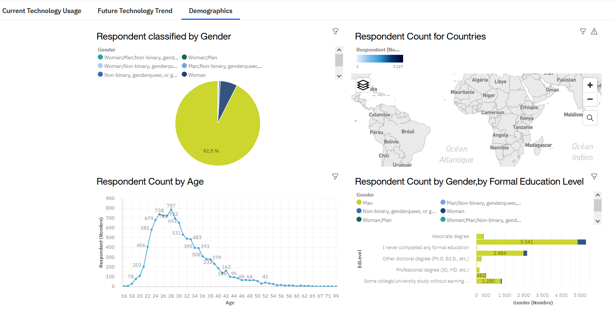
DASHBOARD TAB 3

Slide 15
Discussion

Slide 16
OVERALL FINDINGS & IMPLICATIONS
Findings :
Implications
Employ more people skilled in Docker, AWS and Android, but make reductions to Slack and Windows
Continue to employed workers skilled in JavaScript and HTML/CSS, and focus on TypeScript and Python
Continue to staff enough ASP.NET but employ more people skilled in Vue.js and React.js.
Employ more people skilled in Redis, Elasticsearch, PostgreSQL and MongoDB.
Programming Languages : TypeScript is gaining significant interest and Python continues to grow as well
Databases : Redis, Elasticsearch, PostgreSQL and MongoDB are gaining more interest
Platforms : Interest Slack and Windows is dropping significantly.
WebFrames : Vue.js is gaining substantial interest and React.js continues to grow as well

Slide 17

1 | Dedicate means and time into qualifying and training current employees to fill the gap in their skills and keep up with the demand ( Up-skilling )
2 | Make the recruitement strategy more adapted to the coming demanded skills to remain in the competitive business or IT
3 | Actions to be taken in order to make the IT field more suitable and desirable for women
4 | Re-arrange the staffs for those who posses dying or already dead skills

Slide 18

Appendix

Slide 19
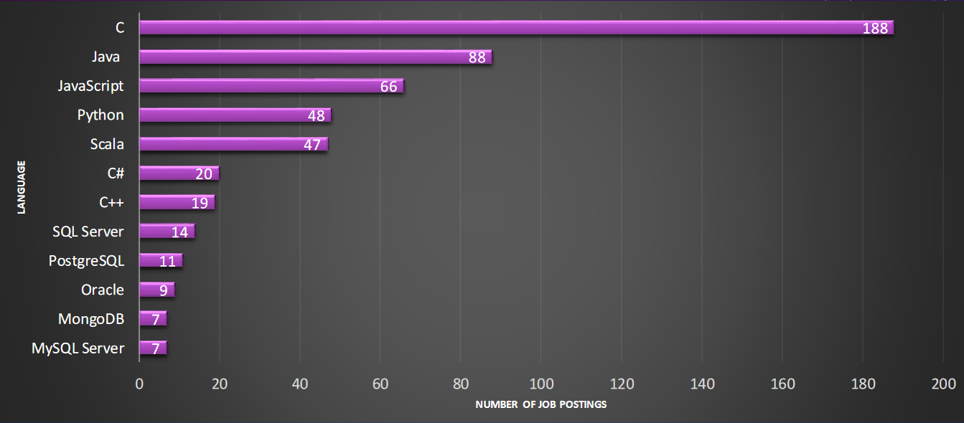
GITHUB JOB POSTINGS

Slide 20
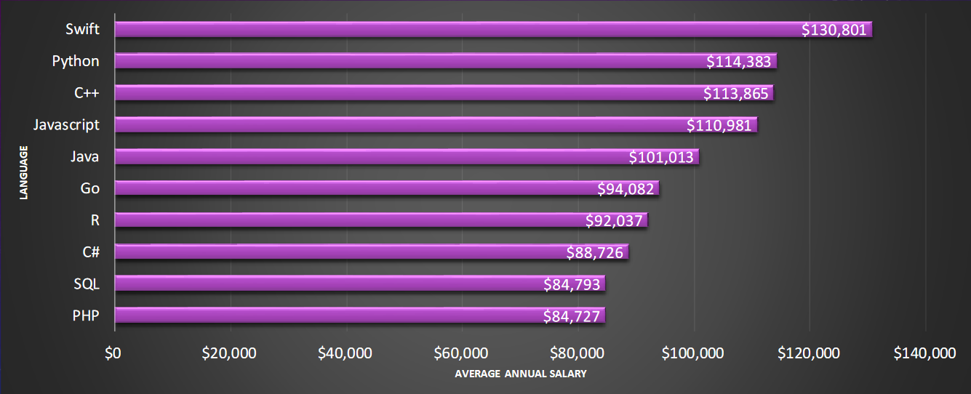
JOB Skill Salary

