Slide 1


Welcome
Web Development Course
Where we are going to create a complete blogging application using ASP.NET Core 9 MVC
ASP.NET Complete Course

Slide 2
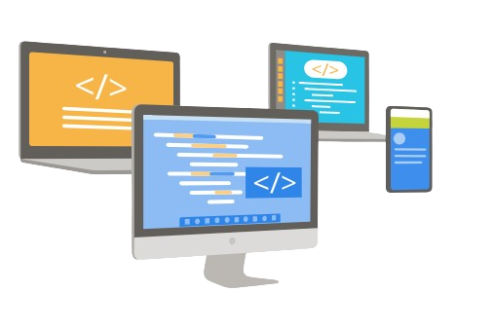
What we are going to build?
We are going to Build a database driven Blogging Platform with features like blogpost, categories, comments, users and roles in ASP.NET Core MVC

Slide 3
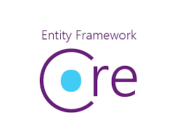
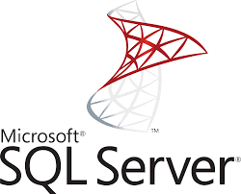




Object Relation Mapper
Database
Identity

Slide 4

What you will learn

Slide 5
Project Setup and Structure
Database Integration with Entity Framework Core
Handling Relationships in EF Core
CRUD Operations for Blog Posts and Categories
Adding Comments using jQuery Ajax
Form Validation and Error Handling
Routing and Navigation
User Authentication and Authorization using Identity
Responsive Frontend Design with Bootstrap
IIS Deployment

Slide 6
Overview of the Application

