Slide 1
Why I do R programming in VSCode instead of RStudio?
Xiaojie Gao (“J”)
09/14/2020

Slide 2
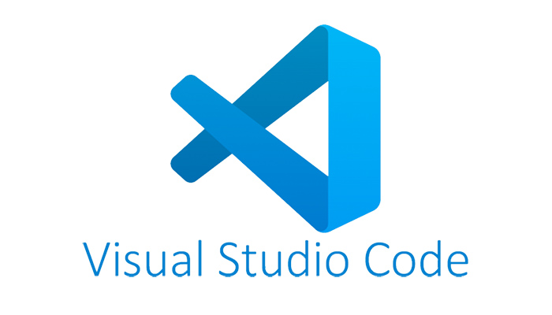
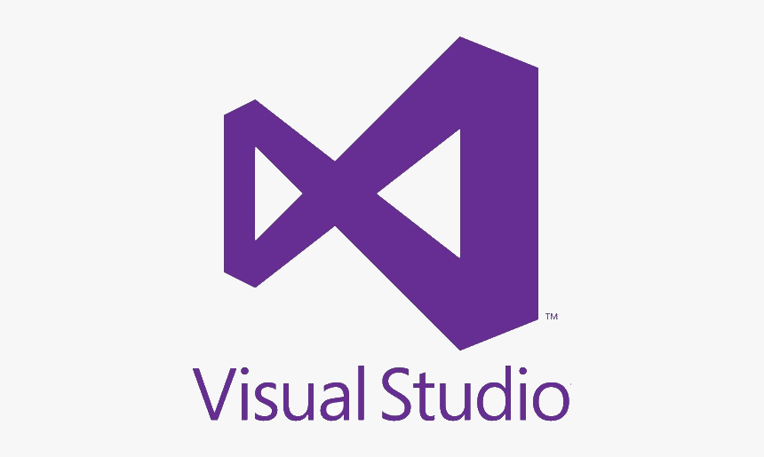
Sorry about the confusion…
but they are different!
A code editor,
although more than that.
Probably the biggest IDE
in the entire universe…

Slide 3
Topics today
Code editing in VSCode
You’ll find most of the skills are not R only
Pros and cons, comparing to RStudio
Questions and discussion

Slide 4


Pros and cons
Vs.
Fast
Fancy
Versatile
Consistent
R Markdown
It’ll come to VSCode soon
Variable preview
VSCode actually can do this, but not very stable yet
Any other pros???

Slide 5
I have to say…
it’s just my own opinion, I know a lot of you disagree…
And,
please tell me how you love RStudio,
I won’t listen though…

Slide 6
Questions?

