Slide 1
Scientific Computing
J Paton

Slide 2
Project Aims
To prepare you for scientific computing at university
To develop a transferable skillset
To improve your employability
To have fun

Slide 3
Project Administration
This project’s resources can be found at https://github.com/MrJPaton/ScientificComputing
Resources are not yet complete and will be updated periodically, check often.

Slide 4
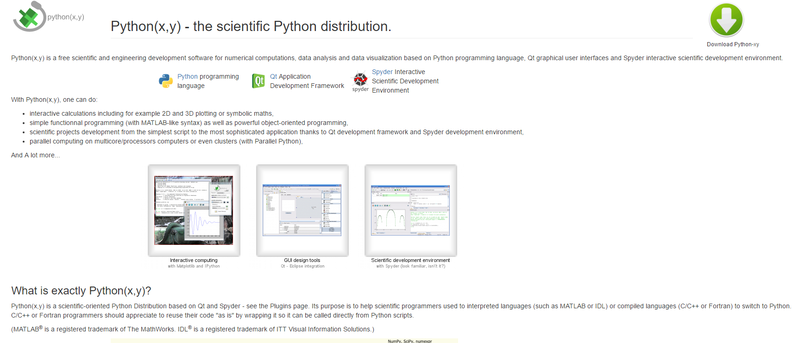
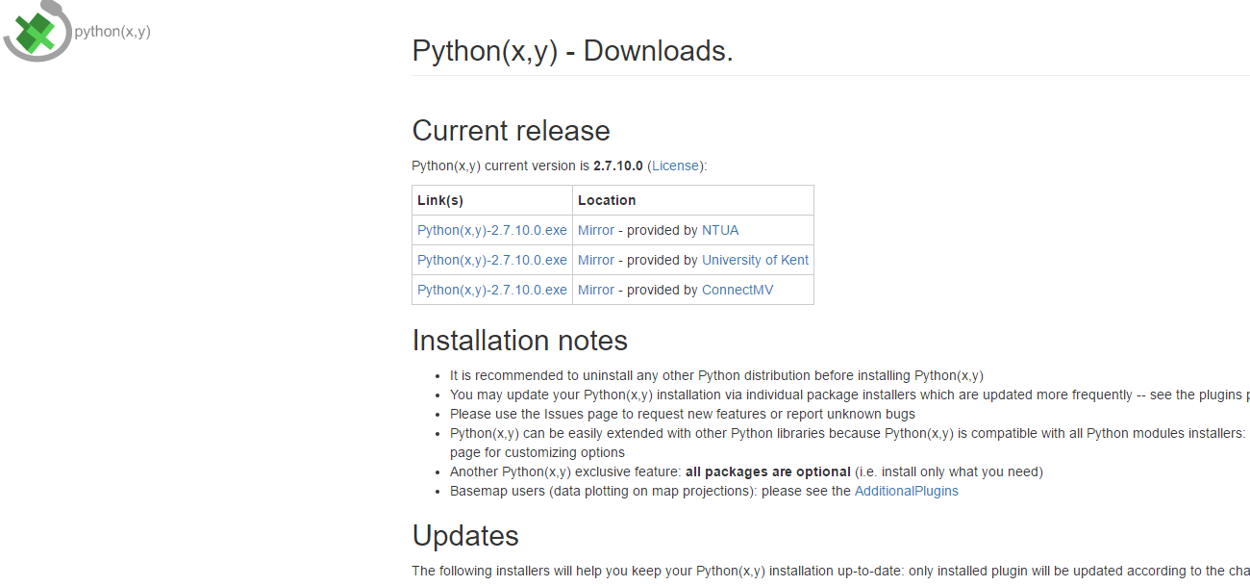
Project Administration
Download python-xy (a scientific oriented distribution that has most of the libraries we’ll be using included) from http://python-xy.github.io
Then
Here

Slide 5
What is python?
Python is a widely used programming language (within the top 5 most common languages)
Python is easy to write
Python is easy to read
Python has extensive use in the sciences due to comprehensive scientific libraries

Slide 6
Who uses python?
Yahoo
Google
Facebook
Dropbox
NASA
ESA
ILM
Pixar
Civilization V

Slide 7
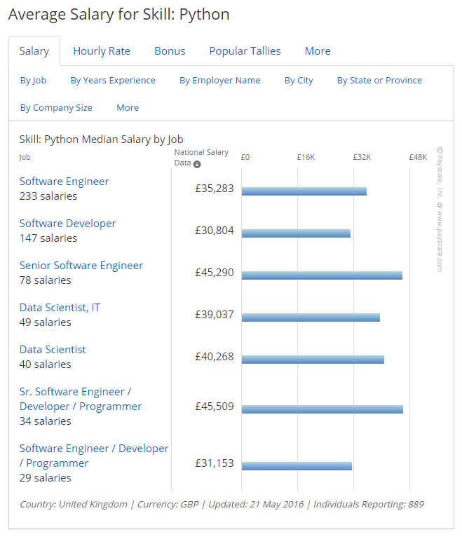
Why learn to program?
One good reason
UK median personal income
Source: https://www.gov.uk/government/collections/personal-income-by-tax-year
Source: http://www.payscale.com/research/UK/Skill=Python/Salary#by_Job

Slide 8
Keywords
In python, as in all* programming languages, some words are special
These special words, known as keywords, are used in specified ways within the language’s grammar
For example, the word print is a keyword in python, any number or text following the print keyword is displayed on the terminal
print "hello world" #>>> hello world

Slide 9
Operators
Operators are symbols that tell python to carry out an operation on one or more operands
e.g. + is an operator and it works by placing it between the two operands, 3 + 4.
print "hello world" #>>> hello world

Slide 10
Variables
A variable is a reference to a value or object
A variable can have any alphanumeric name that starts with a letter
Names should be descriptive lowercase words separated with an underscore

Slide 11
Variables Assignment
To assign a variable name to the object, use the assignment operator =.
This does not mean equals, for example you could write n = n + 1. This is a perfectly valid statement. It means, take n, add one to it, then call that new thing n.

Slide 12
Functions & Procedures
Functions & procedures are snippets of code that are reusable
Functions return something
Procedures do something
In python the syntax is identical

Slide 13
Functions & Procedures Naming & keywords
All functions start with the def keyword
All functions have descriptive lowercase names with words separated by an underscore
All functions end with a return keyword
Procedures do not return an object
def add_two_numbers(a, b): return a + b
def multiply_two_numbers(a, b): return a * b
---------------------------------------
print add_two_numbers(3, 4)
>>> 7
print add_two_numbers(8, 3)
>>> 11
print multiply_two_numbers(3, 4)
>>> 12

