Slide 1

Higher
Order
Ruby
Tom Crinson @MrJaba

Slide 2
Higher
Order
Programming?

Slide 3
Callbacks. Dispatch Tables.
Infinite Streams.
(with just a smidge of Currying)

Slide 4
Callbacks

Slide 5
Dispatch
Tables

Slide 6
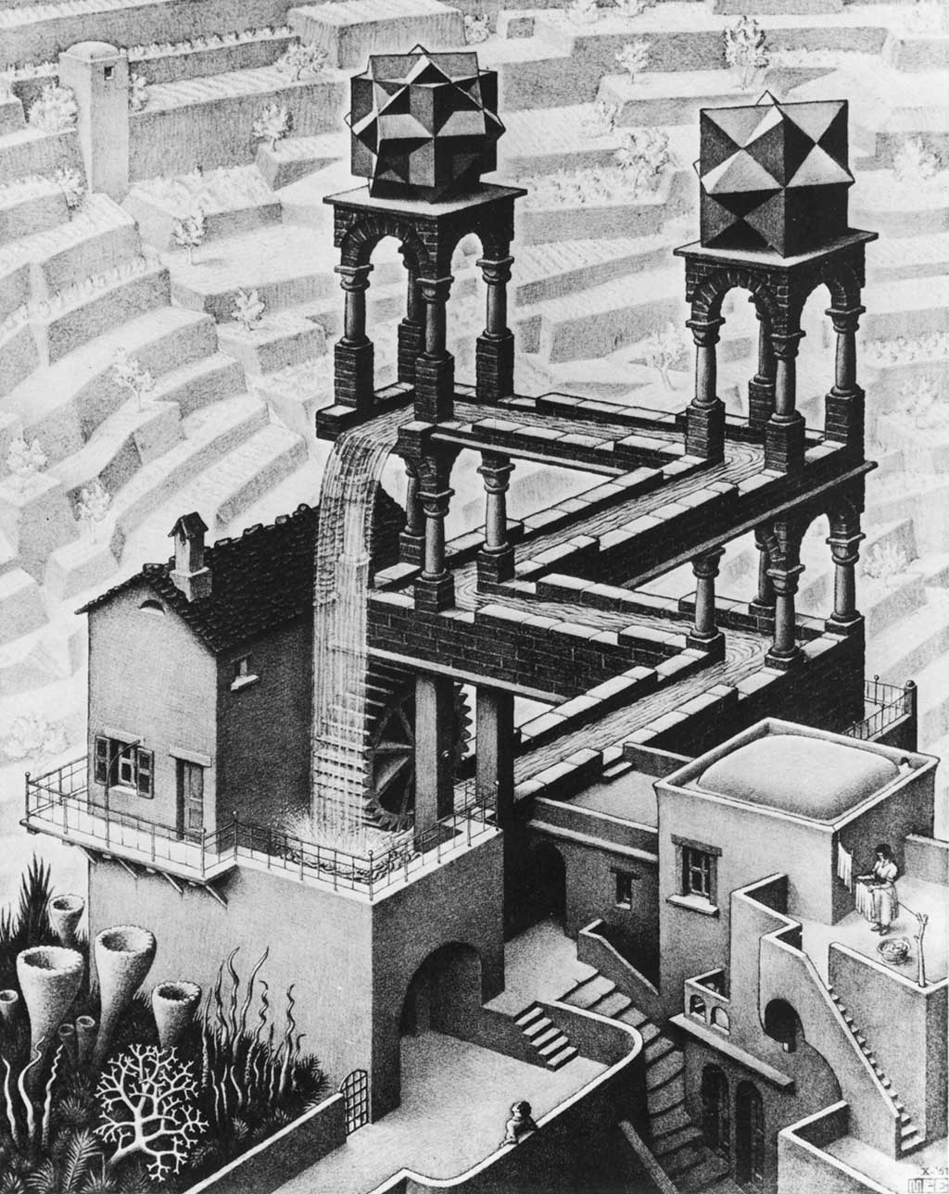
Infinite
Streams

Slide 7
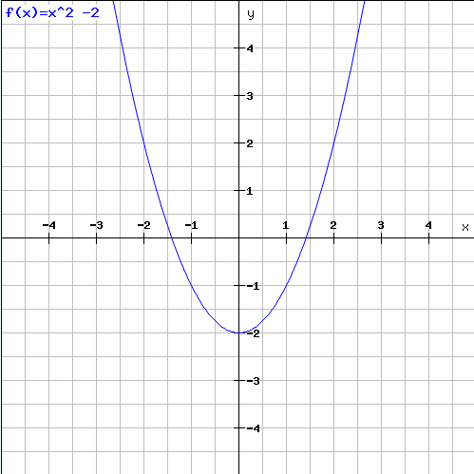
Newton – Raphson Method

Slide 8

CURRYING
lambda { |a, b, c| ... }
lambda { |a| lambda { |b| lambda { |c| ... } } }

Slide 9
Image Credits:
http://www.flickr.com/photos/motoyen/1386840251/sizes/o/in/photostream/
http://www.flickr.com/photos/robbn1/4284266833/sizes/l/in/photostream/
http://www.flickr.com/photos/dps/136564771/
http://www.flickr.com/photos/bbaunach/398807056/sizes/o/in/photostream/
http://www.flickr.com/photos/thebrownhouse/4599233853/sizes/l/in/photostream/
Further Reading:
http://blog.grayproductions.net/categories/higherorder_ruby
Higher Order Perl – Mark Jason Dominus
Code:
http://github.com/mrjaba

