Slide 1

Automated Student Monitoring System for Virtual Classrooms
Real-Time Multi-Person AI Monitoring
Using Computer Vision & Machine Learning
Digital Egypt Pioneers Initiative (DEPI) — Graduation Project
Presented by
Mo’men Ahmed Farouq
Mohamed Tamer Elsheikh
Moaz Abdelmoneim Abdelaleem
Wisal Metwaly Mostafa
Karen Wadid Riad
Reem Yasser Fathy
DEPI - Graduation Project
1

Slide 2
Agenda
1
Project Idea & Challenges
2
Dataset Creation
3
System Pipeline & Architecture
4
Technical Deep Dives
5
Live Application & Web Platform
6
Results & Evaluation
7
Deliverables & Future Work
DEPI - Graduation Project
2

Slide 3
Project Idea
The Problem
📷
Camera Feed
Manually monitoring student attention in classrooms is impossible at scale. Teachers cannot simultaneously track multiple students, objectively measure engagement levels, or detect phone usage and exam cheating in real time.
🧠
AI Analysis
The Solution
A real-time AI-powered system that uses a standard webcam to simultaneously monitor up to 4 students — classifying each student's focus state every second, detecting phone usage, and identifying attempts to spoof the system with printed photos.
📊
Real-Time Overlay
Unique Value Proposition
• First-of-its-kind per-person attribution (phone matched to holder) • Anti-spoofing via adaptive blink detection — not just ML • Zero-effort calibration — 3-second baseline per session • Generates timestamped CSV + analytics charts per student
📈
Session Report
DEPI - Graduation Project
3

Slide 4
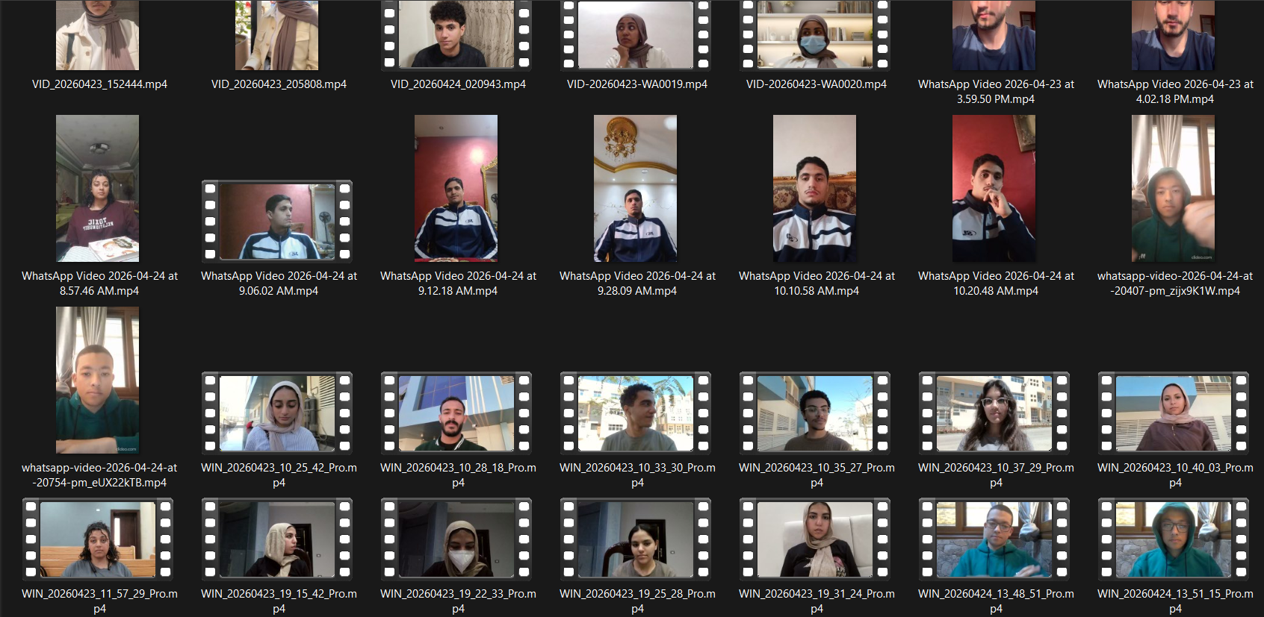
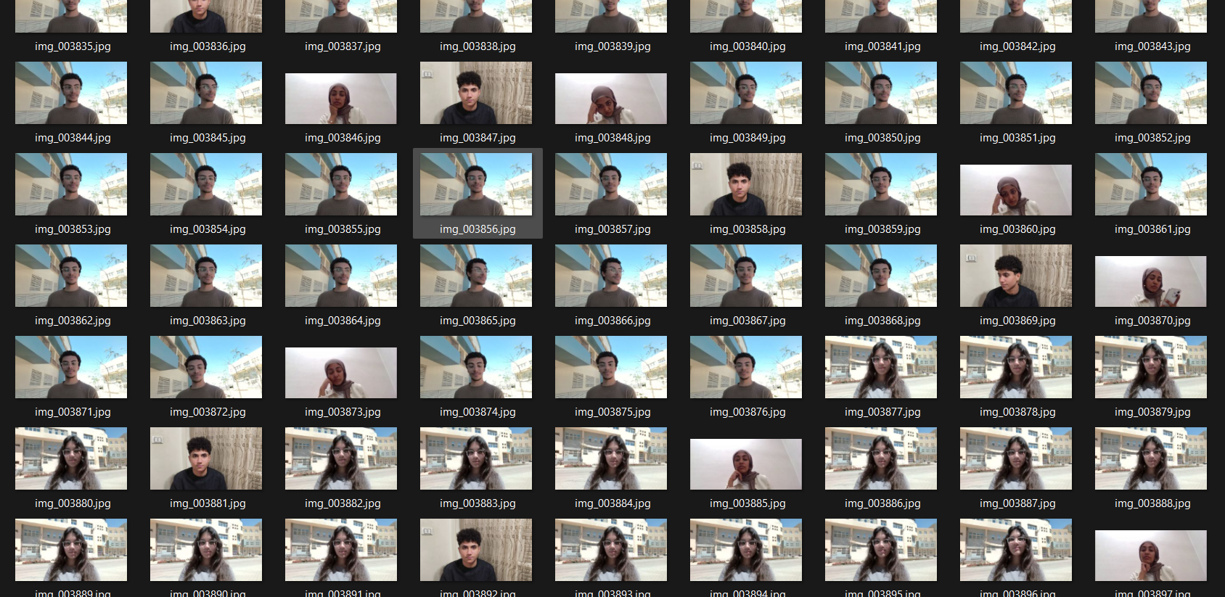
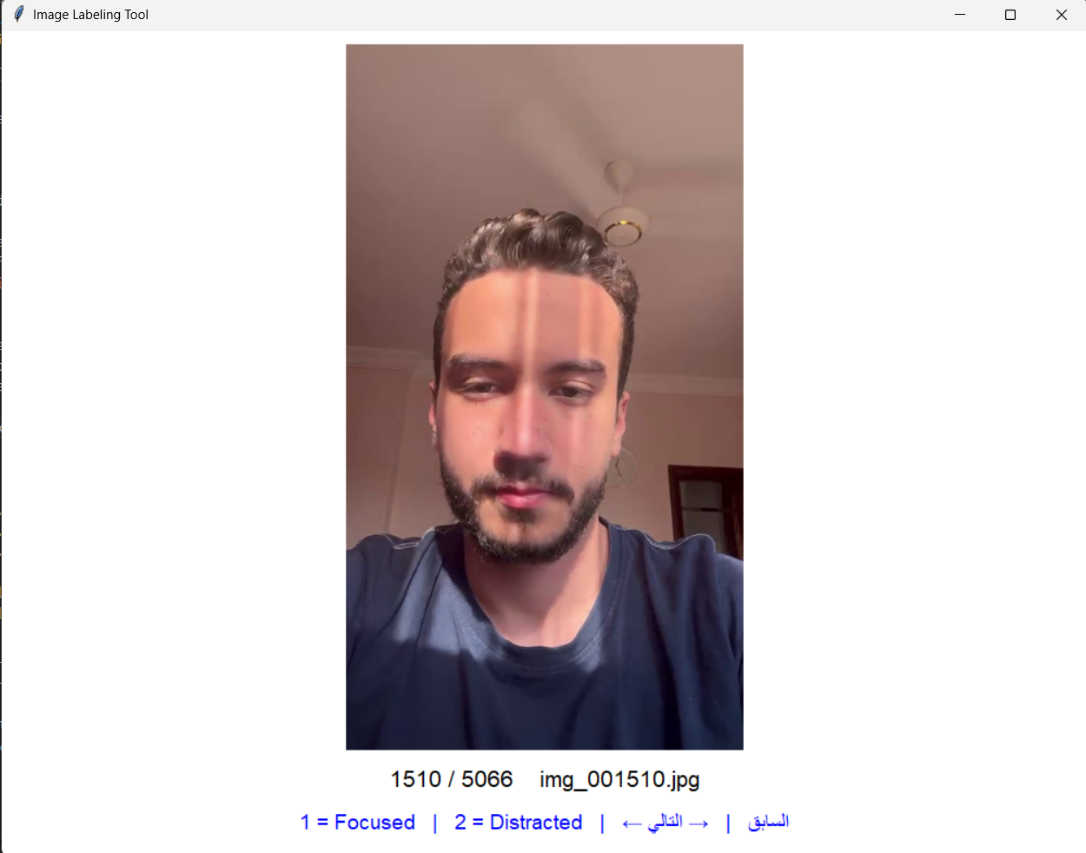
Challenges
Our Solution
We built our own custom dataset from scratch
The Problem
⚠ No publicly available dataset matched our specific project requirements.
Recorded real classroom videos, extracted frames, manually labeled each image for Focused/Distracted.
⚠ Existing datasets lacked realistic classroom scenarios with natural behavior.
⚠ No dataset contained multi-person focus tracking with identity consistency.
⚠ Available data did not support per-person phone attribution or anti-spoofing.
DEPI - Graduation Project
4

Slide 5
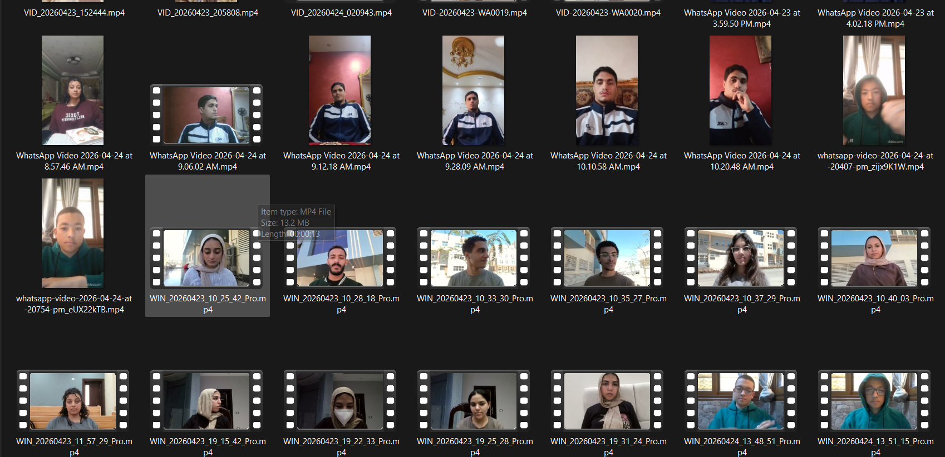
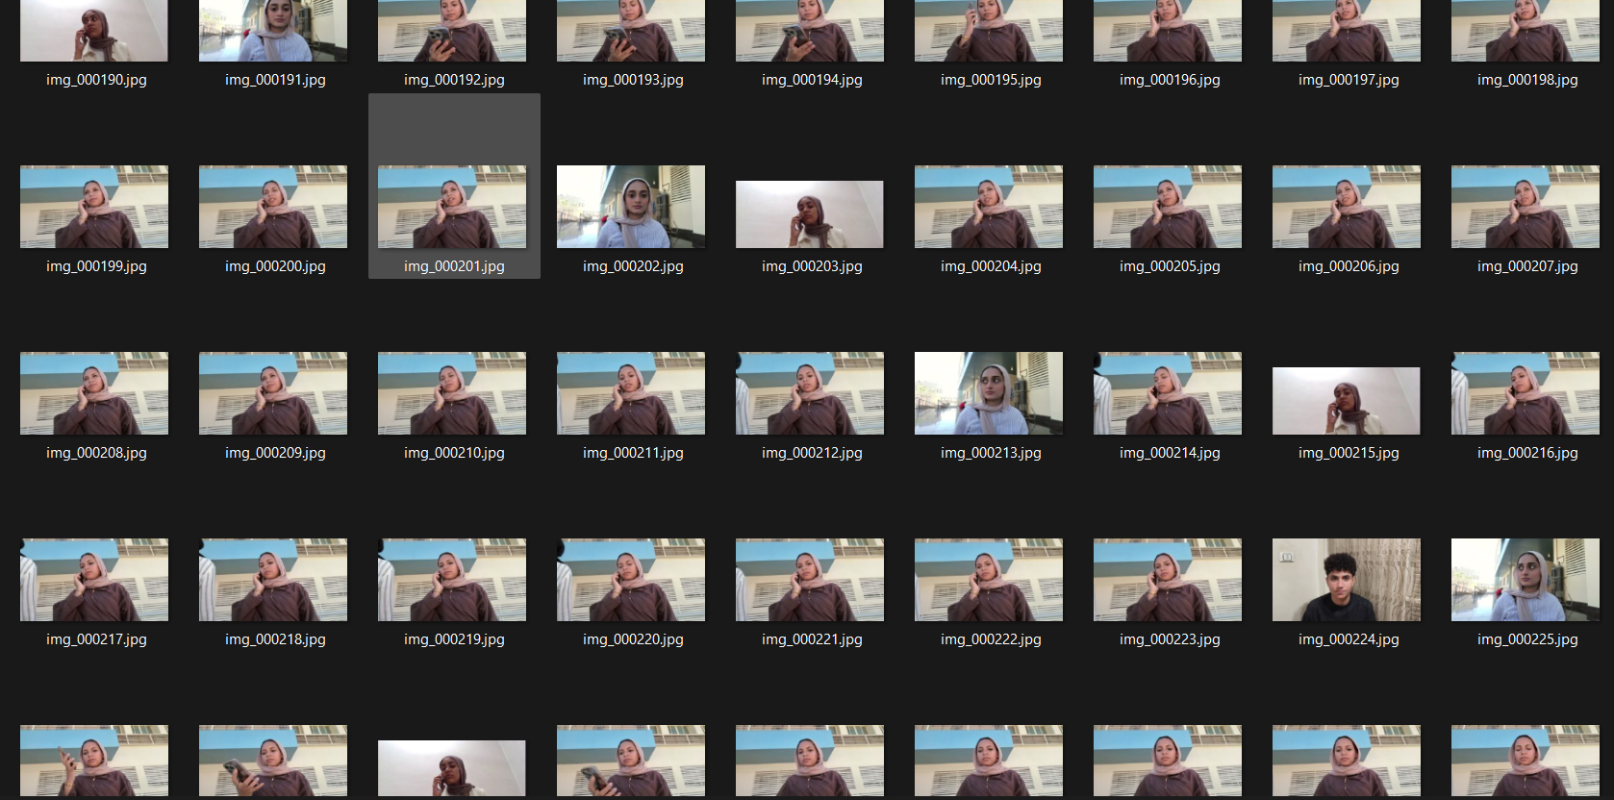
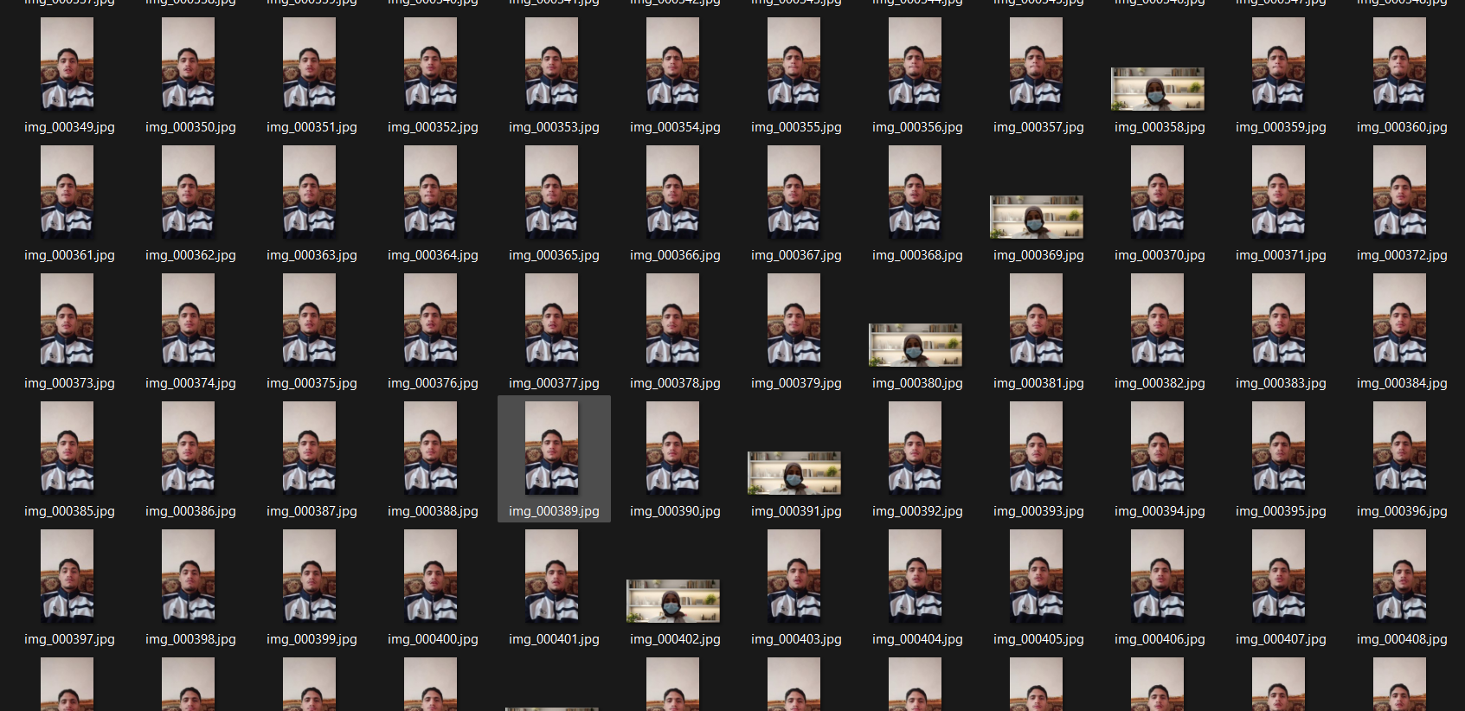
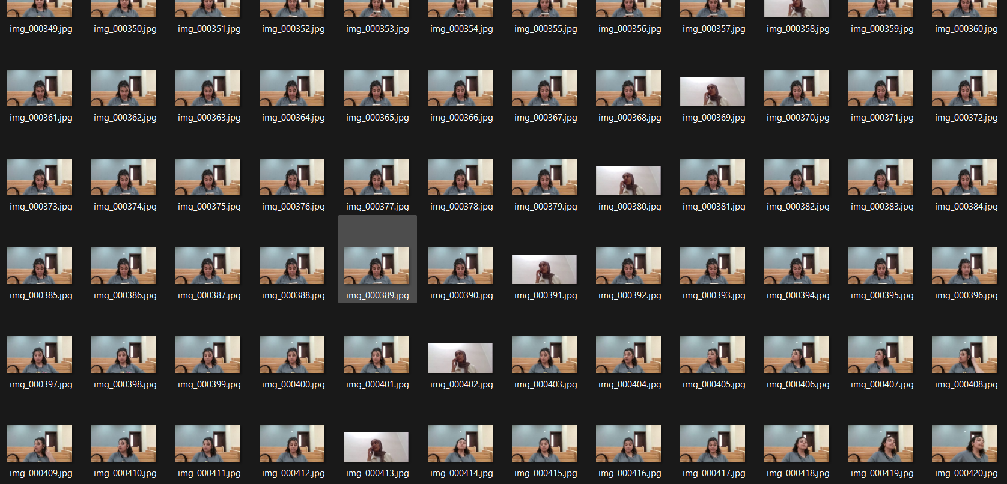
Dataset Creation Pipeline
📹 Record Videos
Dataset Statistics
🎬 Extract Frames
Total Videos:
28
🧹 Manual Cleaning
Total Frames:
5066
🏷 Label Images
Labeled Images:
5022
Focused Class:
2633
📂 Dataset Organization
Distracted Class:
2389
🧮 Feature Extraction
📊 Training CSV
DEPI - Graduation Project
5

Slide 6






Technology Stack
System Architecture
Core Technologies
Frontend & UI
Streamlit · WebRTC
AI & Logic Layer
MediaPipe · DeepFace · YOLOv8 · OpenCV · Scikit-Learn
Data, Storage & Automation
SQLite3 · Pandas · NumPy · n8n
DEPI - Graduation Project
6

Slide 7
System Pipeline
1. DATA CAPTURE
📹 WebRTC Camera Frame
2. AI MODELS & CV
MediaPipe Landmarks
YOLOv8 Phone Detector
DeepFace Face Recognition
Focus Classifier
Liveness Detector
Nearest Face Match
3. AGGREGATION
PersonState Manager (3/sec Majority Vote)
4. OUTPUT & ANALYTICS
Live Dashboard
Session CSV & Charts + n8n Automation (Email/Sheets)
DEPI - Graduation Project
7

Slide 8
End Users & Key Features
Target End Users
Core Features
👨‍🏫
👨🏻‍💼
🏛️
👥
Multi-Person Tracking
🎯
Focus Classification
Instructors
Meetings
Institutions
📱
Phone Attribution
🛡️
Anti-Spoofing
Track student engagement during lectures.
Track people engagement during meeting.
Generate attendance & focus evaluation reports.
👤
Face Recognition
📊
Session Analytics & n8n Automation
DEPI - Graduation Project
8

Slide 9
Feature Extraction Pipeline
🧠 MediaPipe FaceLandmarker
478 Facial Landmarks per Face
EAR
Yaw
Pitch
Roll
Gaze
Feature Vector (5 signals)
⚙ 3-Second Calibration
Per-session baseline offset subtracted from raw features before classification.
🌳 Random Forest Classifier
📊 5 Features
Gaze
Focused / Distracted
EAR (Eye Aspect Ratio) Yaw · Pitch · Roll Gaze (iris position)
AI Model
Processing
Features
Output
DEPI - Graduation Project
9

Slide 10
Data Structure
Sample features clean csv
Training Dataset (features_clean.csv)
time | person | Ear | Yaw | pitch | Roll
3.20 | Mohamed | 0.26 | -0.53 | 4.66 | -0.01
3.53 | Mo’men | 0.33. | -0.49 | 7.49 | 0.02
3.87 | Moaz | 0.18 | 2.67 | --2.79 | 0.27
Gaze
.048
0.31
0.45
state
focused
distracted
focused
Rows: Labeled face images (Focused / Distracted) Features: EAR · Yaw · Pitch · Roll · Gaze Label: Binary — 1 (Focused) / 0 (Distracted)
Session Output CSV & n8n Webhooks
Columns: time · person_id · name · focus_pct · status · phone Generated per-session & synced via n8n to Google Sheets Used for post-session analytics and charts
Face Embeddings (embeddings.pkl)
128-D vectors per registered student Serialized with pickle for fast cosine-similarity matching
Analytics Output
Per-person pie charts + focus line charts Matplotlib-generated visualizations per session
DEPI - Graduation Project
10

Slide 11
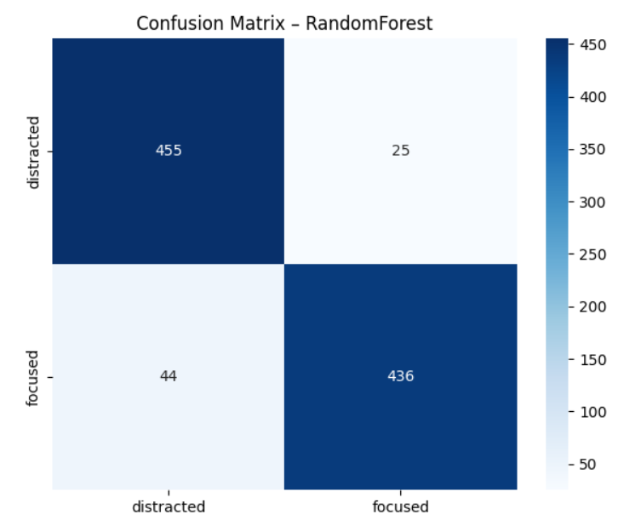
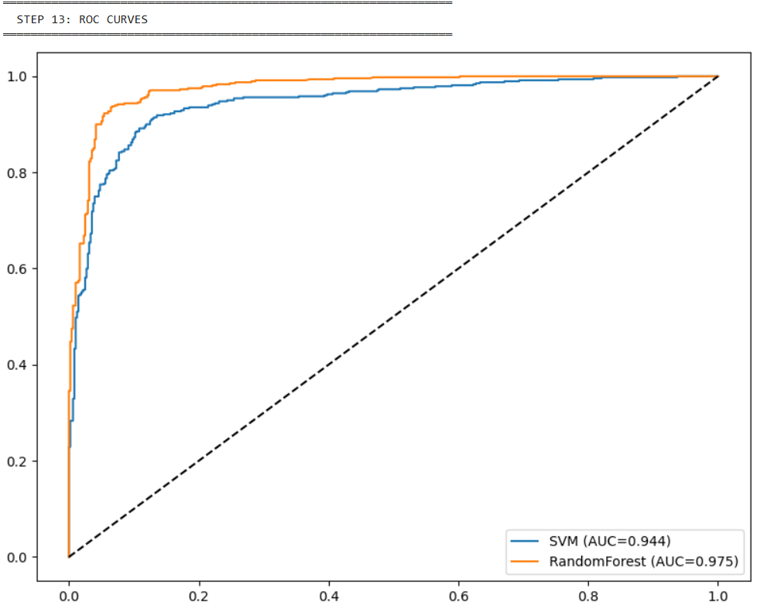
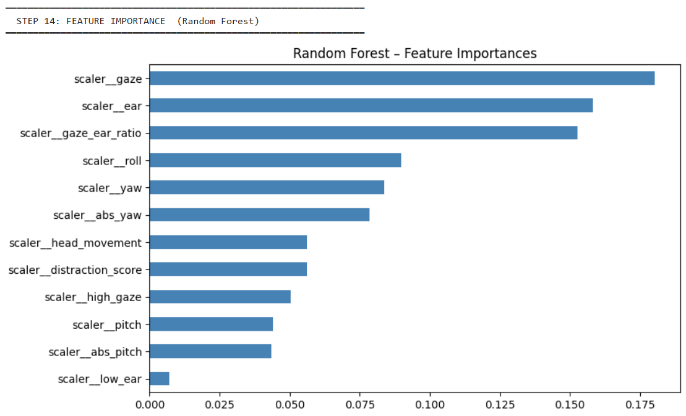
Results & Evaluation
Model Comparison
Model
Accuracy
Precision
Recall
F1
RandomForest
0.9281
0.9288
0.9281
0.9281
SVM
0.8906
0.8911
0.8906
0.8906
XGBoost
0.9094
0.9070
0.9070
0.9070
📷 Confusion Matrix
📷 ROC Curve
📷 Feature Importance
DEPI - Graduation Project
11

Slide 12
Face Recognition Pipeline
📹 Videos
Frames
DeepFace FaceNet
Face Embeddings
embeddings .pkl
Real-time Recognition
Pipeline: Record short video clips per student → Extract frames → Generate 128-D embeddings → Store in .pkl → Match in real-time via cosine similarity
DeepFace + FaceNet
Cosine Similarity
Embedding Storage
Pre-trained CNN generates 128-dimensional face embeddings
Threshold: 0.9 for identity matching
Serialized with pickle for fast loading
DEPI - Graduation Project
12

Slide 13
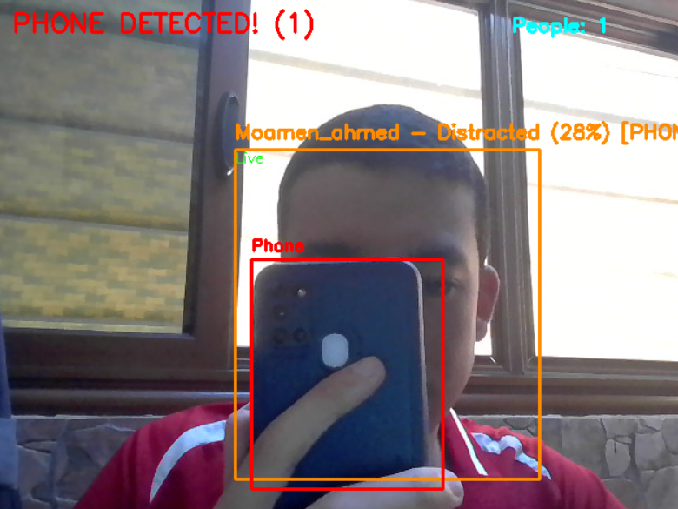
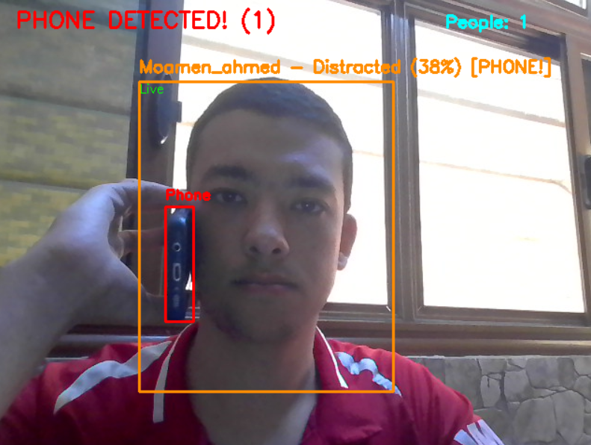
Phone Attribution Pipeline
📱 YOLOv8 Detection
📍 Nearest Face Matching (Bounding Box Proximity)
✅ Phone Owner Assignment
👤 Face Detection
How It Works
Why Per-Person Attribution?
YOLOv8 detects phone bounding boxes. The system calculates the distance to each tracked face and assigns the phone to the nearest person.
Unlike generic phone detection, our system knows WHO is using the phone — enabling fair, individual accountability.
DEPI - Graduation Project
13

Slide 14
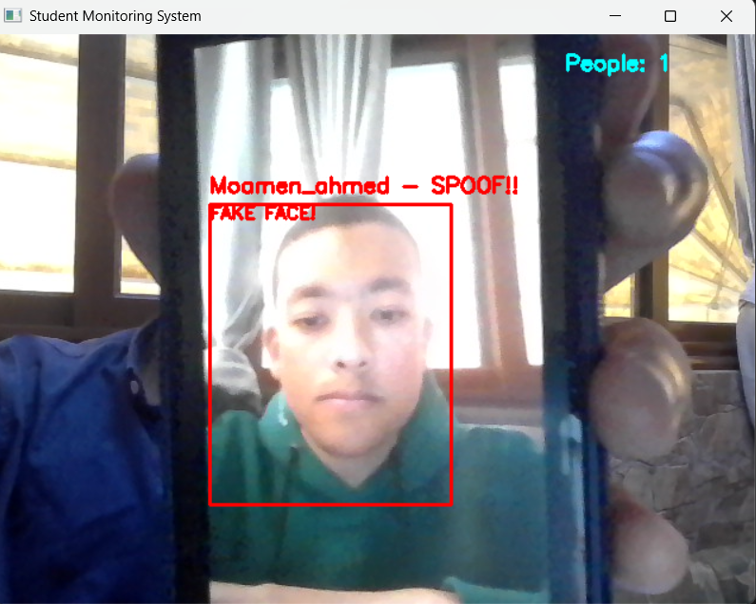
Anti-Spoofing (Liveness Detection)
👁 EAR Monitoring
💡 Blink Detection
✅ Live
Key Parameters
⚠ No Blink Detected
EAR Drop Threshold:
20% below median
Absolute EAR Limit:
< 0.24
⏳ Grace Period
Grace Period:
18 samples (~6 sec)
Liveness Timeout:
150 samples (~50 sec)
🚨 SPOOF DETECTED
Min Blink Frames:
1 frame
Max Blink Frames:
10 frames (~3 sec)
Adaptive EAR Threshold
Grace Period Mechanism
3-second calibration captures personal baseline EAR. Blinks detected when EAR drops below threshold.
After initial liveness confirmation, if no blinks are detected for a configurable timeout, the system flags the face as SPOOF.
DEPI - Graduation Project
14

Slide 15
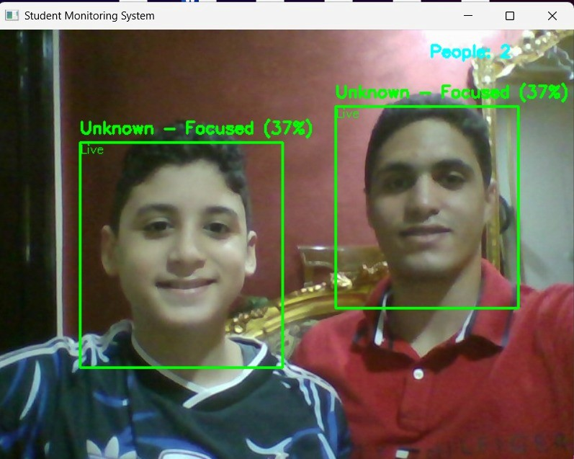
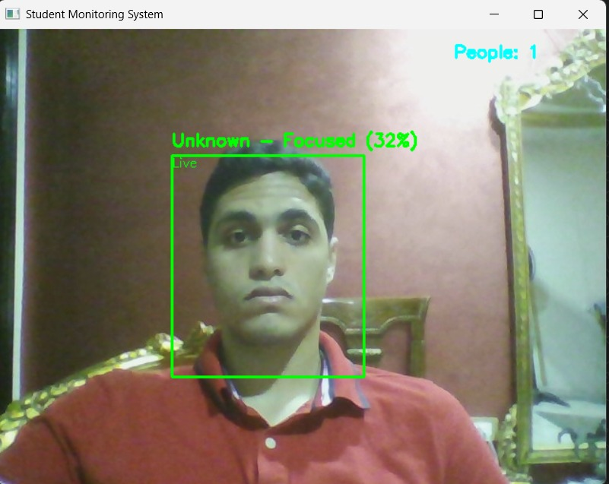
Multi-Person Tracking
📷 Camera
👥 Up to 4 Faces
Independent Tracking
Per-Person Focus
📊 Per-Person Analytics
PersonState Manager
Majority Vote Buffer
Independent Reports
Each detected face gets an independent state object tracking focus votes, blinks, and identity.
3 predictions/sec with rolling majority vote for stable, noise-resistant classification.
Each student gets individual focus %, session duration, and distraction breakdown.
DEPI - Graduation Project
15

Slide 16
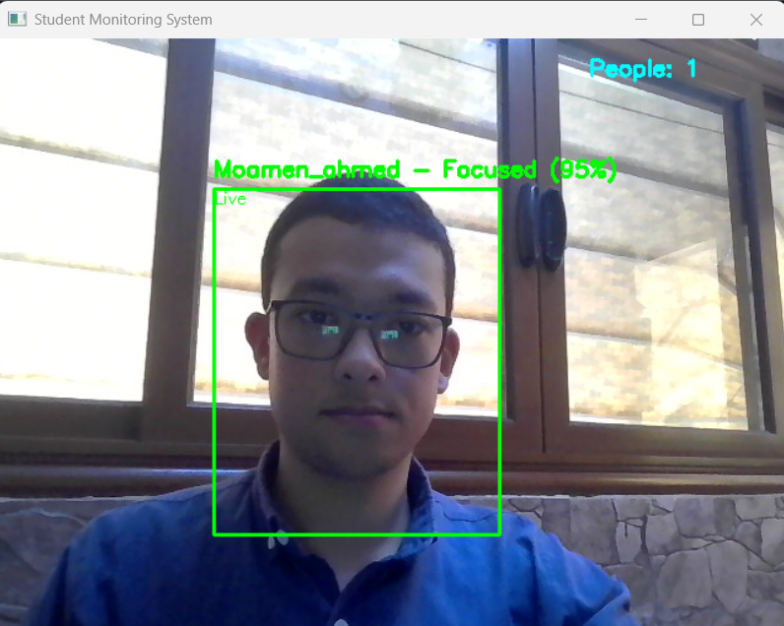
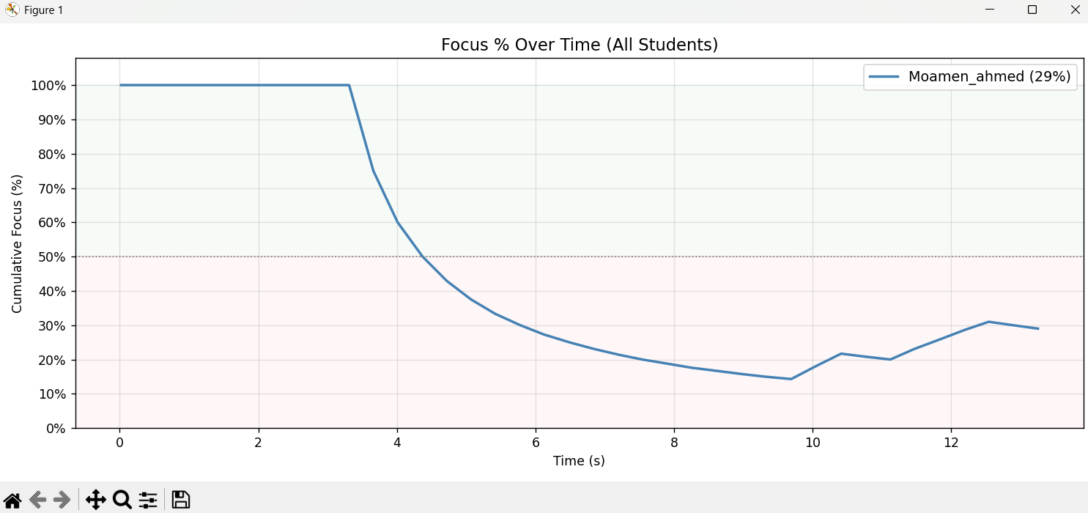
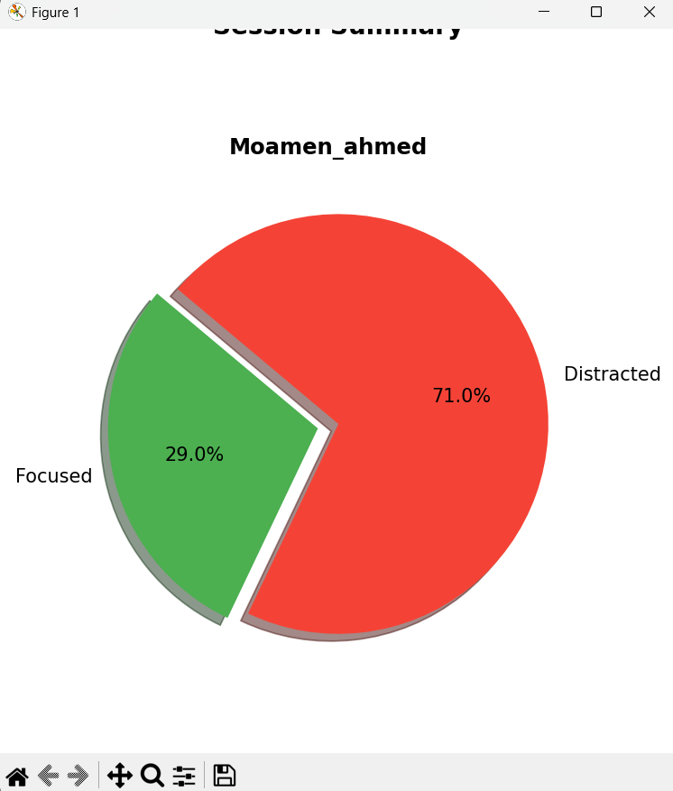
Live Application & Testing
1
Launch
Run py src/main.py — all models load automatically.
2
3-Second Calibration
System reads neutral head pose and EAR baseline to personalize predictions.
3
Real-Time Monitoring
Each person gets a labeled bounding box updated 3× per second.
4
Session End (press Q)
Timestamped CSV saved + per-person analytics charts displayed.
DEPI - Graduation Project
16

Slide 17
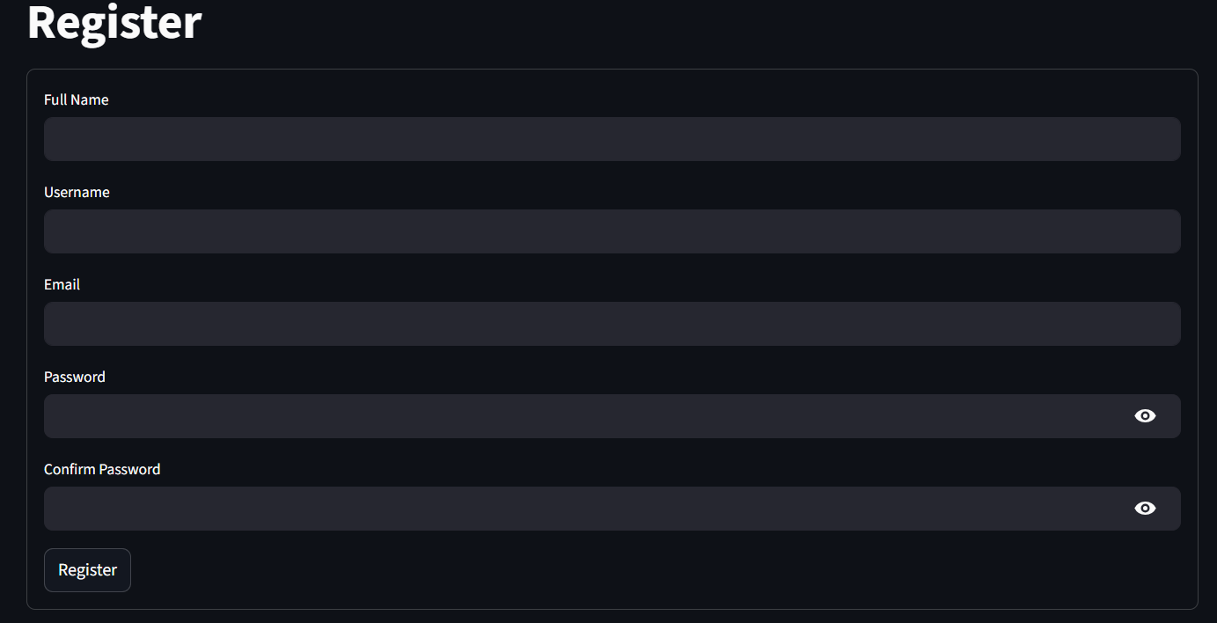
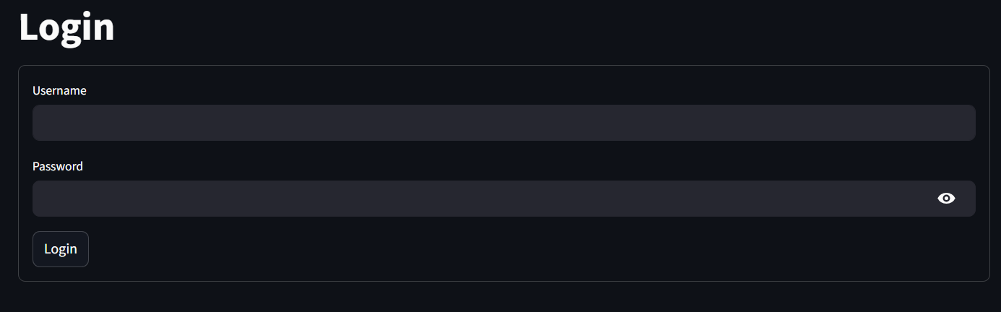
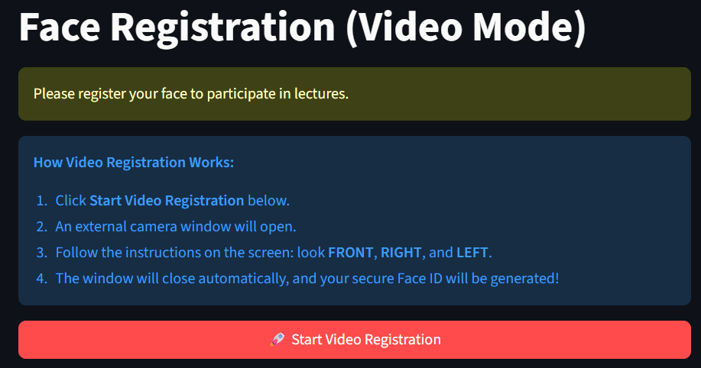
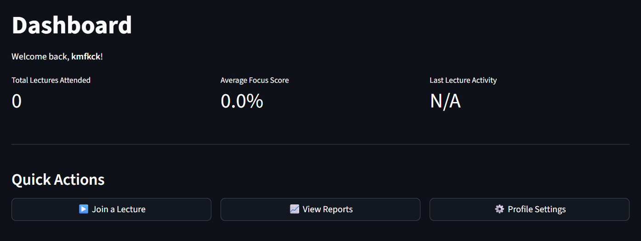
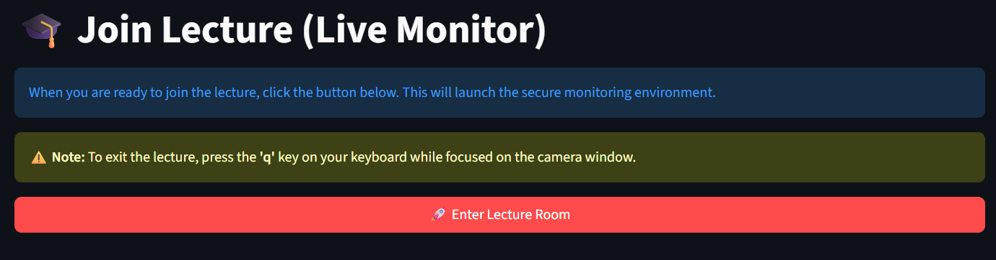
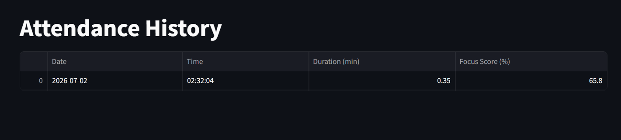
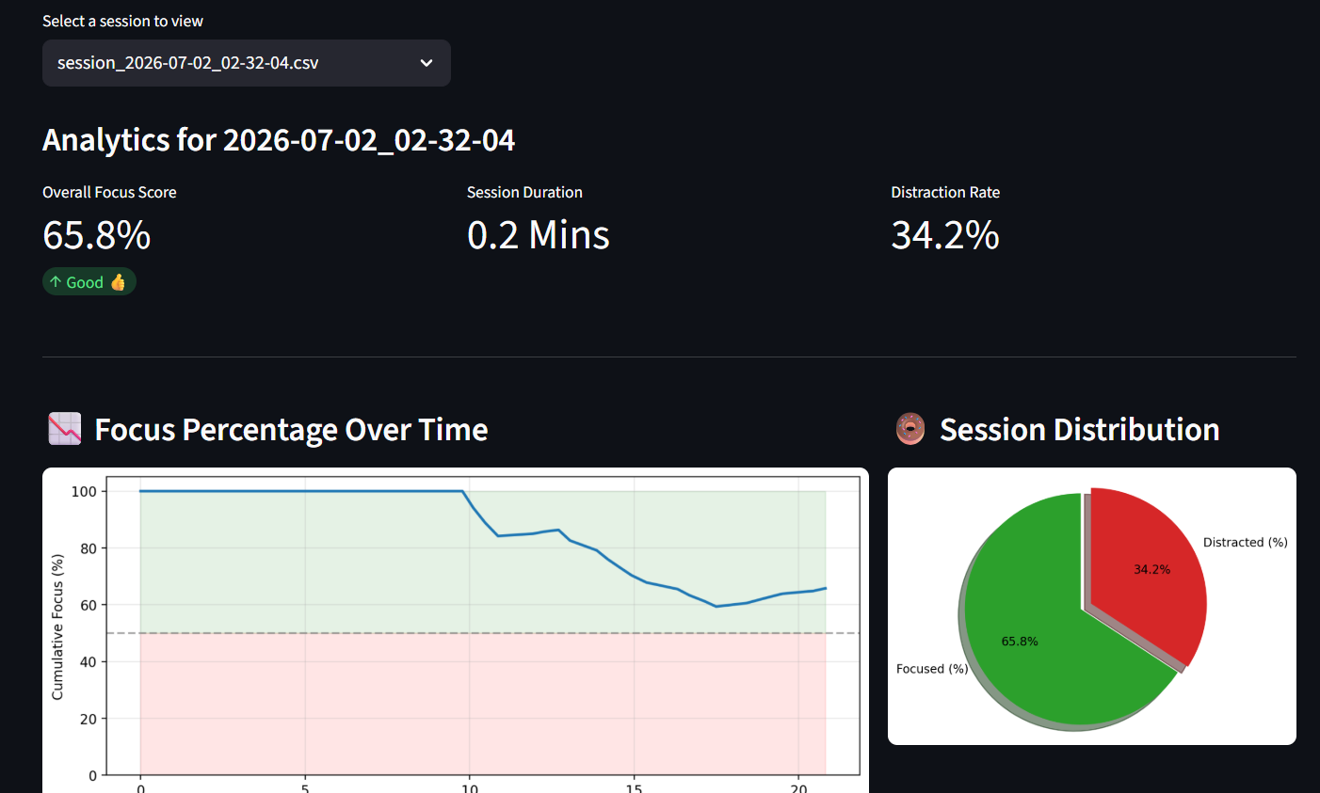
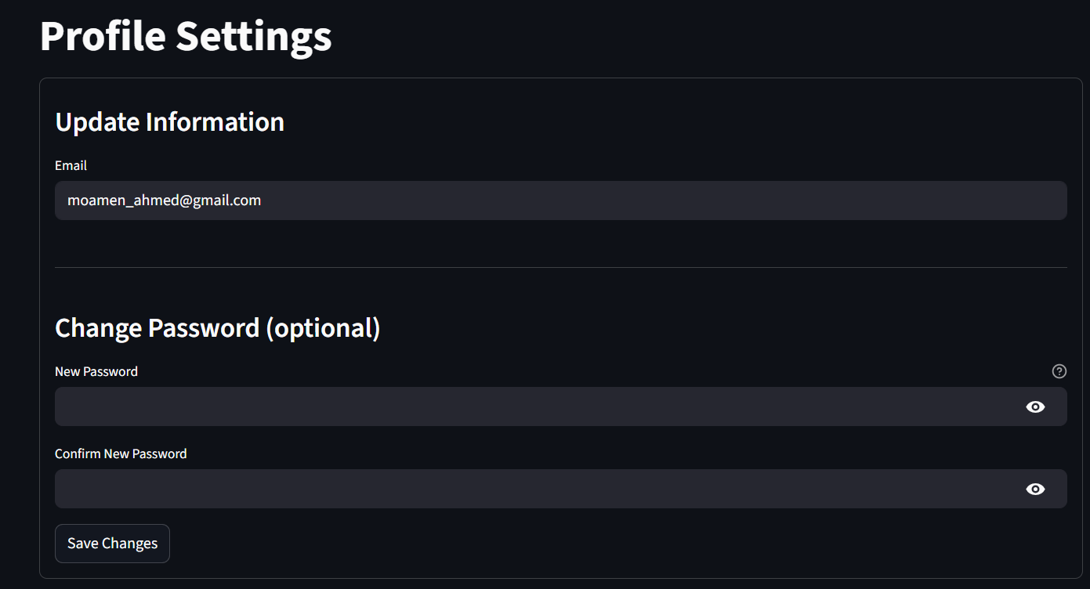
Web Application Architecture
🌐 Browser (Client)
🎮 Streamlit + WebRTC
🔒 Auth + SQLite DB
📷 OpenCV Pipeline
🧠 MediaPipe + AI Models
📊 Dashboard, Reports & n8n Automation
DEPI - Graduation Project
17

Slide 18
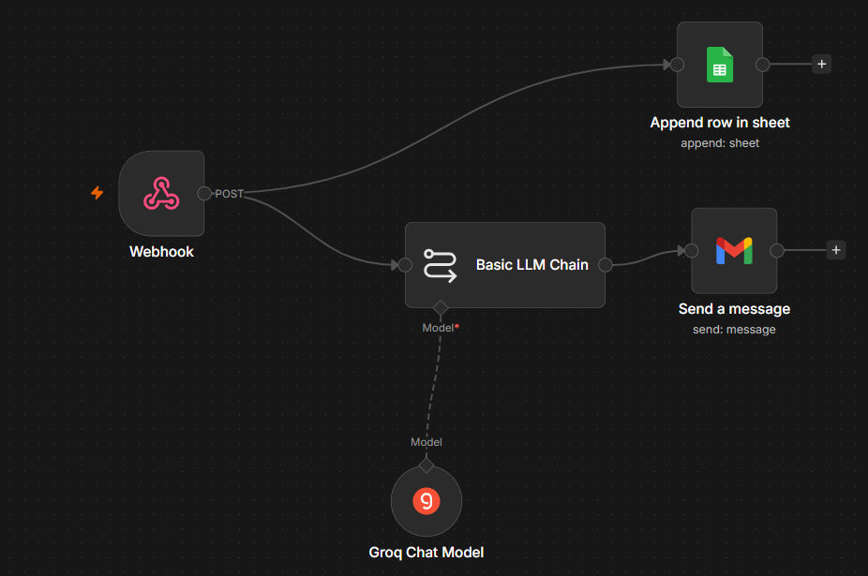
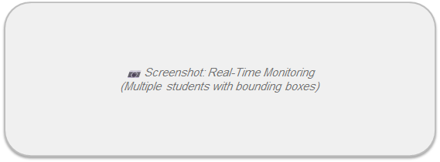
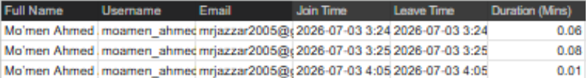
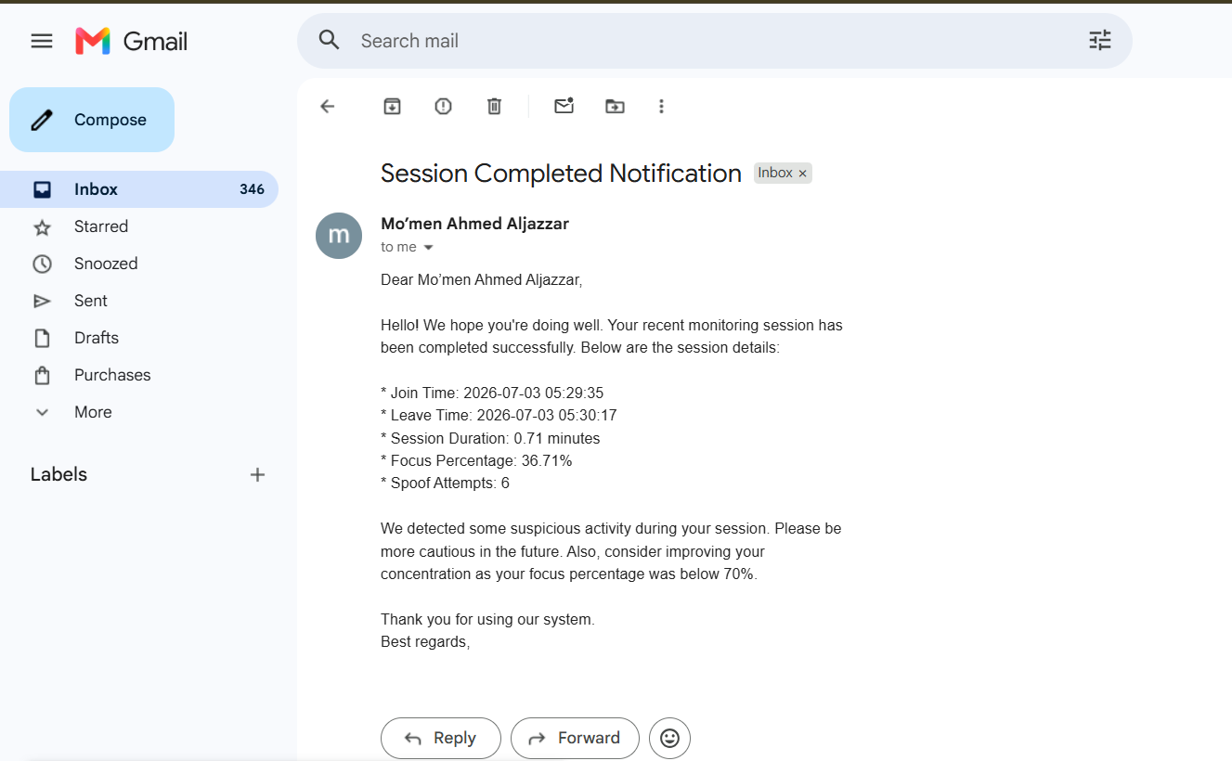
n8n Automation Workflows
1. Session Data Aggregation Triggered via webhook immediately upon session end. Receives student focus metrics and tracking data. 2. Google Sheets Integration Automatically formats and logs attendance, session duration, and average focus percentages directly into a structured Google Sheet for institutional records. 3. Email Notifications Generates and sends personalized feedback emails to students, including their individual performance, focus analysis, and any detected distractions during the session.
DEPI - Graduation Project
18

Slide 19
Limitations
1
⚠ Limited Capacity
Currently supports monitoring up to 4 students simultaneously.
2
👤 Face Visibility Required
Students must have visible, unobstructed faces for accurate detection.
3
📏 Distance Limitations
Accuracy decreases significantly for students sitting beyond 4-5 meters.
4
🗘 Head Pose Constraints
Extreme head rotations beyond ±45° reduce landmark detection quality.
DEPI - Graduation Project
19

Slide 20
Project Deliverables
📦
Source Code Repository
Project Timeline
Full modular OOP codebase on GitHub — src/, scripts/, notebooks/ organized by responsibility.
Dataset Collection& Labeling
🤖
Pre-Trained Model Files
model.pkl (Random Forest) + scaler.pkl (StandardScaler) — ready to run without retraining.
📓
Jupyter Notebook
Feature Engineering & Model Training
notebooks/experimentation.ipynb — full ML pipeline: EDA, feature engineering, model training, evaluation.
📄
Technical Documentation
Detailed README.md covering system architecture, quick-start guide, dataset downloads, and pipeline.
System Integration & Testing
📊
Session Analytics & n8n Automation Output
Per-session timestamped CSV + Matplotlib charts (focus line chart + per-person pie charts).
Final Deployment & Presentation
🐍
Data Preparation Scripts
generate_embeddings.py — builds face DB from video. extract_features.py — converts images to CSV.
🌐
Streamlit Web app
Full 8-page web app + n8n Automated Workflows (Email & Sheets integration)s, Profile.
DEPI - Graduation Project
20

Slide 21
Future Work
📱 Mobile Application
☁ Cloud Deployment
iOS & Android real-time monitoring app
Scalable cloud-based architecture (AWS/GCP)
🤖 Transformer-Based Detection
😊 Emotion Recognition
Vision Transformers for improved focus classification
Detect student emotions for deeper engagement analysis
📏 Distance Limitations
📈 Larger Dataset
Accuracy decreases significantly for students sitting too far (e.g.,beyond 4-5 meter from the camera lens.
Expand dataset with diverse classroom environments
DEPI - Graduation Project
21

Slide 22


Thank You
GitHub Repo
Demo Video
DEPI - Graduation Project
22

