Slide 1
PegasOS
Group 23

Slide 2
PegasOS Team
Hardware
Jacqueline Godier - Drivers Jacob Thomas - MMU
Project Management/Sponsor
Christopher Walen
Software
Kenny Alvarez - File System, Shell Jacqueline Godier - Scheduler, System Tasks Giancarlo Guillen - Command Shell, User System Jacob Thomas - Memory Management, Page Table Christopher Walen - Shell, Scheduler, Dependencies

Slide 3
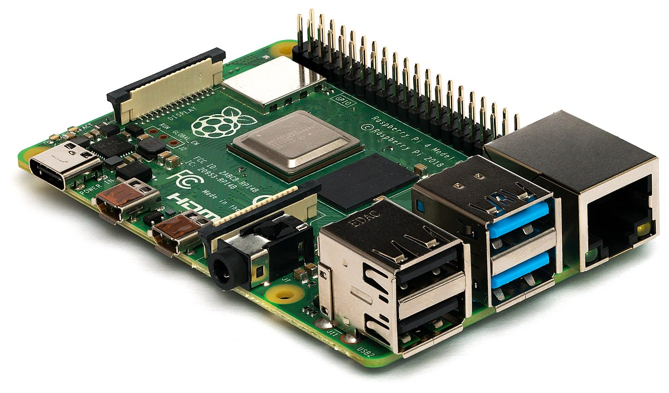
Special Thanks
Raspberry Pi Foundation
Circle Library and Rene Stange (rsta2)

Slide 4
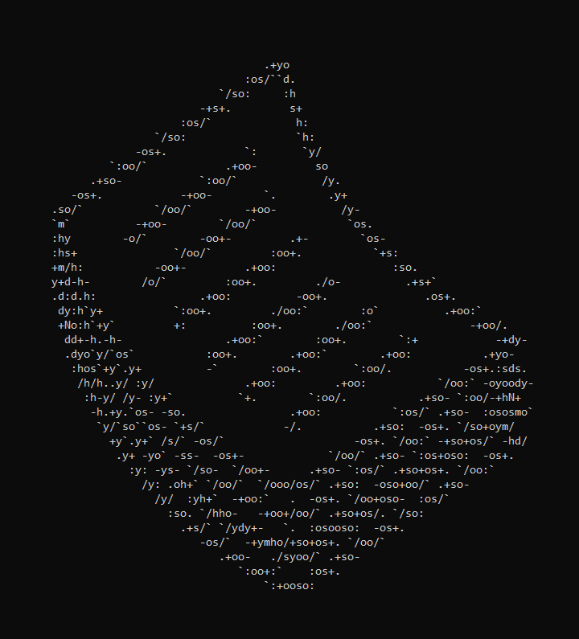
About PegasOS

Slide 5
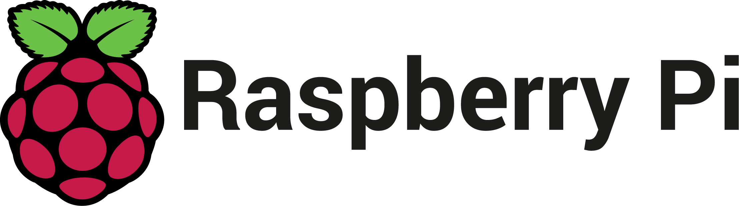
What is PegasOS?
PegasOS is a new operating system for the Raspberry Pi 4. The primary focus is for 64-bit support, but it can also be compiled into a 32-bit kernel image.
Previously known as KnightOS, the name had to be changed to avoid conflict with an existing open-source OS for calculators.

Slide 6

Who is PegasOS for? Why?
PegasOS is for those that are interested in working with the bare-metal of the Raspberry Pi 4. Every aspect of the OS is documented, making it as transparent as possible for users who want more information about the system they’re using.
PegasOS provides an entry point into the lower end of the Raspberry Pi 4, which has previously been a more involved and obscure process.

Slide 7
Project Budget
Project Budget
Item | Price | Quantity | Total Price
Raspberry Pi
Micro HDMI cable | $7 | 1 | $7
Micro SD card | $9 | 1 | $9
Raspberry Pi Kit | $75 | 3 | $225
Total |  |  | $241

Slide 8
Project Licensing
The project is open source under the GNU General Public License, v3 (GPL 3) and newer. All repositories and documentation are currently open to the public and will remain so.
The Circle Library is open source under GPL 3 as well.
The Raspberry Pi itself does not have any licensing requirements, as per the Foundation’s response in their FAQ.
https://www.raspberrypi.org/documentation/faqs/#commercial

Slide 9
Features
Hardware Compatibility Uses the Circle Driver Library, which includes support for USB devices, Raspberry Pi GPIO and System Components, Networking, and Graphics.
Simple Command-Line Interface Commands designed with ease-of-use syntax and naming, to reduce the number of times Google is pulled up.
No Bloatware Any program or service on the system is solely for running the system, and no data is collected and sent to a database somewhere.

Slide 10
Research
To get PegasOS off the ground, we had to become very familiar with the Pi 4 and its changes over previous models. A lot changed between just the Pi 3 and Pi 4.
The research behind PegasOS can be used to get developers up to speed with putting their own projects on the Pi hardware, using the Circle Library, or developing for PegasOS.

Slide 11
Research
Our source-code repository is open to the public. All of our designs, guides, and documentation are available online in a separate GitHub repository.
The work put in to making the system usable for us is as much a resource for ourselves as it is for others wanting to work with the bare-metal of the Pi.
https://github.com/MrJellimann/PegasOS https://github.com/MrJellimann/PegasOSDocumentation

Slide 12
Challenges
Raspberry Pi 4’s quirks meant we couldn’t use old or simple drivers for previous Pi’s, and finding non-Linux drivers for the Pi 4 took time.
Booting off of the Pi previously was an effort in C, converting to Circle meant the entire project had to be rebased in C++.
Circle is a very large driver library, making sense of it has taken a lot of effort and time away from actual development.

Slide 13
PegasOS Hardware

Slide 14
The Raspberry Pi 4
Specs:
CPU: Broadcom BCM2711, Quad core Cortex-A72 (ARM v8) 64-bit SoC, 1.5Ghz
RAM: 2GB/4GB/8GB
Connectivity: 2.4GHz/5.0GHz IEEE 802.11ac wireless, Bluetooth 5.0, BLE
Codecs/Other: H.265, H264, OpenGL ES 3.0
Ports:
2x USB 3.0, 2x USB 2.0
GPIO 40x pin Header
2x Micro-HDMI ports
2-lane MIPI DSI display port,
2-lane MIPI CSI camera port
4-pole stereo audio and composite video port
Micro-SD card slot for OS and Storage
USB-C Power (5v, 3A minimum)
Power-over-Ethernet

Slide 15
Why the Raspberry Pi 4?
Previous Raspberry Pi’s were only capable of running 32-bit operating systems, with the exception of the Pi 3.
With the Pi 4 becoming more popular, we want to use this opportunity to increase the 64-bit OS market.
We also wanted to take full advantage of the SBC’s hardware capabilities. Instead of just running a 32-bit system in 64-bit space.

Slide 16
64-bit
64-bit systems are not going away any time soon, and for good reason. It can handle more data, both in cache and in memory, and old 32-bit software because it can occupy the same space as before on the processor.
Because PegasOS can be compiled by the user, it can also be compiled for 32-bit if they want a 32-bit system.

Slide 17
Cross-Compiling to ARM
Setting up a cross compiler came with several challenges.
Since there was no clear documentation on the process, it was trial and error to get everyone compiling on their computers.
Most team members ran the cross-compiler through Ubuntu on Windows OS. The process of setting up is very long and confusing, and we have a written guide explaining each step of the process.

Slide 18
The Challenges of New Hardware
When researching the hardware design of the Pi 4, we found it to be not just an upgrade over the previous generation, but an entire redesign as well.
To start, the boot is no longer from bootcode.bin but from files already on the internal EEPROM. Any customization to it must be exclusively done through config.txt.
Furthermore, there is little to no online documentation for Pi 4 hardware due to how new it is.

Slide 19
Hardware Drivers
Whereas the Pi 3’s port could be handled with a simple USB driver, the Pi 4 needed PCI bus, host controller, and several types of usb drivers to communicate in tandem.
As such we decided to source the Circle Library, which provides bare-metal environments for programs to run on. The decision to do this was mostly based on time constraints, as building just one driver on the Pi 4 from scratch is a Senior Design project in of itself.

Slide 20
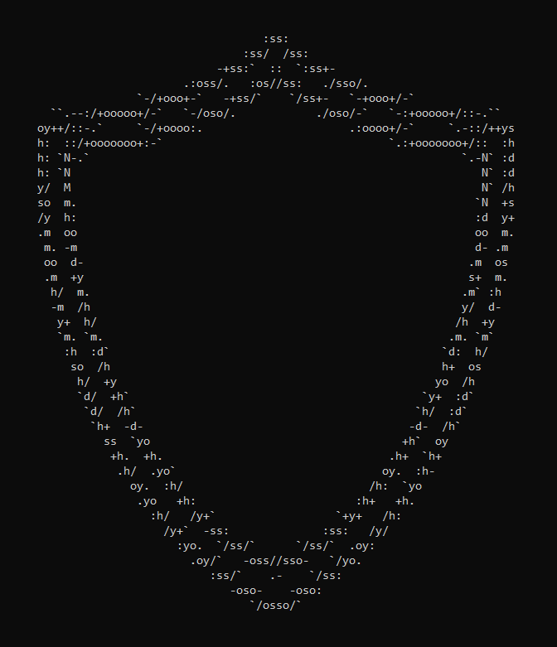
PegasOS Software

Slide 21
Circle Driver Library
The Circle Library is an open-source C++ driver library for the Raspberry Pi, that comes with a bare-metal environment to interact with those drivers.
It allowed us to quickly get above ground level and start implementing substantial OS code.
Circle has been maintained for 6 years and we are actively in contact with the creator.

Slide 22
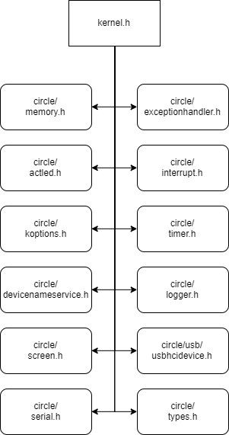
Kernel Design
Our original designs had to be put to the side to work with the framework provided by Circle.
The kernel contains:
Task Management and Interrupts
Memory Management through the MMU
File Management through FAT
USB Keyboard Drivers

Slide 23
Task Management
As of now, the scheduler is based on a FIFO queue. Each tasks can be programmed to given up control after a certain amount of time.
Every task class is encapsulated by a CTask class, so new types of tasks can be scripted and fed into the scheduler as long as it is a child of the CTask class.
We have also implemented weights to each task. The higher the weight, the farther to the front the task will be added to the queue.

Slide 24
Memory Management
An important part of this OS is for it to communicate with the Memory Management Unit (MMU).
A MMU is a hardware component that is responsible for handling memory and caching operations. This MMU is usually located within the CPU.
MMUs will use a translation table to allow us to translate virtual memory to physical memory.

Slide 25
Memory Management
Utilizing the MMU for our OS will help solve several important issues when a program is running.
Required in order for the Raspberry Pi to boot.
Allows for programs to use their own private virtual memory space.
Lets the OS manage the memory, not the programmer or their program.

Slide 26
File Management
Our original plan for PegasOS was to get Ext2 working as our file system. Some of the benefits it offers for our system includes:
Its open source (under GNU GPL v2).
Support of large file sizes (up to 2TB).
More efficient and less likely to encounter errors when compared to a FAT file system.
However the code-base for Ext2 was more complex than we had anticipated.

Slide 27
File Management
We decided on a FAT variant for our system for its simplicity and compatibility with the storage mediums for the Pi (SD, USB).
We did not make our own implementation for the sake of time, and instead are extending a basic implementation found in the Circle Library.

Slide 28
File Management
The Circle Library also contains exFAT but the Pi 4 cannot boot off of exFAT as it can only boot from FAT32/16 partitions and our system can only use the partition it booted from.
Currently PegasOS uses FAT32 on a single partition of the micro SD card.

Slide 29
PegasOS File System Features
Open/create files
Read data from files
Write data to files
Expand file sizes
Shorten file sizes
Remove files
Move files to a different directory
Rename files
Get size of a file
Test for errors on a file
Open/create directories
Remove directories
Read items in a directory
Change current directory
Check existence of a file or directory
Change attribute of a file or directory(ex. set to read-only)

Slide 30
Command Line Interface
While GUIs are ubiquitous and intuitive, they are a project in their own right. We needed something that would be feasible given our scope and timeframe.
The traditional Command-Line has a great aesthetic that we like, and it offers a ton of control over the system that can be hard to find even in well-made GUIs.

Slide 31
PegasOS Visual Shell Design
For the visual design of the shell, we stuck with the tried and true look, hence the black screen and white letters on the screen. We also have commands that allow the user to change their user name and directory color to add some customization.
Our stretch goal was to add more features to the CLI to give PegasOS some more flair but due to time constraint we had to omit them.

Slide 32
PegasOS Internal Shell Design
The way we planned on implementing the shell commands was similar to that of Linux. They have separate files for each of their commands and have one main file that calls them.
We wanted to do this approach because it would future-proof the shell. Expanding or modifying the available commands would be as simple as adding new binaries to the shell’s command directory.
Unfortunately, we were not able to do so due to certain limitations of Circle.

Slide 33
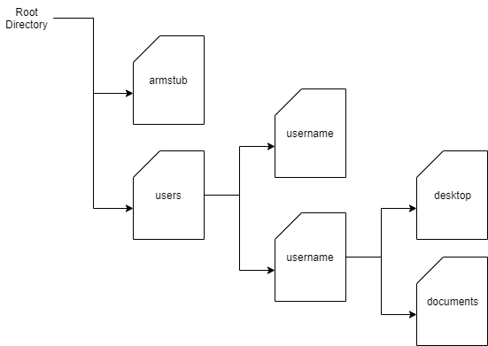
PegasOS Internal Shell Design
For usage of the system, the user will be interacting with the root directory on the initial boot. The user will then be prompted to sign in via entering their username and password.
If no user is found, they will be asked if they wish to create one, if not then they re-enter their username.

Slide 34
PegasOS Shell Commands
For PegasOS we will be implementing 23 commands that will enable the user to navigate through directories, use the file system, and execute tasks.
The supported commands are:
changedir
clear
copy
createdir
createfile
currenttasks
delete
deletedir
dirtext
displaytasks
echo
head
hello
help
listdir
memorystats
move
power
reboot
systeminfo
tail
usertext
writeto

Slide 35
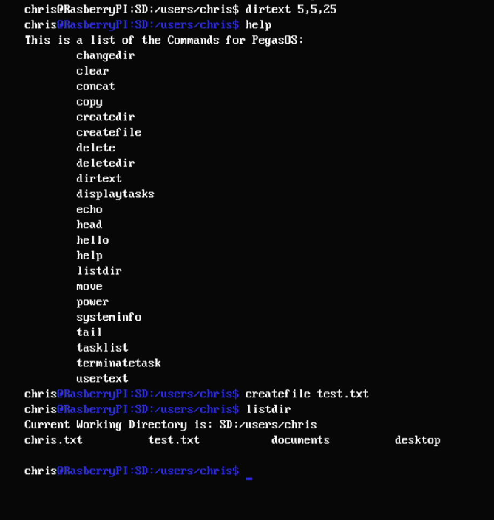
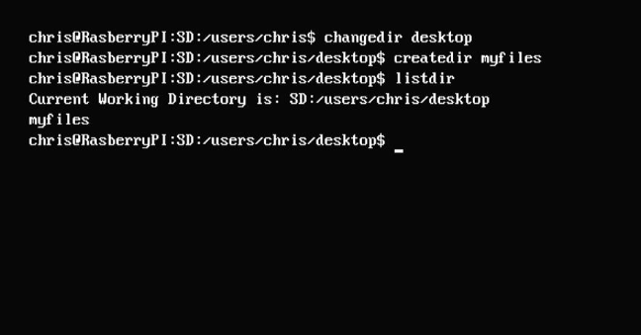
PegasOS Shell Commands

Slide 36
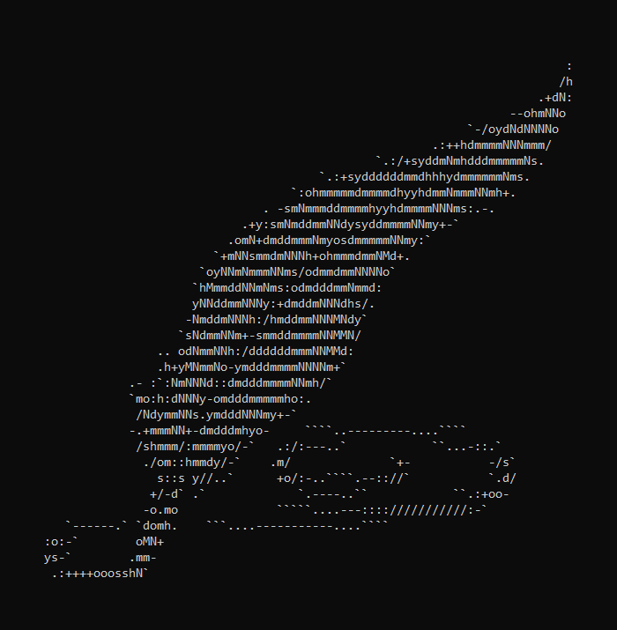
The Future of PegasOS

Slide 37
What’s next for PegasOS?
Our scope had to change as R&D progressed, so not everything that we hoped for is in the current system.
However this means that PegasOS has lots of room for expansion and extra features. With a solid foundation we hope that it can serve as a great jumping off point for future projects, both in and outside of PegasOS.

Slide 38
What’s next for PegasOS?
Future Feature Ideas:
A true GUI interface
System Encryption
System Networking
PegasOS Drivers

Slide 39
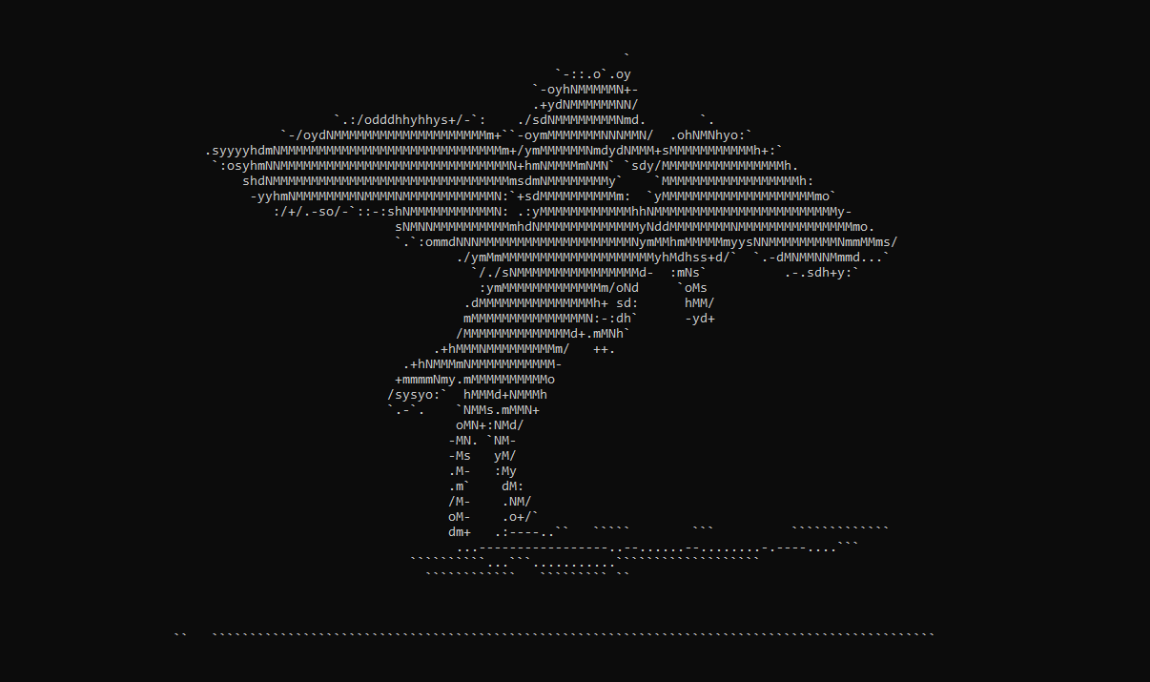
PegasOS

