Slide 1
ELUNA 2019 Dev Days Alma Course
Presenter: Jeremy Hobbs / Cal Poly San Luis Obispo
jthobbs@calpoly.edu
github.com/MrJeremyHobbs

Slide 2
Outline
What to Expect
By the end of this course, you will know how to:
Create your own configuration files.
The basics of creating GUI interfaces.
Make API calls to Alma.
Parse XML data from Alma.
Create or update data in Alma using APIs.
Test your applications.

Slide 3
How?
By re-creating one of my programs, LazyLists, from scratch (or, mostly from scratch).

Slide 4
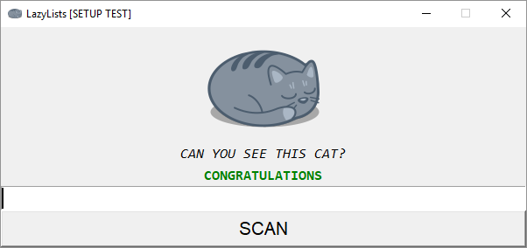
What’s LazyLists
LazyLists is an application that allows a user to add items to a set in Alma by scanning the barcode of a book in hand.
It’s as simple use case that we can re-create in about three hours.
By the end of this course, you will have a fully functioning template that will allow you to plug in your own code to do lots of other tasks in Alma.

Slide 5
Questions?

Slide 6
Let’s get started!
Go to: http://bit.ly/eluna-alma-workshop
Click “Clone or download” and download to your local machine.
*** You already did this during the installation process, but do it again – I’ve updated the course files since then ***

