Slide 1
ELUNA 2019 Dev Days Alma Course
Presenter: Jeremy Hobbs / Cal Poly San Luis Obispo
jthobbs@calpoly.edu
github.com/MrJeremyHobbs

Slide 2
Outline
What to Expect
By the end of this course, you will know how to:
Create your own configuration files.
The basics of creating GUI interfaces.
Make API calls to Alma.
Parse XML data from Alma.
Create or update data in Alma using APIs.
Test your application.
By re-creating one of my programs, LazyLists, from scratch (or, mostly from scratch).

Slide 3
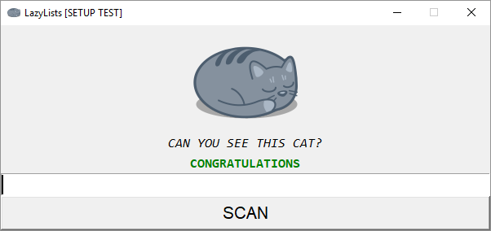
What’s LazyLists?
LazyLists is an application that allows a user to add items to a set in Alma by scanning the barcode of a book in hand.
It’s as simple use case that we can re-create in about three hours.
By the end of this course, you will have a fully functioning application that will serve as a template that you can take home and plug in your own code to create your own apps.

Slide 4
Questions?

Slide 5
Let’s get started!
Go to: http://bit.ly/eluna-alma-workshop
Click “Clone or download” (green button), download to your local machine, and unzip to a location of your choice.
*** You already did this during the installation process, but do it again – I’ve updated the course files since then ***

Slide 6
Config Files
Plain-text files that store settings for a program.
Easier than creating complex GUIs.
Store in a safe place – Security concerns.

Slide 7
GUIs
Graphical User Interface
Tkinter is a crosss-platform, cross-language GUI framework. (MAC, PC, LINUX, Perl, Python, Ruby)
Great way to start learning object oriented programming.
Could be its own lecture!

Slide 8
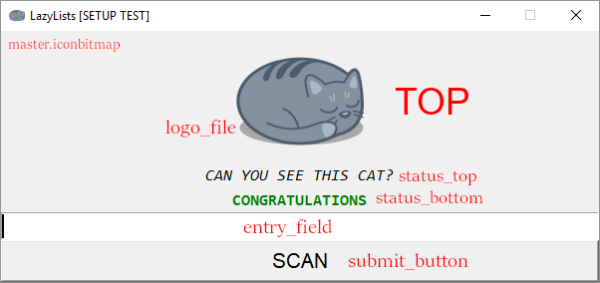
LazyLists GUI Breakdown

Slide 9
REST APIs
APIS – Application Programming Interface (allows programs to talk with each other)
REST – Representational State Transfer (you can ignore this now).
4 commands in REST APIs – GET, POST, PUT, DELETE
Alma has over 100 APIs (and are adding more regularly). Check out Alma Developer’s Network for detailed documentation on each API.

Slide 10
API Security
API permissions are fairly broad, so each application or script should have it’s own API with only the permissions needed for that script or app.
Keep API key for app stored in a safe place.
Three ways to store API keys: plain text config file (what we are doing today), store as environmental variable, or create your own API layer on top of the Alma API.
Keep your IT department in the loop and talk with them about best practices for your institution.

Slide 11
API limits
API have daily limits that are very generous, but be mindful of your API calls.
Don’t make an API call unless you need to.

