Slide 1
NetFPGA-Plus
Rocket Tile
Rocket Tile
qsfp0_phy_1_inst
riscv_qdma_0
Rocket
Rocket
eth-mac-10g_fifo
L/I
L/D
L/I
L/D
AXI LITE SLAVE
Tile Bus
Tile Bus
L2-FrontBus
BSCAN
L2 Bank
L2 Bank
AXI LITE SLAVE
BSCAN
System Bus（RISC-V）
RX
TX
riscv_qdma_0
DDR4 Memory
AXI Master Interface
AXI LITE SLAVE
Control Bus
Periphery Bus
BSCAN
BootRom
PHY MDIO
IIC
SD
DDR
UART
JTAG

Slide 2
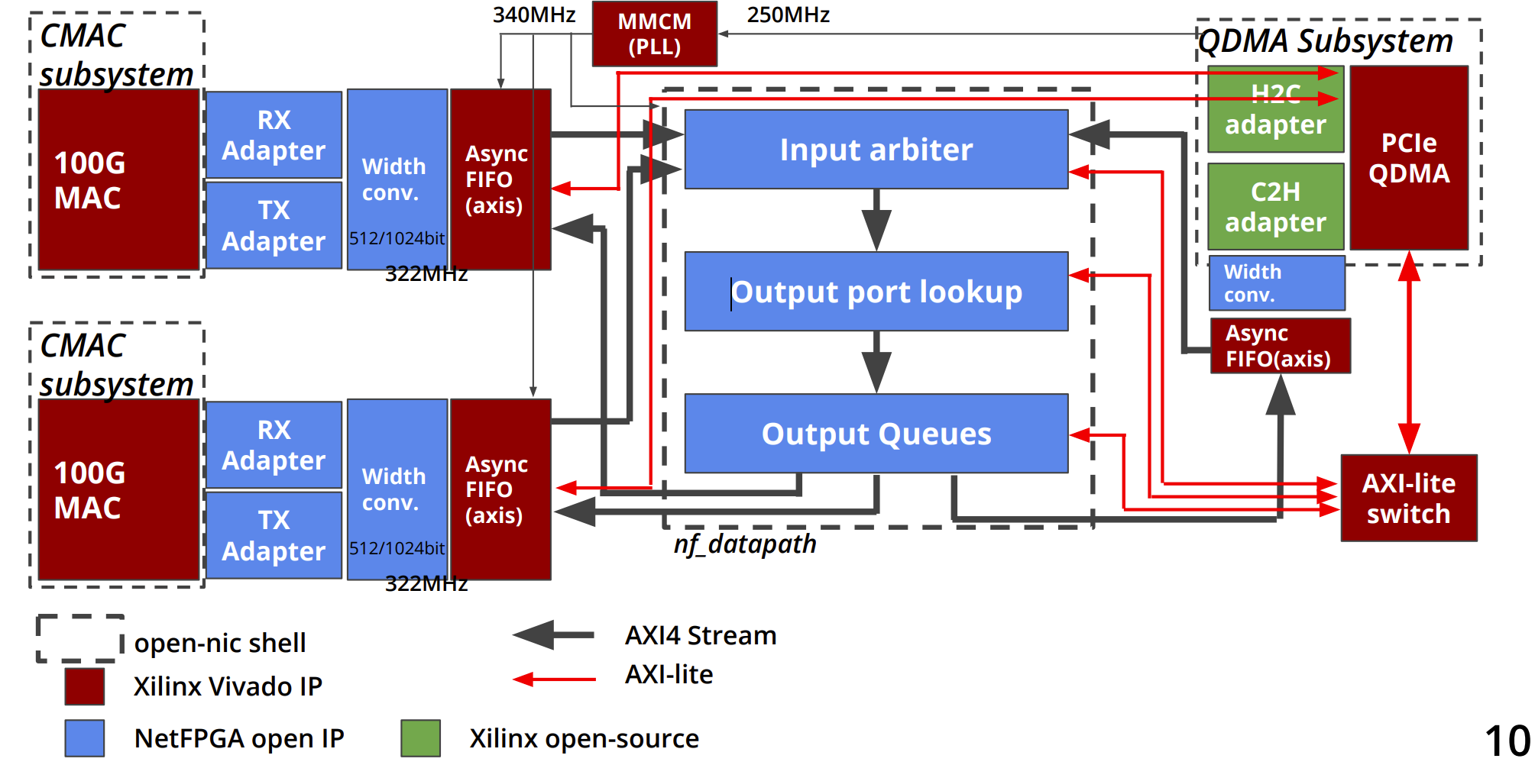

Slide 3
CMAC
OS
NetFPGA Data Path
QDMA
Output Port Lockup
Input Arbiter
Output Queues
Rocket Tile
Rocket Tile
riscv_qdma_0
Rocket
Rocket
eth-mac-10g_fifo
L/I
L/D
L/I
L/D
AXI LITE SLAVE
Tile Bus
Tile Bus
L2-FrontBus
BSCAN
L2 Bank
L2 Bank
AXI LITE SLAVE
BSCAN
System Bus（RISC-V）
RX
TX
riscv_qdma_0
DDR4 Memory
AXI Master Interface
AXI LITE SLAVE
Control Bus
Periphery Bus
BSCAN
BootRom
PHY MDIO
IIC
SD
DDR
UART
JTAG

Slide 4
eth-mac-10g_fifo
riscv_qdma_0
Rocket Tile
Rocket Tile
Rocket
Rocket
L/I
L/D
L/I
L/D
AXI LITE SLAVE
Tile Bus
Tile Bus
L2-FrontBus
BSCAN
L2 Bank
L2 Bank
AXI LITE SLAVE
BSCAN
System Bus（RISC-V）
RX
TX
DDR4 Memory
AXI Master Interface
AXI LITE SLAVE
Periphery Bus
Control Bus
BootRom
BSCAN
PHY MDIO
IIC
SD
DDR
UART
JTAG

