Slide 1
Lecture 1
Computers and Programming Languages

Slide 2
How do computers compute?
Computer: collection of hardware components that allow us to change data
Hardware components use electricity to change data
Electricity can either be present or not present
Two states of electrical presence are a binary system
We think of this system as 0 (electricity not present) or 1 (electricity is present)
A series of 0’s and 1’s causes various actions in the hardware

Slide 3
Other binary systems
Light switch
Clicker pen
Coin flip

Slide 4

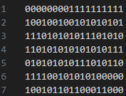
Binary to human-readable
Writing programs in binary is difficult
Compiling: The process by which human-readable text is translated into computer-readable binary
Compiler: A program that translates human-readable text into computer-readable binary
Compilation via a compiler
Human Readable Text
Computer Readable Binary

Slide 5
What is a programming language?
Programming language: A representation of computer code that humans can read and edit
Examples of popular programming languages: Python, Java, C#, JavaScript
This course will focus on the Java programming language

Slide 6
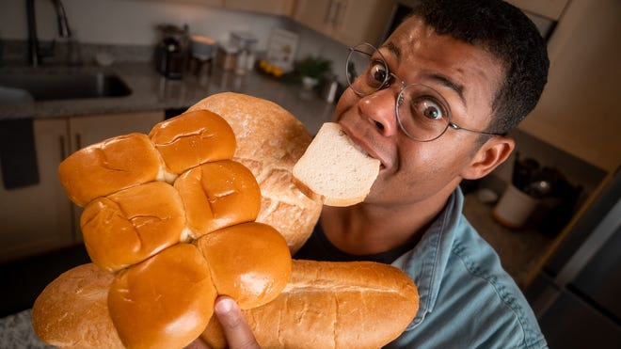
Similarities between programming and natural languages
English: I eat bread
Spanish: Como pan
Haitian Creole: Mwen manje pen
Italian: Io mangio il pane
Java: System.out.println(“Hello, World”);
C#: Console.WriteLine(“Hello, World”);
Python: print(“Hello, World”);
JavaScript: console.log(“Hello, World”);
Hello, World

Slide 7
Connecting programming to algorithms
Computers are good problem solvers! (sometimes)
Algorithm: Step by step process by which a problem is solved
Process to utilize computers to solve a problem:
Find a problem to solve
Describe your problem and a way to solve it (this is an algorithm!)
Translate your natural language algorithm to a programming language algorithm

Slide 8
Example – What’s your name?
Problem: I want to type my name into the computer and have it display on the screen.
What are the steps to solve this problem in a natural language?

Slide 9
Example – What’s your name?
Problem: I want to type my name into the computer and have it display on the screen.
The English algorithm for this problem is:
Type my name and store it in the computer
The computer displays my name

Slide 10
Example – What’s your name?
Now, translate each step in the English algorithm to a programming language (Java)
Type my name and store it in the computer→ String myName = Reader.readLine();
The computer displays my name → System.out.println(myName);

Slide 11
Example – What’s your name?
Finally, combine the steps together to get the completed algorithm!
String myName = Reader.readLine();
System.out.println(myName);
The above two lines of code are how you store and print your name in Java.

Slide 12
Closing Activity
Get with your group
1 point
2 points
3 points
The group with the most points gets LiveSchool points

Slide 13
Question 1
What is a binary system?
A system in which there are only two values
A system in which there are two or more values
A system in which there are no more than two values

Slide 14
Question 2
Is rolling a 6-sided die a binary system?
Yes
No

Slide 15
Question 3
Is turning on a faucet a binary system?
Yes
No

Slide 16
Question 4
What is the process to go from human readable text to computer readable binary called?
Construction
Compilation
Decomposition

Slide 17
Question 5
Which of the following is a programming language?
Spanish
Haitian Creole
Scala

Slide 18
Question 6
What is a programming language?
A language people use to communicate with one another
A language computers use to communicate with one another
A language people use to communicate with a computer

Slide 19
Question 7
Process to utilize computers to solve a problem:
Find a problem to solve
Describe your problem and a way to solve it (this is an algorithm!)
Translate your natural language algorithm to a programming language algorithm
What is the above an example of?
A heuristic
An algorithm
A combination of natural and programming languages

Slide 20
Question 8
How do you display “Bearcat” on a computer in Java?
Display “Bearcat”;
System.out.println(“Bearcat”);
Console.WriteLine(“Bearcat”);

Slide 21
Question 9
What is the process to create code a computer can run?
Write code in a programming language and compile it into binary
Write code in a natural language and compile it into programming code
Write code in a natural language and translate it into a programming language

Slide 22
Question 10
Name a system that isn’t binary.

