Slide 1
The Battle of Neighborhood
Presentation by : Kalpesh Shah
For: Applied Data Science Capstone Project

Slide 2
Introduction
In this assignment we talk about How good Rio de Janeiro is to open a restaurant. And would it be a place with lots of reviews from customers? Which place seems to be the most popular and the last question would be Is there a more popular restaurant in the area and what cuisines are preferred around?
The problem will be solved using the Foursquare API, looking at User Count and Tip Count. This issue will help everyone who wants to open a restaurant in Rio de Janeiro and wants to know if it is a good option where they intend to open.

Slide 3
Data
The data that will are using is Foursquare's data for Rio de Janeiro city. We will focus on venues of restaurant type. The popularity will be an indicator for how good an area is for a restaurant.

Slide 4
Methodology
Basic skills learnt from week 3 Assignments
Majorly relied on Foursquare API to retrieve all venues of each neighborhoods, then group by each neighborhoods and to count how many venues before filter top 10 most common venue types of each neighborhoods.
Lastly I plotted the Data onto map and drew out some conclusions

Slide 5
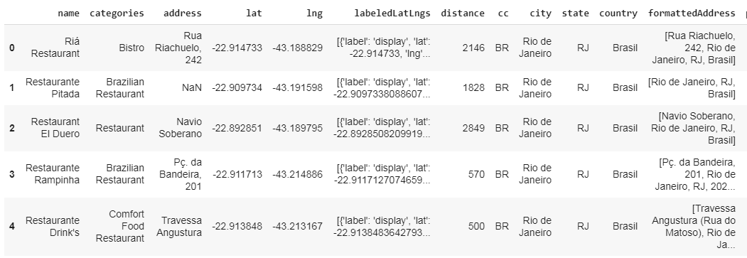
Stages
In This Stage Some of the Restaurants information from FourSquare API and cleaned according to our needs

Slide 6
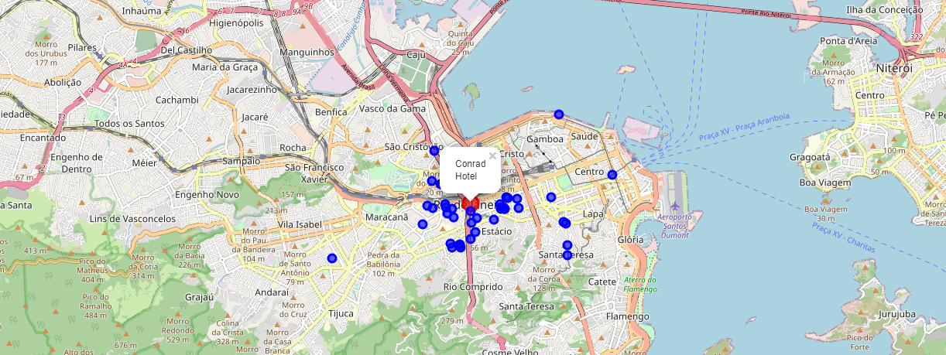
Results
We have created a beautiful Visualization showing the Restaurant Clusters and Popular Cuisines Around the Coastline of Rio de Janeiro

Slide 7
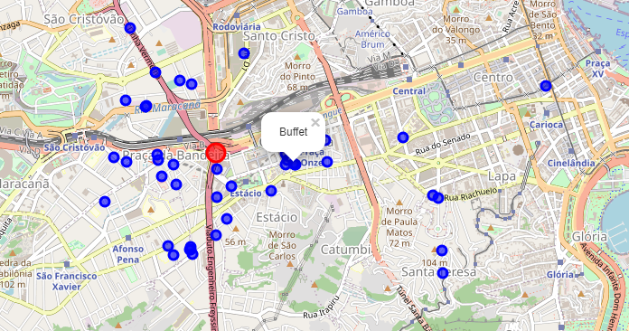
Results
We have located the Hotspots where most of the Restaurants are located

Slide 8
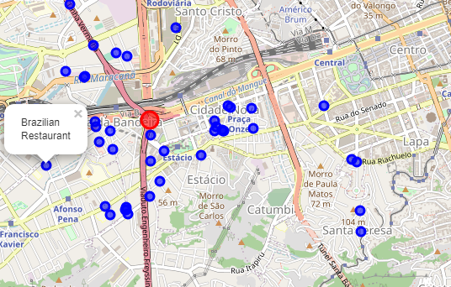
Results
We also found out that Resturants which serve local food only do not trend near hotspot zones

Slide 9
Conclusion
For travelers:
If the Travelers are looking for real local brazilin taste they must move to the remote locations away from the busy streets.
Conrad Hotel is the one stop shop for Travelers.
For business owners:
Restaurants make a good money if they are more towards the coast side.
Restaurants near hotels make more money.
Buffets and Multi- Cuisine restaurants are mostly preferred in Brazil Coast Side.

