Slide 1

ELECTIONS FORECASTING

Slide 2
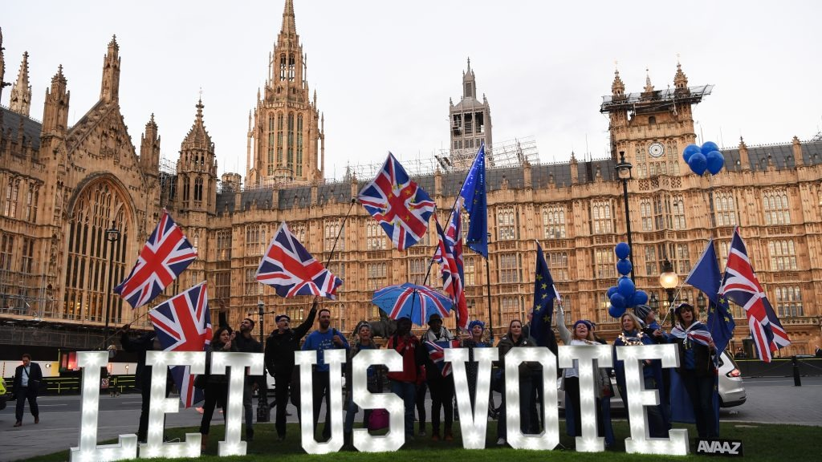



Group_8
Anil Kumar Muttineni
Sasidhar Reddy Katikam
Varshitha Jonnalagadda

Slide 3
ABSTRACT
To create an exit poll that will help in estimating an overall victory as well as the number of seats won by a certain party.
To develop accurate, reliable, and transparent methods and models for predicting election outcomes, while accounting for uncertainty and potential biases.

Slide 4

BUSINESS UNDERSTANDING
To help companies, organizations, and individuals to understand and anticipate the potential outcome of an election, as well as the political landscape that may emerge after the election.
To anticipate potential changes in policy or regulations that may affect Election result.

Slide 5





Approach
SEEKING OUR DATASET FROM KAGGLE
PREPROCESSISNG DATA FOR THE MODEL
DESCRIPTIVE STATISTICS FOR THE DATASET
DATACLEANING BY ENCODING AND SCALING
CONCLUSION AND FUTURE SCOPE

Slide 6
Data Understanding
Data Collection Data select will collect from Kaggle and can be utilized for the Data analysis.
Data Exploration To identify any patterns, trends or outliers that are relevant to the forecasting
Data Cleaning To remove any errors, inconsistencies, or missing values that effect the accuracy of the prediction
Data Validation To ensure that it is accurate, consistent and complete the requirements of the modeling and analysis

Slide 7
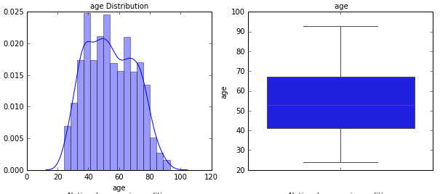
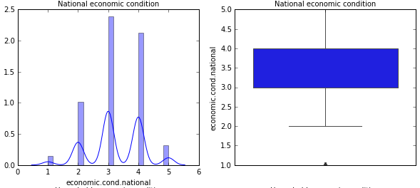
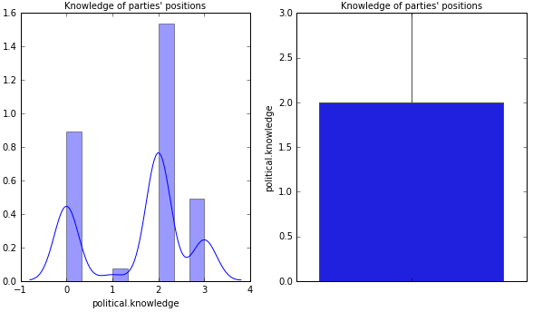
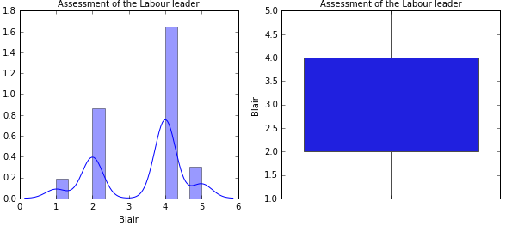
DESCRIPTIVE STATISTICS
UNIVARIATE ANALYSIS

Slide 8
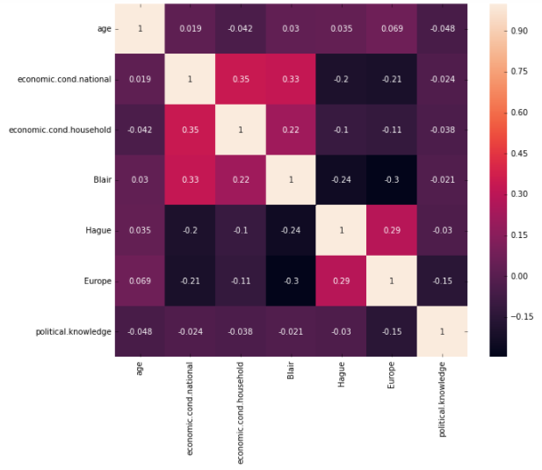
BIVARIATE ANALYSIS AND CORRELATIONS

Slide 9
FUTURE SCOPE
Further analysis on this data
Using logistic regression
Linear discriminant analysis
KNN models
Naïve Bayer’s Models
Predict out election results and the winner!
See you in the final project!

Slide 10



