Slide 1

ELECTIONS FORECASTING

Slide 2
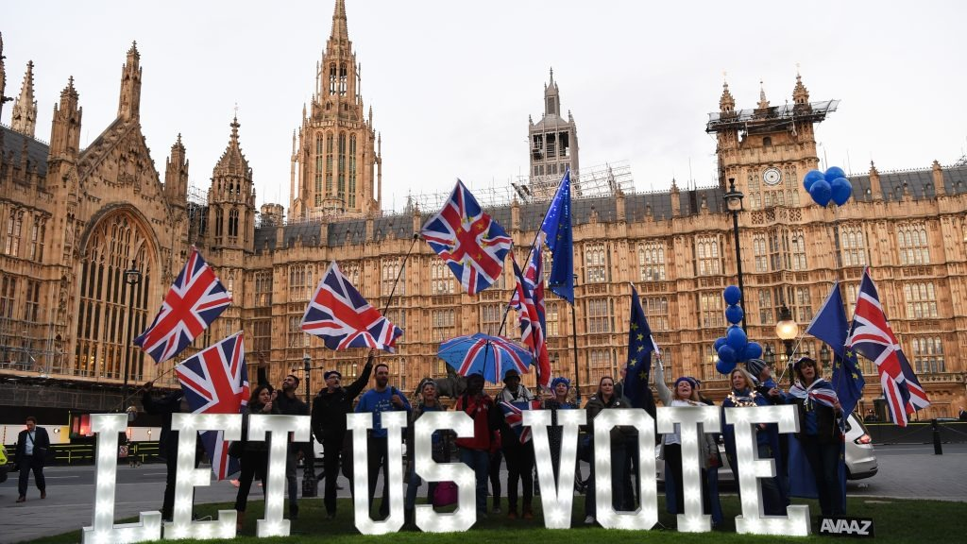



Group_8
Anil Kumar Muttineni
(Business Analyst)
Sasidhar Reddy Katikam
(Data Scientist)
Varshitha Jonnalagadda
(Data Engineer)

Slide 3
ABSTRACT
In our project, we predict the presidential election using a decision tree and Sklearn.
Only the Democrats and Republicans, the two most powerful parties in US election history, have consistently won elections every four years. So, we’ll do binary classification.

Slide 4
BUSINESS UNDERSTANDING
A decision tree is a machine learning algorithm that can be used to understand and analyze the factors that contribute to a presidential election's outcome. The process involves collecting relevant data, cleaning and preprocessing it, building a decision tree model using Scikit-Learn library, evaluating the model's performance, and interpreting the results. By using this approach, we can gain insights into which variables are the most important predictors of the election outcome, which can inform political campaigns and help them make data-driven decisions.

Slide 5





Approach
DATA PROCESSING
MACHINE LEARNING MODELING
TEST TRAINED MODELS WITH THE 2020 DATASET
PLOT PERFORMANCE OF 2 DECISION TREE MODELS
DEPLOYMENT
CONCLUSION

Slide 6
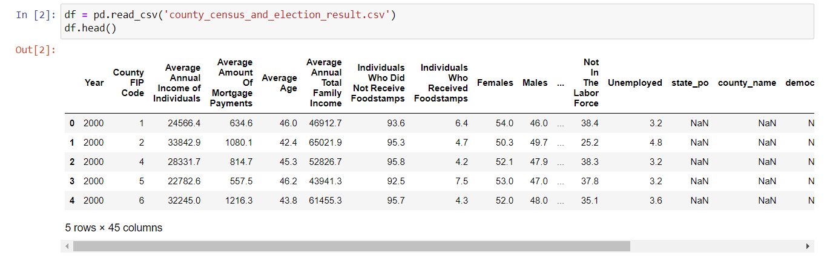
1.DATA PROCESSING
In Data Processing ,First we imported the data from Kaggle and then further we processed the data in respective steps

Slide 7
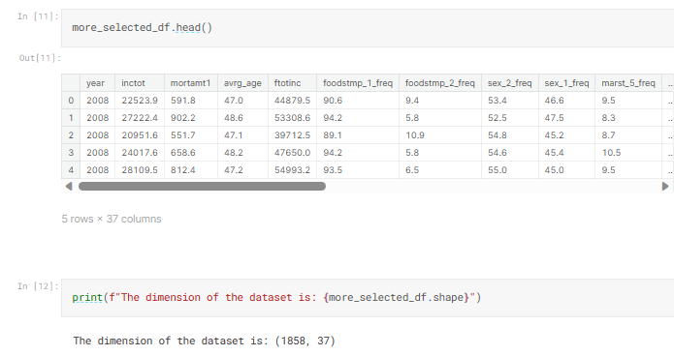
1.1. Process Original Dataset
As we consider each row as a data point to our ML model, we will drop the categorical state names and abbreviation. We will also drop the all the number of votes labels except for "winner" columns (0 for democrats and 1 for republican). We don't concern other parties as they do not have a history of winning anyway.

Slide 8
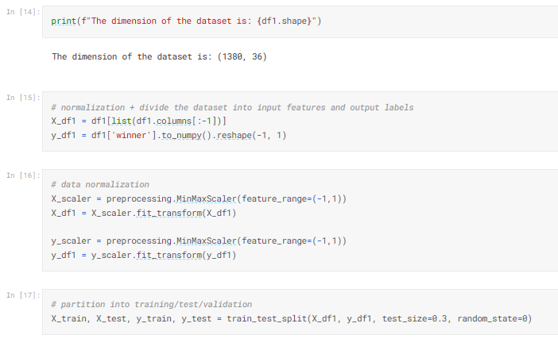
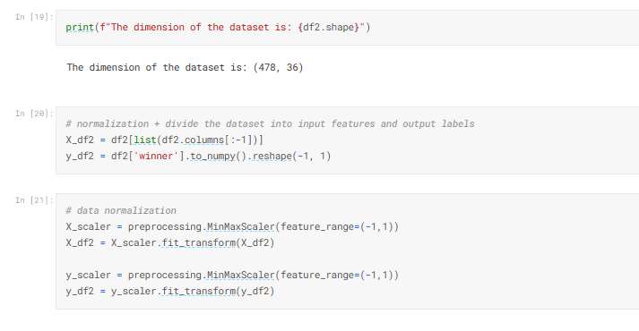
Divide the dataset into 2 datasets. Dataset 1 is within 2008, 2012, 2016 for machine learning modeling. Dataset 2 is of 2020 for testing the prediction power of the trained and validated data
1.2. Process The Dataset Of 2008, 2012, 2016 Election Years
1.3. Process The Dataset Of 2020 Election Year

Slide 9
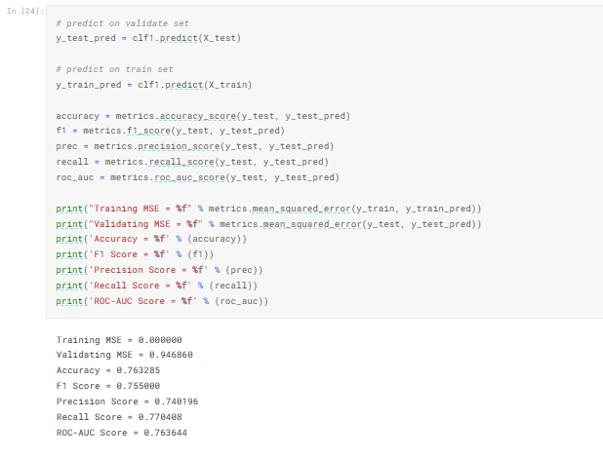
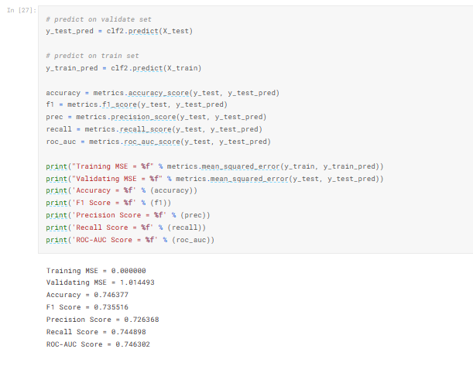
2.Machine Learning Modeling
2.1. Decision Tree With Gini Criterion
2.2. Decision Tree With Entropy Criterion

Slide 10
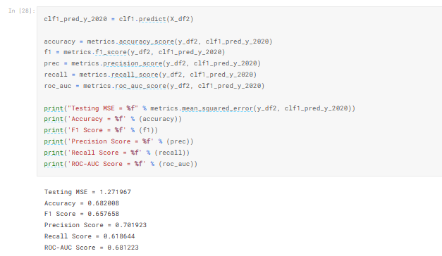
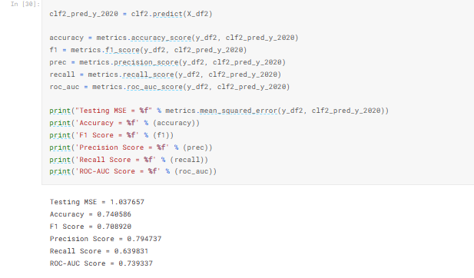
3. Test Trained Models With The 2020 Dataset
3.1. Decision Tree With Gini Criterion
3.2. Decision Tree With Entropy Criterion

Slide 11
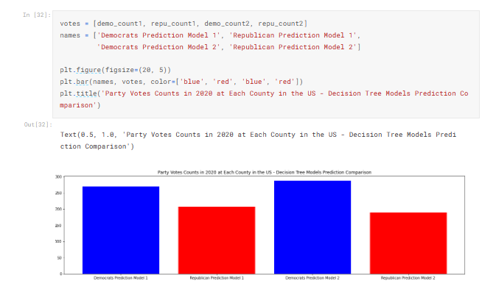
4. Plot Performance Of 2 Decision Tree Models

Slide 12

Model Deployment in Cloud
For model deployment, we are using AWS platform that we have learnt in this course.
We first write a code for the model in the backend and then deploy the best algorithm in cloud.

Slide 13
Conclusion
Decision tree Algorithm is used for both classification and regression
It can be used to classify data into multiple classes based on their features
In our project we need to classify data and need to predict, hence algorithm is best fit
Using Gini and Entropy methods we predicted accuracy and obtained the Election Result Prediction
By following this model after running for all categories we got the prediction as “ Democrat’s “ are going to win the elections

Slide 14

Submissions
Final Project Report
Presentation Video
Jupyter File
Team08_GithubLink

Slide 15

Thank You

