Slide 1
The Impact of Red Lionfish (Pterois miles and P. volitans) at Little Cayman Island.
Introduction to Data Science
Springboard
Capstone Project
Kevin Tajkowski, M.S.
Notes:
Title Page

Slide 2
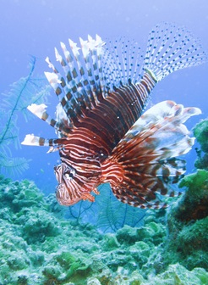
Invasive Species
Common Rabbit
Kudzu (a vine)
European Starling
Cane Toad
Water Hyacinth
Asian Carp
Zebra Mussels
Red Lionfish (Pterois volitans)
www.reef.org
Notes:
Introduction of issue: Invasive Species.
Introduction of subject: Red Lionfish.
Aquarium trade in 1980s (ref 1).

Slide 3
Lionfish Quickfacts (www.reef.org)
Generalist carnivores that consume over 70 species of fish and many invertebrates
No natural predators in the Tropical Western Atlantic
Have reduced prey populations by up to 90% at heavily invaded sites
Reach sexual maturity in less than a year and can reproduce every four days
Susceptible to very few parasites
Venomous dorsal, ventral and anal spines deter predators
Notes:
Reasons that the lionfish are such a danger.
Native to the Indo-Pacific.
Mention: study at New Providence Island, Bahamas – 65% decline in biomass of Atlantic prey species over 2 years (ref 2).

Slide 4
Interested Parties
NOAA (National Oceanic and Atmospheric Administration)
REEF (Reef Environmental Education Foundation)
Simon Fraser University (British Columbia, Canada)
USGS (United States Geological Survey)
Governments of Island Nations and nations with coastline
Notes:
Organizations involved in marine activities, concerns, etc.
All are potential clients.

Slide 5
REEF
Committed to ocean conservation
Divers and marine enthusiasts
Collects survey data on marine organisms
Started in 1990
Supported by The Nature Conservancy (TNC) and the Southeast Fisheries Science Center of the National Marine Fisheries Service (NMFS)
Lionfish project
Notes:
Details about REEF (where the data came from).
Reports, Resources, Derbies.

Slide 6
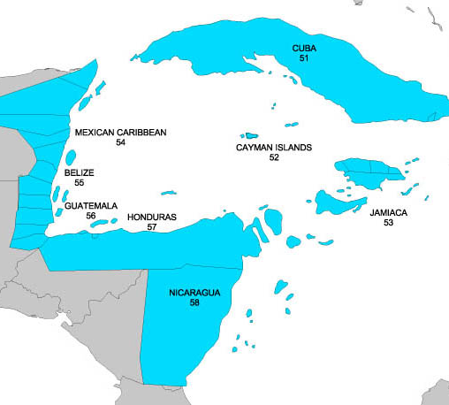
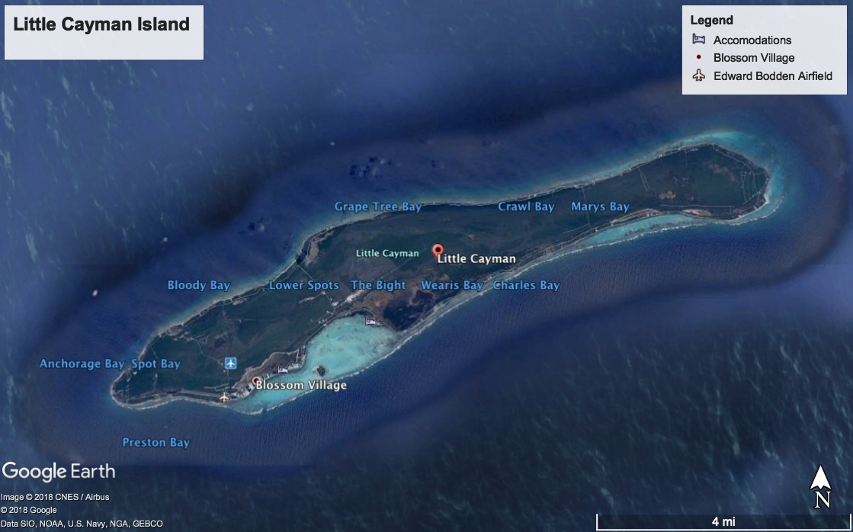
Location of Study (TWA Region 5)
Notes:
Region 5 is the designation used by REEF. The organization has created a code for all areas of study.
LC has 91 dive sites.

Slide 7
Survey Information
Diver survey status: Novice or Expert
Temperatures (water, air)
Depths (maximum, average)
Species (name, ID, family name, family ID, scientific name)
Abundance
1: 1 individual
2: 2 – 10 individuals
3: 11 – 100 individuals
4: 100+ individuals
Notes:
Every species and family has a unique ID (number).
Lionfish are species 683.
The family name is in Latin and English.

Slide 8
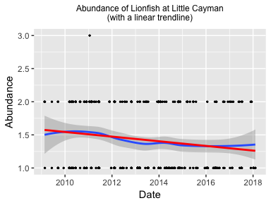
Lionfish Presence
First recorded sighting:
17 February 2009
Notes:
1 survey of more than 10 lionfish.
Observed at 53 dive sites.
First LF spotted in 2008 (ref 5).

Slide 9
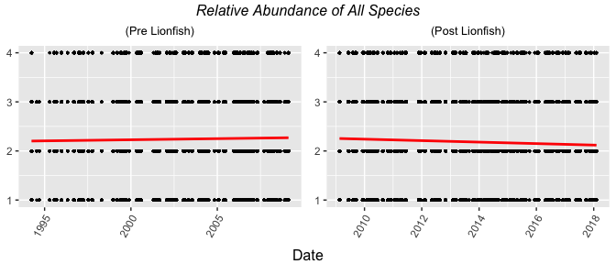
Fish Species Presence
Notes:
Due to size of island, all data included.
LC is about 10 miles by 1 mile (roughly 11 square miles).

Slide 10
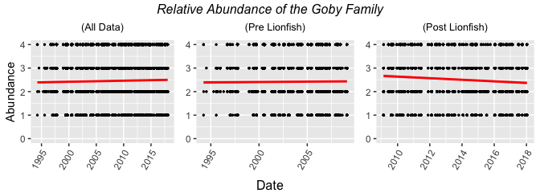
Goby Family
Notes:
Chosen due to characteristics of fish: long, slender body.
1 of ideal characteristics to be lionfish prey.
25 species in this family.

Slide 11
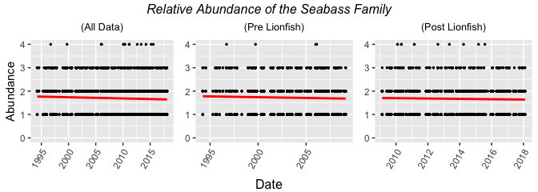
Seabass Family
Notes:
Grouper are major predators in this family.
Juveniles have long, slender bodies and are small enough to be LF prey.
39 species in this family including Goliath Grouper, Nassau Grouper and Tiger Grouper.

Slide 12
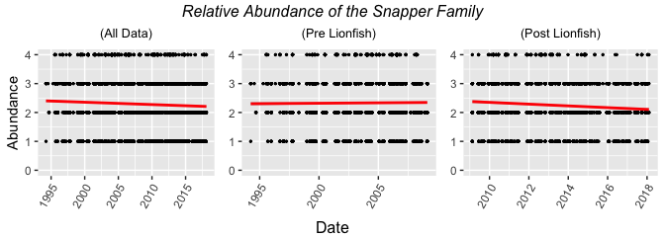
Snapper Family
Notes:
Snapper are major predators.
Juveniles have long, slender bodies and are small enough to be LF prey.
10 species in this family.

Slide 13
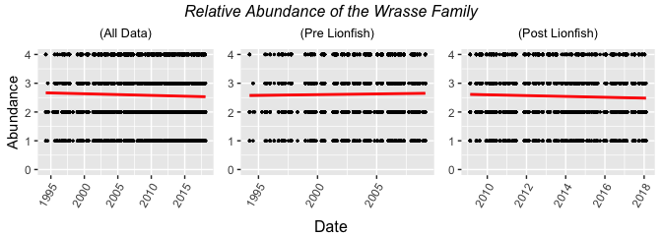
Wrasse Family
Notes:
Chosen due to characteristics of fish: long, slender body.
Discovered in stomach contents of lionfish.
16 species in this family.

Slide 14
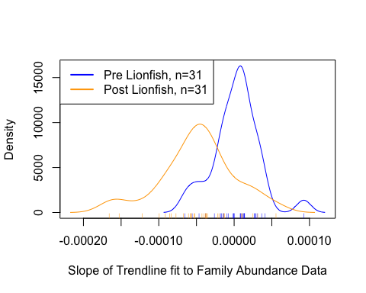
Density Plot Comparison
Notes:
All family data.
Data split at 17 February 2009.
Density of slopes of trendlines from family abundance data.

Slide 15
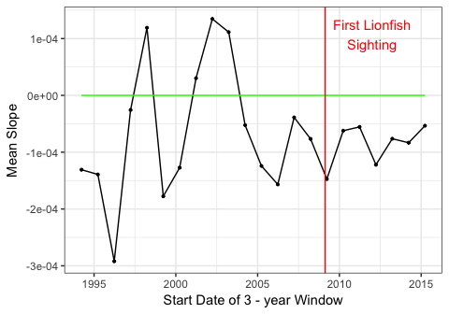
Mean Slope
3-year moving window
Shift: 1 year
Start date:
27 March 1994
End date:
27 March 2018
Notes:
22 windows – partial windows not used.

Slide 16
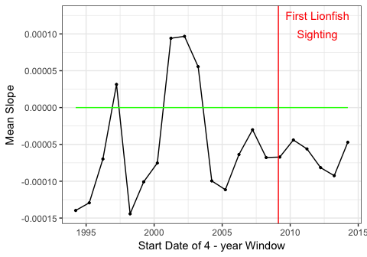
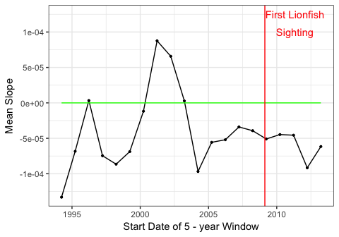
Mean Slope
Notes:
21 windows for 4-year
20 windows for 5-year

Slide 17
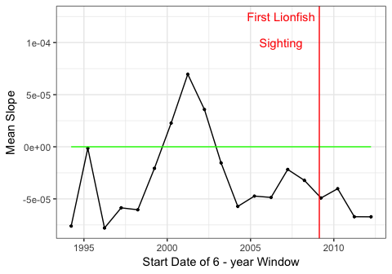
Mean Slope
Notes:
19 windows for 6-year

Slide 18
Results
Negative trends are very small for all families
Slope on the order of 10⁻⁴
No positive mean values after lionfish introduction (early 2009)
Lionfish may have a small impact
Culling appears to be successful in keeping lionfish numbers down at Little Cayman
Notes:
More data after the lionfish were first spotted would be nice.

Slide 19
Recommendations
Conduct species analysis for species with lionfish prey characteristics
Conduct this analysis on other data sets
Continue (or even increase) culling events
Begin culling events if none exist
Increase offerings at restaurants to encourage safe culling
Notes:
Characteristics: 1) long, slender bodies, 2) solitary behavior, 3) near seafloor at dusk or during the night.
REEF already has culling events.
Little Cayman has volunteers culling on a regular basis.
Island nations and countries with coastline could begin events.

