Slide 1
The purpose of this deck is to fulfill the requirement of DSI 39, Project 3.
Role: Ministry of Social and Family Development (MSF) Data Science Team
Audience: MSF's Senior Management
Problem Statement: Declining number of marriages and earlier divorces are a cause for concern. With one of the key reasons for divorces being communication problems, how can we help couples facing difficulties in their relationship, strengthen communication, through recognizing and understanding their attachment styles?
Done by: The Colony (Jackie Seah, Li Cheng, Mei Qi, Yvonne Lim)

Slide 2
A self-help tool for couples to understand their attachment style
MSF Senior Management Meeting
29 Sep 2023

Slide 3
Meeting Agenda
1. Marriage landscape in Singapore
2. Methodology
3. Summary of results
4. Prototype of our solution

Slide 4

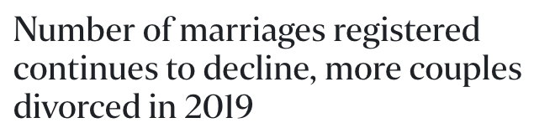


Slide 5
↓4.6%
Recent trends in declining number of marriages and earlier divorces are a cause for concern
Annual avg marriage registered
(comparison between 2018-2022 and 2013-2017)
Avg crude divorce rate in the last 10 years
(per 1000 resident)
1.9
Cost for contested divorce
$10,000-$35,000
Notes:
Data on marriage and divorce from Department of Statistics Singapore
Crude divorce rate refers to the number of divorces and annulments granted in the year per thousand population.
Data on cost of divorce from DBS
Notes:
Marriage registered (drop by 4.6%)
Annual Average Between 2013-2017: 27,833
Annual Average Between 2018-2022: 26,562
Average crude divorce rate in the last ten years: 1.9 per 1000 residents.
Crude divorce rate refers to the number of divorces and annulments granted in the year per thousand population.
Cost of divorce
Simplified uncontested divorces cost from $1,500 to $3,500.
Contested divorce cost ranging between $10,000 and $35,000. A contested divorce occurs when a couple cannot agree on the issues involved in the dissolution of their marriage

Slide 6
Communication is one common reason for divorce.
A strong and lasting relationship requires
healthy communications.

Slide 7
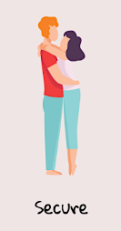

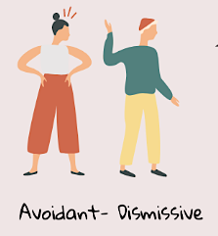
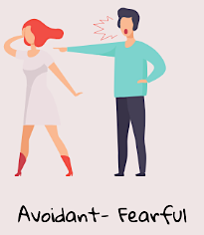
Attachment styles influence how we connect with others
Comfortable communicating needs and with closeness
Feel compelled to maintain frequent communication due to constant need of approval and reassurance
Tend to overanalyze partner's message and behaviour due to fear of rejection
Self-reliant
Hesitant to express actual emotions
Difficulty in verbal expression of love
Inconsistent behaviour due to internal conflict between desire for intimacy and fear of it
Notes:
The way we communicate with people is influenced by our attachment styles. Generally, there are 4 attachment styles.
Secure: trusting, comfortable relying on others, Securely attached individuals are comfortable with intimacy and can balance dependence and independence in relationships. Comfortable communicating needs and with closeness.
Anxious: worry that you will be hurt
Fearful: inconsistent in relationships; desire close relationships and fear vulnerability. They may behave unpredictably in relationships due to their internal conflict between a desire for intimacy and fear of it.
attachment styles can be flexible and evolve over time with self-awareness and personal growth. Recognizing one's attachment style and working on developing more secure communication and coping strategies can be beneficial for building healthier and more satisfying relationships.

Slide 8

How can we help couples
facing difficulties in their relationship, strengthen communication,
through recognising and understanding
their attachment style?

Slide 9
To develop a self-help tool that users can use easily to identify attachment style of both
themselves and their partner's,
with an accuracy of more than 0.8
Notes:
Mei Qi end here

Slide 10
Work Flow
01
02
03
04
Modelling
App Design
Procuring Data Source
Data Cleaning and Analysis
Scraping post data from 2 subreddits to use as labelled data for the machine learning model.
Cleaning and processing the dataset to sift out the distinct features.
Training and evaluating multiple machine learning models to be able to make accurate predictions.
Designing an web application that is user-friendly for couples to self-help.
Notes:
Jackie start here

Slide 11
Labelled data is sourced from Reddit to feed in ML model
Reddit is a website where registered users (or "redditors") post content. Posts are organized by subject into user-created boards called "communities" or "subreddits".
There are subreddits where people with specific attachment styles gather to share experiences and provide support for each other.
r/AnxiousAttachment. 38k members
r/AvoidantAttachment. 19k members.
Posts scrapped from these 2 subreddits are then used as labelled data to feed into a machine learning model. The assumption is that posts made in these subreddits reflect the patterns of someone with said attachment style.

Slide 12
Text from each post are processed to sift out key features from each style.
Only text data (post title) are processed.
Each post will go through the following cleaning steps:
Remove punctuations, URLs, numbers.
Split the text into words (tokenize).
Remove commonly used words (stop words) like “this”, “is”, “and”.
Breaking down words into its root form (lemmatization) like “running” -> “run”.

Slide 13
About 50% of words found in one subreddit can also be found in another.
For good NLP (Natural Language Processing) model performance, it is important for the text in both classes to be distinct.
One challenge is that almost 50% of words found in one subreddit can be also found in another.
Number of Unique Words
906
1048
1095
Avoidant
Anxious

Slide 14
To improve model performance, overlapping words that appeared equally in both subreddits were removed.
Distribution of the Difference in Frequency of Overlapping Words
Not all overlapping words appeared equally in both subreddits. This difference in “appearance count” is a differentiating feature.
Overlapping words that have a difference in appearance count of 10 or less were removed.
Percentile | Difference in Appearance Count
50 | 1 | Removed
60 | 2 | Removed
70 | 3 | Removed
80 | 5 | Removed
90 | 8 | Removed
92 | 10 | Removed
94 | 12 | Kept
96 | 20 | Kept
98 | 29 | Kept
100 | 699 | Kept
Examples of Overlapping Words
Overlapping Words | Appearance in "Avoidant" | Appearance in "Anxious" | Difference in Appearance Count
legitimately | 1 | 1 | 0 | Removed
unattractive | 1 | 1 | 0 | Removed
emotional | 15 | 10 | 5 | Removed
deactivation | 40 | 5 | 35 | Kept
attachment | 101 | 196 | 95 | Kept
Notes:
Jackie end here

Slide 15
Model Overview
Data Class
Class 0 – Avoidant Attachment Style (1,355 rows)
Class 1 – Anxious Attachment Style (1,811 rows)
Machine Learning Models Used
Vectorization Methods
Naive Bayes (Bernoulli)
Naive Bayes (Multinomial)
Logistic Regression
Count Vectorization
N-Gram Vectorization
TF-IDF (Term Frequency-Inverse Document Frequency)
Vectorization is the process of encoding text as integers to create a feature vector of numerical features that represent an object.
Notes:
Yvonne start here

Slide 16
Model Performance
Models | Train accuracy | Test accuracy | Precision | Recall | F1 Score
Naive Bayes Bernoulli (With Count Vectorizer) | 0.90 | 0.88 | 0.85 | 0.96 | 0.90
Naive Bayes Multinomial (With Count Vectorizer) | 0.90 | 0.88 | 0.87 | 0.92 | 0.90
Logistic Regression (with Count Vectorizer) | 0.90 | 0.90 | 0.89 | 0.93 | 0.91
Logistic Regression (with TF-IDF Vectorizer) | 0.88 | 0.89 | 0.87 | 0.94 | 0.90
Accuracy = Total Correct Predictions / Total Predictions
Precision = Total Anxious Styles Predicted Correctly / Total Anxious Styles Predicted
Recall = Total Anxious Styles Predicted Correctly / All Anxious Styles Observed
F1 = Weighted Average of Precision and Recall

Slide 17
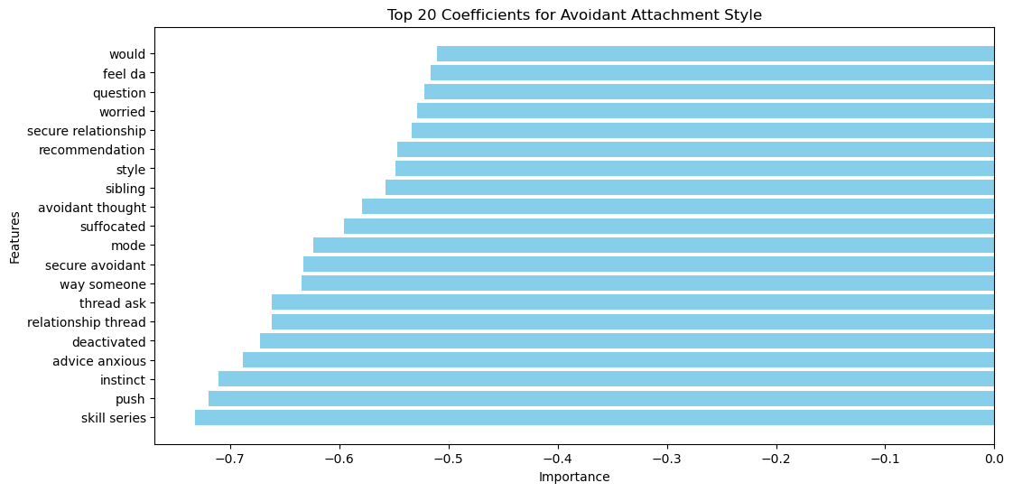
Top 20 features of Avoidant Style Class
(based on coefficient value)

Slide 18
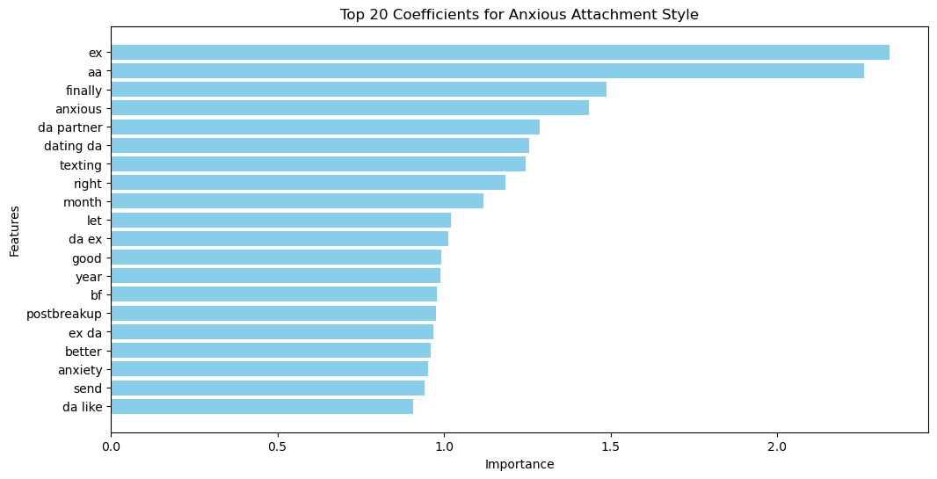
Top 20 features of Anxious Style Class
(based on coefficient value)
Notes:
Yvonne ends here

Slide 19
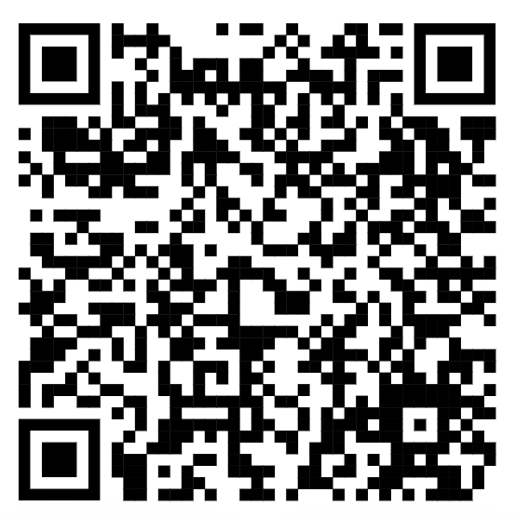
Demo
attachment-style-classifier.streamlit.app
Notes:
Li Cheng starts here

Slide 20
Summary
Problem statement:
How can we help couples facing difficulties in their relationship, strengthen communication, through recognising and understanding their attachment styles?
Deliverables:
  Build a classifier model with accuracy of > 0.8
  Deploy an easy-to-use self-help tool using the classifier model embedded to provide information and resources for couples to improve on their communication with each other.

Slide 21
Moving forward
Phase 1
Phase 2
Phase 3
First release of the app on:
MSF website
MSF’s Telegram channel (i.e.,MSFCares)
Improve accuracy of classifier model to ≥0.95 through:
collecting more data from other similar subreddits
exploring further ways to tune the existing classifier model
exploring the use of other classifier models (e.g., XGBoost)
Second release of the app with:
expanded coverage of the other two attachment styles

Slide 22
Thank you
Notes:
Li Cheng ends here

