Slide 1
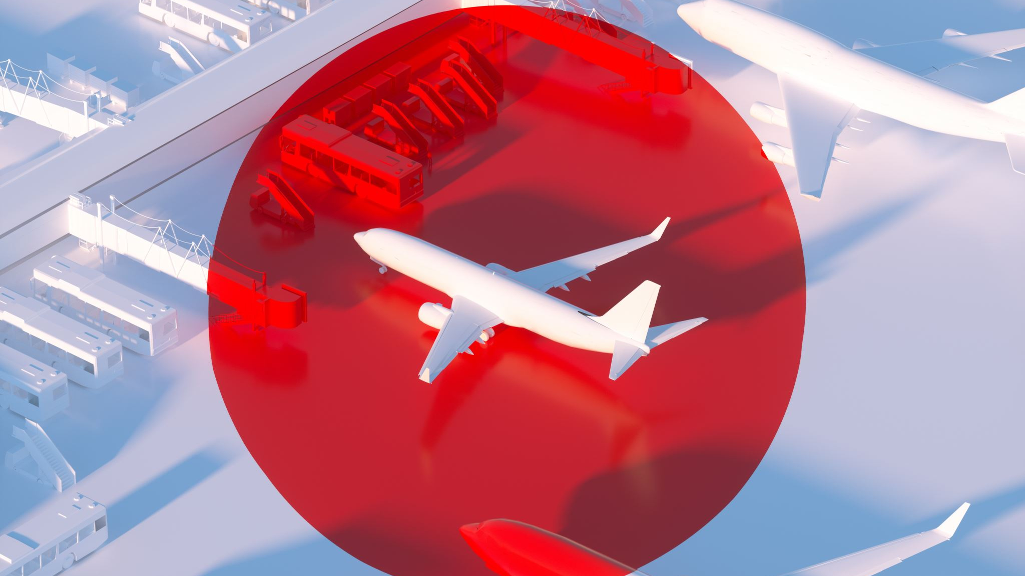
Airline Travel Safety Executive Summary
Taylor Imhof
Bellevue University | DSC 640
8/02/2022

Slide 2
Overview
Project driving motivation
Visualizations/Insights
Team Recommendations
Questions

Slide 3
Driving Motivation
Media: "No longer safe to travel by air"
Not citing their sources
Based on facts?
Claim more dangerous than driving
Revitalize public trust in airline safety protocols
Educate via fact-based, data-driven visualizations
Encourage public engagement/discourse
PSAs: Blog posts, infographics, video presentation

Slide 4
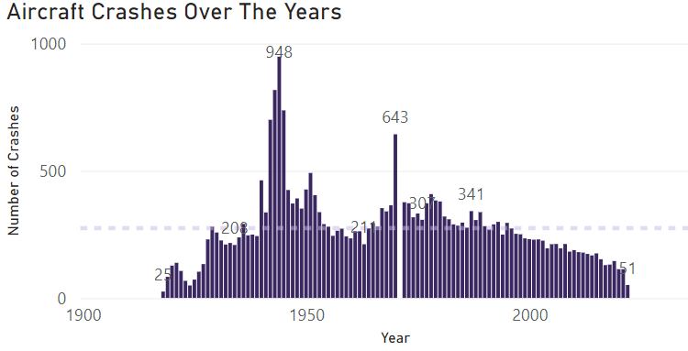
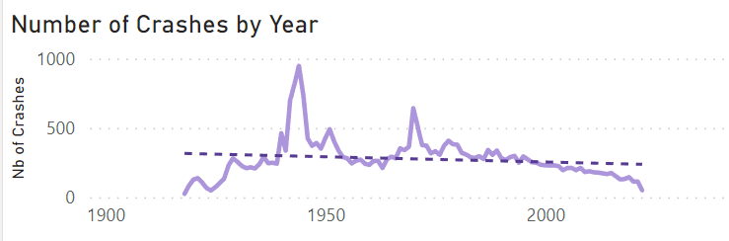
Visualizations/Insights
Total crashes across last ~ 100 years
1919-2022
Trend line slight downwards tilt
Spikes near 1940 and 1970 look "scary"
Explainable in context: WW2 and Russian Aeroflot
Much steeper past 2000
Indicates flight travel increasing in overall safety

Slide 5
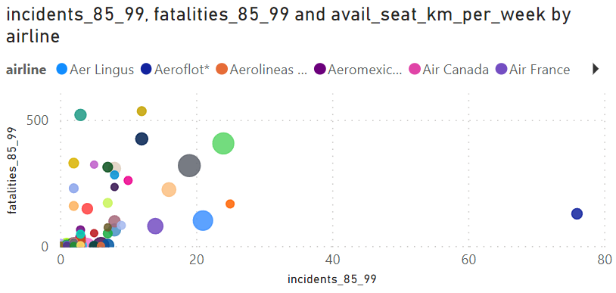
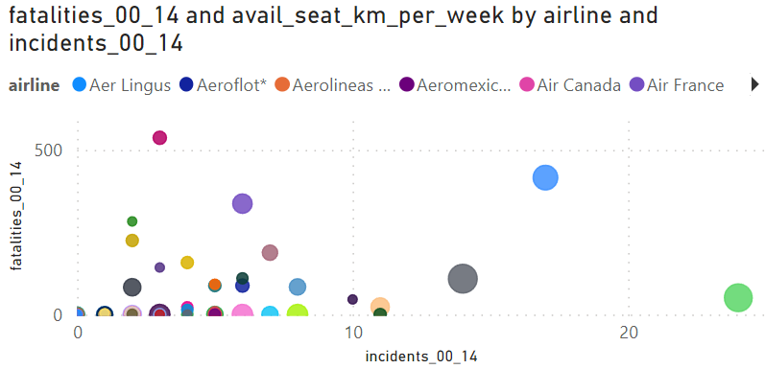
Visualizations/Insights
Aircraft accidents versus fatalities
With seat-kilometers per week additional weight
Bubbles outside general clustering indicates there are outliers skewing total results
e.g., blue bubble in far-right of 85'-99' time frame
Russian Aeroflot series of incidents
Bubbles more spread out and lower in y-axis
Indicates while there are still several incidents, there are much less fatalities overall

Slide 6
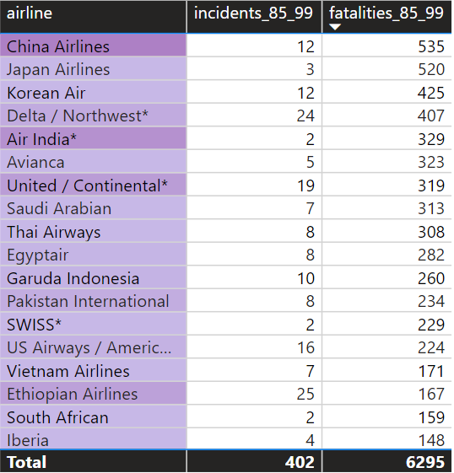
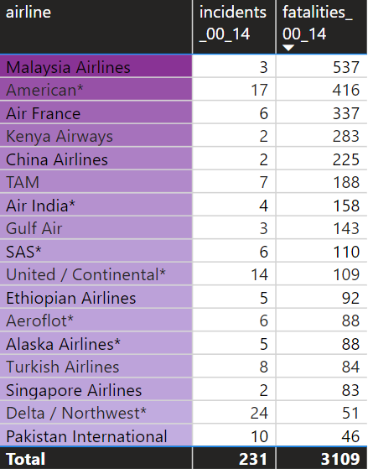
Visualizations/Insights
Data in tabular format
Little harder to draw insights from
Total incidents and fatalities down significantly
402 -> 231 (incidents)
6295 -> 3109 (fatalities)
Can't single out any one airline that is more "dangerous" than others
Malasia and Kenya outliers
Few incidents but large fatality figures

Slide 7
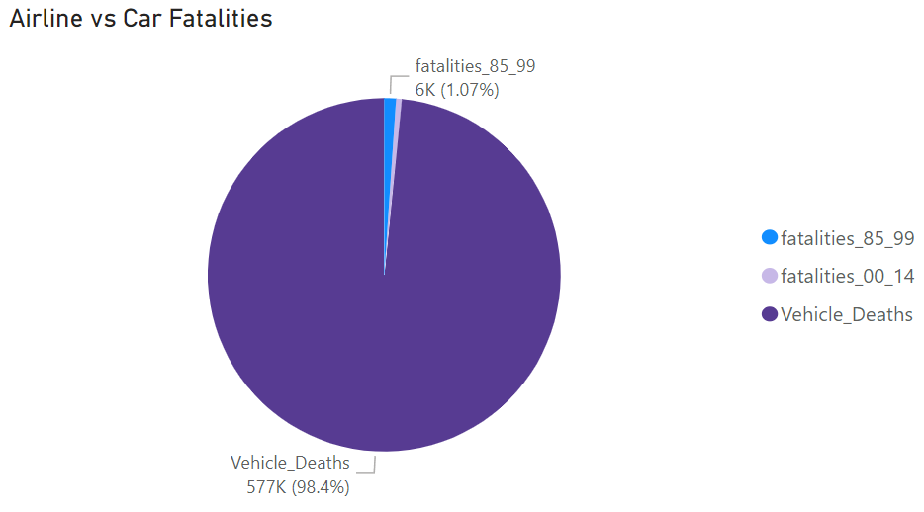
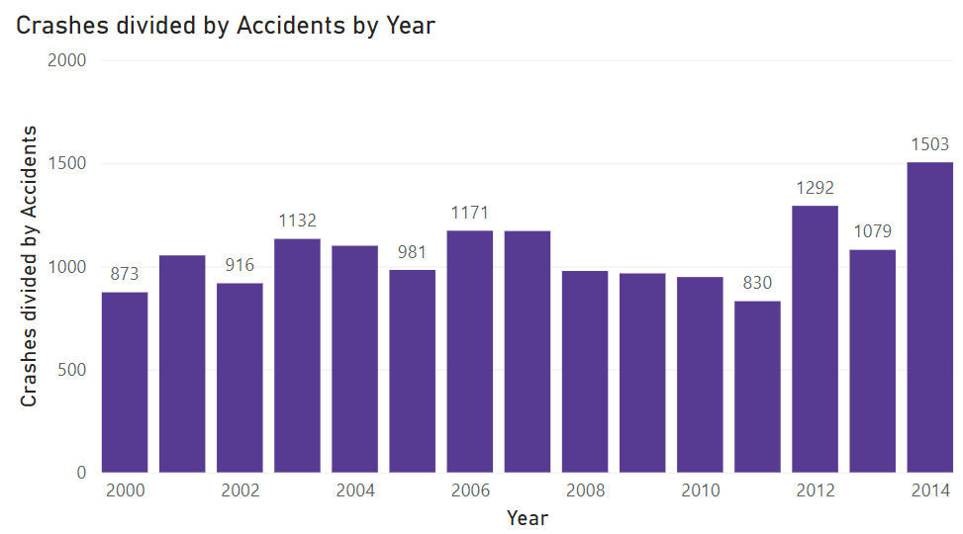
Visualization/Insights
Comparison with car travel
Even accounting for both 85-99 and 00' onward:
Cannot compare with total car fatalities across same timeframe
Crash incidents over accidents
Remained relatively constant (high)
Even seems to be increasing

Slide 8
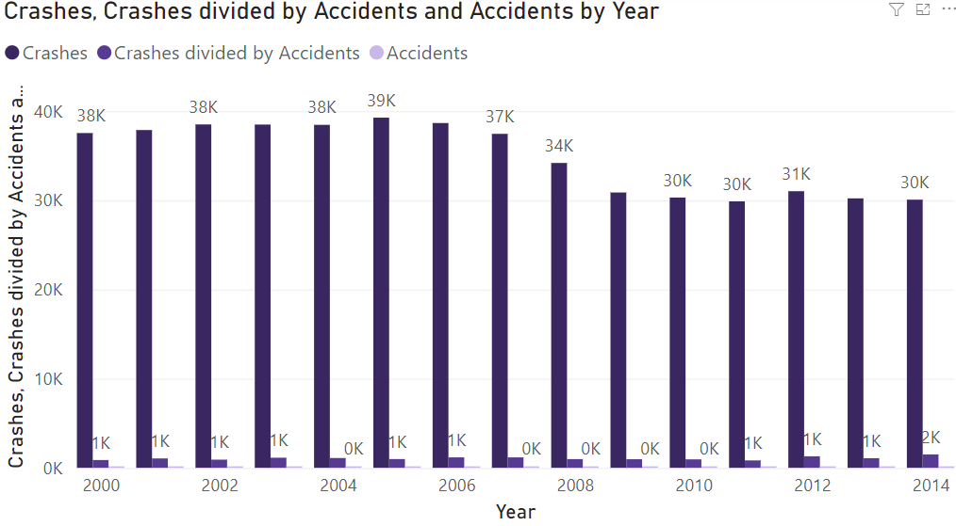
Visualizations/Insights
Bar chart car crashes versus airlines accidents
Ludicrous for media to make assertion driving is safer than flying by plane
Many variables to consider:
Less skilled drivers vs. trained pilots
More daily drivers vs. flyers, etc.

Slide 9
Team Recommendations
Reach out regionally to customer base
Disseminate data-driven findings
Improve trust and reputation for airline company
Reallocate funds for marketing campaign efforts
Blog post:
Contract blog authors to report facts regarding airline travel
Infographic:
Consolidate visuals for easier sharing to customers
Video Presentation

Slide 10

Questions

