Slide 1

Drive or Fly: Which Is The Safer Option?
Presented by: Taylor Imhof
Bellevue University | DSC 640
8/10/2022

Slide 2
Recent Media Coverage
Tragedy at Bellevue Airport
50 souls claimed due to equipment failure (not mentioned in reports)
Using natural emotions to push anti-air agenda
Lobbied by big "Ford" corporations
Claim driving is now safer than flying
About 40% experience flight anxiety (Schaaff, 2019)

Slide 3
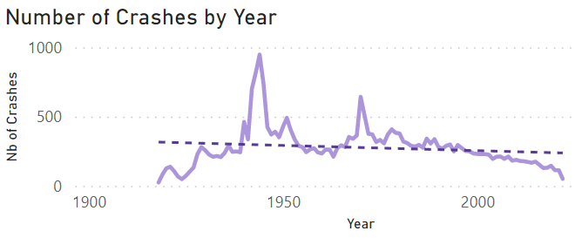
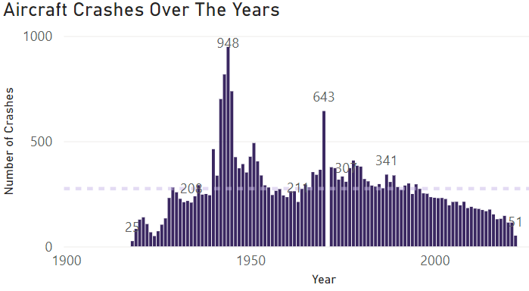
Aircraft Accidents Over Last 100 Years
Incidents on steady decline
Airline travel much safer since end of WW2
Sharper decline in recent years
Better technology and safeguard measured

Slide 4
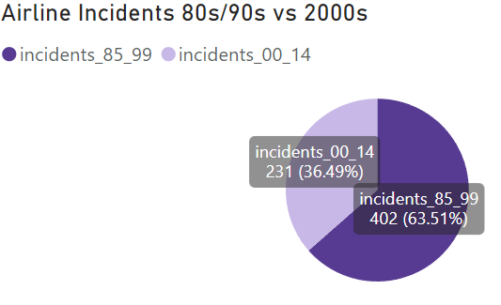
Incidents In The Past Vs. Now
Incidents down nearly half in recent years compared with 80s/90s
If trends continues:
Fewer incidents as tech increases
Even increasing number of fliers/flights per year

Slide 5
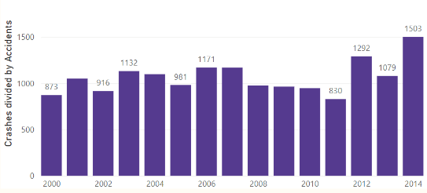
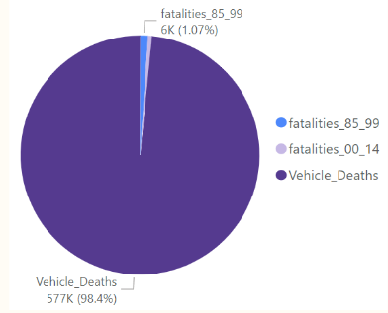
Driving Vs. Flying
Ratio of car crashes to flight crashes relatively constant
Trending higher in recent years
If driving safer:
Bars would be getting smaller or negative
Flight deaths makes up barely 1% of total when driving deaths accounted for

Slide 6
References
Schaaf, S. V. (2019, October 12). Lots of Americans have a fear of flying. There are ways to overcome the anxiety disorder. The Washington Post. Retrieved from https://www.washingtonpost.com/health/lots-of-americans-have-a-fear-of-flying-there-are-way-to-overcome-the-anxiety-disorder/2019/10/11/d4746d84-d338-11e9-86ac-0f250cc91758_story.html

