Slide 1

PROJECT 13.
100906493 || SEHREEN KHAN
100943751 || HANI NOORBUX SHAIKH
100943852 || CHETNA MANCHANDA
100940786 || ABHINAV TANWAR
100944330 || DECLAN TREVOR KINTU

Slide 2
SO, WHAT IS BUZZHIRE?
Find new staff with the power of Artificial Intelligence!
BuzzHire is an AI-powered Hiring Portal that uses Machine Learning to read applicant resumes, perform an applicant Myers-Briggs Personality Indicator test and match applicants to roles according to the skills being sought by the recruiter.

Slide 3
FULL FEATURE LIST:
Secure User Authentication and Authorisation
Create and Manage Job Posts
Apply to Job Posts
Resume Parsing
Myers-Briggs Personality Indicator Test
Skill-based Role Matching
Interactive Applicant Dashboard
Interactive Recruiter Dashboard
Email Notifications

Slide 4
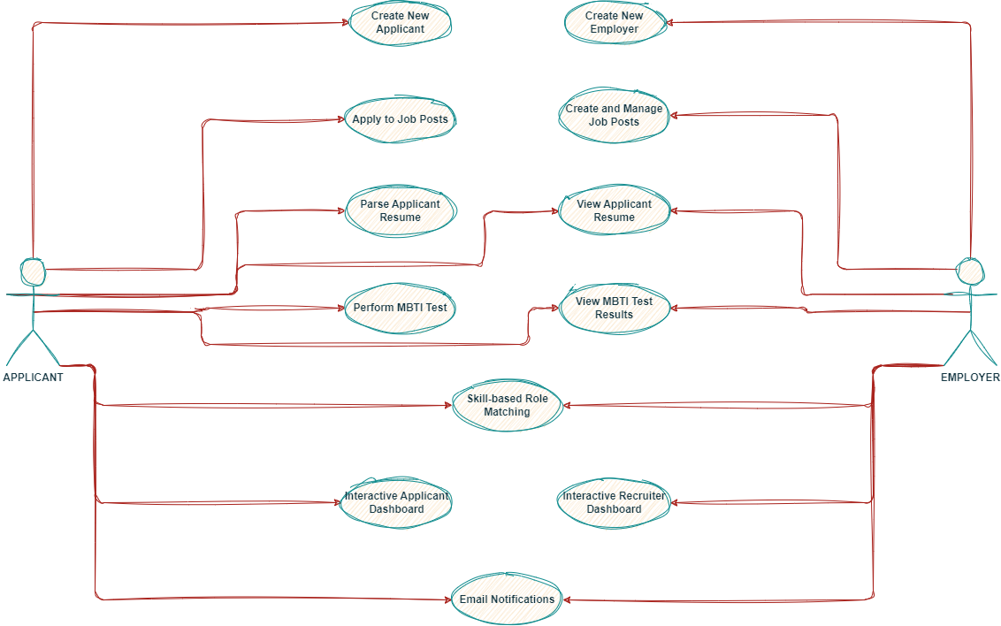
FEATURES DESCRIBED:

Slide 5
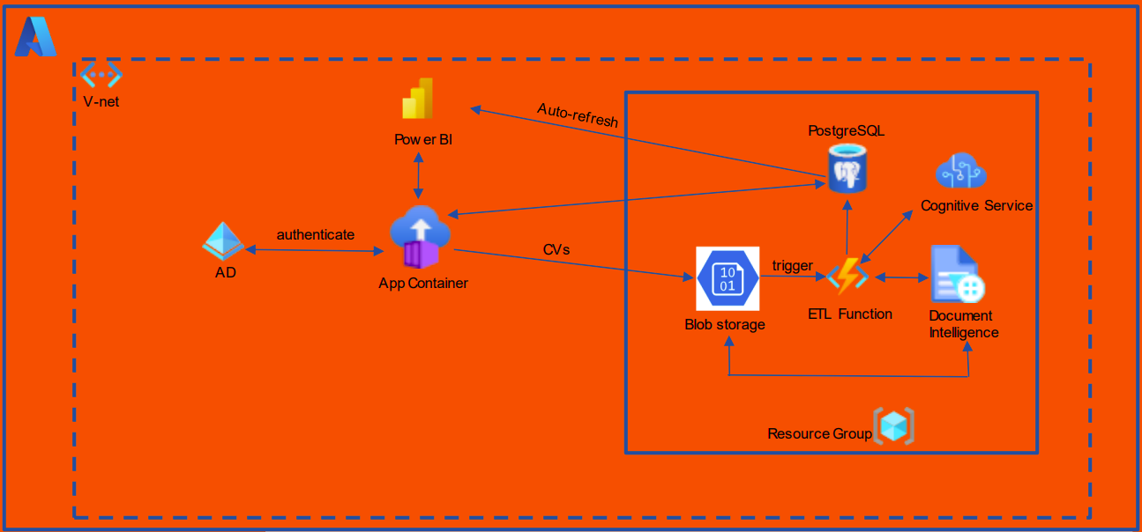
APPLICATION ARCHITECTURE.

Slide 6
APPLICATION TECHNOLOGIES:
Front End: The application’s user interfaces are created using HTML, CSS and JavaScript.
Back End: The application uses the Django Framework in Python to serve the front end and interact with the application database.
Database: The application uses a PostgreSQL Database

Slide 7

MACHINE LEARNING:
As mentioned earlier our application uses Machine Learning to perform its AI features. These are the ML techniques we employ:
OpenAI API to parse Applicant Resumes
A custom-trained Random Forest Classification model to perform the Myers-Briggs Personality Indicator Test assessment
A custom-trained Classification Model to match applicant skills to relevant recruiter job posts.

Slide 8
Fin!
A presentation by The Buzzies.
Here is a link to our project repo: Click Me!
Any Questions?

