Slide 1
AIDI1100 Final Project
Group 4

Slide 2

Group Members
Anish Harekar
Darren Saguil
Declan Kintu
Harshil Biren Mistry
Mohit Chadha
Sahil Khan
Shoaib Ahmed Shaikh

Slide 3
Project Goals
Gather Data by scraping it from a news website
Save the Data to a CSV for research
Use the Data to learn about stocks from the news
Create visualizations to understand the Data and stock info
Use the Market Research to determine if a stock is worth buying

Slide 4

Scanning and Parsing
To start, we scanned the page https://www.prnewswire.com for articles
The algorithm is as follows:
Load a page with the corresponding URL using the HTML library
Scan the page for the list of articles
Load each article using BeautifulSoup and save it to a CSV
Repeat from 1 until all URLs from the desired number of days are scanned
For each article saved, we parsed it for ticker symbols
Ticker symbols were found using a regex
The symbols were then saved to an array
Example output:

Slide 5
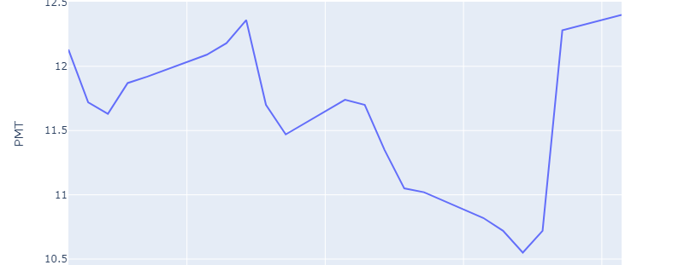
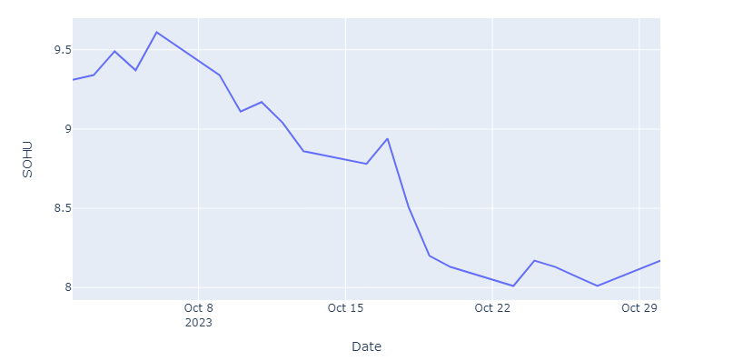
Data Retrieval
Using the ticker symbols found, we found that stock's history
To do this, we used the yfinance module for Python
The yfinance module is a wrapper for the Yahoo Finance API for Python
Using yfinance, we downloaded the stock's history for the past 30 days and saved it to a dataframe

Slide 6
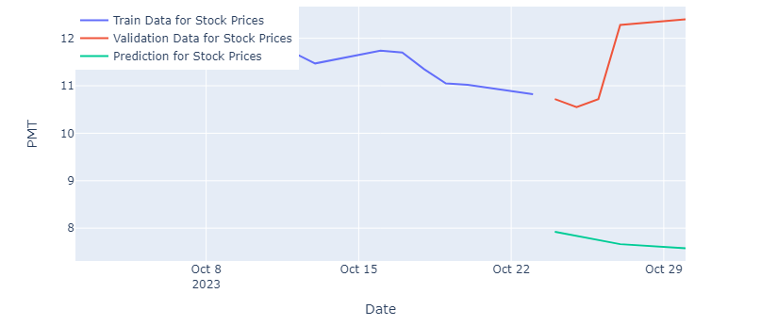
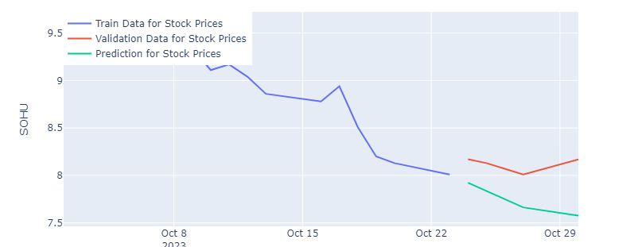
The Extra Mile
To determine if a stock is worth purchasing, we used 2 methods
Simple Math
Calculate the percent change of the last 30 days of closing prices
If the closing price percent change surpasses a threshold, e.g., +5%, it is worth purchasing
ARIMA Model
Uses machine learning (aka the ARIMA model)
Trains the model on the time series of each stock
Use the model to predict the future of the stock to determine if it is worth purchasing

Slide 7

Thank You!
GROUP 4

